Slide 1
I
UA FINANCE · COMPLETE BRIEFING
Product & SDK
LedgeRX
II
Architecture
Loyalty ledger domain service
for CTO & Internal IT
III
UAF landscape
IV
Earn · Process · Burn
Product · Architecture · Landscape · Live demo · Appendix
V
Appendix board
Confidential

Slide 2
Agenda
One complete deck
I
Product & SDK
Mission, value, Internal IT journey
II
Architecture
Netflix-style landscape + call paths
III
UAF landscape
Whiteboard → LedgeRX applied
IV
Earn · Process · Burn
HKD 500 demo — one idea per slide
V
Appendix
Full sequence board in 2 halves
LedgeRX × UA Finance · Complete briefing · Confidential
1

Slide 3
PART I
Product & SDK

Slide 4
The enterprise problem
Loyalty points are financial liabilities
01
Fragmented SoR
02
Slow change
Balances scatter across CRM, campaigns, files.
Earn rules wait on release trains.
03
Weak audit
04
Integration tax
Hard to prove earn or skip.
Every channel re-builds wallet logic.
LedgeRX × UA Finance · Complete briefing · Confidential
2

Slide 5
What LedgeRX is
Domain microservice for programme balances
System of record for wallets & loyalty points — double-entry, runtime rules, SDK for Internal IT. Deploy in your cluster.
We provide
UA Finance owns
• ledger-engine service
• CRM / membership
• Java SDK for IT
• Card & loan cores
• Admin (Door · Brain · COA)
• cc-xapi / adapters
• Dry-run · trace · fail queue
• Campaign & coupon fulfil
• Docs + event skeleton
• Cluster & observability
LedgeRX × UA Finance · Complete briefing · Confidential
3

Slide 6
SDK-first for Internal IT
Integration is a product feature
Versioned Java SDK — onboard, ingest, dry-run, query — so cc-xapi / loan adapters integrate in a sprint.
1
2
3
4
5
6
1 Receive
2 Deploy
3 Configure
4 Integrate
5 UAT
6 Live
SDK JAR +
playbook
Engine +
PG cluster
Door · Brain
· COA
xapi calls
SDK
Dry-run
event matrix
Ops
runbooks
LedgeRX × UA Finance · Complete briefing · Confidential
4

Slide 7
Core capabilities
Six blocks · one spine
Door
Brain
Wallet
Ingest control
Decisioning
Member books
Traffic · auto-wallet
Filters + formula
1 ownerId · multi-ccy
Books
COA
Trust
Double-entry
Schemes
Safety pack
PROGRAM · legs
CC / Loan profiles
Dry-run · fail queue
LedgeRX × UA Finance · Complete briefing · Confidential
5

Slide 8
PART II
Architecture

Slide 9
Platform shape (CTO view)
LedgeRX = one domain service in your mesh
EDGE
Channels
API Gateway
Service Mesh
IAM
SERVICES
CRM
cc-xapi
★ LedgeRX+SDK
Loan adapter
Admin
Coupon
DATA
CRM DB
★ LedgeRX PG
Loan DBs
Warehouse
LedgeRX × UA Finance · Complete briefing · Confidential
6

Slide 10
How Internal IT plugs in
Primary SDK paths
Onboard
SDK.createWallet() → books open
Earn
SDK.ingestEvent() → Door→Brain→Books
Dry-run
SDK.dryRun() → points + skip trace
Configure
Admin / API → Door · Brain · COA
Read
SDK.getWallet() → balances / history
Burn
SDK ingest REDEEM → burn DE → coupon out
LedgeRX × UA Finance · Complete briefing · Confidential
7

Slide 11
PART III
Apply to UA Finance landscape

Slide 12
Whiteboard as-is
UAF Reward (CC + Loan)
IN
NEW (green box)
OUT
• e6 / digital CC
Ledger + SDK
• Loan:CC
IT integrate surface
• ~21 CC events
• Loan:Loan
Posting / Rules / Calc
• Mobile loan
→ LedgeRX Books+Brain
• E-Coupon
Ledger × N yellow
• N loan events
→ ONE engine + COA
• Stock / Adapter
Onboarding / Referrer
UAF + wallet only
LedgeRX × UA Finance · Complete briefing · Confidential
8

Slide 13
Target — LedgeRX applied
Keep edges · one green core
IN
EXISTING
NEW ★
OUT
e6 · Loan
CRM ownerId
cc-xapi
loan adapter
LedgeRX
SDK · Door
Brain · Books
COA
Loan cores
E-Coupon
Stock
→
→
→
LedgeRX × UA Finance · Complete briefing · Confidential
9

Slide 14
CTO one-liner
Keep cc-xapi and loan cores.
Put one LedgeRX in the green box.
Internal IT integrates with the Java SDK.
Not three ledger microservices.

Slide 15
PART IV
Earn · Process · Burn
HKD 500 grocery demo

Slide 16
Demo story map
One idea per following slide
A
B
C
D
E
Pay
Ingest
Calculate
Earn
Burn
HKD 500
MCC 5411
xapi → SDK
→ Door
Brain
500 × 1%
Books DE
+5 LP
Redeem
−5 LP
LedgeRX × UA Finance · Complete briefing · Confidential
10

Slide 17
A · PAY
Customer pays merchant HKD 500
Amount
MCC
HKD 500
5411 grocery
Member
Event
ownerId = 01A…
txn-88
LedgeRX × UA Finance · Complete briefing · Confidential
11

Slide 18
A · CHANNEL → cc-xapi
Existing edge — normalize only
1. Maps one of ~21 CC events
2. Fills amount · currency · MCC · customer
3. Does NOT calculate LP
4. Hands off to Java SDK
LedgeRX × UA Finance · Complete briefing · Confidential
12

Slide 19
B · SDK.ingestEvent
TransactionalEvent into LedgeRX
eventType
amount
currency
PURCHASE
500
HKD
mcc
coaProfile
eventId
5411
CC
txn-88
LedgeRX × UA Finance · Complete briefing · Confidential
13

Slide 20
B · DOOR
Accept only — no LP math
Checks
Does NOT
• Enabled?
• Calculate points
• Auto-wallet?
• Apply MCC rules
• Default COA?
• Post double-entry
LedgeRX × UA Finance · Complete briefing · Confidential
14

Slide 21
C · THE MATH
500 × 1% = 5 LP
Rule CC_EARN_MCC_5411 · Formula RATE 0.01
Match PURCHASE + HKD + MCC 5411 · Result EARN 5 LP

Slide 22
D · BOOKS — earn post
Double-entry for +5 LP
DEBIT
CREDIT
PROGRAM pool LP
Member LP account
+ 5
+ 5
LedgeRX × UA Finance · Complete briefing · Confidential
15

Slide 23
D · MEMBER SEES RESULT
API response
Wallet
status
EARNED
+5 LP
points
5
rule
available balance
CC_EARN_MCC_5411
eventId
txn-88
LedgeRX × UA Finance · Complete briefing · Confidential
16

Slide 24
E · BURN / REDEEM
Later — same spine, reverse posting
10
11
12
Redeem
Burn
Fulfil
Customer wants
e-coupon 5 LP
REDEEM · AMT 5
DR member / CR pool
LP −5
E-Coupon issues
LedgeRX × UA Finance · Complete briefing · Confidential
17

Slide 25
Demo end state
Full audit trail kept
After earn
How LP calculated
UAF landscape
• status = EARNED
• RATE = amt × rate
• In = e6 / POS
• points = 5 LP
• FIXED = constant
• Existing = cc-xapi
• rule = MCC_5411
• First match wins
• New = LedgeRX+SDK
• legs = 2 balanced
• No match → skip
• Out = coupon
LedgeRX × UA Finance · Complete briefing · Confidential
18

Slide 26
PART V · APPENDIX
Full sequence board
(2 halves)
Leave-behind view of the same demo — not for live walkthrough pace.

Slide 27
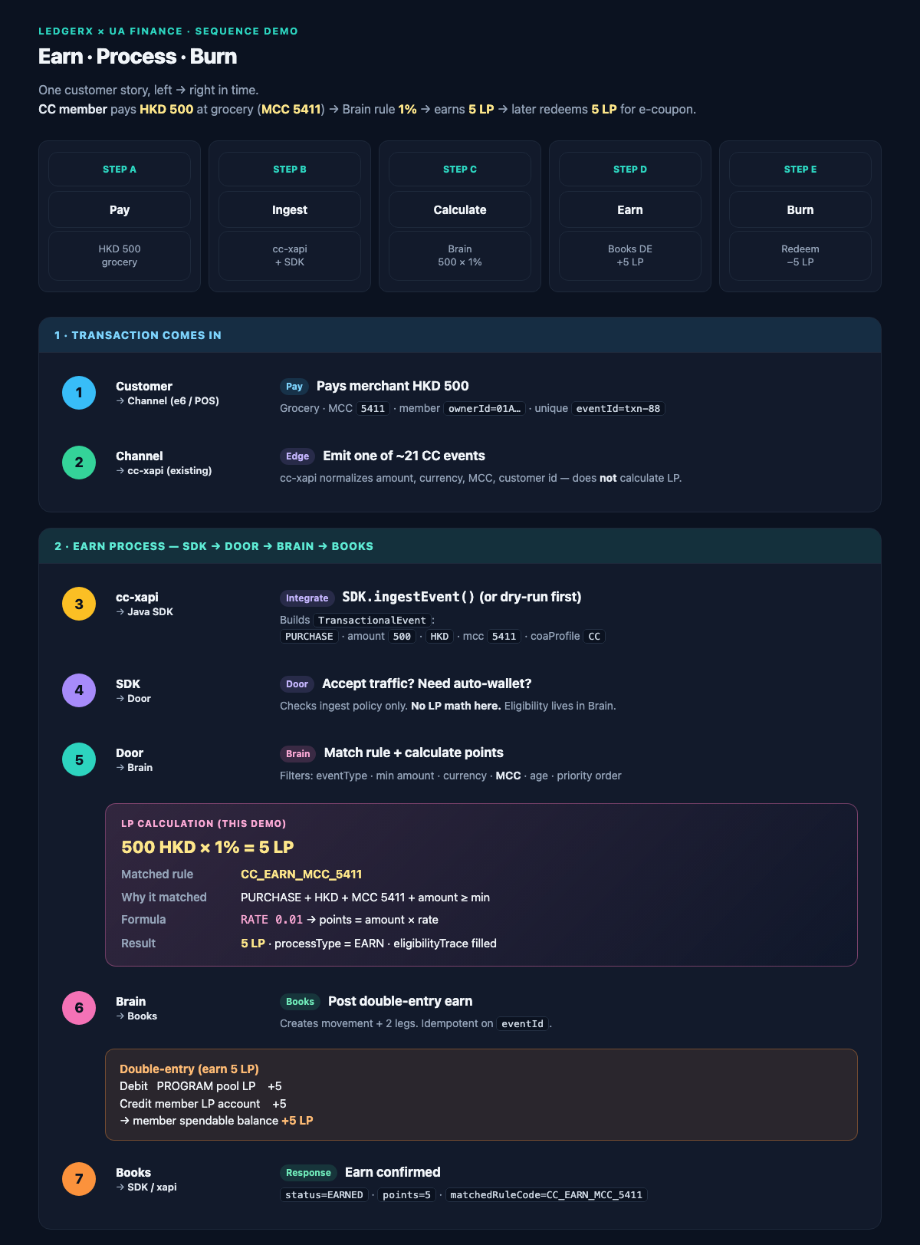
APPENDIX A1 · Sequence (1/2) · Pay → Earn

Slide 28
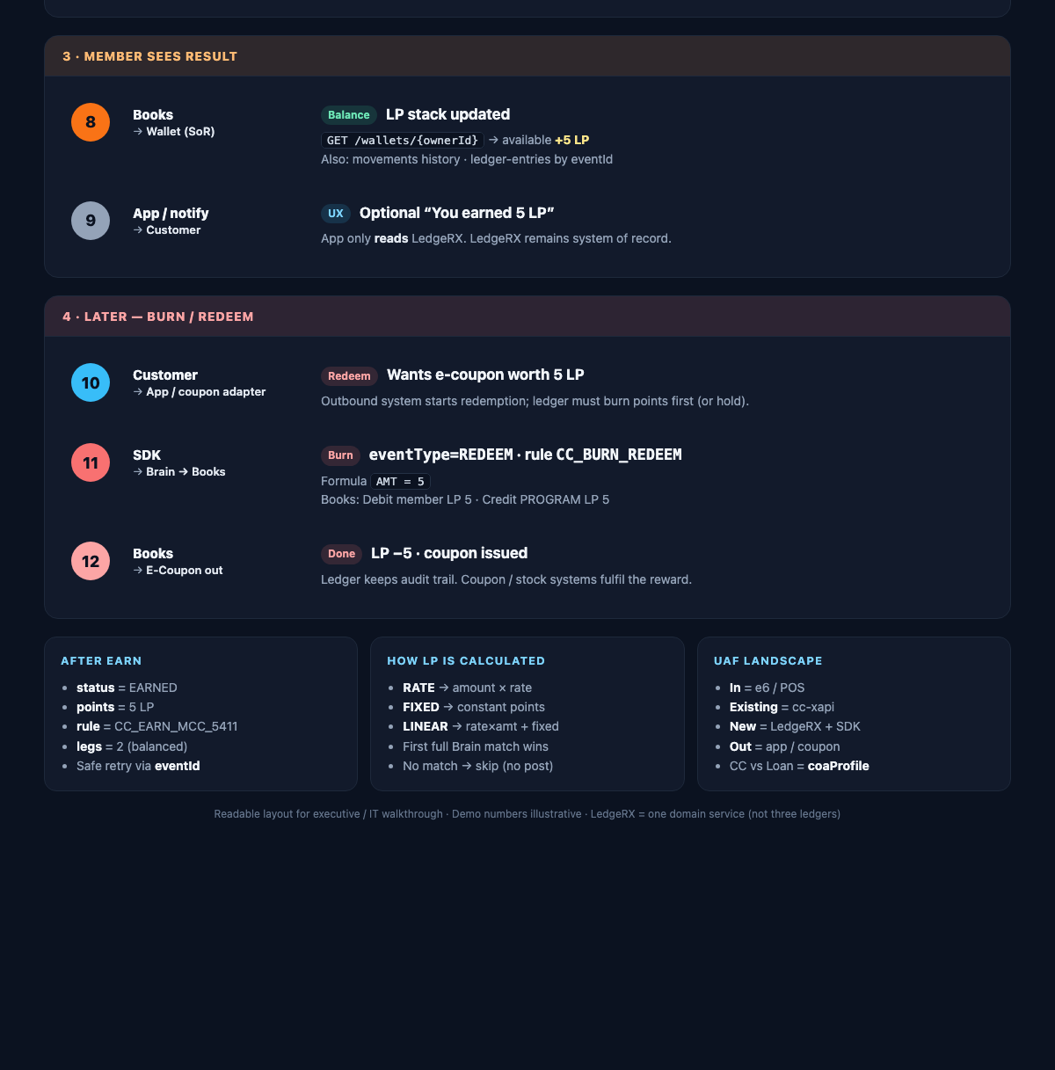
APPENDIX A2 · Sequence (2/2) · Result → Burn

Slide 29
UA FINANCE
One LedgeRX domain service.
SDK for Internal IT.
CC + Loan books — not three ledgers.
Runtime rules. Audit-grade posts.
Ask: SDK package · sandbox · joint IT workshop · filled event matrix

