Slide 1
UA FINANCE · DEMO CASE
Earn · Process · Burn
Main deck = one idea per slide
Appendix = full sequence board (2 pages)
HKD 500 grocery (MCC 5411) → 1% → +5 LP → later redeem −5 LP

Slide 2
How we walk the story
A
B
C
D
E
Pay
Ingest
Calculate
Earn
Burn
Customer → Channel
xapi → SDK → Door
Brain 500 × 1%
Books +5 LP
Redeem −5 LP
LedgeRX × UA Finance · Earn · Process · Burn
2 / 15

Slide 3
A · PAY — transaction comes in
1
Customer → Channel (e6 / POS)
Pays merchant HKD 500
Amount
MCC
HKD 500
5411 (grocery)
Member
Event id
ownerId = 01A…
txn-88
LedgeRX × UA Finance · Earn · Process · Burn
3 / 15

Slide 4
A · PAY — existing edge
2
Channel → cc-xapi (existing)
Emit CC event · normalize fields
What cc-xapi does
→ Maps one of ~21 CC events into a clean payload
→ Fills amount, currency, MCC, customer id
→ Does NOT calculate loyalty points
→ Next: Internal IT calls LedgeRX Java SDK
LedgeRX × UA Finance · Earn · Process · Burn
4 / 15

Slide 5
B · INGEST — Internal IT
3
cc-xapi → Java SDK
SDK.ingestEvent( … )
eventType
amount
currency
PURCHASE
500
HKD
metadata.mcc
coaProfile
eventId
5411
CC
txn-88
LedgeRX × UA Finance · Earn · Process · Burn
5 / 15

Slide 6
B · INGEST — Door only
4
SDK → Door
Accept traffic? Auto-create wallet?
Door checks
Door does NOT
• Ingest enabled?
• Calculate points
• Auto-wallet if first visit?
• Read MCC earn rules
• Default COA for open books?
• Post double-entry
LedgeRX × UA Finance · Earn · Process · Burn
6 / 15

Slide 7
C · CALCULATE — Brain
5
Door → Brain
Match rule + calculate LP
1
2
3
4
5
eventType
= PURCHASE
currency
= HKD
MCC
= 5411
amount
≥ min
age within
max days
LedgeRX × UA Finance · Earn · Process · Burn
7 / 15

Slide 8
C · THE MATH
How many LP?
500 × 1% = 5 LP
Rule
Formula
CC_EARN_MCC_5411
RATE 0.01
Why matched
Result
PURCHASE + HKD + MCC 5411
5 LP · processType = EARN

Slide 9
D · EARN — Books double-entry
6
Brain → Books
Post earn — balanced ledger
Double-entry for +5 LP
DEBIT
CREDIT
PROGRAM pool LP
Member LP account
+ 5
+ 5
LedgeRX × UA Finance · Earn · Process · Burn
9 / 15

Slide 10
D · EARN — result
What comes back · what the member has
API response
Member wallet
status
EARNED
+5 LP
points
5
matchedRule
available balance
GET /wallets/{ownerId}
CC_EARN_MCC_5411
idempotent
eventId = txn-88
LedgeRX × UA Finance · Earn · Process · Burn
10 / 15

Slide 11
E · BURN — later redeem
Same spine · opposite direction
10
11
12
Customer wants coupon
SDK → Brain → Books
LP out · coupon out
Redeem worth 5 LP
via app / adapter
REDEEM · CC_BURN_REDEEM
AMT = 5
Member −5 LP
E-Coupon fulfils
LedgeRX × UA Finance · Earn · Process · Burn
11 / 15

Slide 12
End of main walkthrough
Burn DE
Story net
DEBIT member LP 5
CREDIT PROGRAM 5
Paid 500 → +5 LP
Redeemed → 0 net
Audit on eventId
Appendix next
Full sequence board split into 2 slides — same content as the readable HTML one-pager, for leave-behind.
LedgeRX × UA Finance · Earn · Process · Burn
12 / 15

Slide 13
APPENDIX
Full sequence board
(2 halves)
Part 1 — Pay · Ingest · Calculate · Earn
Part 2 — Member result · Burn / redeem · summary cards

Slide 14
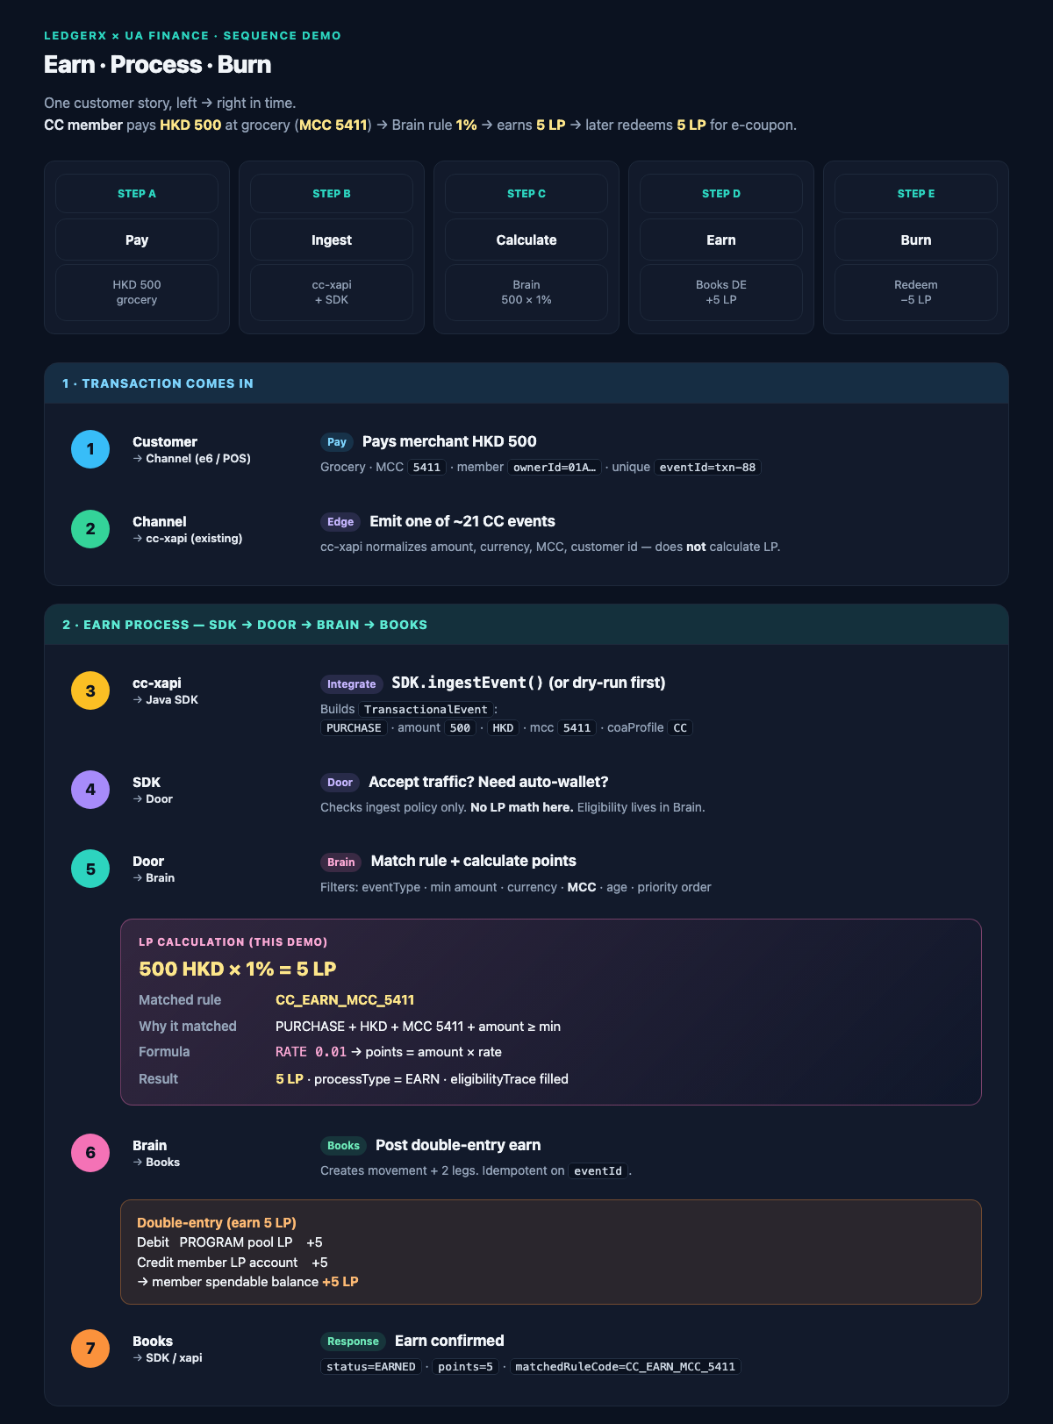
APPENDIX A1 · Sequence board (1/2) · Transaction → Earn

Slide 15
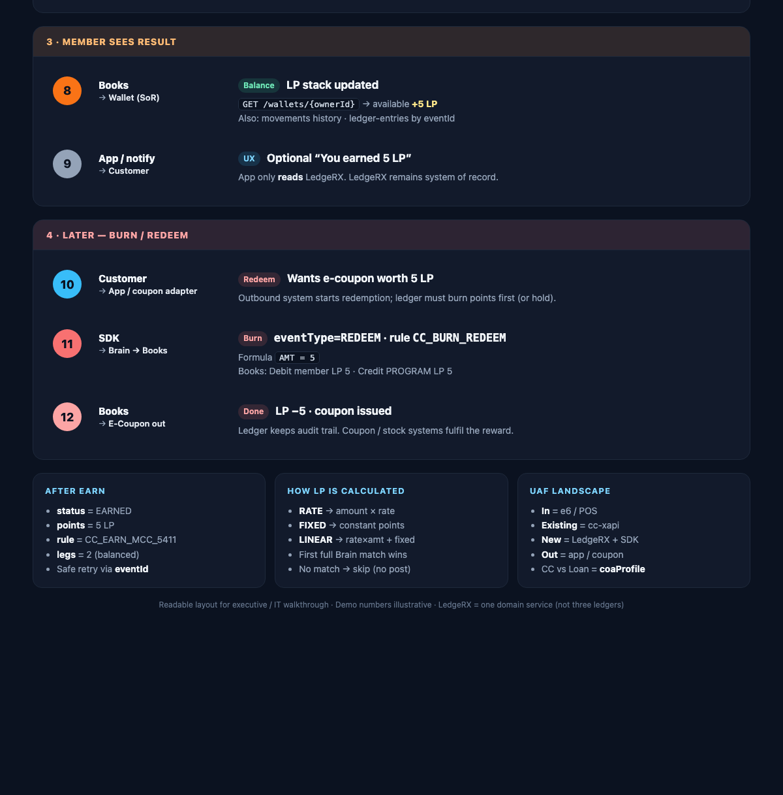
APPENDIX A2 · Sequence board (2/2) · Result → Burn + summary

