Slide 1
UA FINANCE · CTO & INTERNAL IT
Part A
Product & SDK
LedgeRX
Part B
Full product briefing
SDK · capabilities · architecture · landscape apply
CTO architecture
Part C
UAF landscape
Part D
Event mapping
Confidential draft for alignment

Slide 2
Agenda
One deck — product to UAF apply
A1–A6
Mission · value · SDK-first · IT journey · capabilities
B7–B10
Netflix-style landscape · request paths · engagement · outcomes
C11–C16
Whiteboard as-is · wishlist · target apply · box mapping · runtime
D17–D21
Event map guide · CC 01–21 · Loan · workshop
Close
Asks for next conversation
LedgeRX × UA Finance · Full briefing · Confidential
1

Slide 3
The enterprise problem
Loyalty points are financial liabilities
01
Fragmented SoR
02
Slow change
Balances scatter across CRM, campaigns, files.
Earn rules wait on release trains.
03
Weak audit
04
Integration tax
Hard to prove earn or skip.
Every channel re-builds wallet logic.
LedgeRX × UA Finance · Full briefing · Confidential
2

Slide 4
What LedgeRX is
Domain microservice for programme balances
System of record for wallets & loyalty points — cloud-native, double-entry, runtime-configurable. UA Finance Internal IT integrates via Java SDK + stable HTTP APIs.
We provide
UA Finance owns
Engine (ledger-engine)
CRM / membership
Java SDK for Internal IT
Card & loan cores
Admin control plane
cc-xapi / adapters
Door · Brain · Books · COA
Campaign & coupon fulfil
Dry-run / trace / fail ops
Cluster & observability
LedgeRX × UA Finance · Full briefing · Confidential
3

Slide 5
Business cases
Patterns LedgeRX is built for
A
B
C
Card / retail earn
Multi-line books
Hold → settle
Events → points
CC vs Loan COA
Auth lock LP
Same-day rule change
One engine · separable books
Issuer-style control
LedgeRX × UA Finance · Full briefing · Confidential
4

Slide 6
SDK-first for Internal IT
Ease of integration is a product feature
Versioned Java SDK (ledger-engine-sdk) — typed clients, playbooks, dry-run — so cc-xapi / loan adapters integrate in a sprint, not a research project.
Java SDK package
Happy-path APIs
Playbooks
Versioned JAR under contract for enterprise IT
Onboard · ingest · dry-run · balances · history
Bootstrap, errors, idempotent eventId
Runtime control
Safe cut-over
Platform native
Door / Brain / COA without platform release
Dry-run + eligibilityTrace + fail queue
ClusterIP · mesh · your observability
LedgeRX × UA Finance · Full briefing · Confidential
5

Slide 7
Internal IT journey
Receive SDK → production events
1
2
3
4
5
6
SDK
Deploy
Config
Integrate
UAT
Live
JAR + guide
Engine + PG
Door Brain COA
xapi + SDK
Dry-run matrix
Ops runbooks
Buzzword-accurate · engineering-honest
API-first · SDK-assisted · cloud-native · event-driven earn · runtime policy engine · audit-grade double-entry · zero-trust friendly (in-cluster; API key roadmap).
LedgeRX × UA Finance · Full briefing · Confidential
6

Slide 8
Core capabilities
Door · Brain · Wallet · Books · COA · Trust
Door
Brain
Wallet
Ingest control
Decisioning
Member books
Traffic · auto-wallet · default COA
Filters + formula JSON
1 ownerId · multi-ccy
Books
COA
Trust
Double-entry
Schemes
Safety pack
PROGRAM pool · legs
CC / Loan profiles
Dry-run · trace · fail queue
LedgeRX × UA Finance · Full briefing · Confidential
7

Slide 9
FOR UA FINANCE CTO
Target microservices landscape
Netflix-style platform view · ★ LedgeRX + SDK · Internal IT adapters
EDGE
Channels
API Gateway
Service Mesh
IAM
Internal only
app · e6 · POS
routing · TLS
mTLS · retries
enterprise IdP
ClusterIP
CRM
cc-xapi
Loan path
★ LedgeRX + SDK
Campaign
Notify
ownerId
existing
adapter
ledger-engine
offers
push
MS
Config
Secrets
Admin BFF
IT adapters
Audit
Reporting
flags
vault
ops UI
SDK clients
immutable
extracts
Door · Brain · Books · COA · Trust
ASYNC
Kafka* optional
Txn events
Ledger outcomes*
Today: sync SDK
evolution
CC + Loan
earned/skip
async-ready
DATA
CRM DB
LedgeRX PG ★
Loan DBs
Warehouse
Object
member
wallet rules legs
cores
analytics
exports
* Illustrative. ★ LedgeRX-owned. Not three ledger microservices.

Slide 10
How Internal IT plugs in
SDK call paths
Onboard
CRM / job → SDK.createWallet() → LedgeRX → PG
Earn sync
cc-xapi / loan → SDK.ingestEvent() → Door→Brain→Books
Dry-run
IT/Ops → SDK.dryRun() → trace only
Configure
Ops → Admin/API → Door·Brain·COA
Read
App BFF → SDK.getWallet() → balances
Async later
Bus consumer → same event contract
LedgeRX × UA Finance · Full briefing · Confidential
8

Slide 11
What UA Finance receives
Engagement package
Product
LedgeRX engine — deployable domain service
SDK
Java client — onboard, ingest, dry-run, query
Admin
Door, Brain, COA, simulator, review
Docs
START_HERE · flows · event skeleton · runbooks
Architecture pack
Landscape apply + Netflix-style CTO view
Support path
Versioned delivery · IT workshop
LedgeRX × UA Finance · Full briefing · Confidential
9

Slide 12
PART C
Apply to UA Finance landscape
From whiteboard (CC + Loan Reward) → target architecture

Slide 13
Whiteboard as-is
UAF Reward System (CC + Loan)
IN
NEW (green)
OUT
e6 web (CC)
Ledger + SDK v1
IT integrate surface
Loan:CC existing
Onboarding
Member / wallet
~21 CC events
Loan:Loan existing
Referrer MGT
Referral
Mobile (Loan)
E-Coupon new
Posting
Points movements
N Loan events
Account Rules
Decisioning
Adapter new
→ cc-xapi
Calculation Config
Rates / formulas
Stock new
→ loan path
Ledger × N (yellow)
Multiple books drawn
…
Config Rules
Runtime policy
LedgeRX × UA Finance · Full briefing · Confidential
10

Slide 14
Wishlist ownership
Orange sticky → honest split
Capability
Wave
Owner
Note
Real-time cashback
P1
LedgeRX + xapi
Event → Books
LP stack
P1
LedgeRX
Wallet + history
Redemption
P1–2
LedgeRX + Coupon
Burn + fulfil out
Tier / ranking
Later
UAF CRM
Not LedgeRX core
Promotion merch
Later
Campaign
Win → event in
Referrer MGT
Parallel
UAF New
May emit earn
LedgeRX × UA Finance · Full briefing · Confidential
11

Slide 15
Target — LedgeRX applied
One domain service · multi-book · SDK
IN
EXISTING
NEW · LedgeRX
OUT
Single domain service
e6 / digital
engine + Java SDK v1
Loan:CC
cc-xapi
Existing
CC ~21
→ SDK
Door
Brain
Ingest
Rules+calc
Loan:Loan
Mobile loan
Existing
N events
Books
COA
E-Coupon
loan adapter
DE post
CC/Loan
Fulfil
CRM
→ SDK
ownerId
Stock
NOT 3 ledger MS — multi-book one SoR
Fulfil
LedgeRX × UA Finance · Full briefing · Confidential
12

Slide 16
Whiteboard → LedgeRX
What the yellow ledgers become
Whiteboard
Decision
Implication
Ledger : SDK v1
★ Java SDK
Primary IT surface
Ledger × N yellow
★ One engine + COA
CC vs Loan books
Posting
★ Books DE
Earn/burn/hold
Account Rules
★ Brain
Eligibility
Calculation Config
★ Formula JSON
Runtime rates
Config Rules
★ Admin + APIs
No redeploy
Onboarding
⚠ Wallet only
KYC stays UAF
Referrer
○ Outside
Emit earn events
cc-xapi
○ Keep
Adapter → SDK
Coupon/Stock
○ Outbound
Burn then fulfil
LedgeRX × UA Finance · Full briefing · Confidential
13

Slide 17
Runtime path (CC)
Loan uses same spine · different COA/rules
Event
→
xapi
→
SDK
→
Door
→
Brain
→
Books
→
Out
CTO one-liner
Keep cc-xapi and loan cores. Put one LedgeRX in the green box. Internal IT integrates with the Java SDK. Configuration Rules = Door + Brain + COA — not a second rules platform and not three ledger microservices.
LedgeRX × UA Finance · Full briefing · Confidential
14

Slide 18
PART D
Event → Brain mapping skeleton
CC ~21 · Loan N · also in docs/UAF_EVENT_MAPPING_SKELETON.md

Slide 19
Mapping columns
Workshop sheet dictionary
eventCode
Real UAF / e6 code
channel
CC | LOAN | BOTH
mapsToEventType
TransactionalEvent.eventType
brainRuleCode
digestion_rule.code
formulaIntent
RATE / FIXED / AMT / NONE / HOLD
coaProfile
CC stream vs LOAN stream
phase
P1 dry-run · P1 live · P2
status
TODO · MAPPED · UAT · LIVE
LedgeRX × UA Finance · Full briefing · Confidential
15

Slide 20
CC skeleton 01–12
Replace codes with real e6 catalogue
#
eventCode
eventType
Brain rule
Formula
COA
Ph
01
CC_PURCHASE_POSTED
PURCHASE
CC_EARN_BASE
RATE
CC
P1
02
CC_PURCHASE_AUTH
AUTH
CC_HOLD_OPT
HOLD
CC
P2
03
CC_PURCHASE_CAPTURE
CAPTURE
CC_EARN_BASE
RATE
CC
P1
04
CC_REFUND
REFUND
CC_BURN_REFUND
AMT
CC
P1
05
CC_CHARGEBACK
CHARGEBACK
CC_BURN_CB
AMT
CC
P1
06
CC_FX_MARKUP
PURCHASE
CC_EARN_FX
RATE
CC
P2
07
CC_CASH_ADVANCE
CASH_ADV
SKIP_OR_RATE
TBD
CC
P2
08
CC_FEE_POSTED
FEE
SKIP
NONE
CC
P1
09
CC_PAYMENT_RECV
PAYMENT
SKIP
NONE
CC
P1
10
CC_INTEREST_POST
INTEREST
SKIP
NONE
CC
P1
11
CC_MCC_GROCERY
PURCHASE
CC_EARN_MCC_5411
RATE+
CC
P1
12
CC_MCC_DINING
PURCHASE
CC_EARN_MCC_5812
RATE+
CC
P1
LedgeRX × UA Finance · Full briefing · Confidential
16

Slide 21
CC 13–21 + Loan skeleton
Full sheet in UAF_EVENT_MAPPING_SKELETON.md
#
eventCode
eventType
Brain rule
Formula
COA
Ph
13
CC_MCC_TRAVEL
PURCHASE
CC_EARN_TRAVEL
RATE+
CC
P2
14
CC_ONLINE_ECOM
PURCHASE
CC_EARN_ONLINE
RATE
CC
P1
15
CC_INSTALMENT
INSTALL
CC_EARN_OR_SKIP
TBD
CC
P2
16
CC_REWARD_REDEEM
REDEEM
CC_BURN_REDEEM
AMT
CC
P1
17
CC_REWARD_EXPIRE
EXPIRE
CC_BURN_EXPIRE
AMT
CC
P2
18
CC_ADJUSTMENT_CR
ADJ_CR
CC_EARN_ADJ
AMT
CC
P1
19
CC_ADJUSTMENT_DR
ADJ_DR
CC_BURN_ADJ
AMT
CC
P1
20
CC_CARD_ACTIVATION
SIGNUP
CC_EARN_WELCOME
FIXED
CC
P1
21
CC_ANNUAL_FEE_WAIVE
FEE_WAIVE
SKIP_OR_FIXED
TBD
CC
P2
L1
LOAN_DISBURSE
DISBURSE
LN_EARN_OR_SKIP
TBD
LOAN
P1
L2
LOAN_REPAYMENT
REPAY
LN_EARN_REPAY
RATE
LOAN
P1
L3
LOAN_EARLY_SETTLE
SETTLE
LN_EARN_BONUS
FIXED
LOAN
P2
L4
LOAN_OVERDUE
OVERDUE
SKIP_OR_HOLD
NONE
LOAN
P2
L+
… N more
TBD
TBD
TBD
LOAN
TBD
LedgeRX × UA Finance · Full briefing · Confidential
17

Slide 22
Next workshop & asks
Internal IT + Biz + LedgeRX
1
Lock catalogue
Real 21 CC + Loan N codes into the sheet
2
Normalize
xapi → TransactionalEvent field map
3
P1 rules
Brain formulas for P1 rows only
4
COA / ownerId
CC vs Loan books strategy
5
SDK spike
5 golden dry-runs from cc-xapi
6
Outbound
Redeem burn ↔ E-Coupon sequence
LedgeRX × UA Finance · Full briefing · Confidential
18

Slide 23
UA FINANCE
One LedgeRX domain service.
SDK for Internal IT.
CC + Loan books — not three ledgers.
Runtime rules. Audit-grade posts.
Ask: SDK package · sandbox · joint IT workshop · filled event matrix
Discussion · Questions · Pilot scope

Slide 24
APPENDIX
Earn · Process · Burn — full sequence board
Split into 2 slides (readable HTML board)

Slide 25
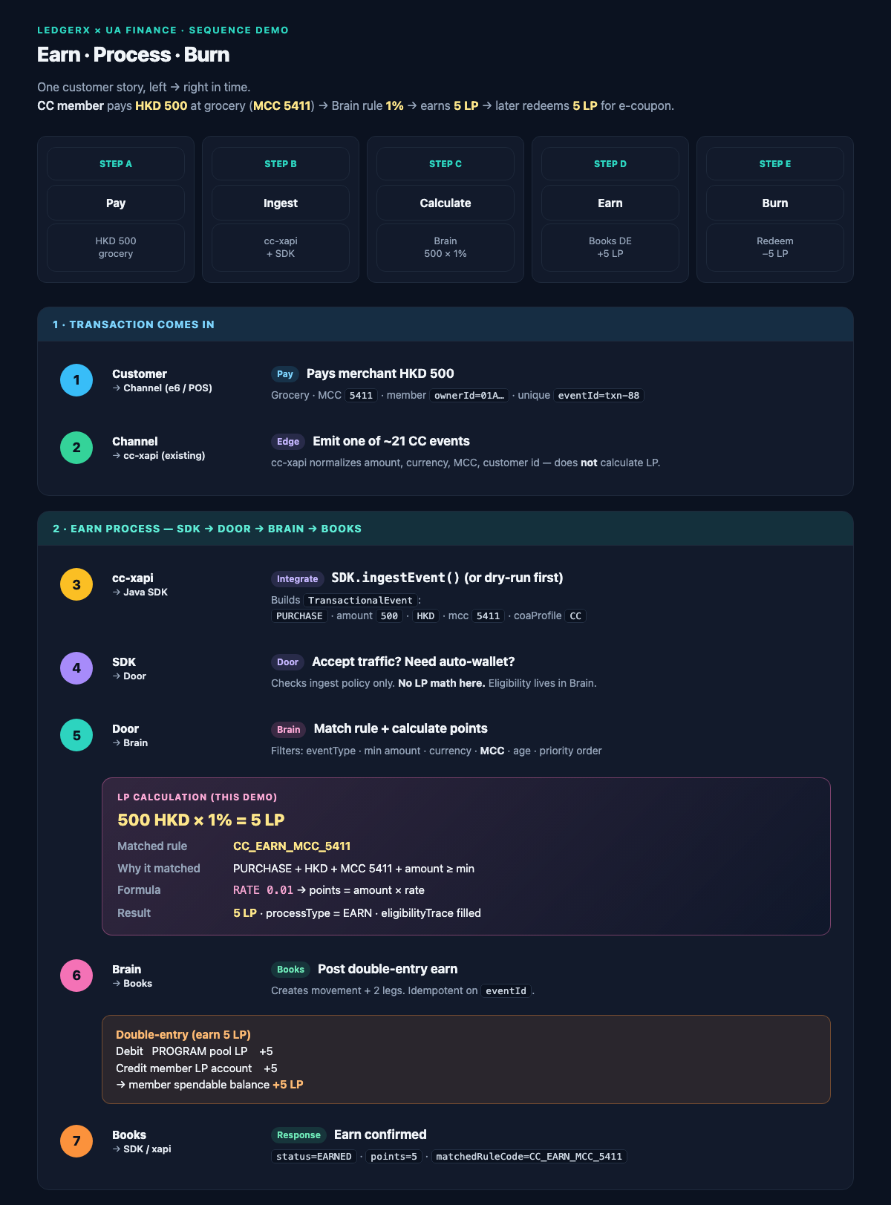
APPENDIX A1 · Sequence board (1/2) · Transaction → Earn

Slide 26
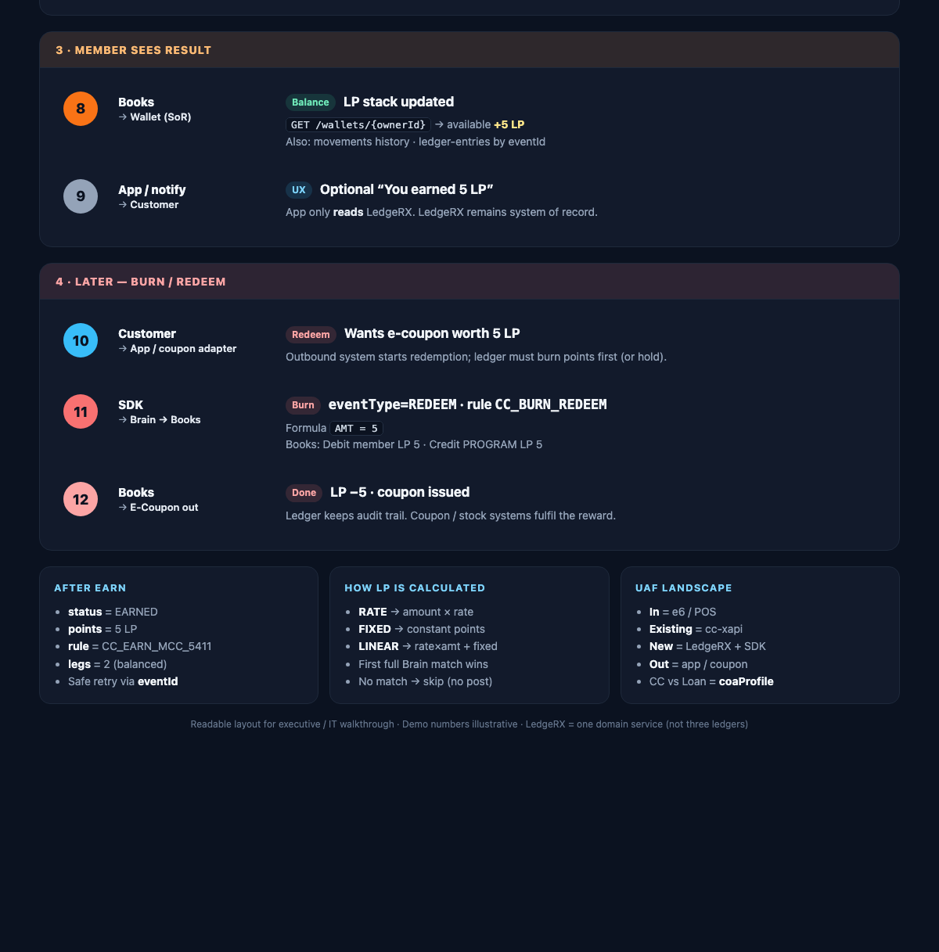
APPENDIX A2 · Sequence board (2/2) · Result → Burn + summary

