Slide 2

Medical Statistics
(full English class)
Ji-Qian Fang
School of Public Health
Sun Yat-Sen University

Slide 3
Chapter 12
Linear Correlation and
Linear Regression

Slide 6
Up to now, the statistical methods we have learnt concern with single variable only
Such as
Estimate the average height among high school students
Comparing the average height of high school students between city and country side
The relationship between two variables are often concerned:
Example: For high school students,
Height and Age – linear relation?
Height and Vital capacity -- linear relation?

Slide 7
In this chapter, we are going to study
two variables
linear relationship
Two types of questions:
Whether there is a linear relationship?
-- Linear correlation
How to predict one variable by another variable?
-- Linear regression

Slide 8
Example Chest circumference and vital capacity of 15 high school female students
Is there a linear relationship between Vital Capacity Y and Chest circumference X? -- Linear correlation
If Chest circumference X is known, can we predict her Vital Capacity Y? -- Linear regression

Slide 9
12.1 Linear correlation

Slide 10
Scatter Diagram

Slide 11
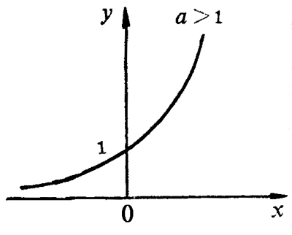
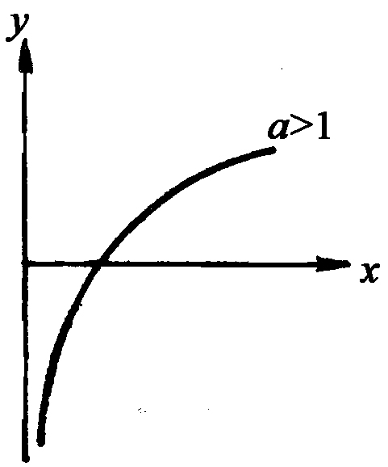
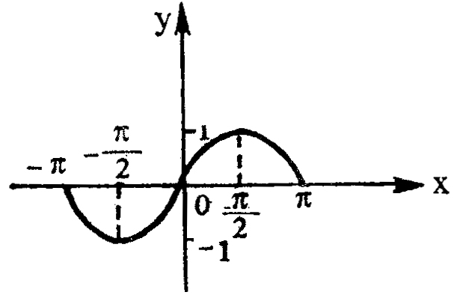
Function between Y and X
Exponential function
Logarithm function
Sine Function
There is a fixed value of Y
corresponding to any given value of X

Slide 12
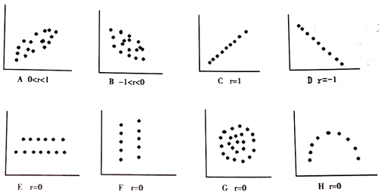
Fig 12-2 Linear correlation

Slide 13
Correlation Coefficient and Calculation
A measurement of linear relationship:
1) Whether there is a correlation;
If the correlation coefficient is 0 or not big
enough -- no correlation
2) If correlation coefficient is big enough
The direction of correlation?
-- positive + or negative -
The strength of correlation? high or not?
-- +1 or -1, complete correlation

Slide 16
2. Hypothesis test
r is sample correlation coefficient, change from sample to sample
There is a population correlation coefficient, denoted by ρ
Question : Whether ρ=0 or not?

Slide 17
H₀: ρ=0, H₁: ρ≠0
α=0.05
(1) Checking a special table (Table 12-3)
Two-side 0.05 and 0.01
H₀ is rejected.
Conclusion: There is linear correlation between Vital Capacity and Chest Circumference
Question: Since , very small, can we say the correlation is very strong?

Slide 18
Table 12-3 Critical values for r
Question:
If r=0.90, can you claim the two variables are correlated
each other?
Does a small P value mean that the correlation is strong ?

Slide 19
(2) t test (Assume normal distribution)
H₀: ρ=0, H₁: ρ≠0
If P-value <α, then reject H₀ , conclude that
the population correlation coefficient is significantly different from 0.
υ=10-2=8, p<0.05. The population correlation coefficient might not be 0.

Slide 20
12.2 Rank correlation
1. Spearman rank correlation coefficient
It is useful to:
Ranked data
Measurement data
-- not follow normal distribution;
or not precisely measured

Slide 22
2. Hypothesis test for r_{s}
(1) Checking a special table (Table 12-4)
P=0.01 and it is significant
(2) t test Same as the t test for Pearson’s correlation
coefficient
H₀: ρ=0, H₁: ρ≠0

Slide 23
What if there are more ties?
(1) ranking the values of x and y separately
-- Calculate the mean rank
(2) Calculating the spearman r_{s}:
Use the formula for Pearson correlation
-- Put the ranks (column 4 and 5) into the formula of Pearson’s correlation coefficient r

Slide 24
Caution for correlation

Slide 25


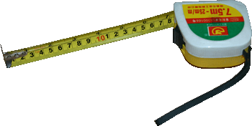
Story 1 Correlation between height of son and tree.
A correlation coefficient was calculated at the first
anniversary
Conclusion: The tree made his son growing up quickly, or
his son made the tree growing up quickly?!

Slide 26


Story 2 Correlation between swimming and ice cream.
They calculated a correlation coefficient at the end of year
Conclusion: Swimming people must like ice ream, or buying ice ream must go to swimming?!

Slide 27
1) Don’t put any two variables together for correlation
-- They must have some relation in subject matter
2) Simple correlation
= Direct association + indirect association
Simple correlation does not necessary mean a
direct association
Son
?
Tree
Swimming
?
Ice ream
Time
Temperature

Slide 28
Summary
Concept of linear correlation
-- The scatter diagram shows a linear tendency
Correlation Direct association
Correlation Causation
After calculating a sample correlation coefficient, it is necessary to have a test for
H₀: ρ=0, H₁: ρ≠0
Rejecting H₀ just means ρ≠0.
There are two correlation coefficients commonly used:
Pearson’s product moment correlation coefficient r
Spearmen’s rank correlation correlation coefficient r_{s}
-- The formulas do not have to be remembered

Slide 29
Next lecture
Question:
If there is linear correlation between X and Y,
Given a value of X, can we predict the value
of Y ? How?
-- Linear regression

