Slide 2
Analysis of Variance
（Part Ⅱ）
March,10th,2005

Slide 3
A medical research on p.297

Slide 6
Conditions for ANOVA application
Individuals are drawn from the population randomly and independently.
The concerned populations all belong to normal distributions.
The variances in each populations are equal.

Slide 7
Vocabulary
randomized block design 随机区组设计
restrain 抑制
carcinoma 瘤体
common status （个体的）一般状况
rank 排列顺序
multiple comparison 两两多重比较

Slide 8
Contents
1. Introduction
2. A practical medicine research
3. Source of variation in Randomized Block Design
4. Steps of ANOVA
5. Multiple comparison

Slide 11
Contents
1. Introduction
2. A practical medicine research
3. Source of variation in Randomized Block Design
4. Steps of ANOVA
5. Multiple comparison

Slide 12
A practical medicine research
The effectiveness of medicines to restrain carcinoma is correlated with the common status of the individuals. Twenty mice are used and every four mice,who have similar common status, are assigned in to a same sub-group(statistically called block).
Individuals in a same block will be given a medicine randomly.

Slide 13
Analysis to Example 9-20 on p. 299

Slide 14
Contents
1. Introduction
2. A practical medicine research
3. Source of variation in Randomized Block Design
4. Steps of ANOVA
5. Multiple comparison

Slide 15
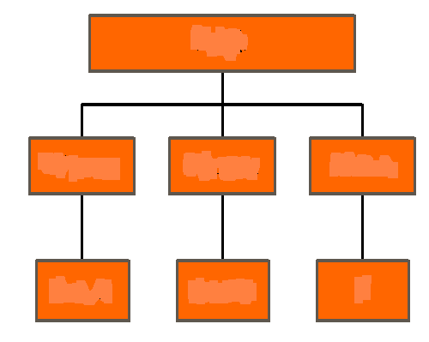
A+E
B+E
E

Slide 17
Where,

Slide 18
Two types of one-way ANOVA
1. Completely randomized design
All the individuals,who are assumed with homogeneity , are assigned into each groups randomly.
2. Randomized block design
In every block, the individuals,who are assumed with homogeneity, accept the given treatments randomly. Those who are not in the same block may be different in some status.

Slide 19
Contents
1. Introduction
2. A practical medicine research
3. Source of variation in Randomized Block Design
4. Steps of ANOVA
5. Multiple comparison

Slide 20
4. Steps of ANOVA for Randomized Block Design
(1) Hypothesis & significance level.
H₀: μ₁=μ₂=…=μ_{k}
H₁: μ₁,μ₂,…,μ_{k} are not same in all
H₀: μ₁=μ₂=…=μ_{b}
H₁: μ₁,μ₂,…,μ_{b} are not same in all
α=0.05
(2) Calculation of F value.
Construct a table of ANOVA
(3) Make a judgment based on P value .

Slide 21
Analysis to Example 9-20 on p. 299
(1) Hypothesis & significance level.
H₀: μ₁=μ₂= μ₃ = μ₄
H₁: μ₁,μ₂, μ₃ , μ₄ are not equal in all
H₀: μ₁=μ₂= μ₃ = μ₄ =μ₅
H₁: μ₁,μ₂ , μ₃ , μ₄,μ₅ are not equal in all
α=0.05

Slide 22
(2) Calculation of F-value.
F_{0.05 (3，12)}=3.49，F_{0.01 (3，12)}=5.95
F_{0.05 (4，12)}=3.26
F-table, p.295

Slide 23
(3) Make a judgment based on P value .
As to treatment, since P < 0.01, it can be concluded that the means of carcinoma weight are not same in all. The effectiveness of 4 medicines are of statistically significant difference.
Question: Is the above mentioned means are sample means or population means?

Slide 24
As to block , since P > 0.05, it can be concluded that the means of carcinoma weight in each family can be regarded as the same in all. The difference among blocks are not statistically significant.
In this research, block factor is not concerned so much. Treatment is the focused factor.

Slide 25
Because the differences among the sample means are statistically significant, we can draw a conclusion that the population means are not same in all.
If we try to know in detail, which pair of them are different, which pair of them are equal, we need to do further analysis.

Slide 26
Contents
1. Introduction
2. A practical medicine research
3. Source of variation in Randomized Block Design
4. Steps of ANOVA
5. Multiple comparison

Slide 27
Multiple comparison (q test)
There are many methods to fulfill multiple comparison. They may be appropriate under particular situation.
When we haven’t any information about the forms of influence produced by treatments, SNK (Student-Newman-Keuls) method is suitable, which is also called q test.

Slide 28
Steps of q test
1. Hypothesis & significance level.
2. Rank the means of each groups.
3. Calculate q value for each comparison.
Count a — the number of groups which are covered by the compared pairs.
4. Check out P value from q table , then draw conclusions respectively.

Slide 29
(1) Hypothesis & significance level
H₀：μ_{A}＝μ_{B}， population means in group A and B are equal
H₁：μ_{A}≠μ_{B}， population means in group A and B are not equal
α＝0.05
Analysis to Example 9-19 on p. 297

Slide 30
(2) Rank the means of each groups
Rank 1 2 3 4
Mean 3.3200 3.0975 2.6850 2.4025
Group D C B A

Slide 31
（3）Calculate q value for each comparison

Slide 32
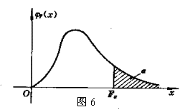



q - distribution

Slide 34
4. Check out P value from q table , then draw conclusions respectively
A B C D
Between A & B or Between C & D, the diets cause same influence on liver/body ratios to mice.
However, between any other pairs of diets, the difference are of statistical significance. Those with diets C or D have higher ratios than with A or B.

