Slide 1
Screen
Main, Second(junhee), review (Chelsea), cart , login (Chelsea)

Slide 2




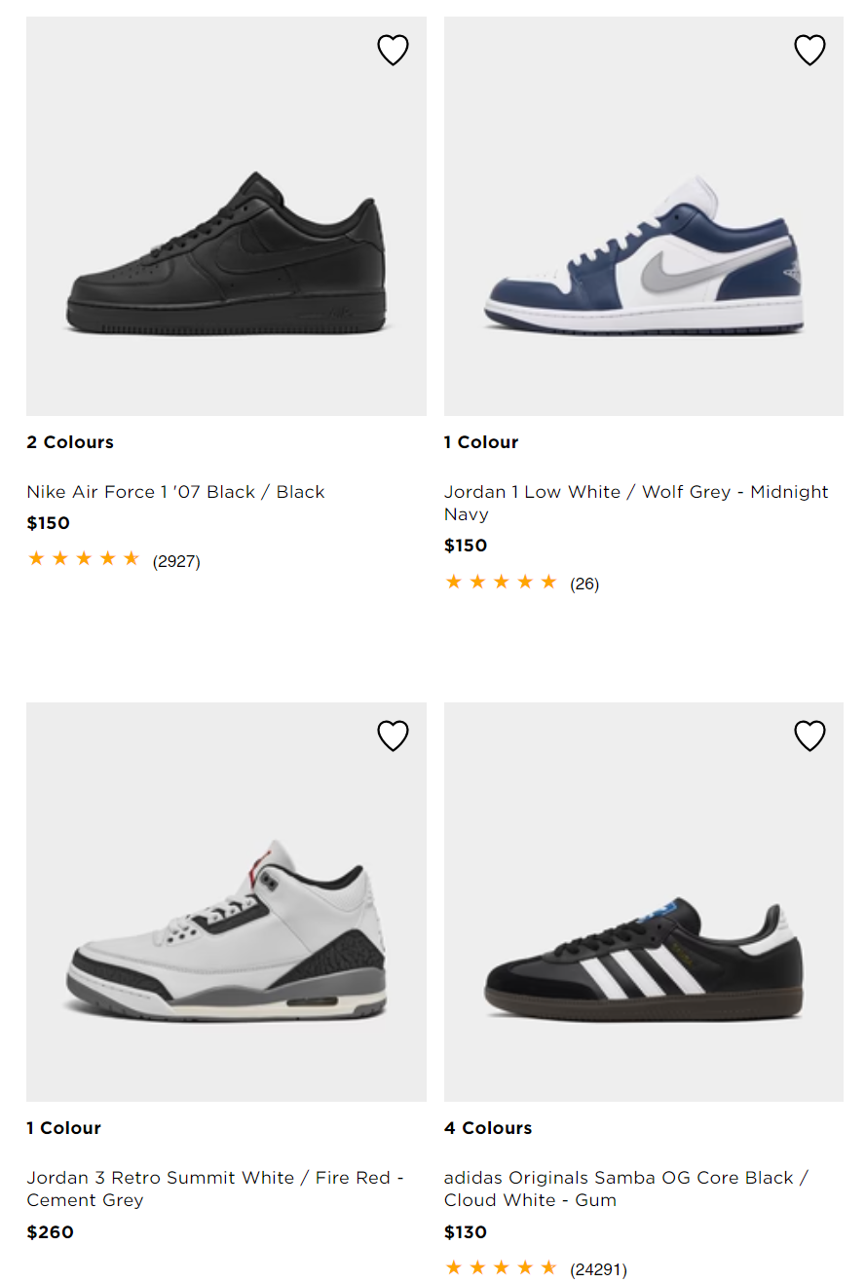
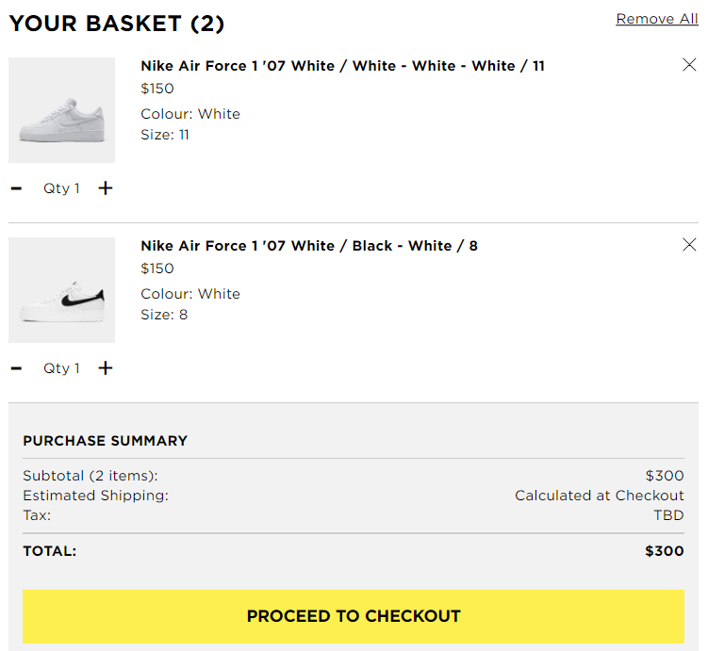
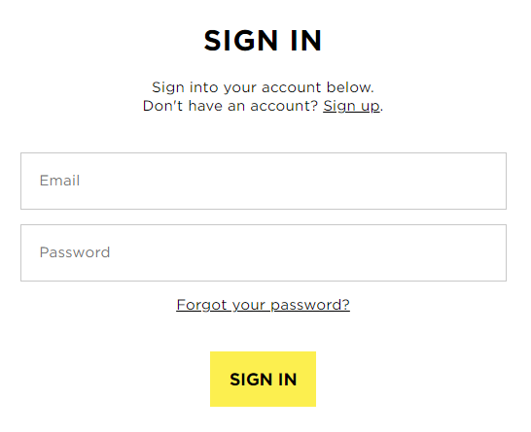
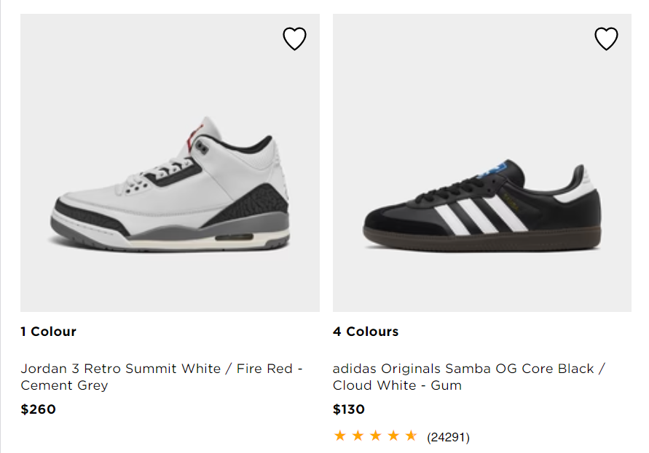

Main activity
option
cart activity
login activity

Slide 3
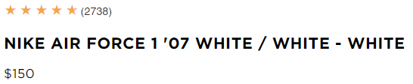
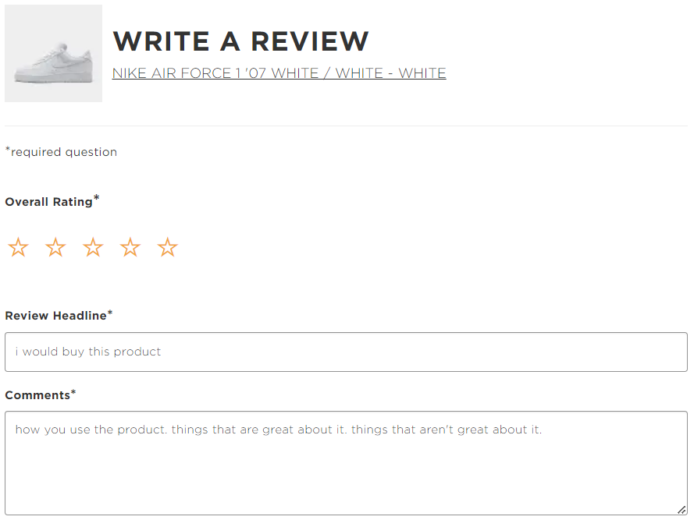
Second activity
review activity
picture
Add to cart
review
Review list
Write a review

Slide 4
Main activity
[Main activity]
Use database (shoes list, filter, sort, review, rating)
Use list or grid view to show all products
Use expandable-navigation drawer for filter and sort

Slide 5
cart activity
Use database(add items)
Use listview to show all items in cart
- image, text
Calculate price (include tax)
Add button for checkout
If user click the checkout button, show confirm dialog

Slide 6
login activity
[login activity]
Use database (add customer, check validate)
Input text
Create account button

Slide 7
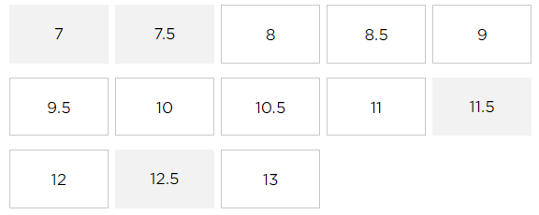
Second activity
Show detailed information about the item
- Use imagview, text, button, ratingbar, etc
Use database(add to cart, get review, size)
picture
Add to cart
review
Review list
Write a review

Slide 8
Review activity
Use database(add review data, calculate rating)
Use ratingbar
Use text field to take user input
(review title, comments, etc)

Slide 9
DB architecture
Shoes list: id(pk), product code(pk), title, brand, color, price, thumbnail
Review list: id(pk), product code(fk), review title, comment, rating
Cart items: id(pk), cart id, product code, quantity, size
Size: id(pk), product code(fk), 230, 235, 240, 255 ~~~~~~
User list: id(pk), id, password(using hash), email

Slide 10
Additional features
Launch screen
Create app logo image and change app icon
If possible,
add favorite

