Slide 1
NoteLMs: The three-model organization framework for student notes
Yan Levin
yl-2010@outlook.com
notelms.com
July 2026
Notes:
add email
and notelms link

Slide 2

Abstract
• Student notes are often chaotic and rarely reviewed
• Existing tools still require manual organization
• NoteLMs auto-classifies into folders, HTML-formats notes, and reads notes aloud for review
• This saves students’ time, making them more likely to review their notes in the future
• Three models compete; accuracy scored in real time

Slide 3
Introduction
• Website that auto-sorts and formats student notes
• Fully-functioning, live website, free to use
• Research questions:
Are LMs capable of categorizing notes into subjects?
If so, which LM is best?
• We have found that fine-tuned BERT is the most accurate LM at subject classification.

Slide 4



Related Products
• Microsoft OneNote
• Apple Notes
• Physical notebooks
• All require manual organizing and formatting

Slide 5
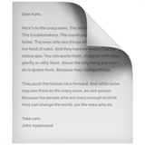



Conceptual Solution
• Input: plain-text notes or note images
• Output: Classify subject → place in subject folder
• Output: Auto HTML-format for readability
• Output: Natural AI readout

Slide 6
Conceptual Solution
• Input: plain-text notes or note images
• Output: Classify subject → place in subject folder
• Output: Auto HTML-format for readability
• Output: Natural AI readout

Slide 7




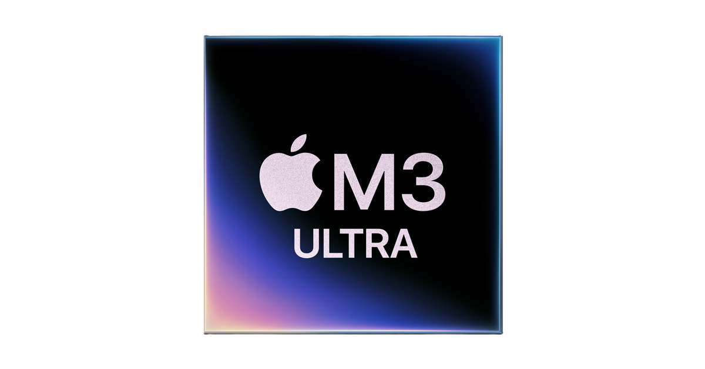
Implementation
• Vercel-hosted web app + Cloudfare tunnel ->
server running on mac

Slide 8
Implementation
• Vercel-hosted web app + Cloudfare tunnel
• 3 language models for classification:
Zero-shot BERT, Fine-tuned BERT, GPT-OSS:20b
Inference on Mac Studio, M3 Ultra w/ 96 gb unified memory
    Orchestrator:
    GPT-OSS:20b
Zero-shot BERT
Fine-tuned BERT
Reasoning llm: GPT-OSS:20b
Notes:
BERTs both running on pytorch, fine tuned on pytortch
Gpt oss running on lm studio

Slide 9
Implementation
• Vercel-hosted web app + Cloudfare tunnel
• Three language models for classification
Zero-shot BERT, Fine-tuned BERT, GPT-OSS:20b
Inference on Mac Studio, M3 Ultra w/ 96 gb unified memory
• Image -> text is done through OpenAI API key
Zero-shot BERT
Fine-tuned BERT
Reasoning llm: GPT-OSS:20b

Slide 10
Implementation
• Vercel-hosted web app + Cloudfare tunnel
• Three language models for classification
Zero-shot BERT, Fine-tuned BERT, GPT-OSS:20b
Inference on Mac Studio, M3 Ultra w/ 96 gb unified memory
• Image -> text is done through OpenAI API key
• User notes stored on local filesystem
Zero-shot BERT
Fine-tuned BERT
Reasoning llm: GPT-OSS:20b

Slide 11
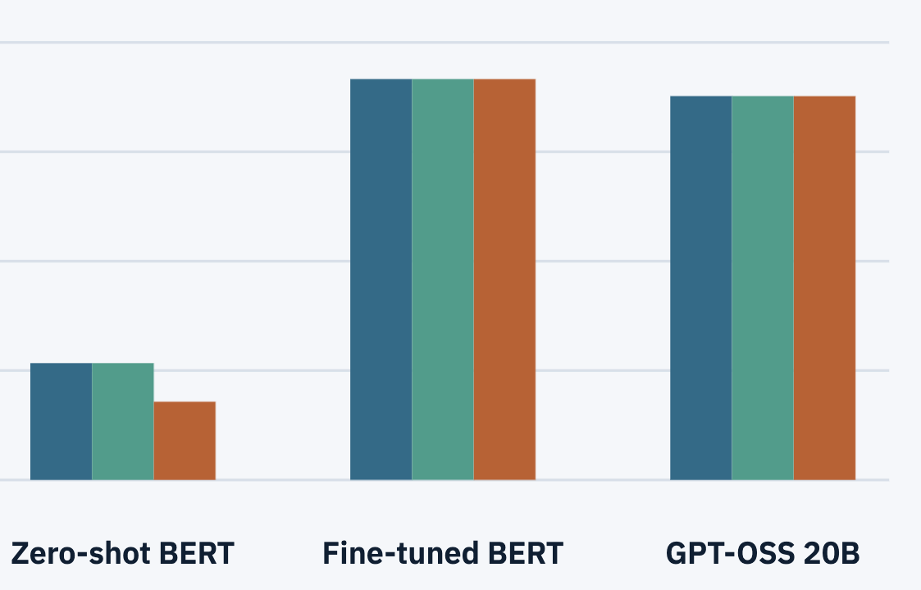
Evaluation
• Goal: measure classification accuracy
2,000 original eval runs
Models evaluated with every use of NoteLMs
• Threats: limited non-diverse data
Solution: introduce diversity by
drawing in real-world user data
Notes:
We already have over 30 evaluations of user data
Another threat is still

Slide 12
Conclusion
• Problem: students don’t review their notes because of no organization
• Solution: we fully sort and format their notes for them
Built-in chatbot answers questions about notes
Voice reads aloud notes when it’s time for test
• Research: compares and score three models live, with every new input
• Future work: local image to text, comparing between different LLMs
Notes:
reiterate problem, solution, and what the eval showed

Slide 13


Site Demo
https://notelms.com/

