Slide 1
Result summary
10/15/2024
Atwood lab & Provital
Notes:
Part_II

Slide 2
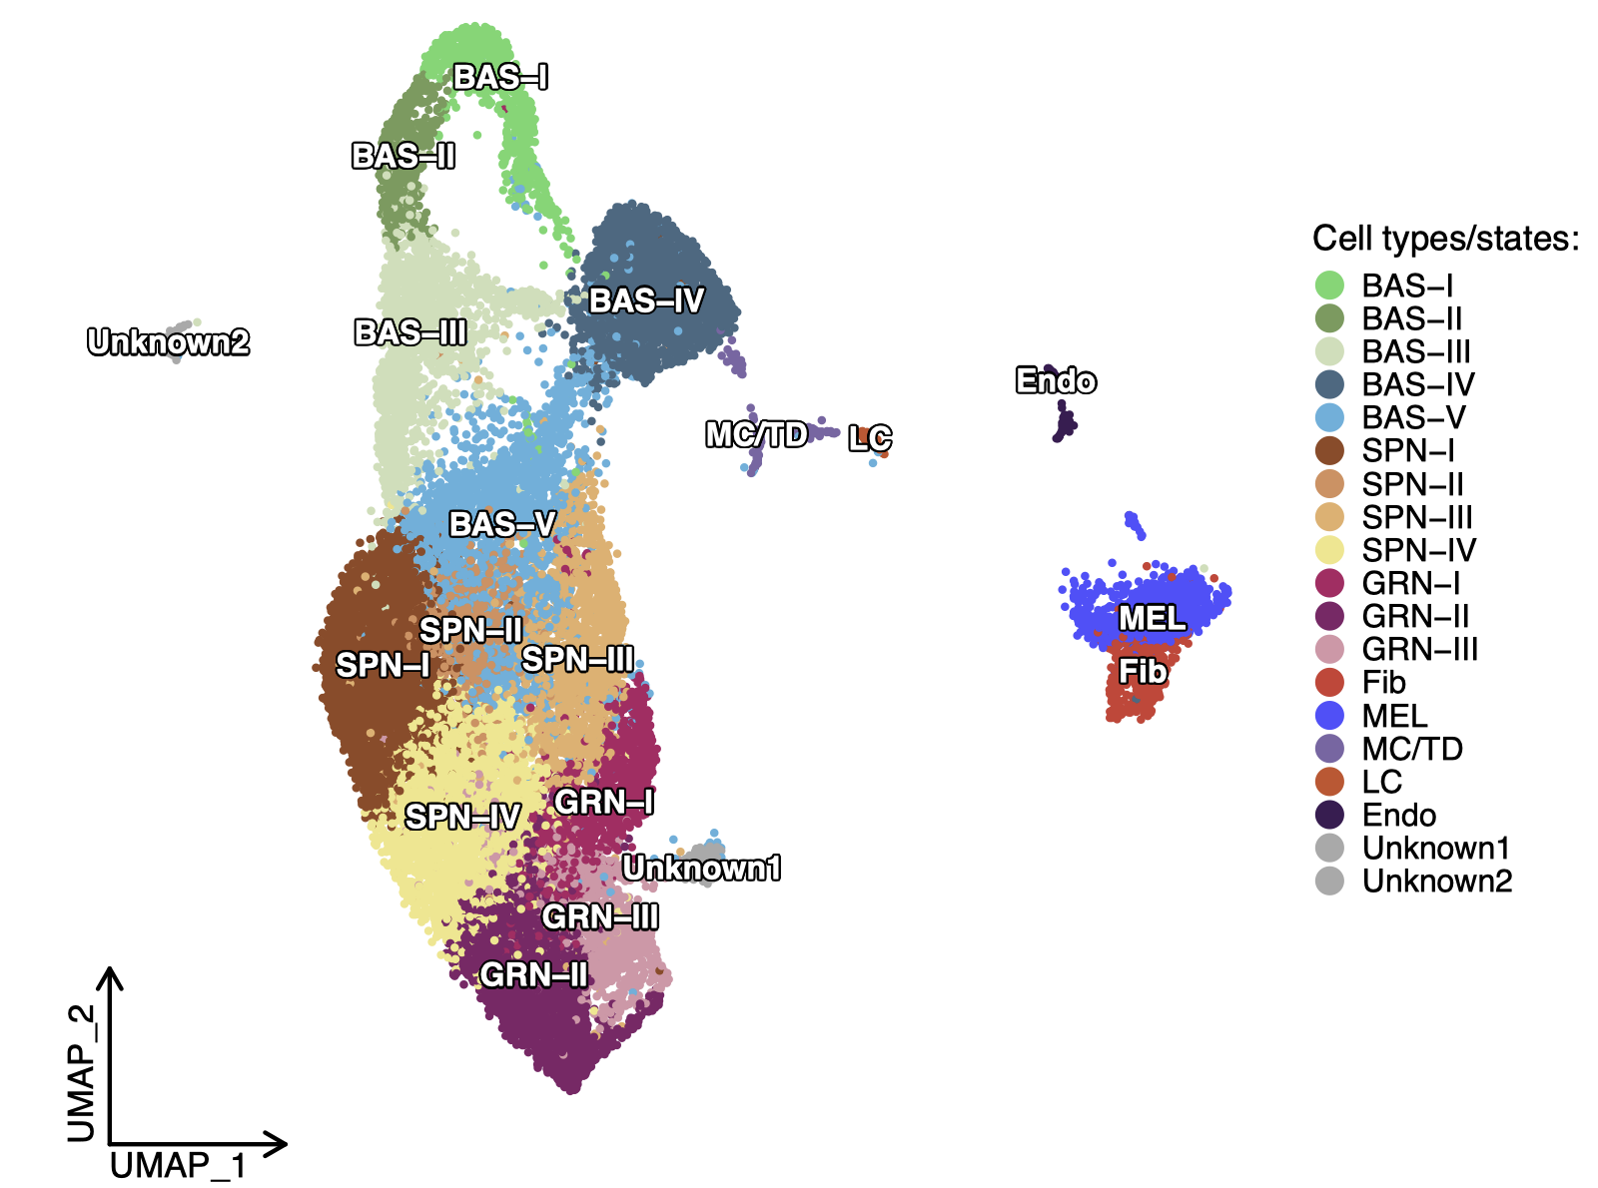
@ Main figures
R9_1.1_all_cells_umap.pdf

Slide 3
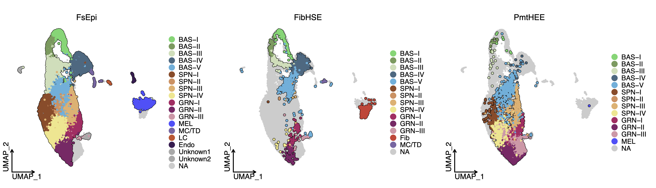
@ Supp.
R9_1.2_Cell_type_umap_plot_split.pdf

Slide 4
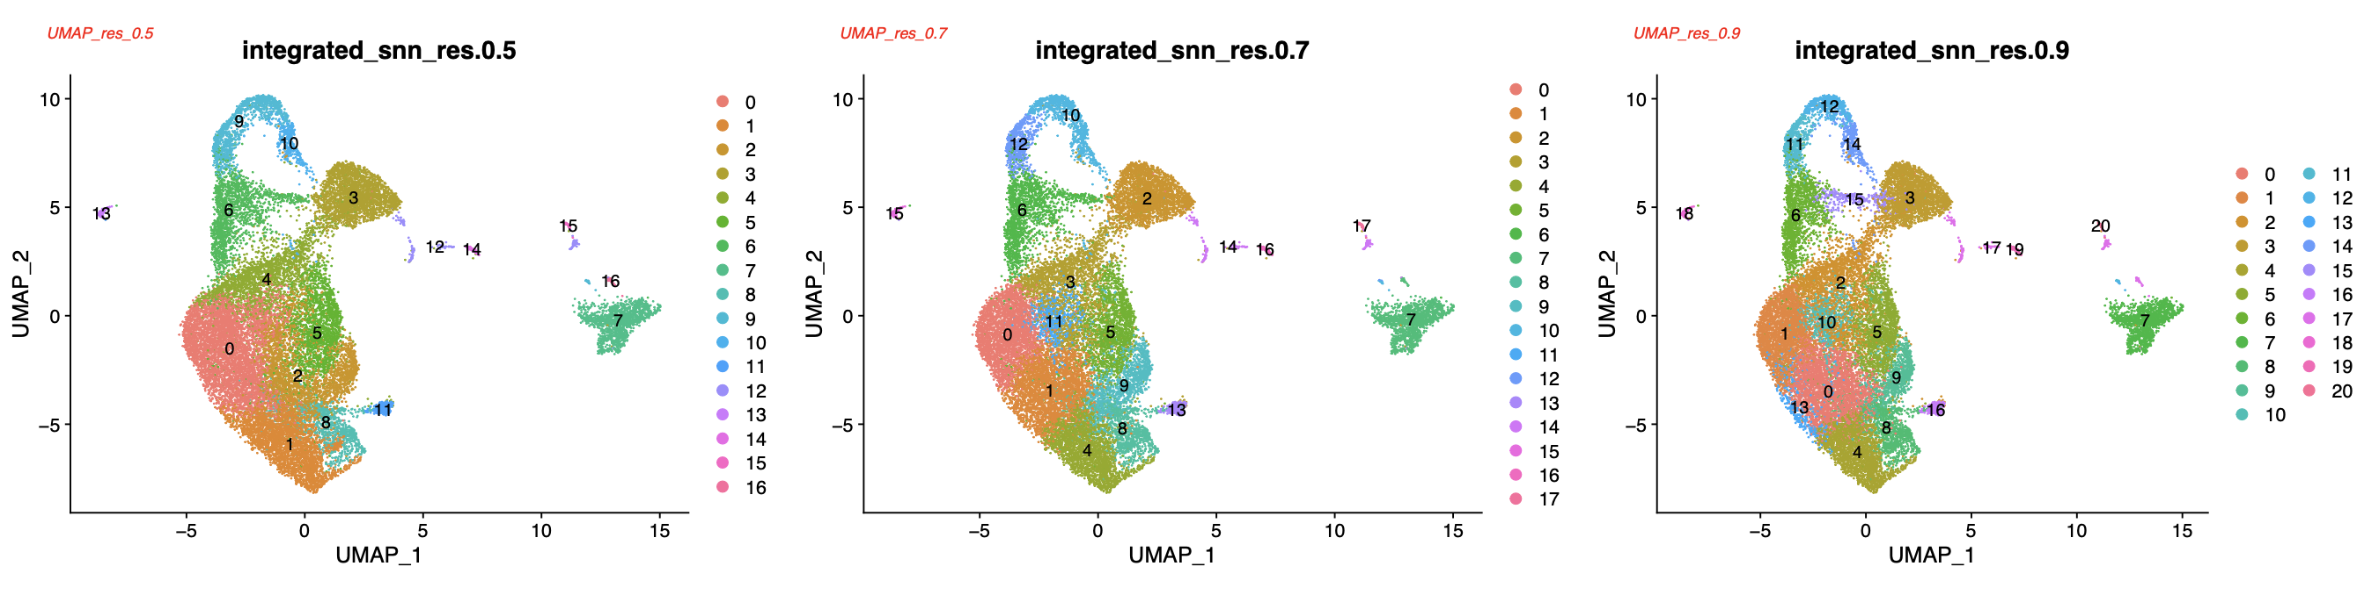
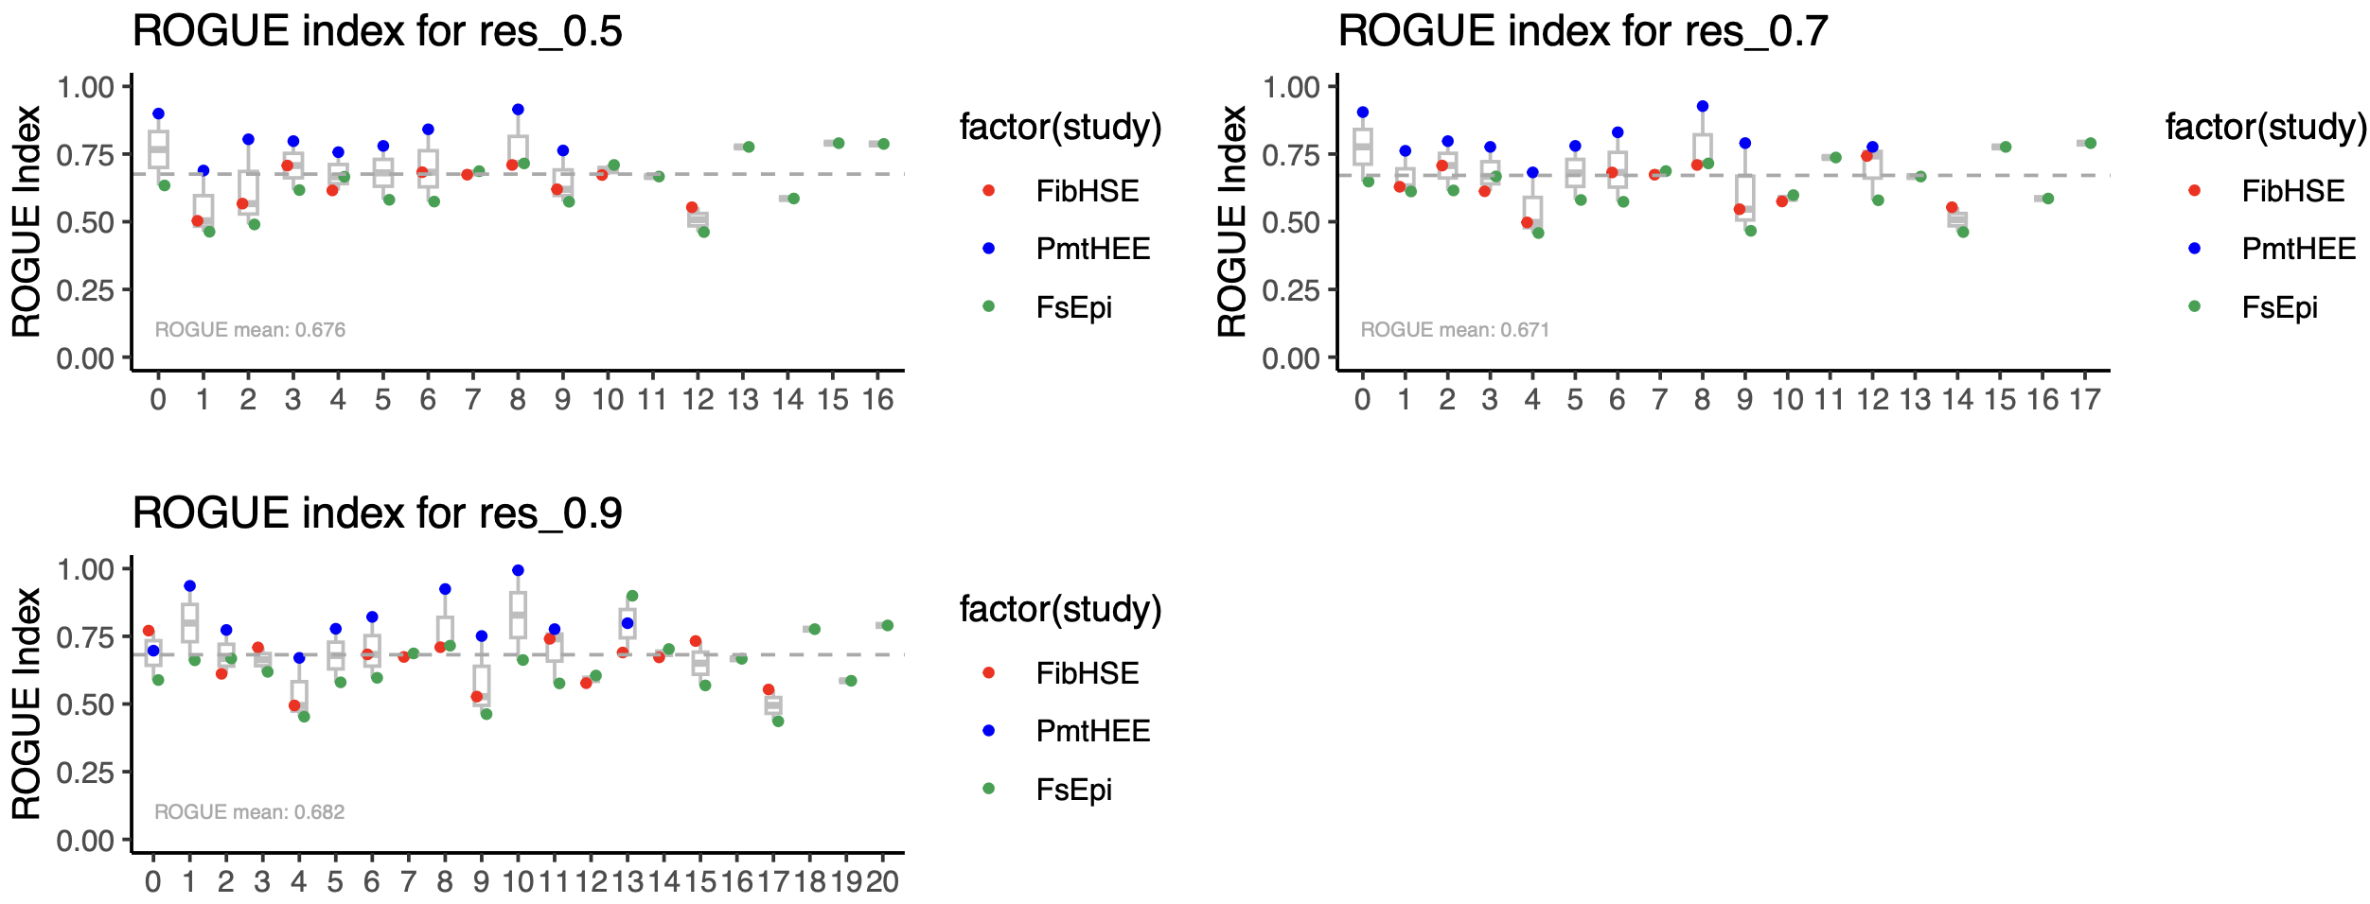
@ Supp.
1.2.4_Resolution_UMAP_seurat_cluster.pdf
1.2.5_purity_check_res_05_07_09_UMAP_seurat_cluster.pdf

Slide 5
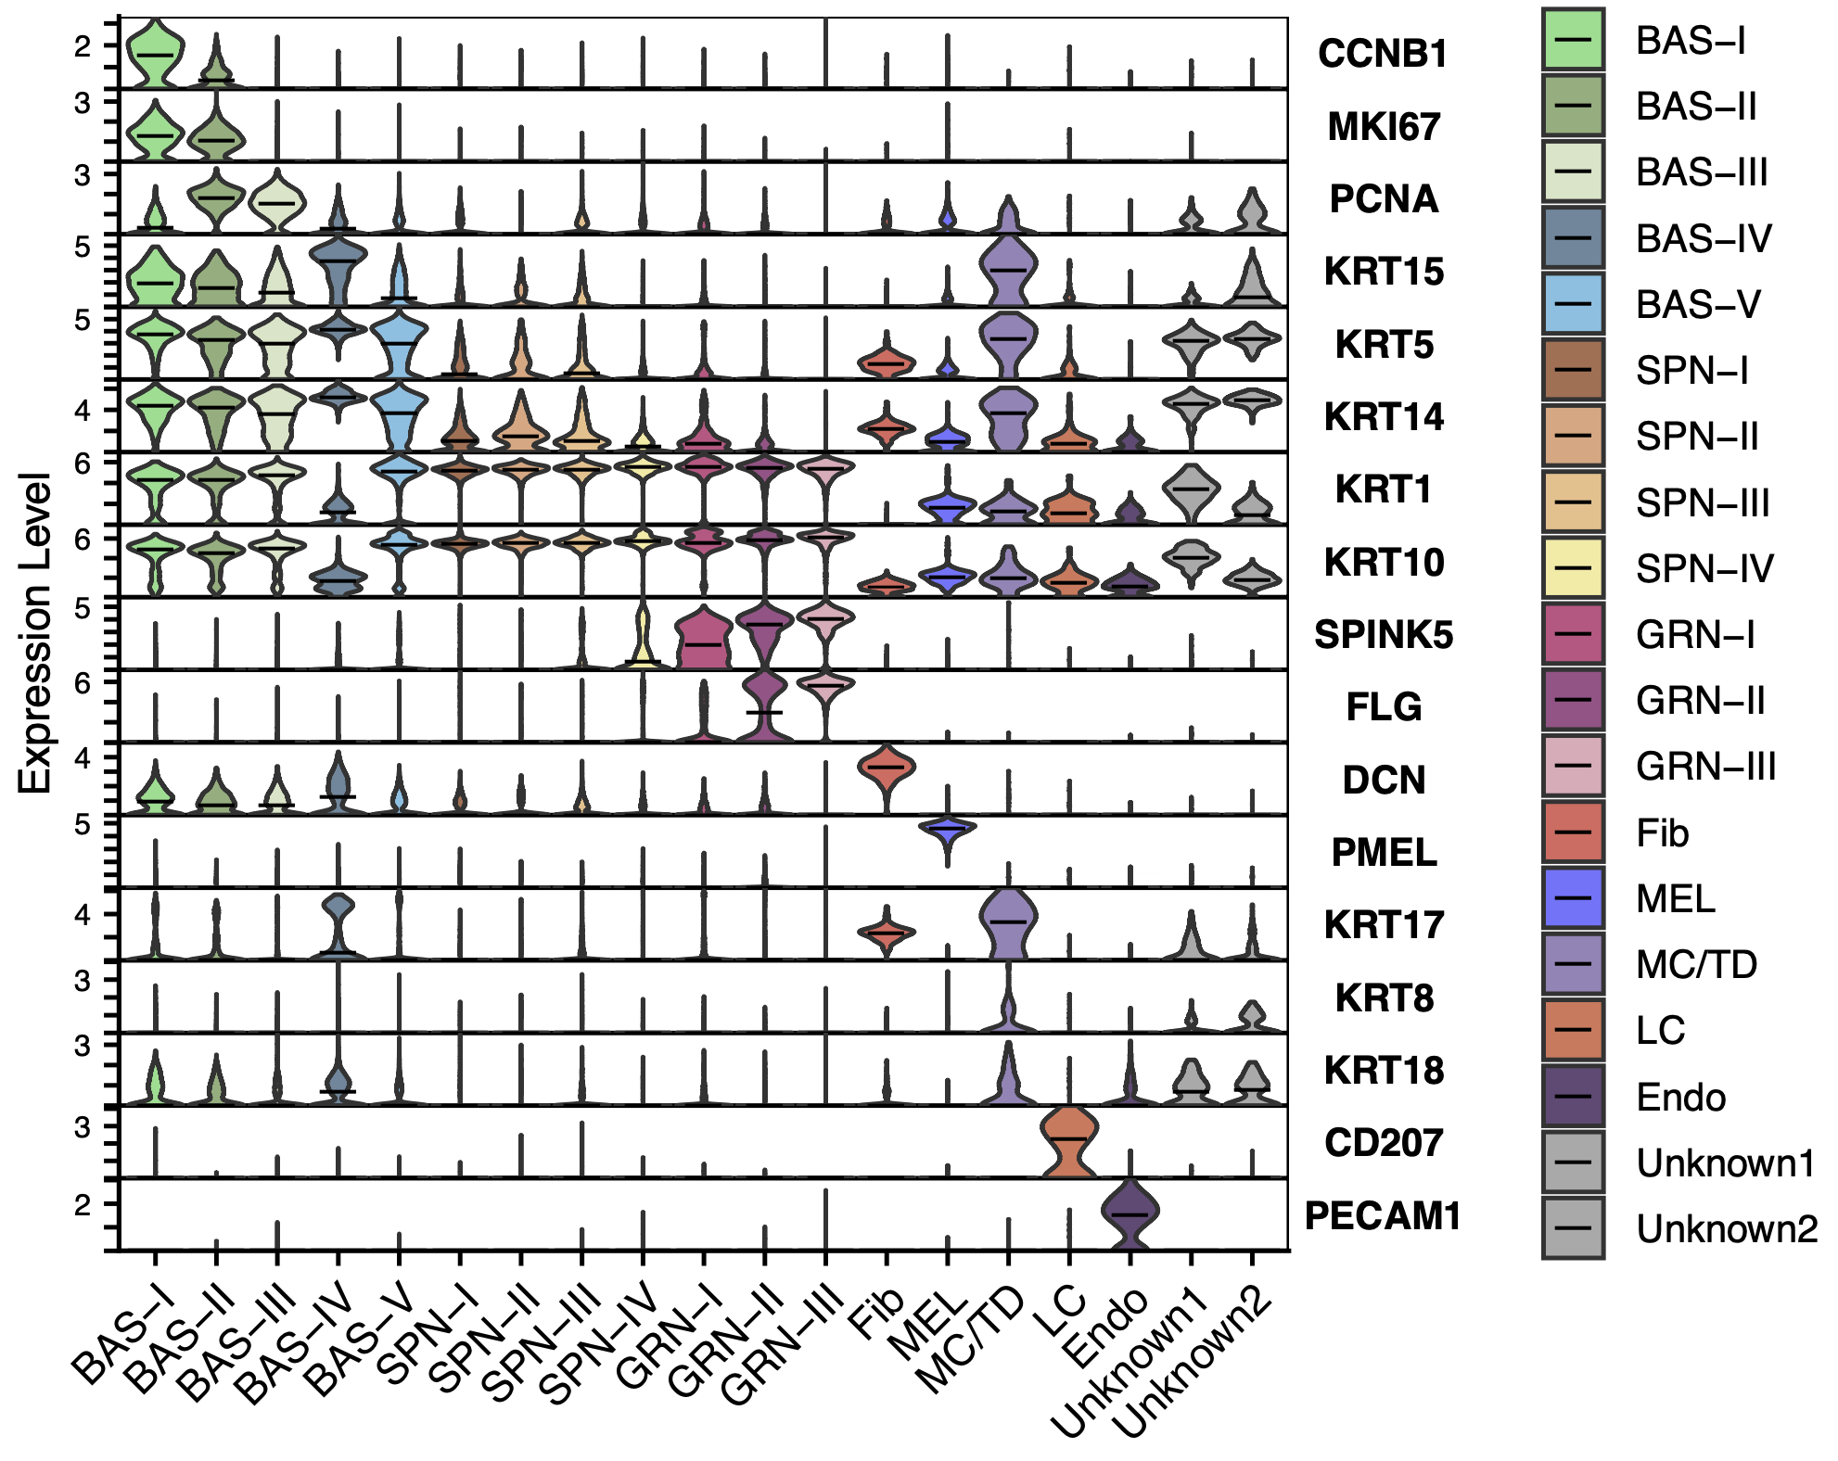
@ Main figures
R3_5_marker_genens_vlnplot.pdf

Slide 6
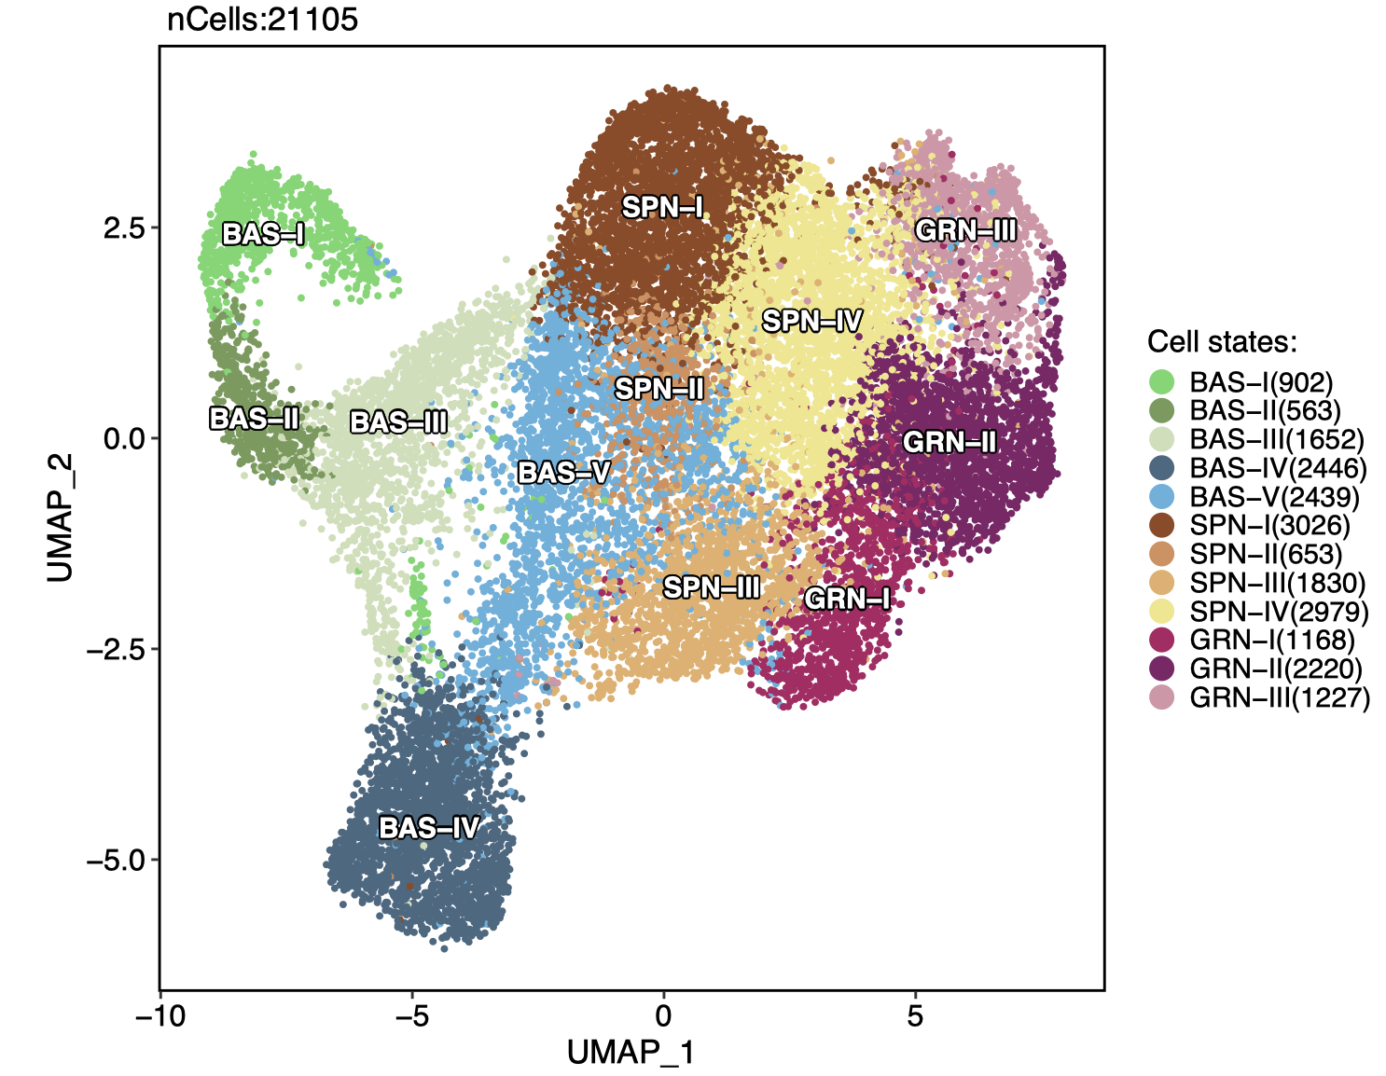
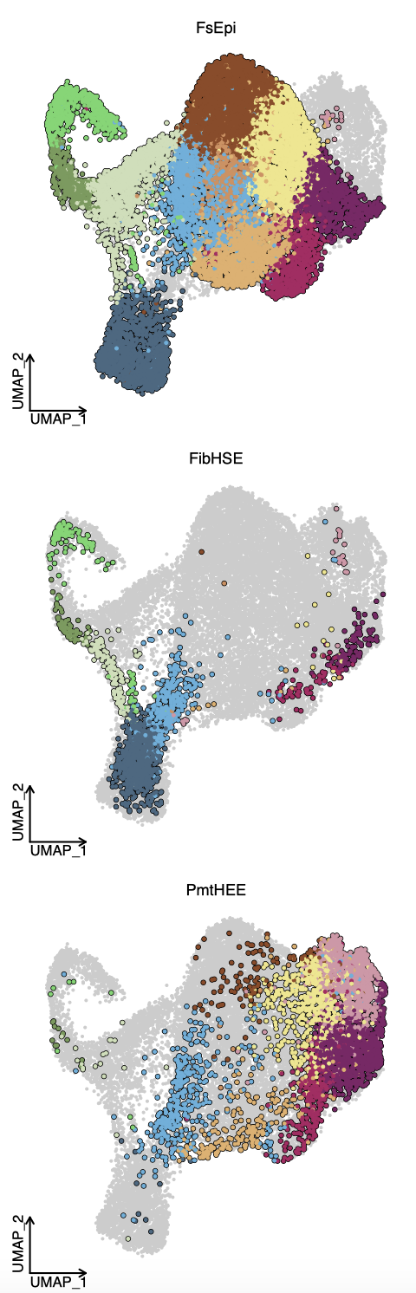
@ Main figures
R8_KC_1_Cell_type_umap_plot.pdf
R9_2_KC_Cell_type_umap_plot_split.pdf
Notes:
@ Main

Slide 7
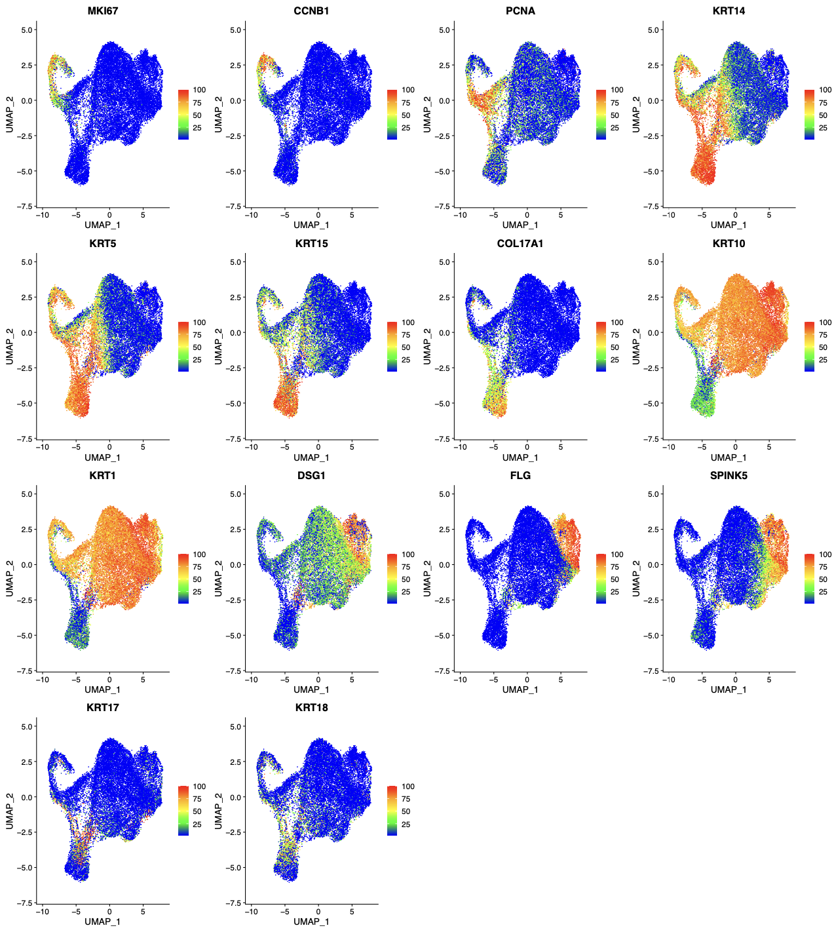
@ Supp.
R4_6.4_marker_gene_seurat_reclustered.pdf

Slide 8
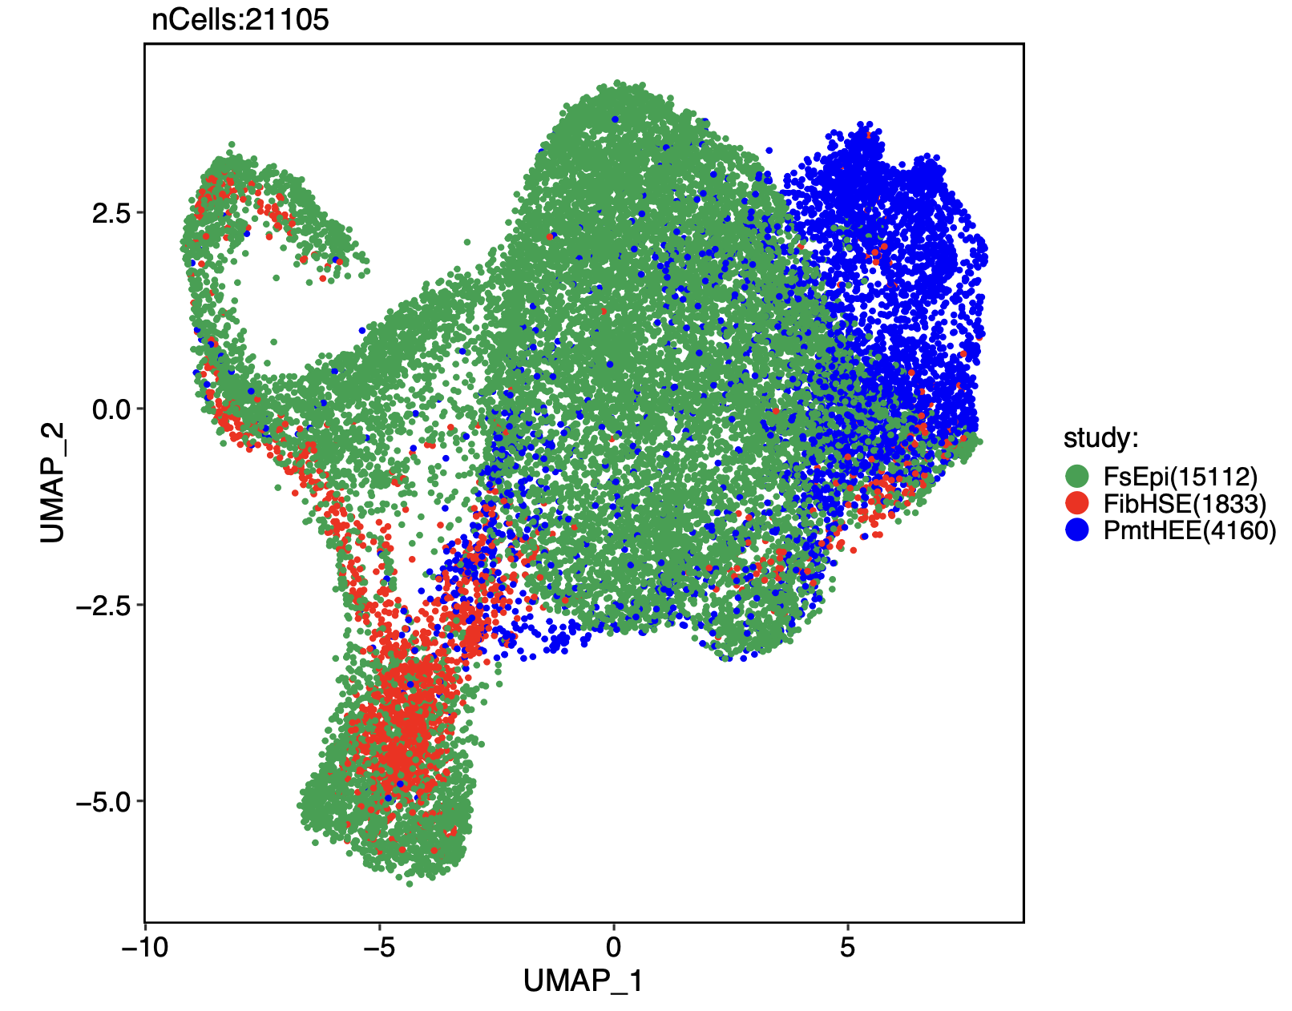
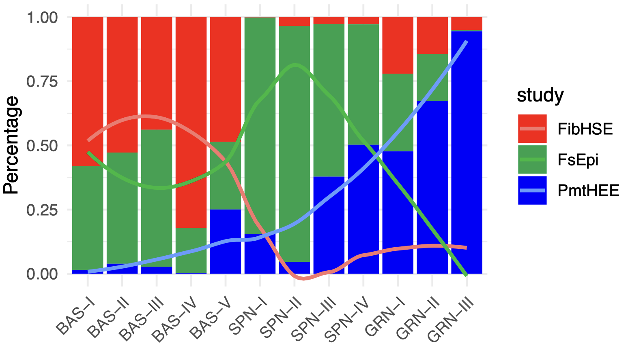
@ Sup.
R4_7.1_study_cell_type_percent_ratio_with_curve_new_sample_nor.pdf
R9_3_KC_study_umap_plot.pdf

Slide 9
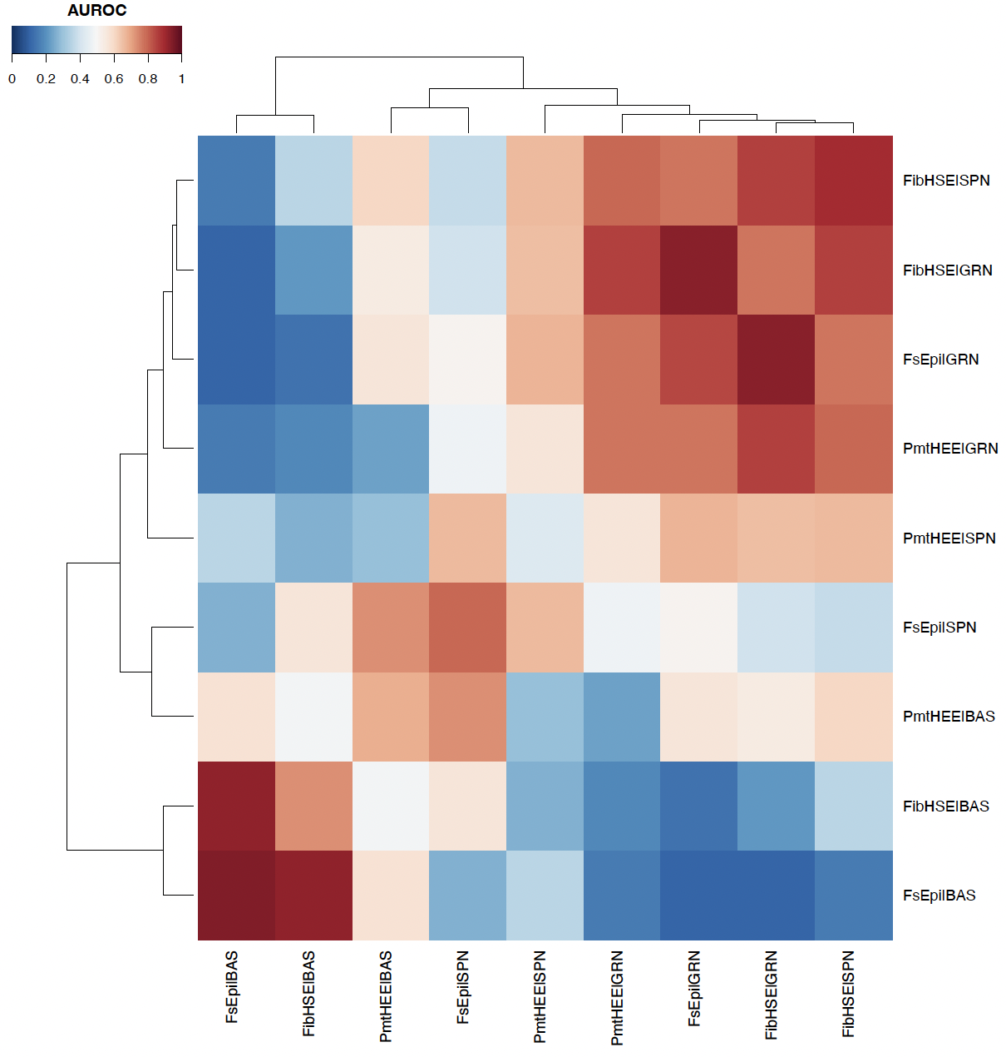
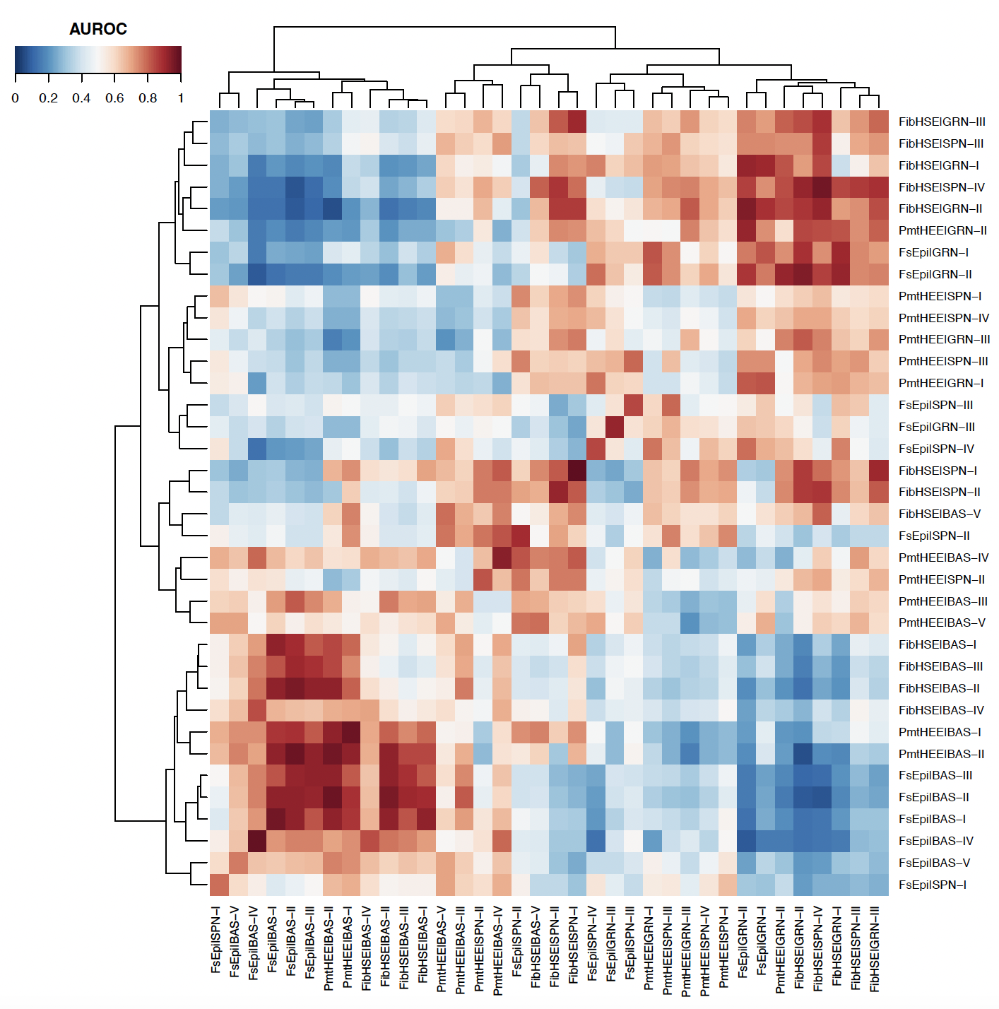
@ Main figures
@ Sup.
R5_B_3_metaneighbor_plot.pdf
R5_14_metaneighbor_plot.pdf

Slide 10
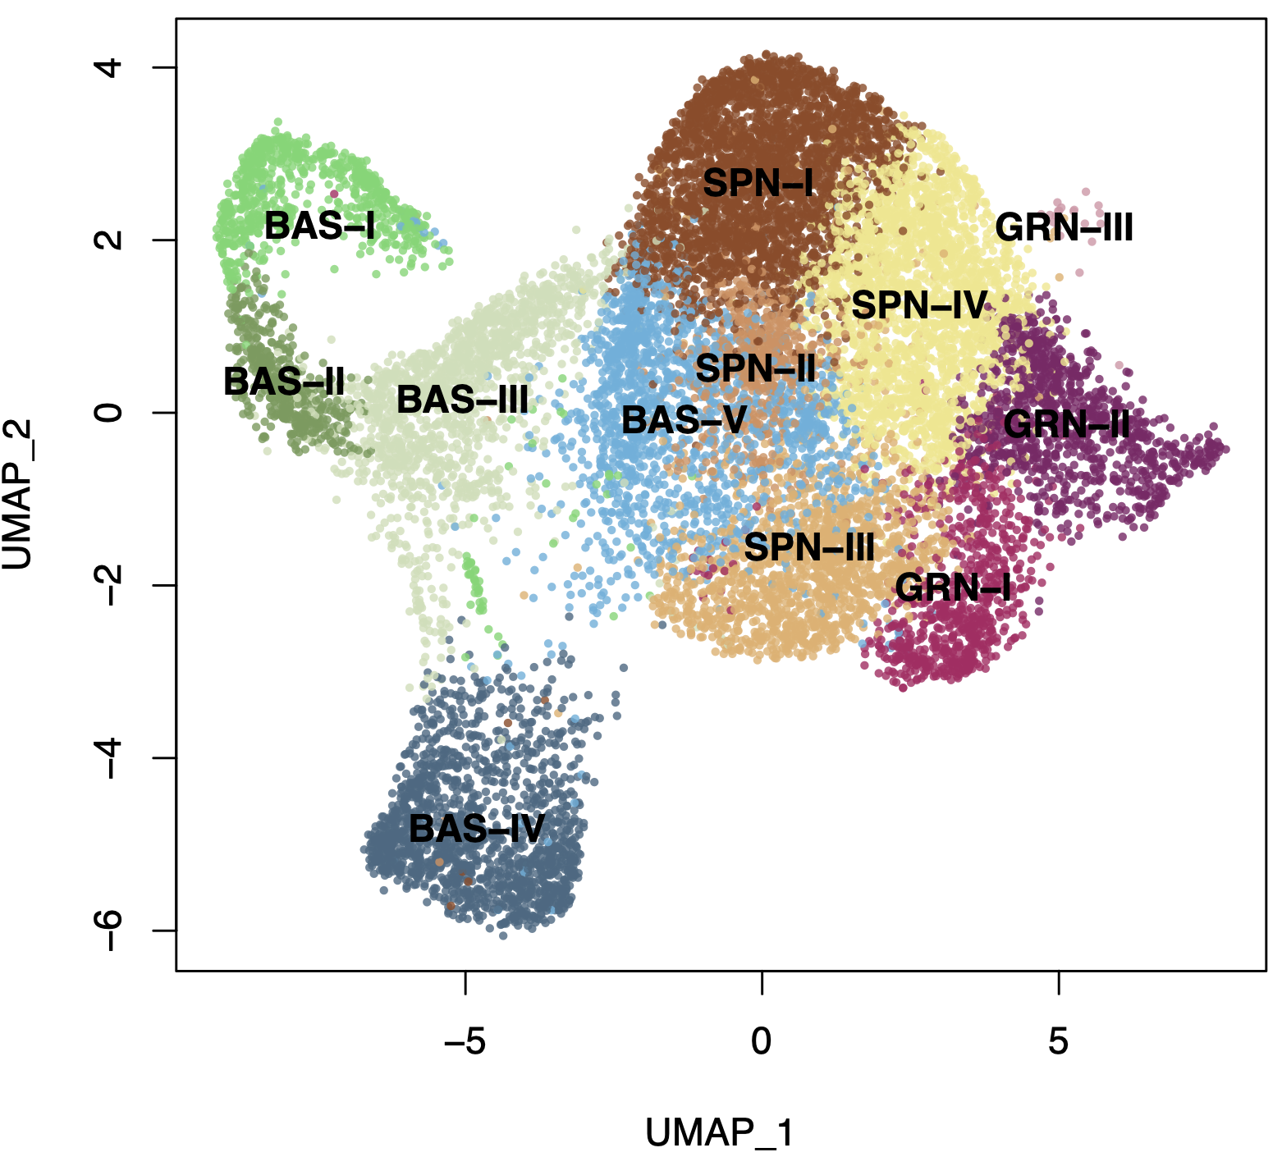
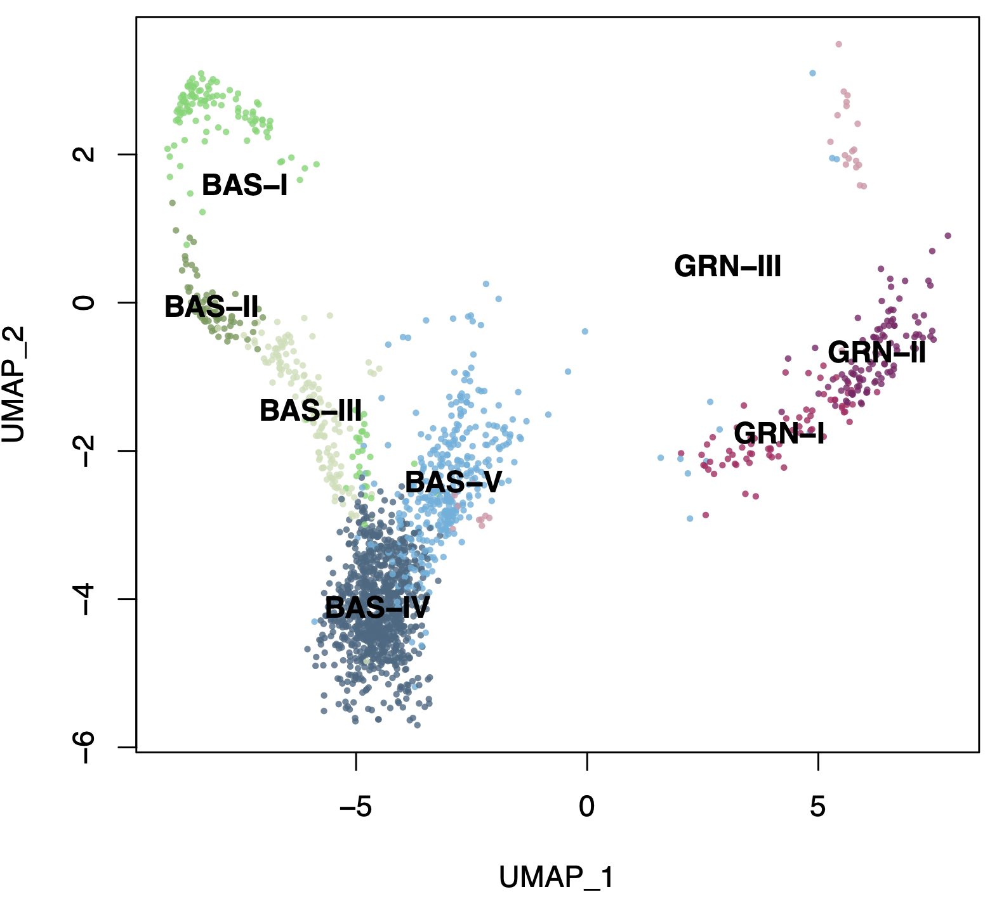
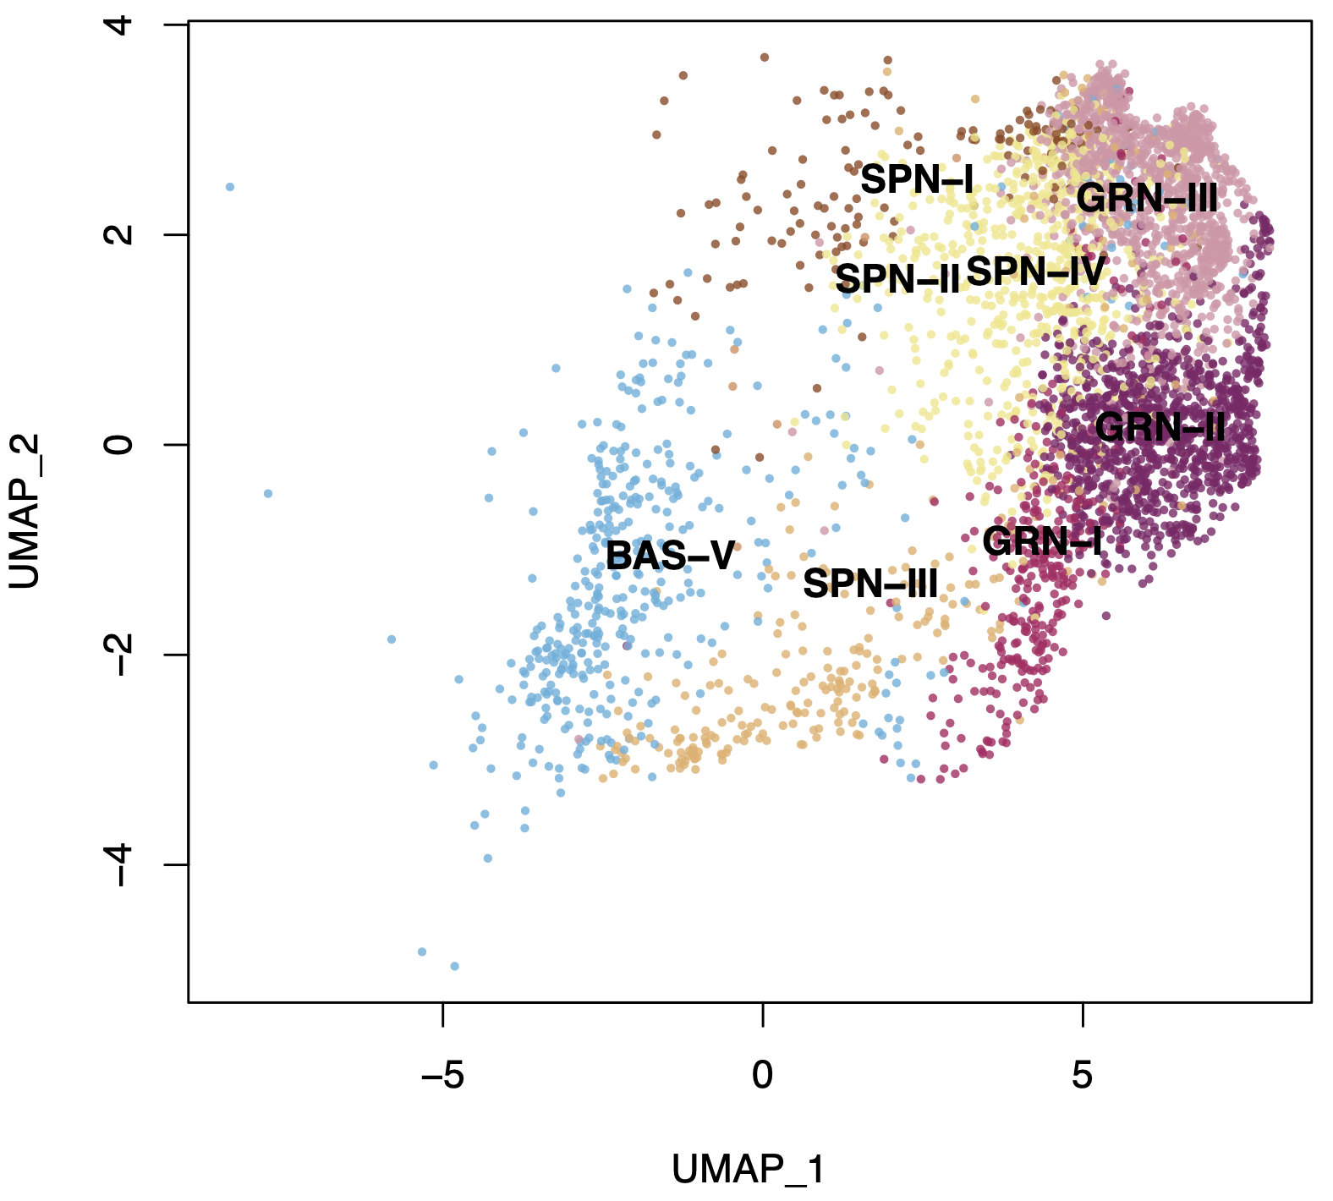
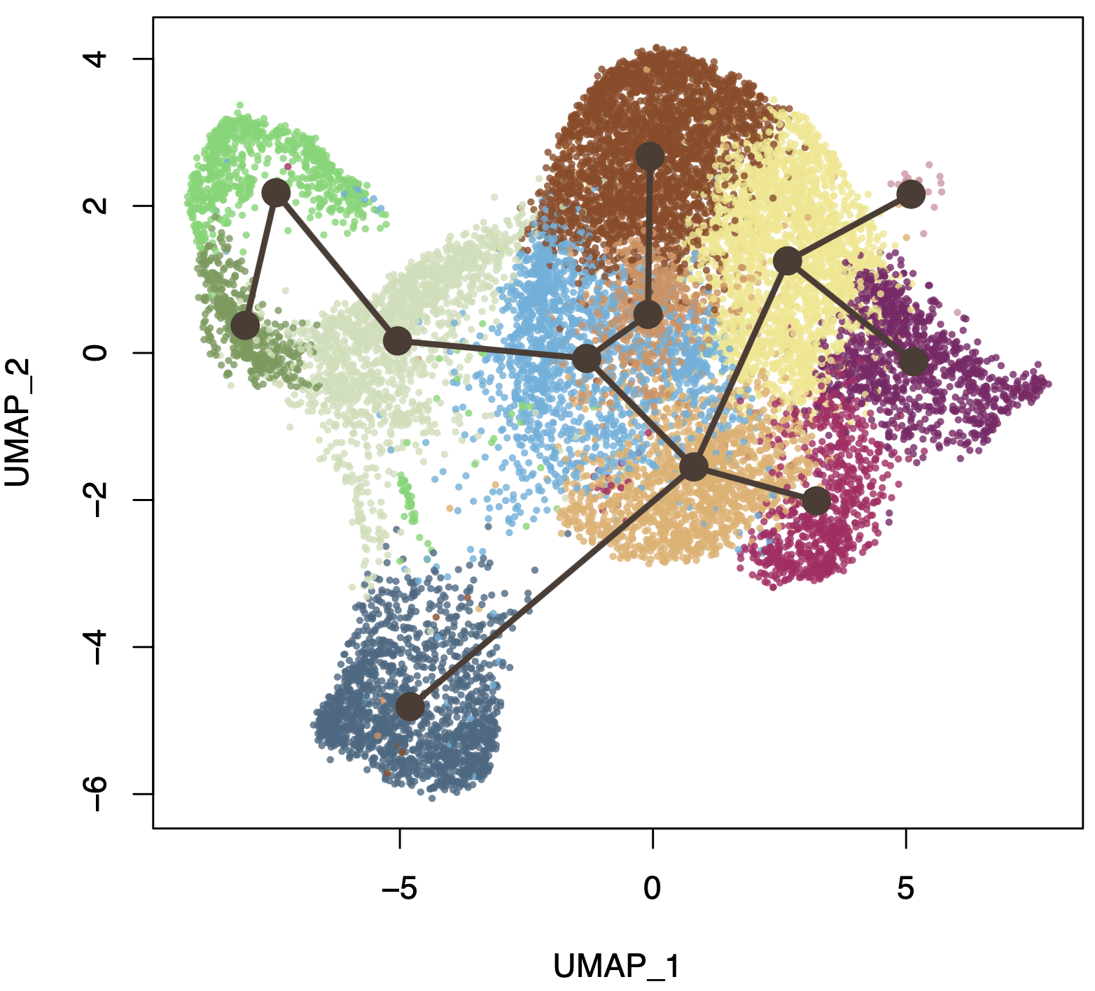
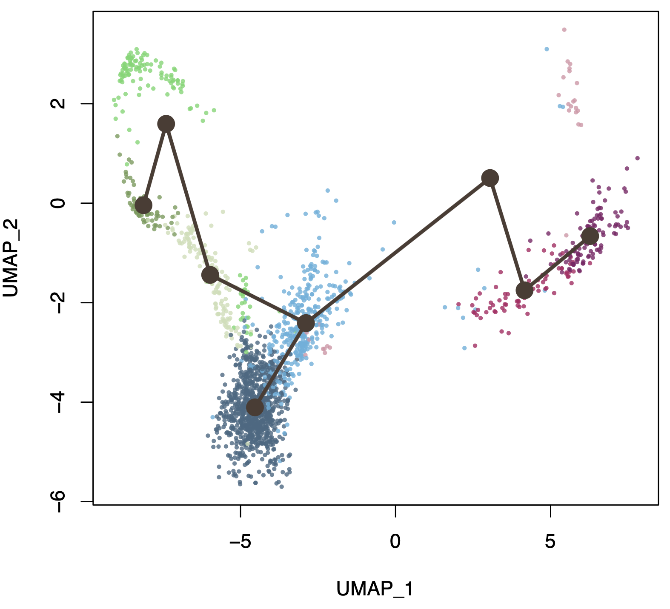
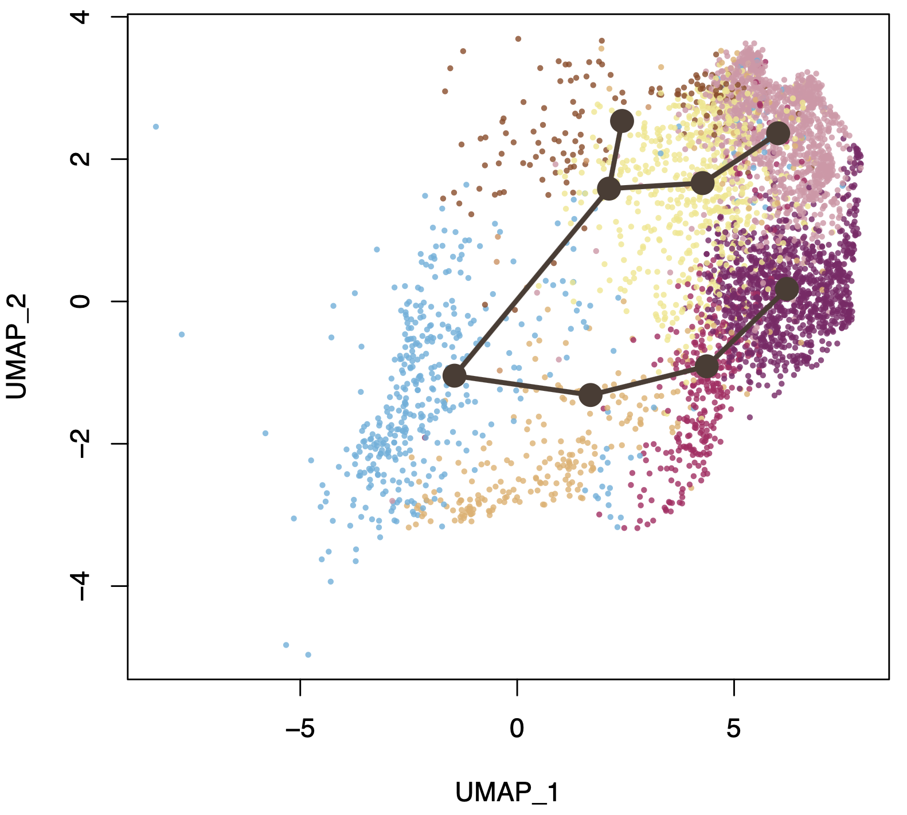
@ Main figures
FsEpi
FibHSE
PmtHEE
R7_FsEpi_3_umap_lineages_plot_anno.pdf
Path_4
Path_2
Path_3
Path_1
Path_1
Path_1
Path_2
R7_FsEpi_3_umap_lineages_plot.pdf
Path_5
Path_3
Path_2
R7_FibHSE_3_umap_lineages_plot.pdf
R7_PmtHEE_3.1_umap_lineages_plot_anno.pdf
R7_FibHSE_3_umap_lineages_plot_anno.pdf
R7_PmtHEE_3.1_umap_lineages_plot.pdf
Notes:
Akk KCs

Slide 11
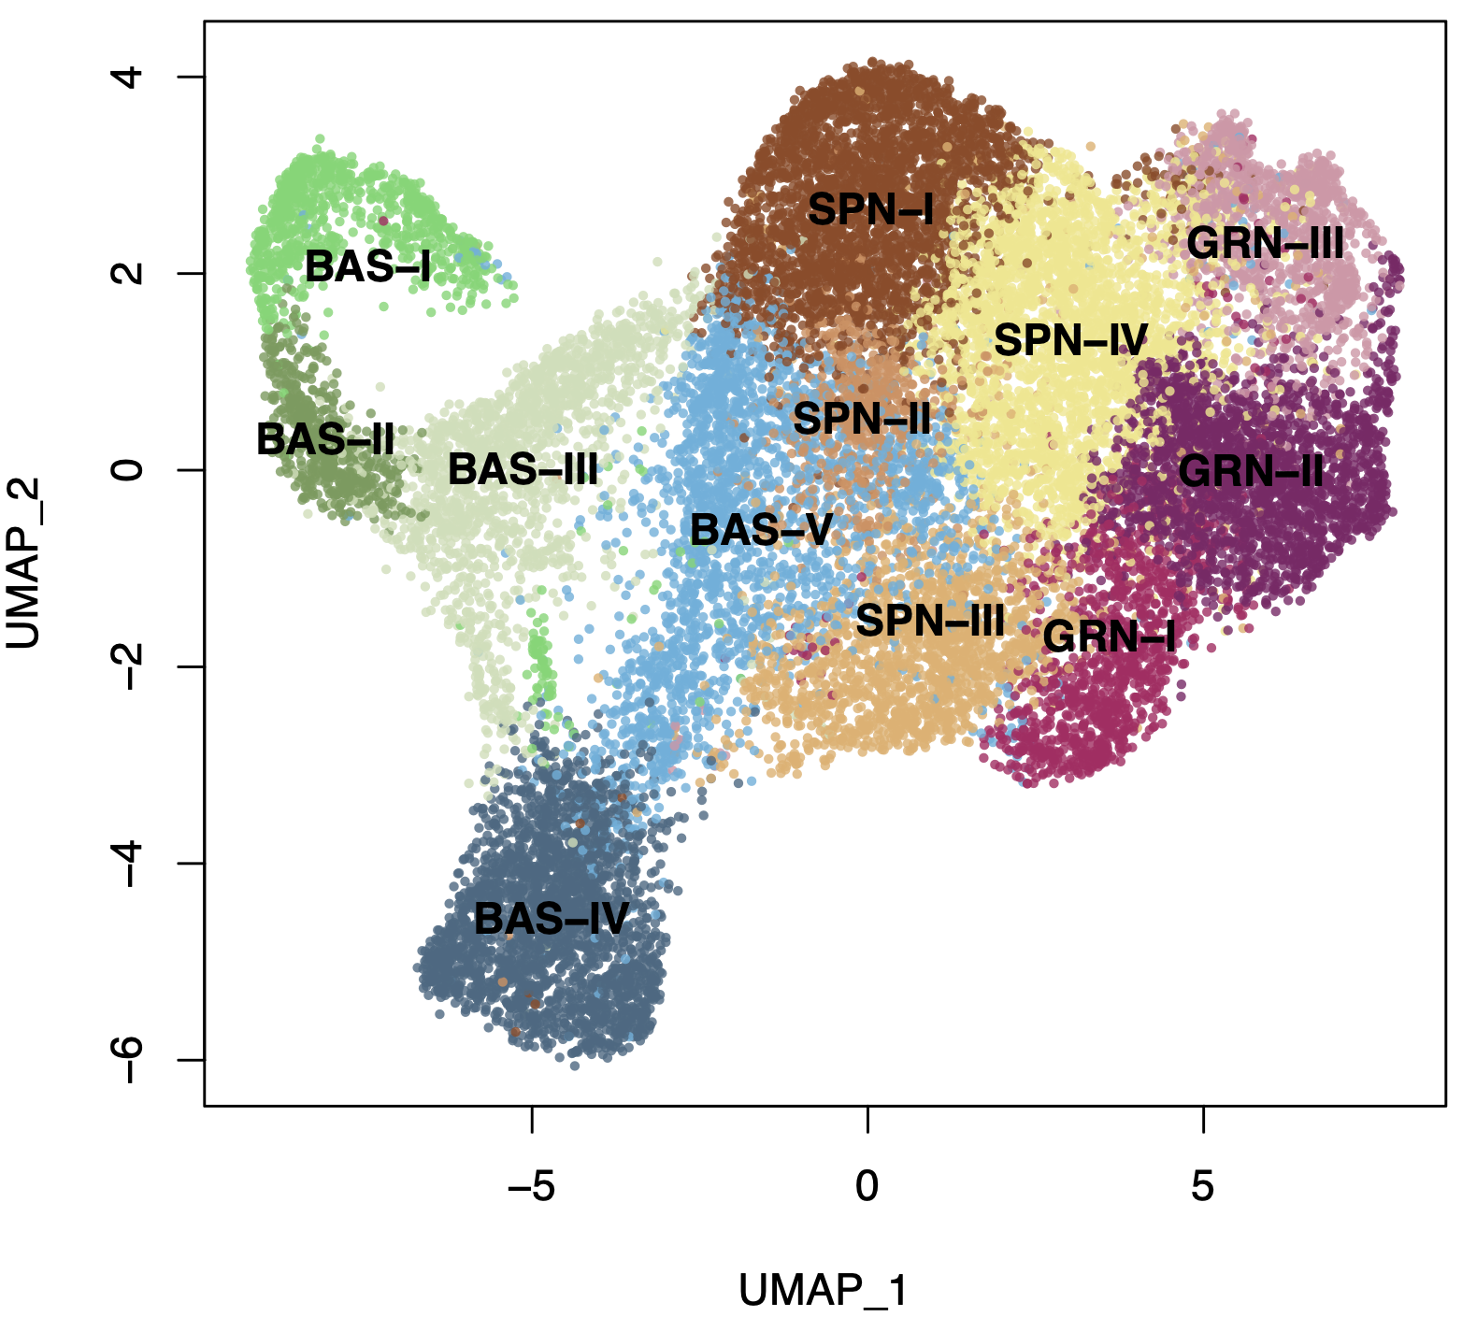
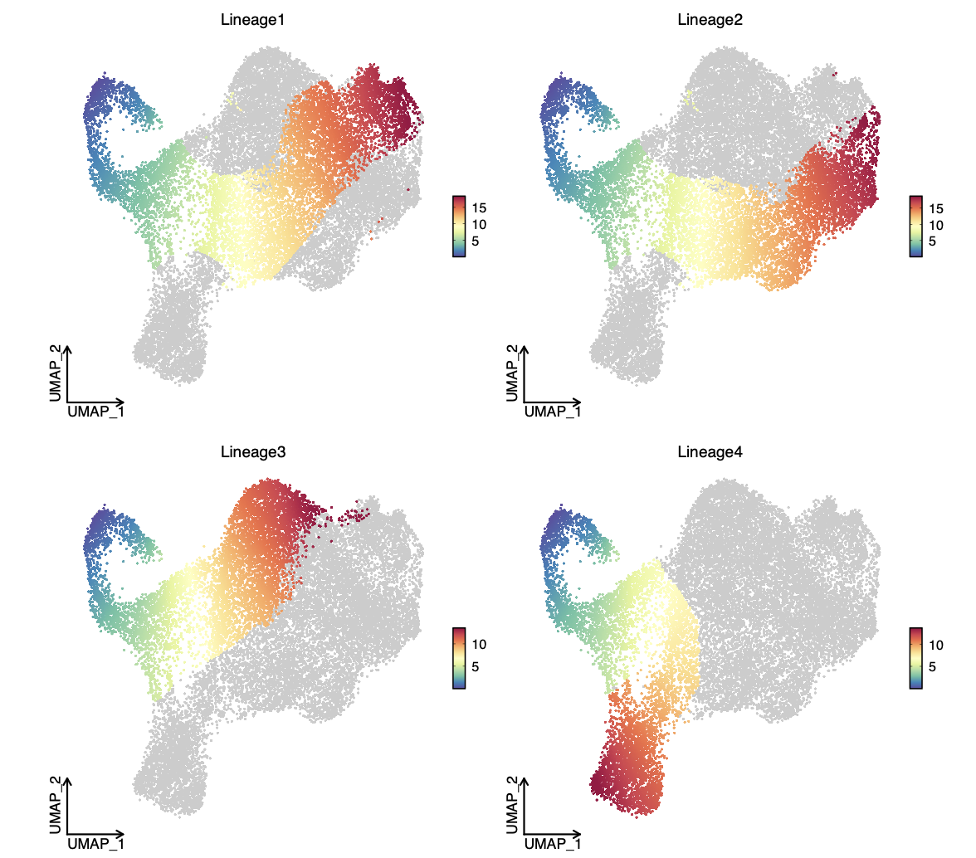
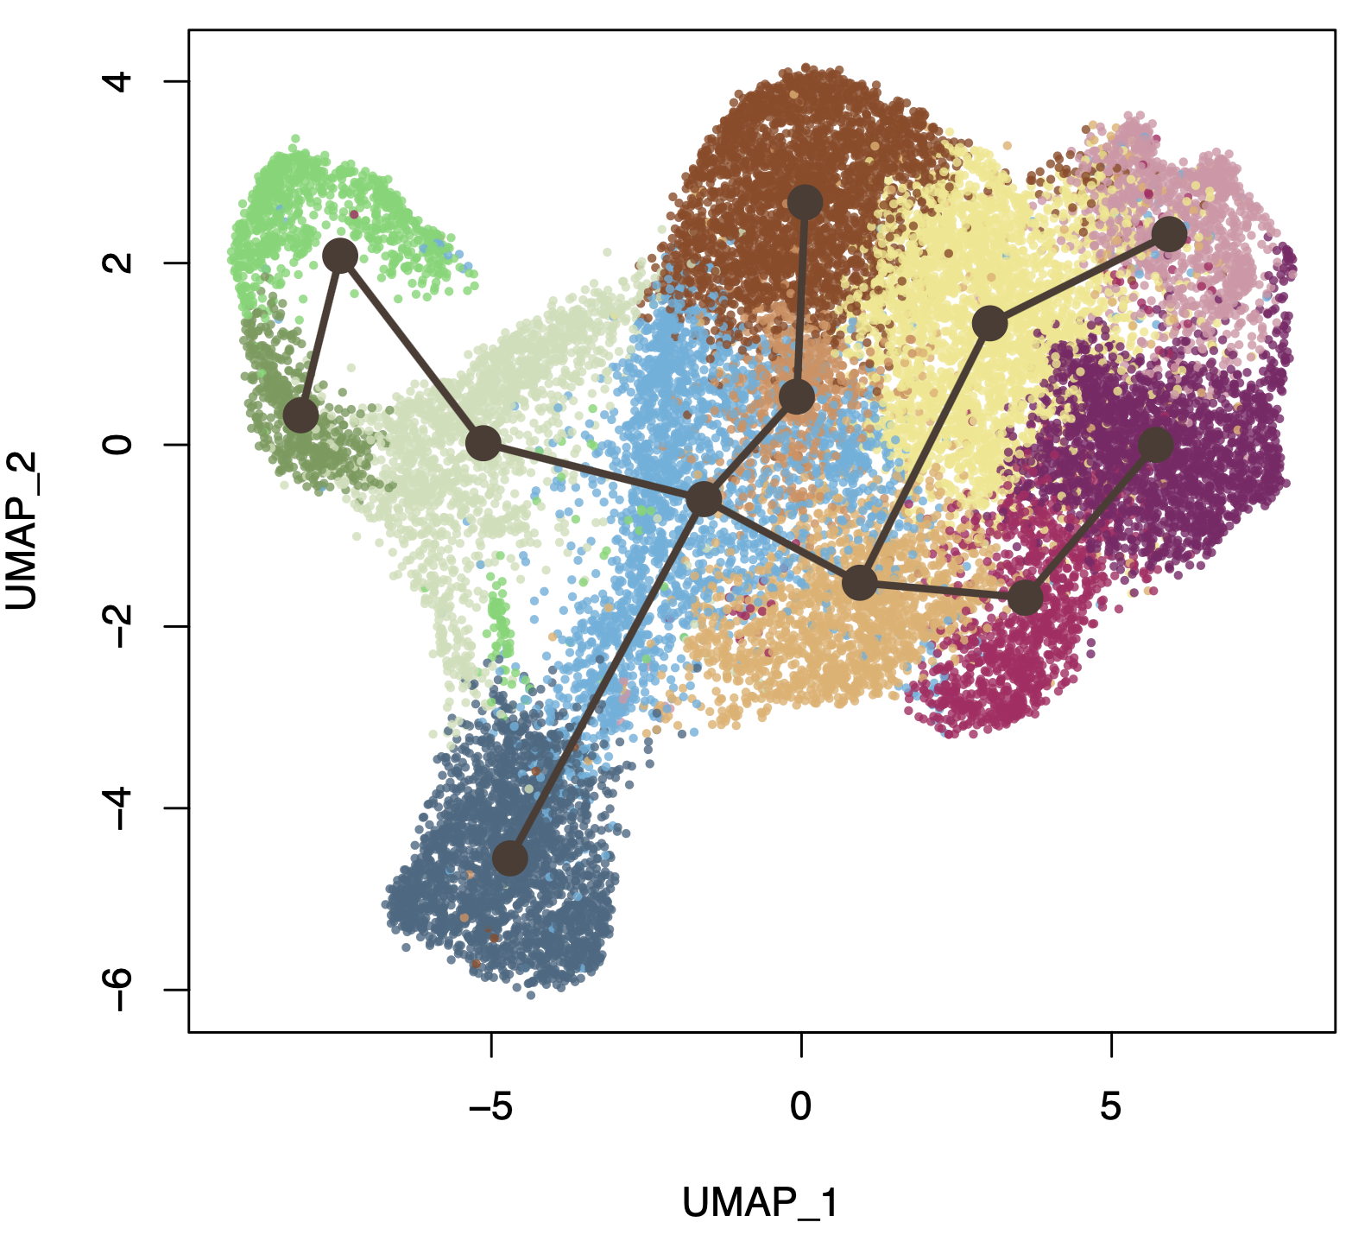
@ Supp.
All KCs
R7_3_KC_umap_lineages_plot_anno.pdf
Path_3
Path_1
Path_2
R7_3_KC_umap_lineages_plot.pdf
Path_4
R8_3_KC_umap_paths_plot.pdf

Slide 12
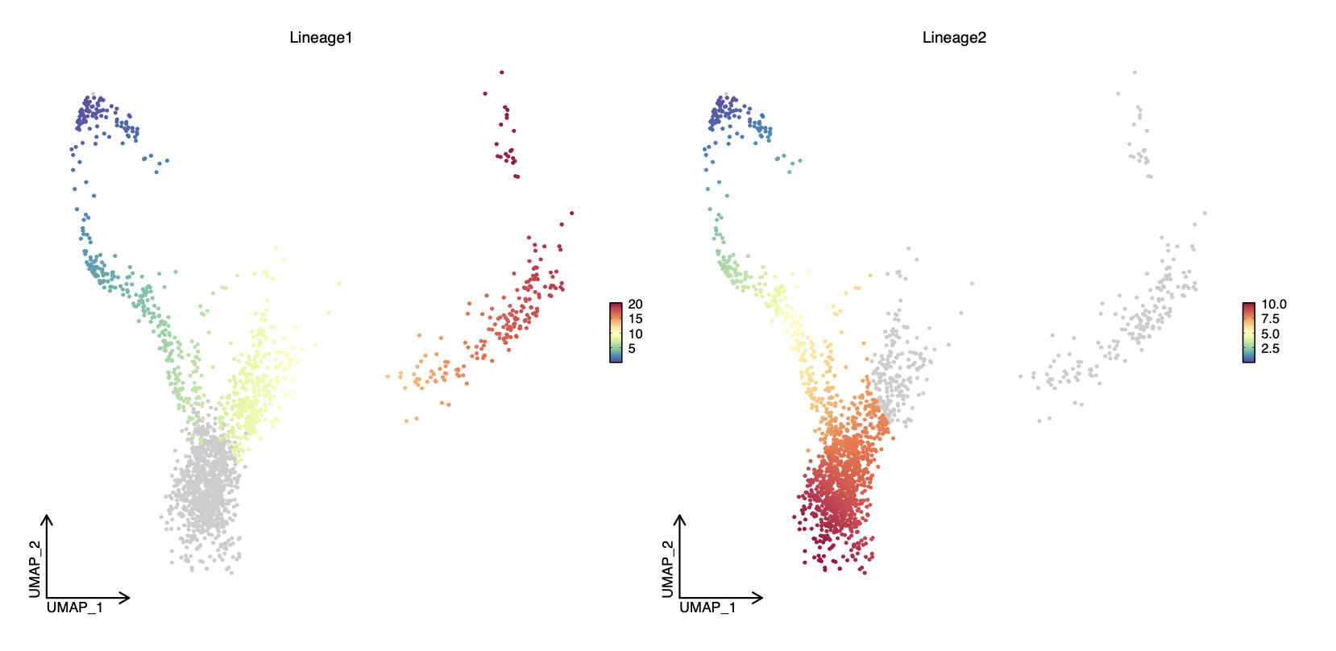
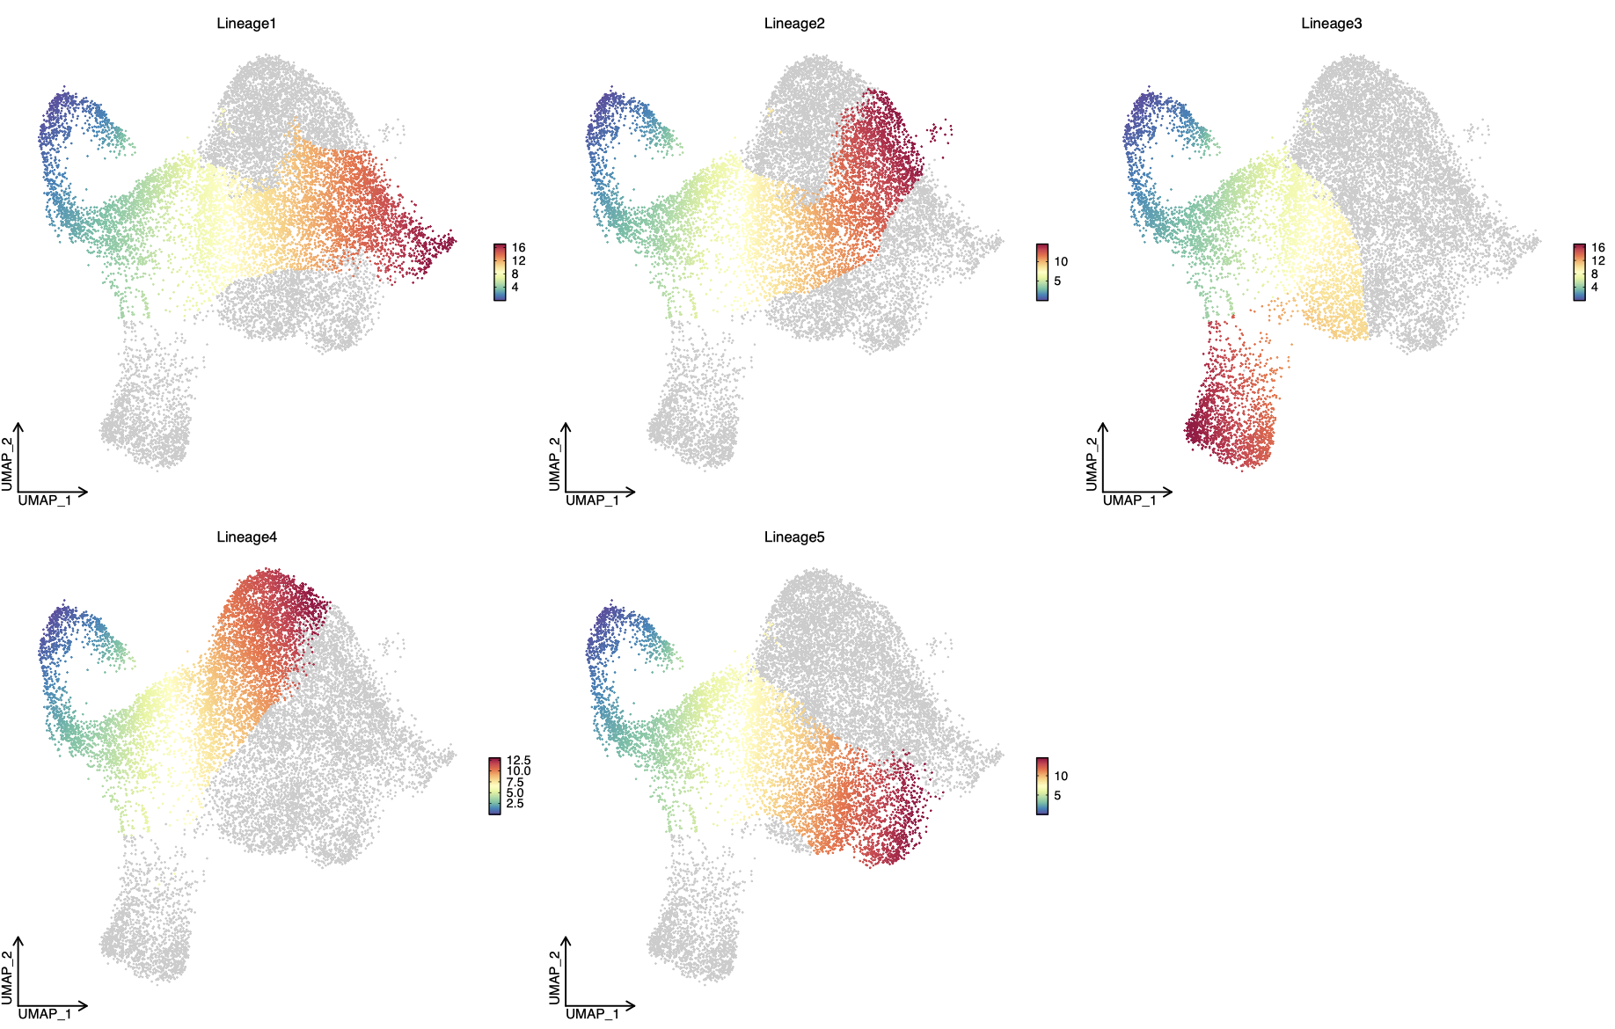
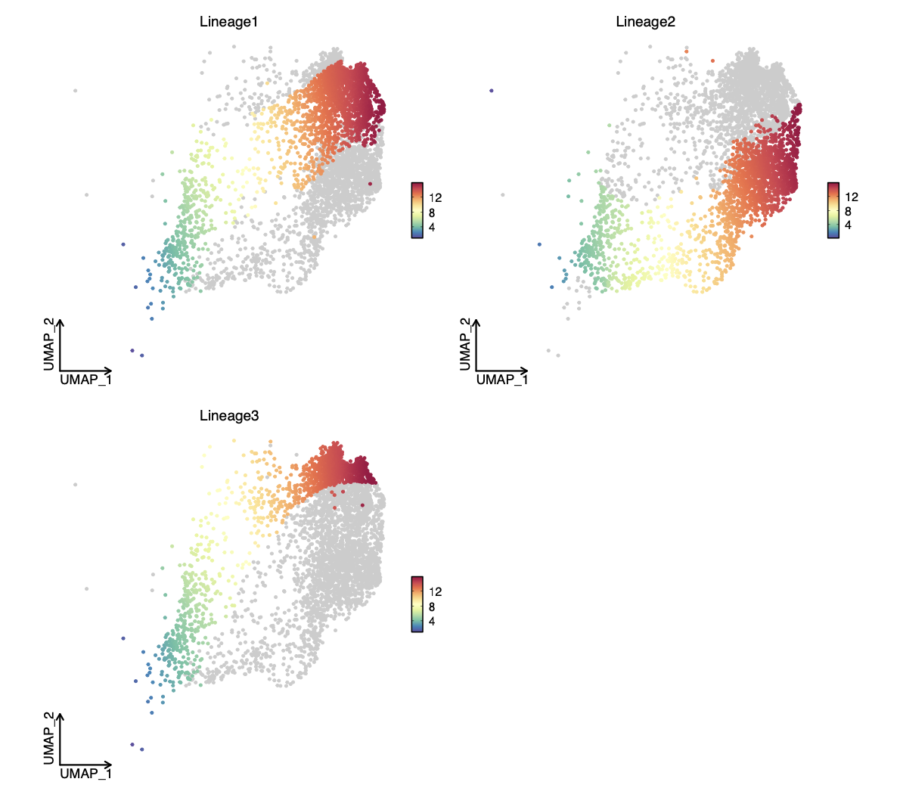
@ Supp.
R8_3_FibHSE_umap_paths_plot.pdf
R8_3_FsEpi_umap_paths_plot.pdf
R8_3_PmtHEE_umap_paths_plot.pdf

Slide 13
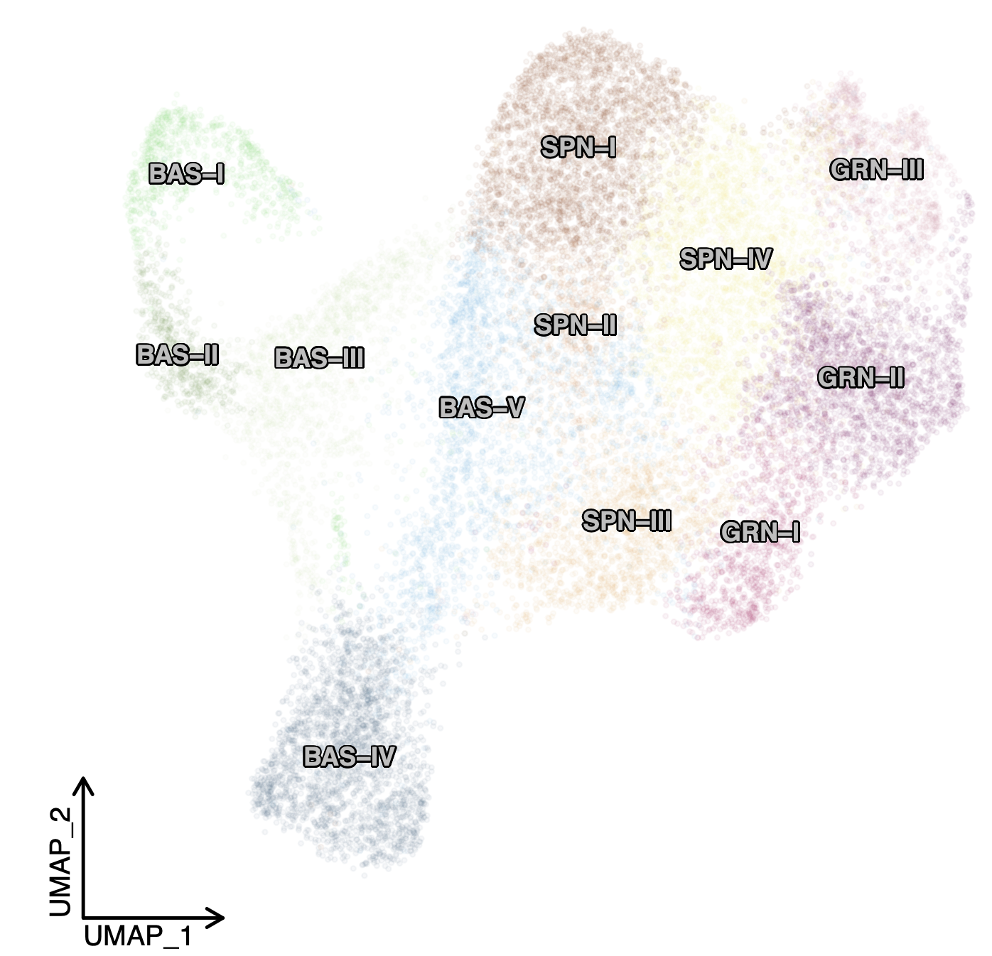
@ Main figures
PmtHEE-based HF cell states
FibHSE-based HF cell states
Trajectories:
FsEpi
FibHSE
PmtHEE
Hand-made trajectory summary based on
R8_KC_1_Cell_type_umap_plot_transparency.pdf
Notes:
HF: high-fidelity

