Slide 1
Group Meeting
Yunlong Pan

Slide 2
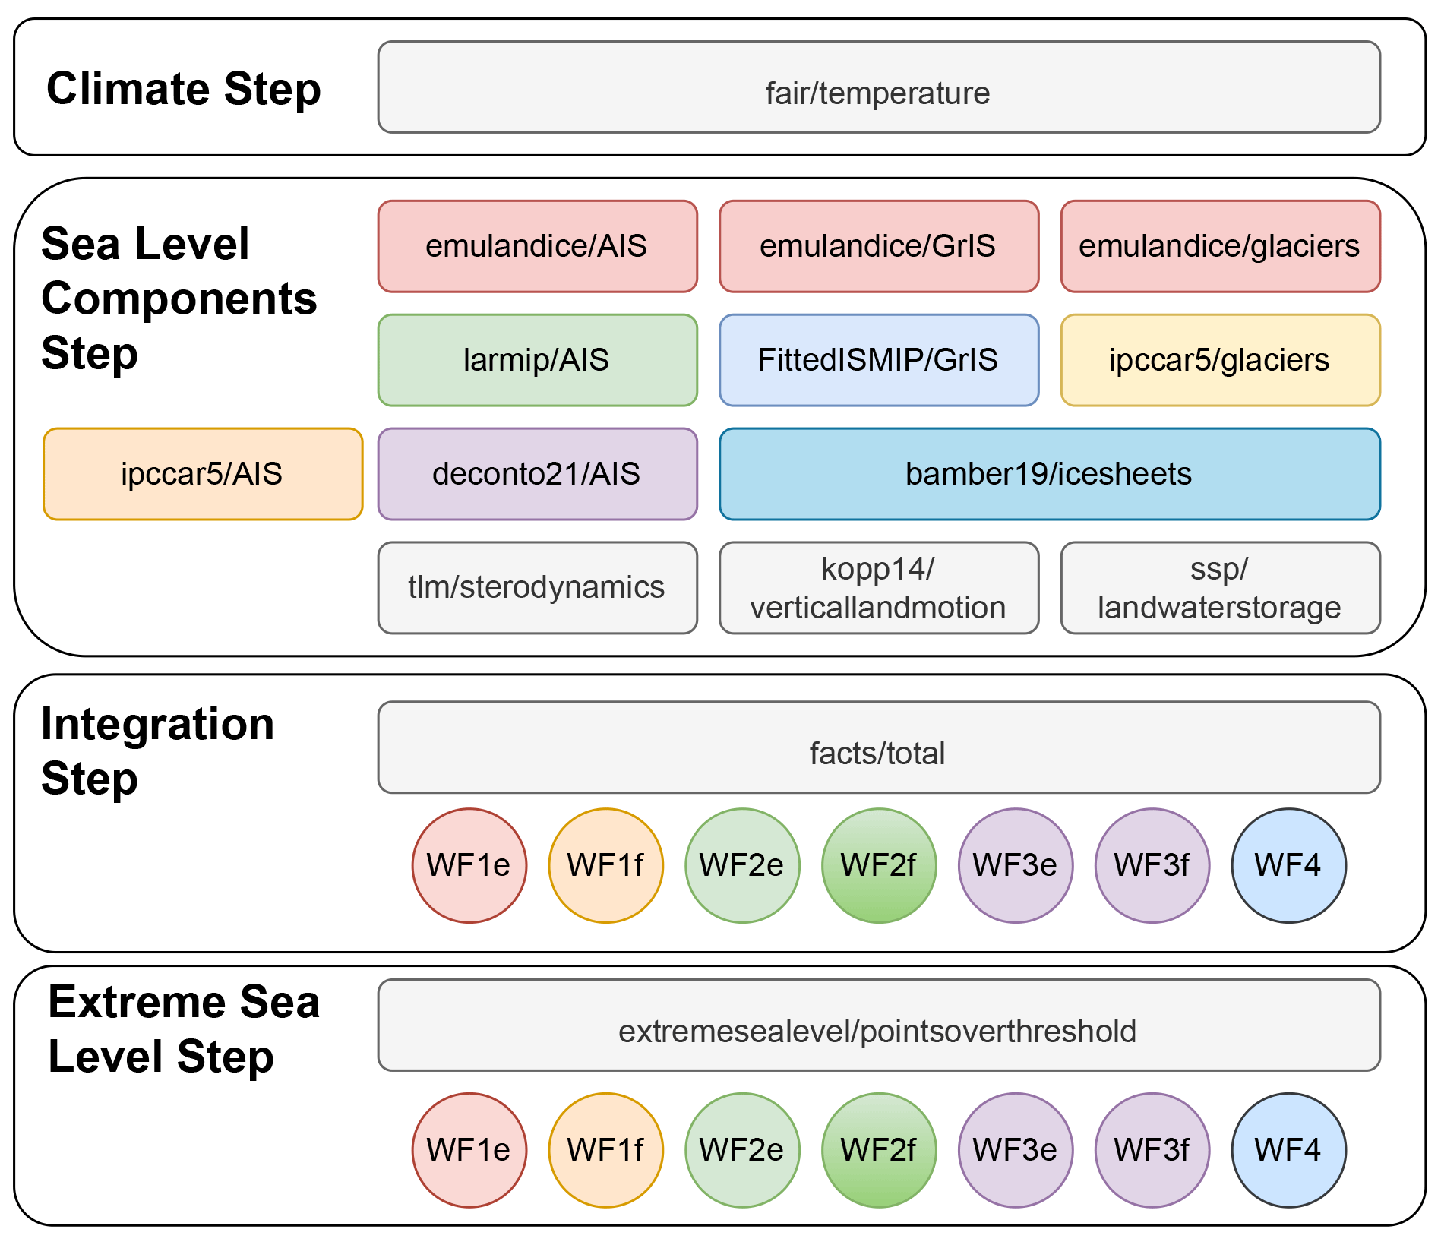
Outline
Fair/temperature
Emulandice/AIS, GrIS, glaciers
Tlm/sterodynamics
Kopp14/verticallandmotion

Slide 3
Fair/temperature
<<FAIR v1.3: a simple emissions-based impulse response and carbon cycle model>>
https://gmd.copernicus.org/articles/11/2273/2018/
18 Jun 2018
<<FaIRv2.0.0: a generalized impulse response model for climate uncertainty and future scenario exploration>>
https://gmd.copernicus.org/articles/14/3007/2021/
27 May 2021

Slide 4
Fair/temperature
<<FAIR v1.3: a simple emissions-based impulse response and carbon cycle model>>
https://gmd.copernicus.org/articles/11/2273/2018/
18 Jun 2018
Dataset: https://www.pik-potsdam.de/~mmalte/rcps/
Code
https://github.com/OMS-NetZero/FAIR
https://docs.fairmodel.net/en/latest/index.html

Slide 5
Emulandice/AIS, GrIS, glaciers
<<Projected land ice contributions to twenty-first-century sea level rise>>
https://www.nature.com/articles/s41586-021-03302-y
05 May 2021
Dataset: https://github.com/tamsinedwards/emulandice/tree/master/inst/extdata
Code: https://github.com/OMS-NetZero/FAIR

Slide 6
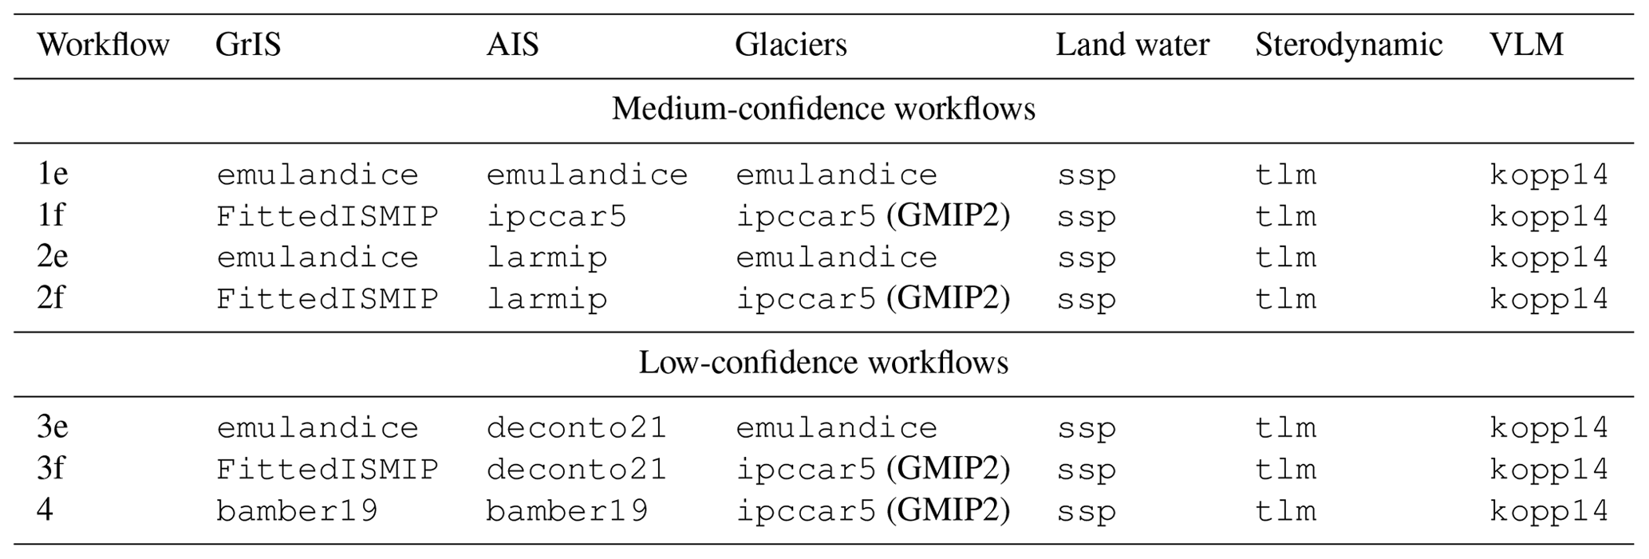
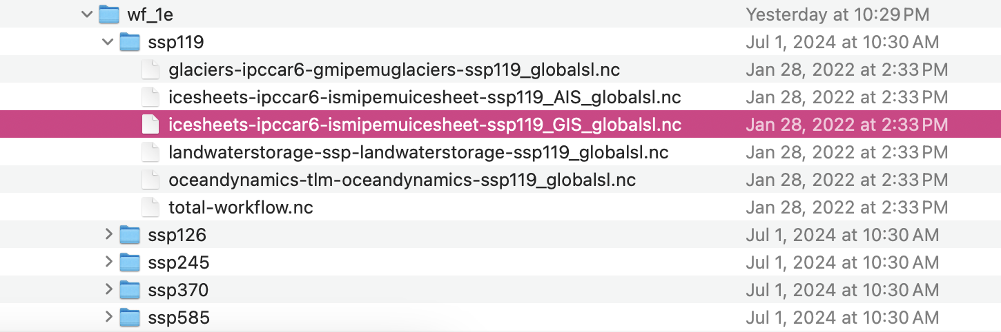
Emulandice/AIS, GrIS, glaciers
Result: https://zenodo.org/records/6382554
Ex: wf1e-ssp119_GIS_globalsl

Slide 7
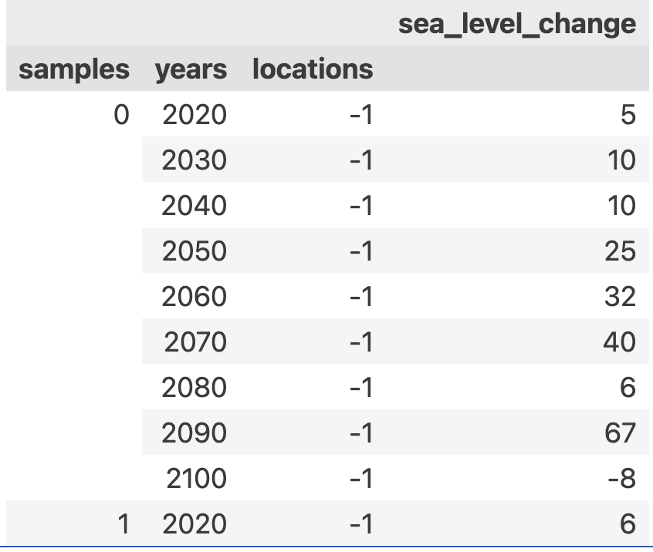
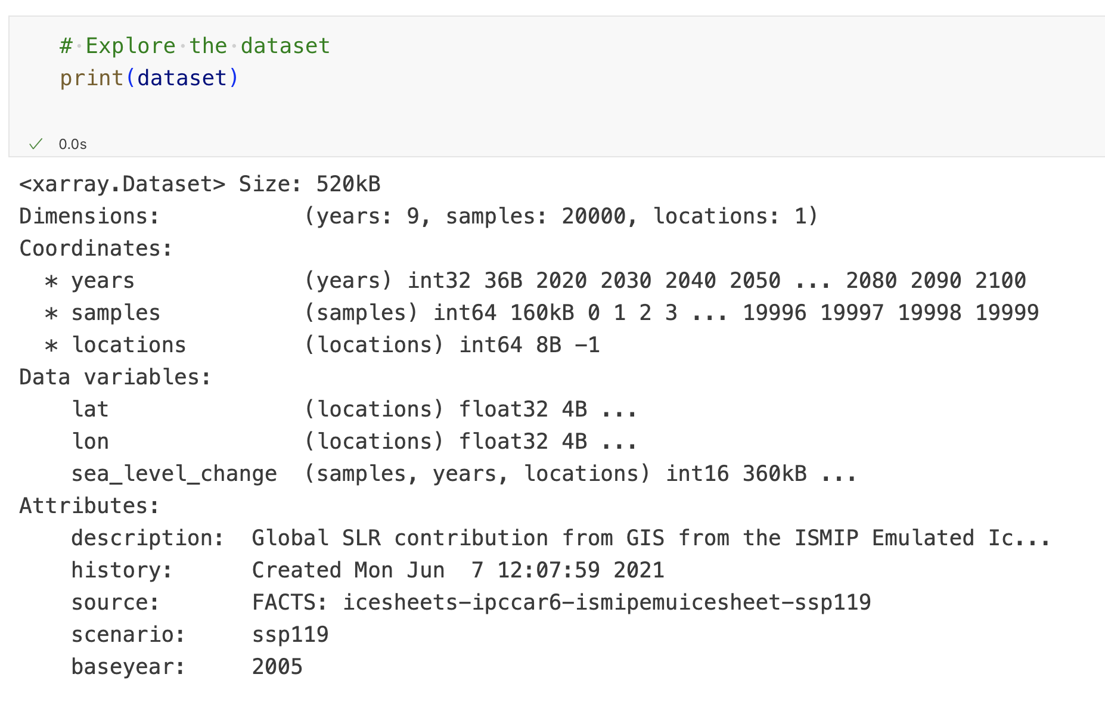
Ex: wf1e-ssp119_GIS_globalsl

Slide 8
Tlm/sterodynamics
<<The Framework for Assessing Changes To Sea-level (FACTS) v1.0: a platform for characterizing parametric and structural uncertainty in future global, relative, and extreme sea-level change>>
https://gmd.copernicus.org/articles/16/7461/2023/
21 Dec 2023
Dataset, Code: https://zenodo.org/records/6419954

Slide 9
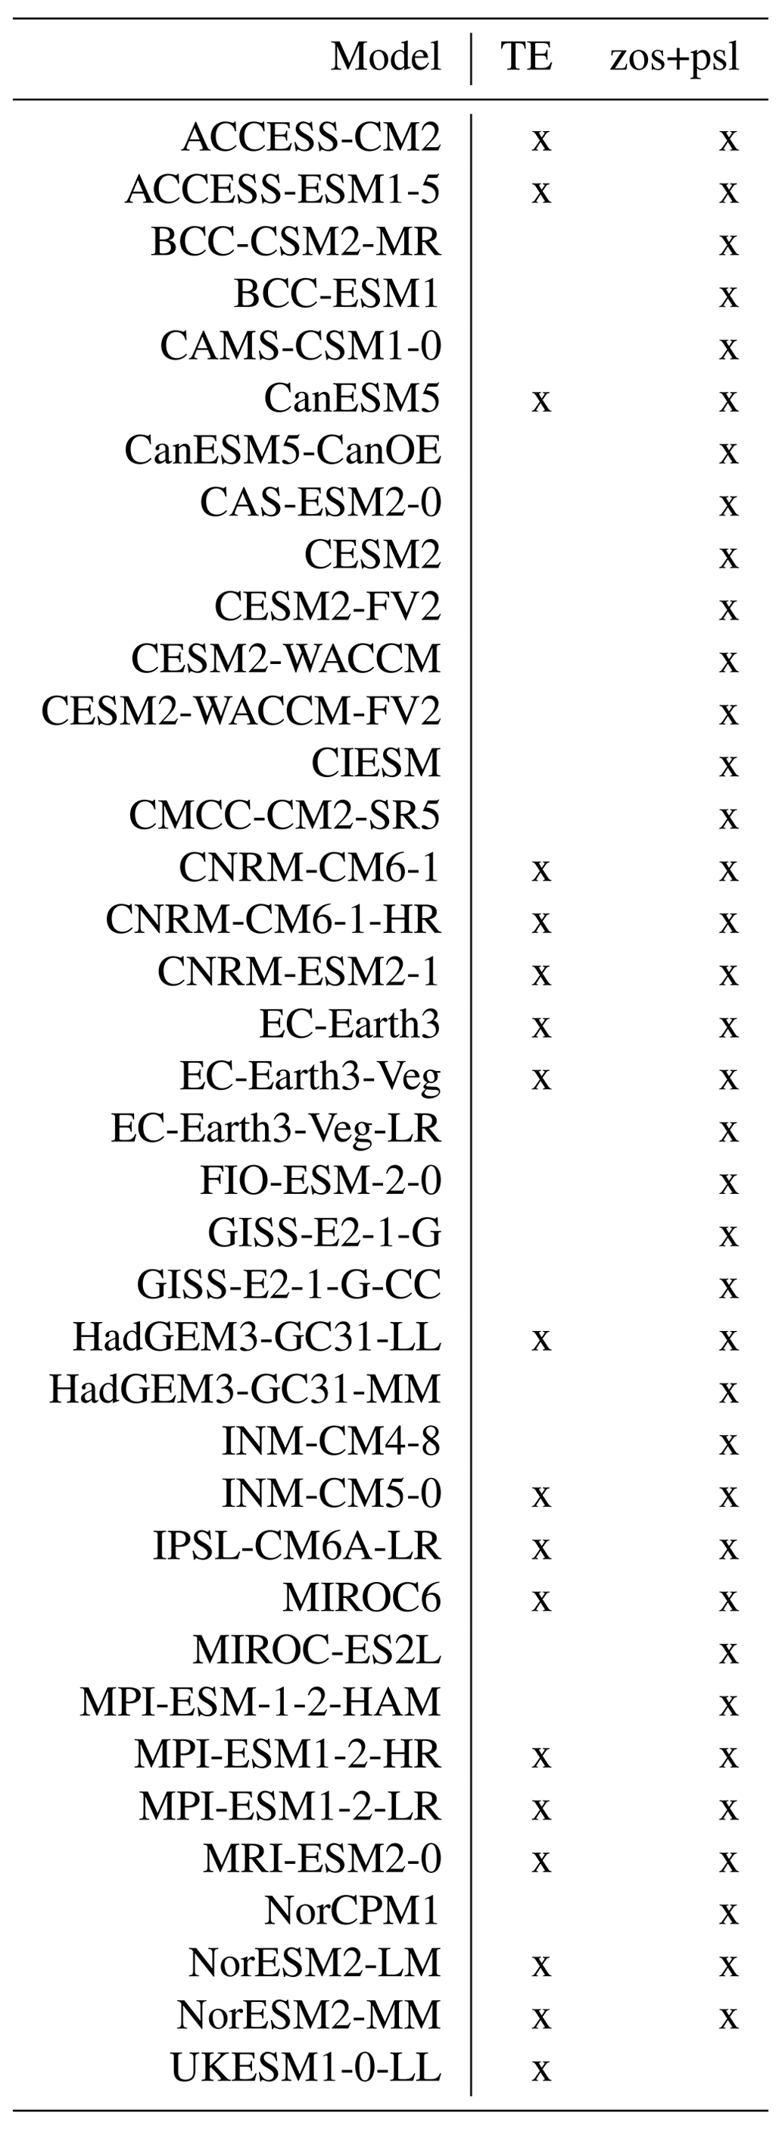
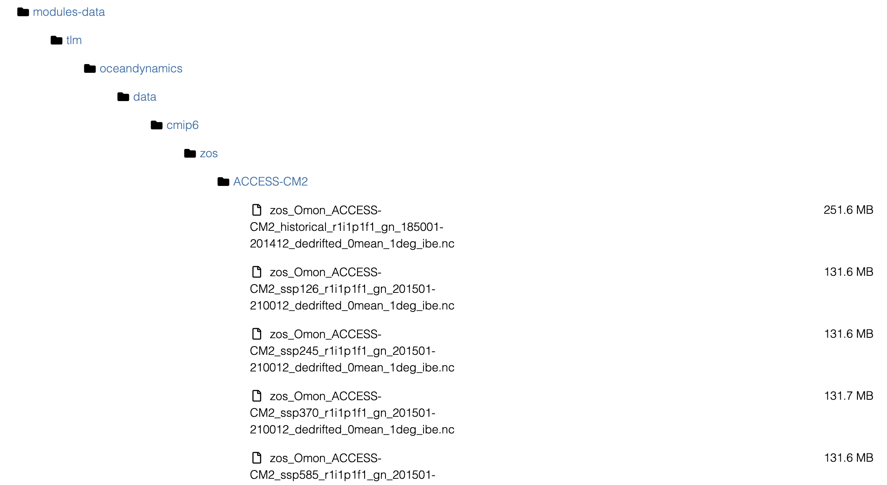
Tlm/sterodynamics
Table A3 CMIP6 models used for calibrating the thermal expansion coefficients of Fox-Kemper et al. (2021a) (TE, left column) and for projecting ocean dynamic sea-level change and the IB effect (zos+psl, right column) in the tlm/sterodynamics module.
Ex: ACCESS-CM2 ssp126, oceandynamics_ssp370

Slide 10
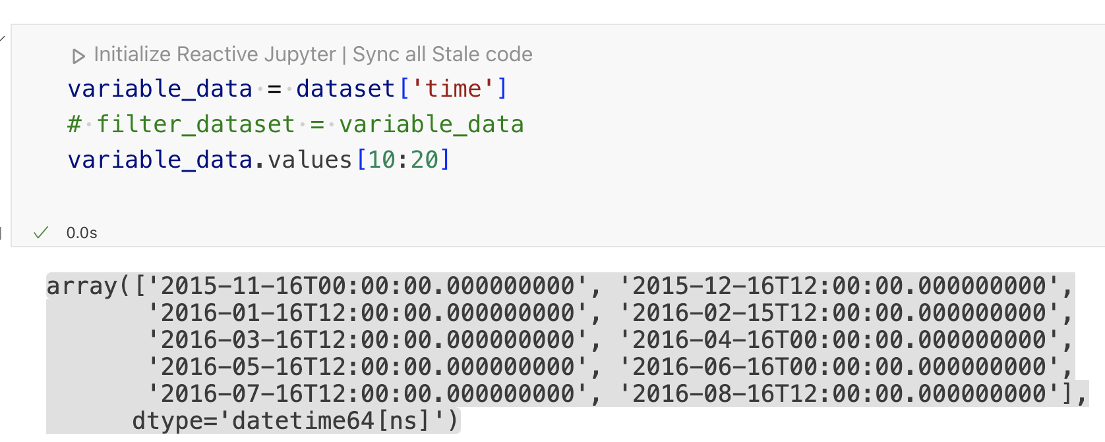
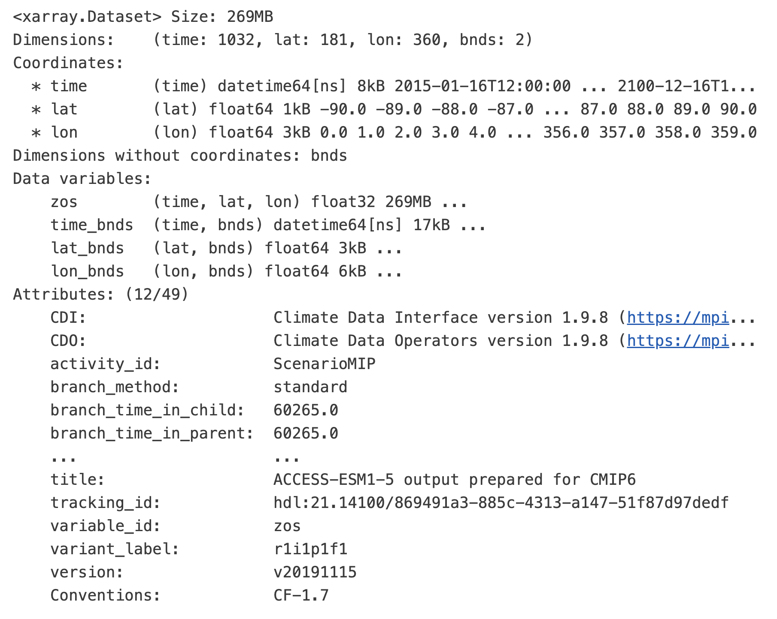
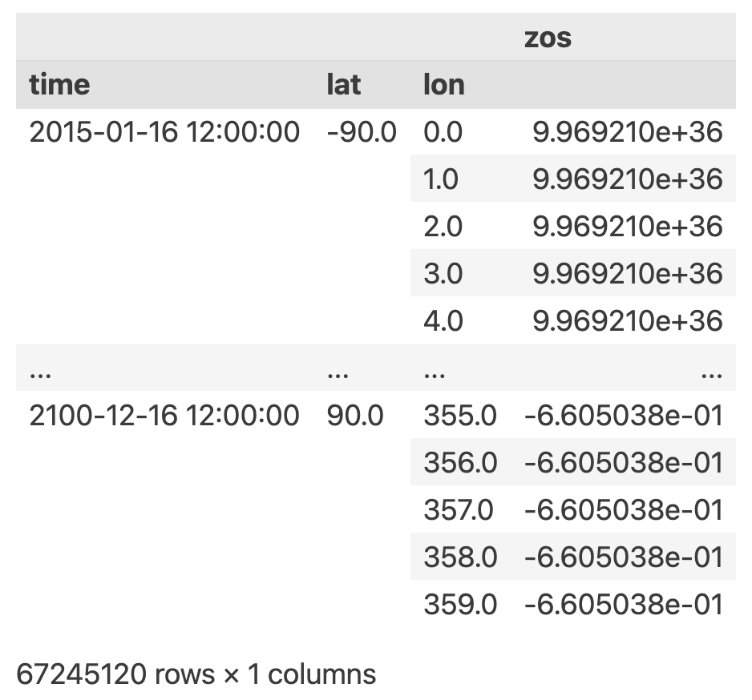
Tlm/sterodynamics Ex: ACCESS-CM2 ssp126

Slide 11
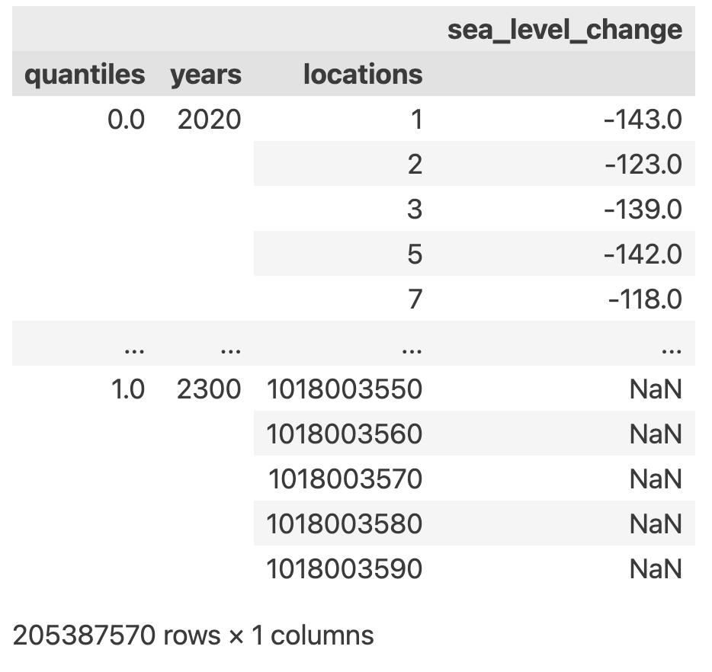
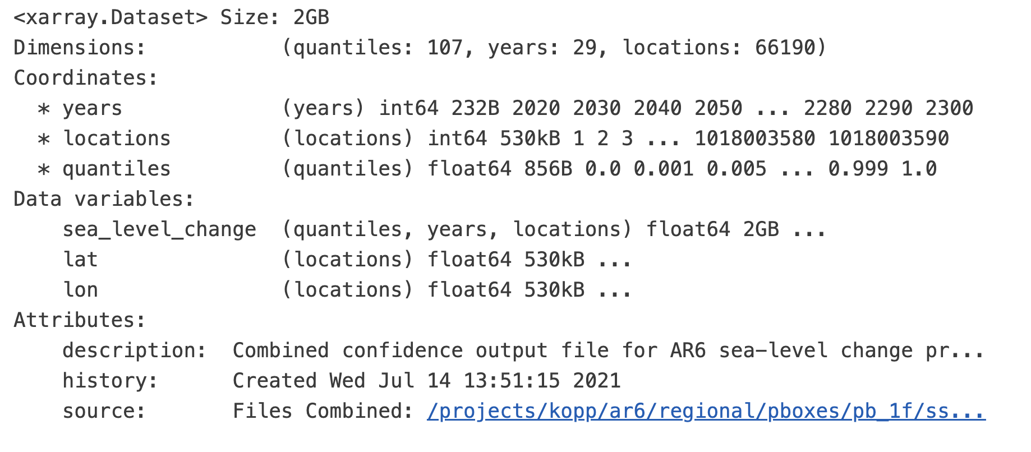
Tlm/sterodynamics Ex:oceandynamics_ssp370

Slide 12
Kopp14/verticallandmotion
<<Probabilistic 21st and 22nd century sea-level projections at a global network of tide-gauge sites>>
https://agupubs.onlinelibrary.wiley.com/doi/10.1002/2014EF000239
16 OCT 2014
Ex: Reginal verticallandmotion ssp370(same as all sceneries)

Slide 13
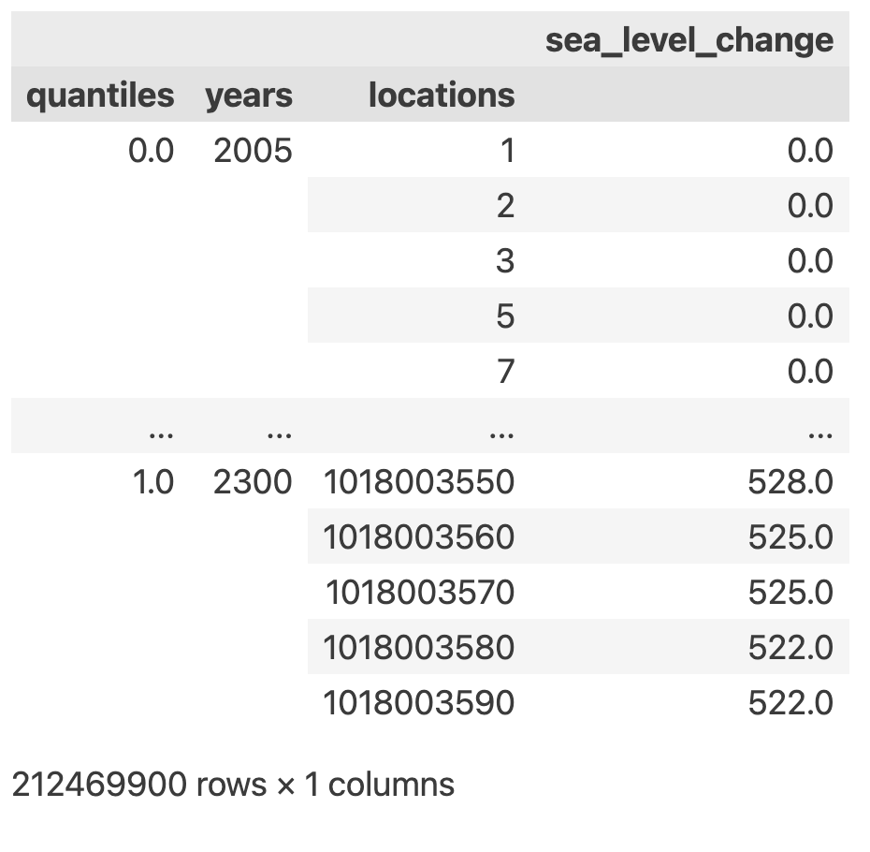
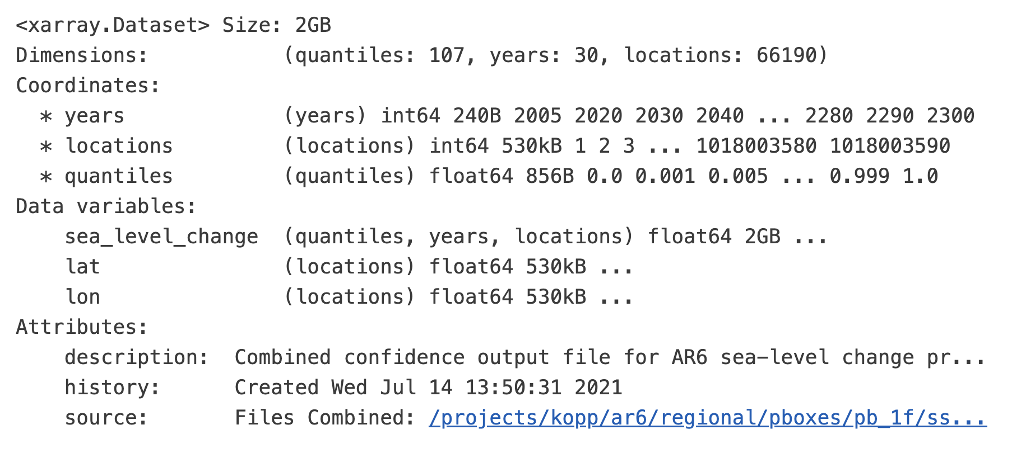
Ex: Reginal verticallandmotion ssp370
Ex: Reginal verticallandmotion ssp370(same for all sceneries)

Slide 14
Summary
Fair/temperature
Emulandice/AIS, GrIS, glaciers
Tlm/sterodynamics
Kopp14/verticallandmotion

Slide 15
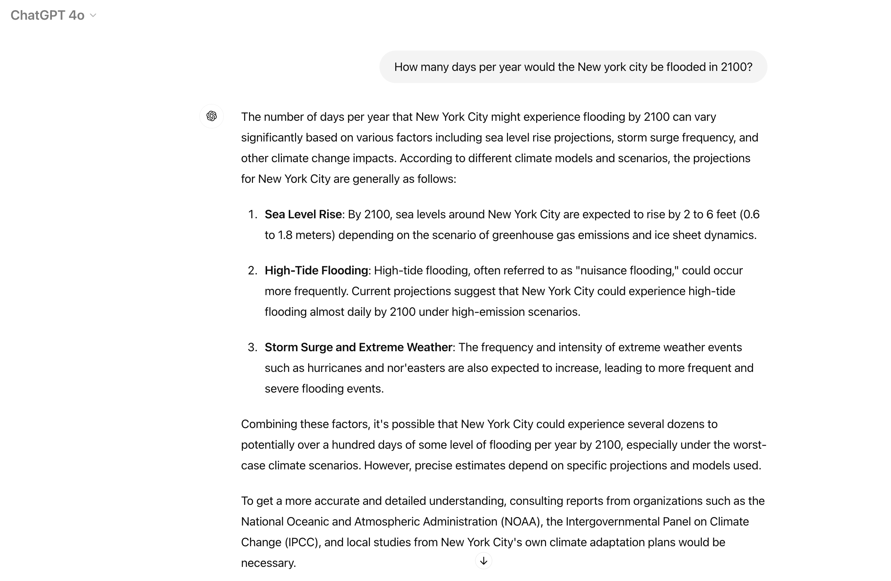
Flood
https://www.independent.co.uk/climate-change/news/new-york-flood-climate-crisis-nasa-b1900734.html
https://www.nyc.gov/site/planning/data-maps/flood-hazard-mapper.page
https://climate.cityofnewyork.us/initiatives/planyc-getting-sustainability-done/

Slide 16
Discussion

