Slide 1
Group Meeting
Yunlong Pan

Slide 2
Outline
ADCIRC
Method 1
Docker
Input and output
Demo
Method 2
SMS

Slide 3
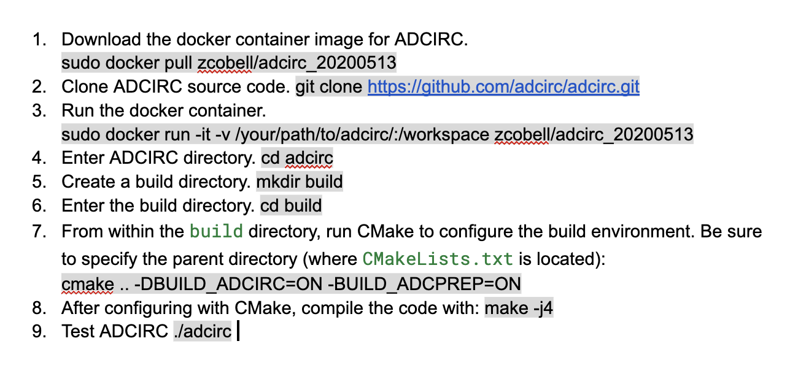
Method 1: Docker

Slide 4
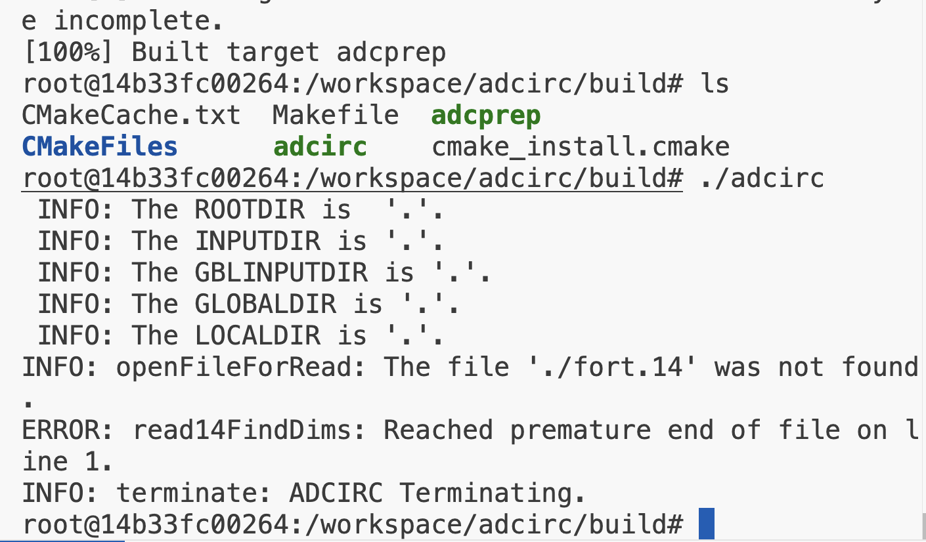
Method 1: Docker

Slide 5
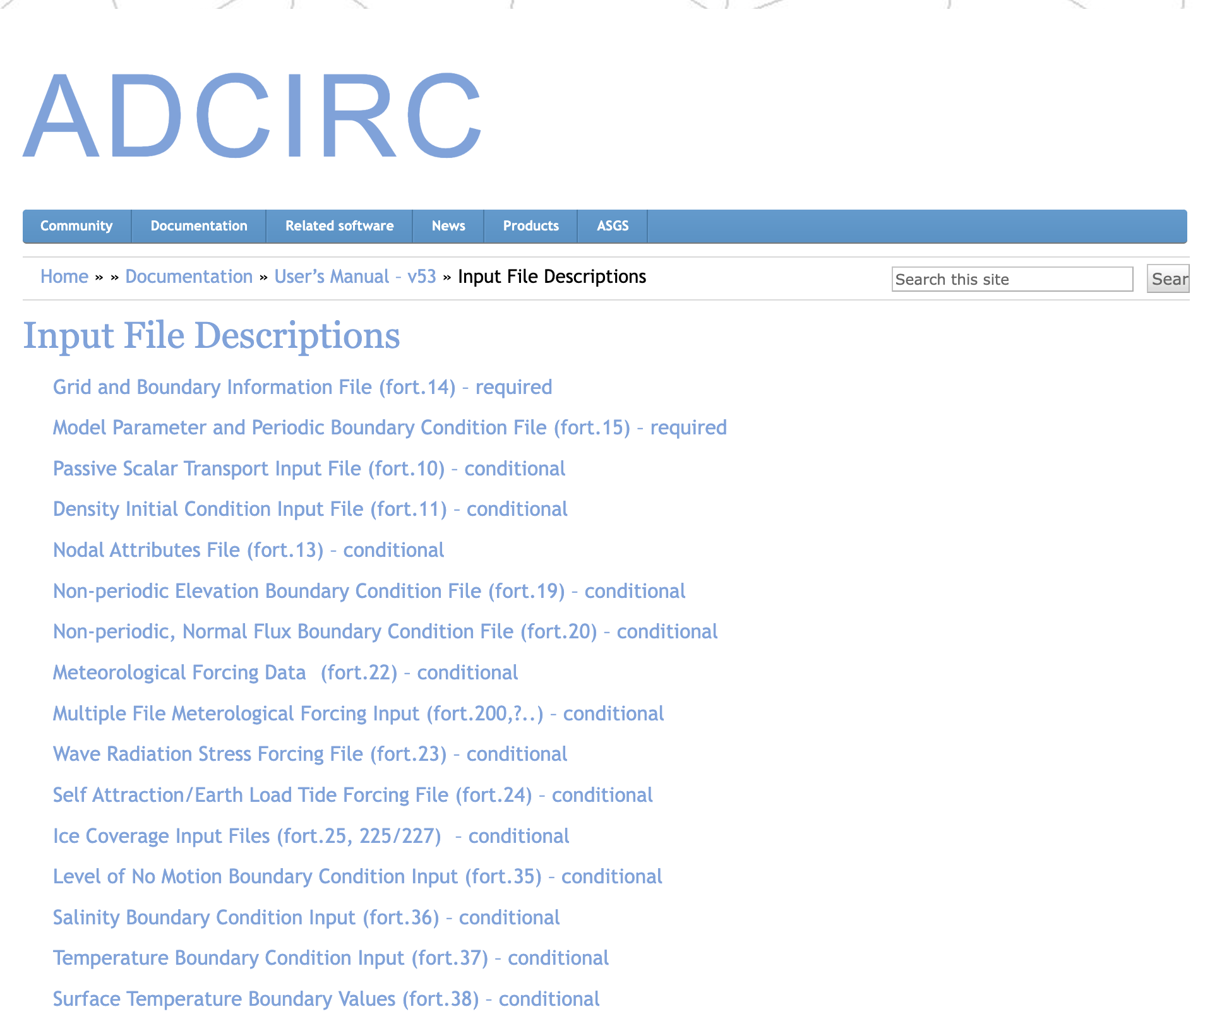
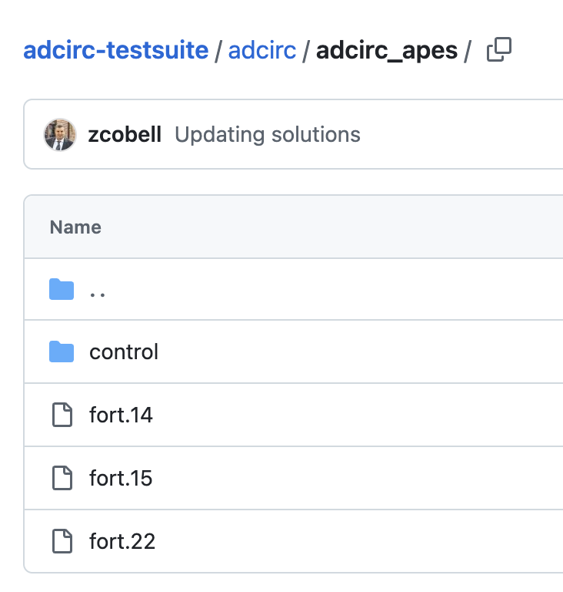
Method 1: Input
Input File Descriptions
Ex: input files
https://github.com/adcirc/adcirc-testsuite/tree/main/adcirc
https://adcirc.org/home/documentation/users-manual-v53/input-file-descriptions/

Slide 6
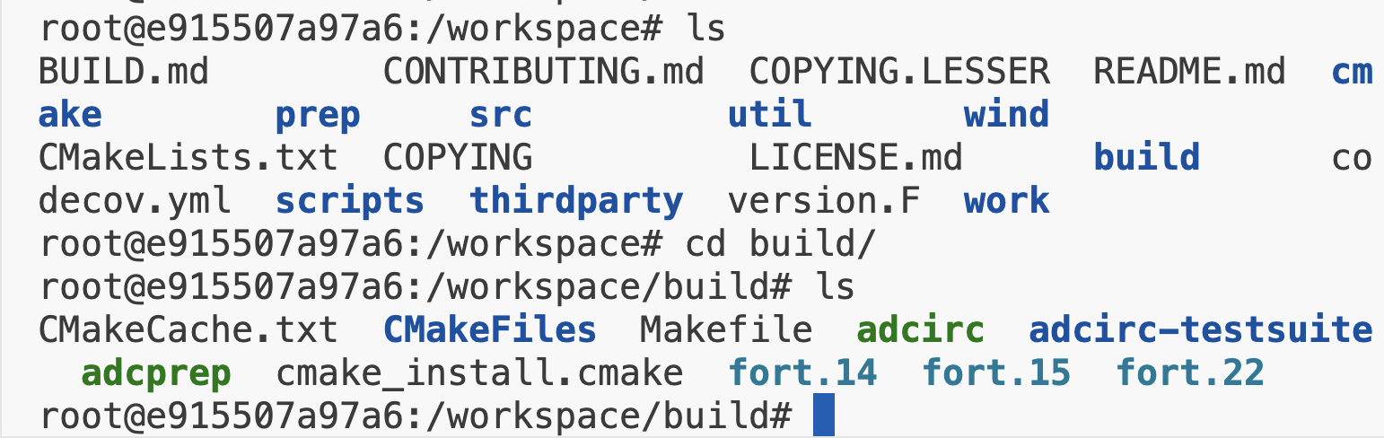
Method 1: Demo

Slide 7
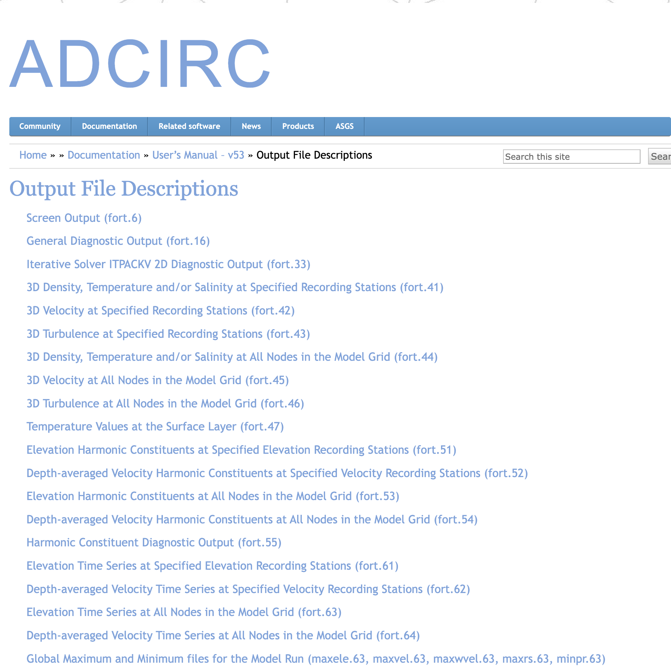
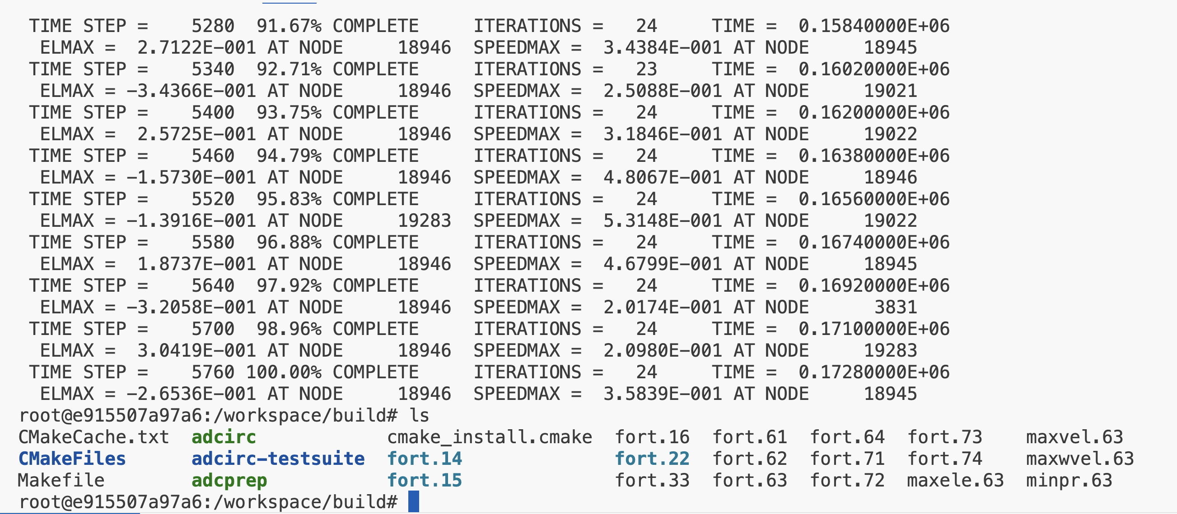
Method 1: output
Output File Descriptions
Ex: Output files
https://adcirc.org/home/documentation/users-manual-v53/output-file-descriptions/

Slide 8
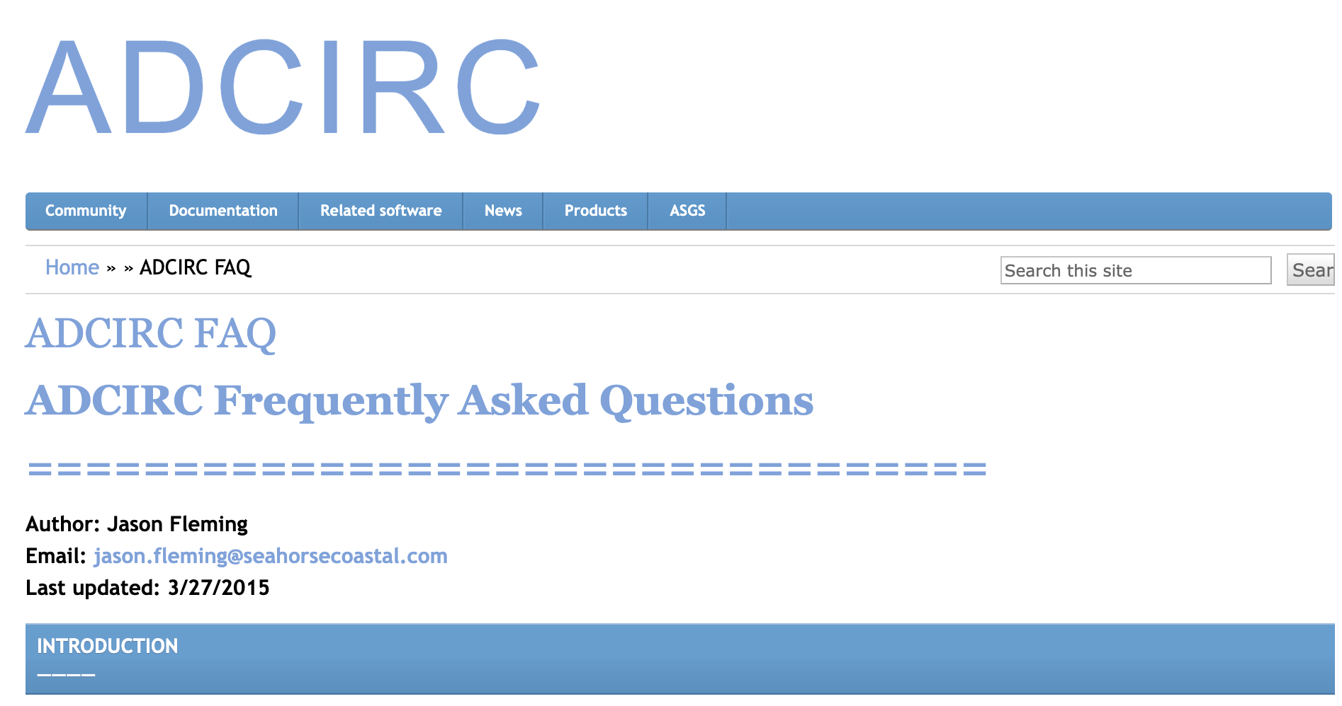
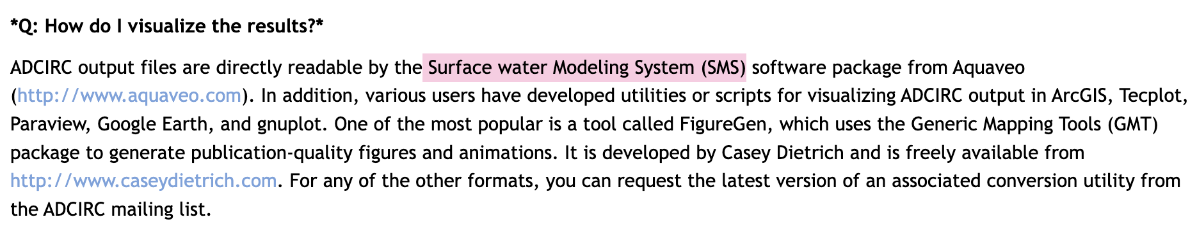
Method 2: SMS
https://adcirc.org/home/adcirc-faq/
https://www.aquaveo.com/

Slide 9
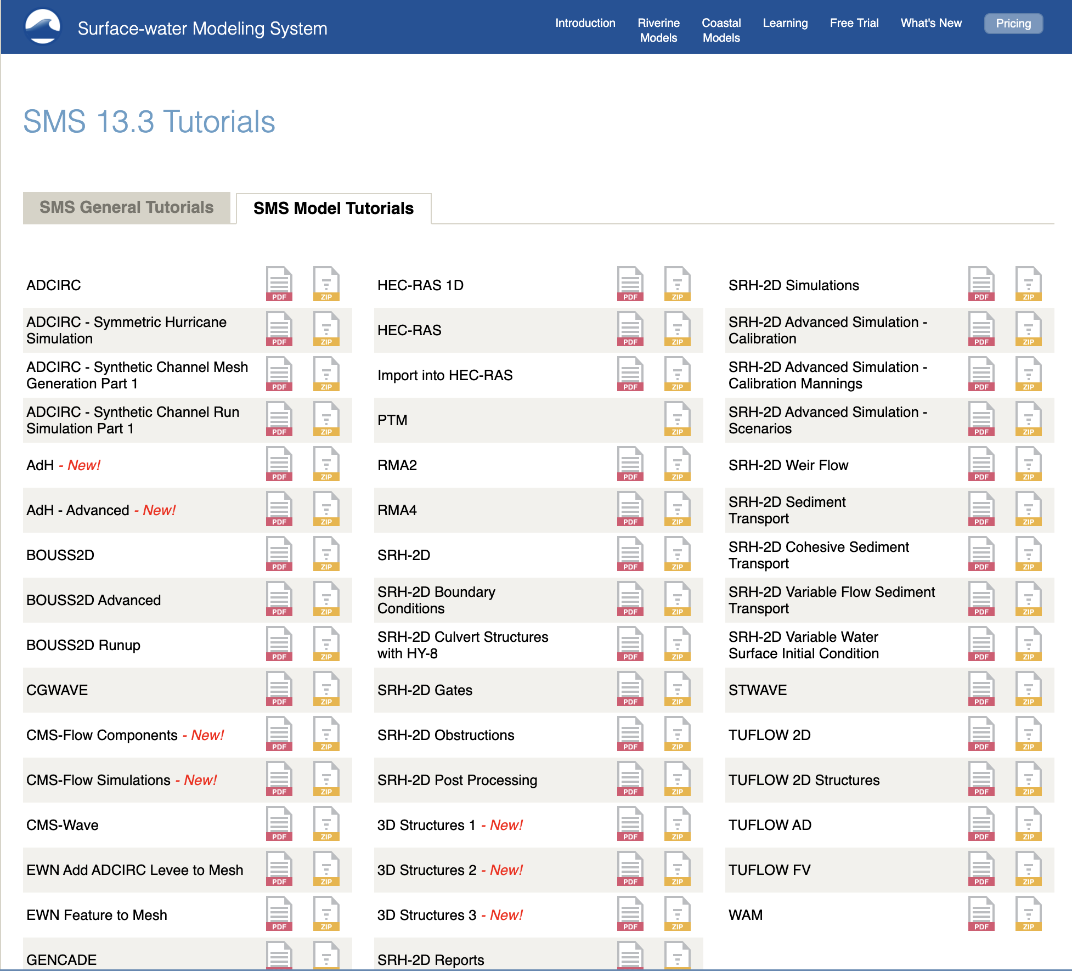
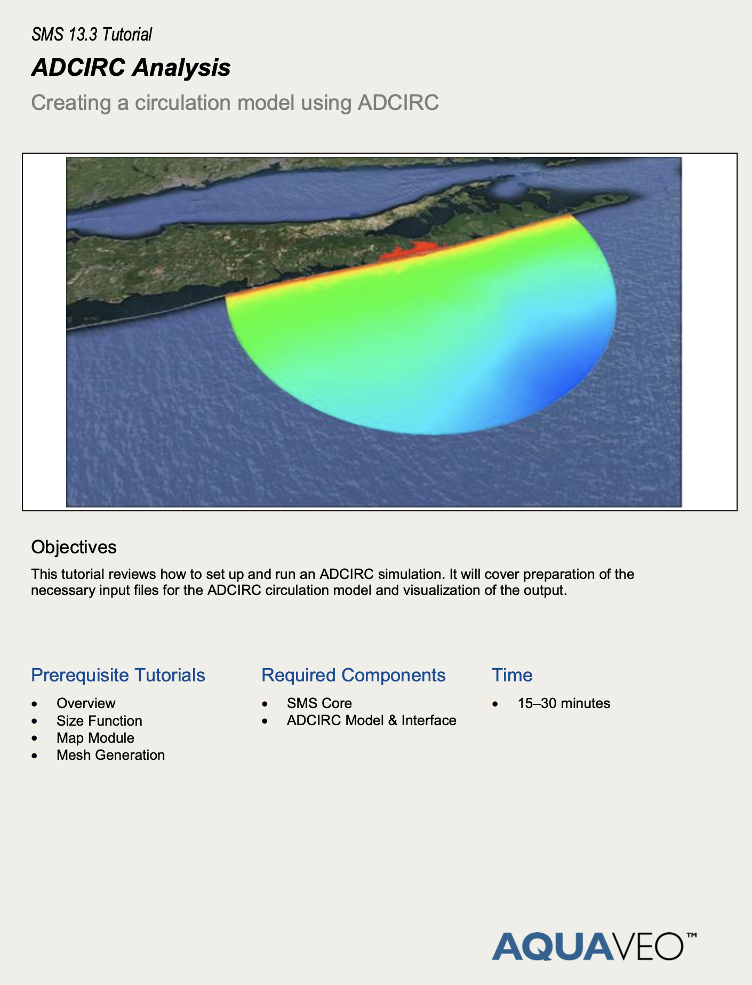
Method 2: SMS
https://www.aquaveo.com/software/sms-learning-tutorials

Slide 10
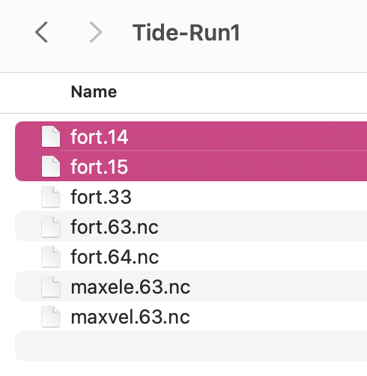
Method 2: SMS
https://www.aquaveo.com/software/sms-learning-tutorials

Slide 11
Suggestions from Ruyi
Basic References
Luettich Jr., R A, J J Westerink, and Norman W Scheffner (1992). ADCIRC: An Advanced Three-Dimensional Circulation Model for Shelves, Coasts, and Estuaries. Report 1. Theory and Methodology of ADCIRC-2DDI and ADCIRC-3DL.
Westerink, J J et al. (1994). ADCIRC: An Advanced Three-Dimensional Circulation Model for Shelves, Coasts, and Estuaries. Report 2. User’s Manual for ADCIRC-2DDI.
Luettich, Rick A. and Joannes Westerink (2004). Formulation and Numerical Implementation of the 2D / 3D ADCIRC Finite Element Model Version 44. XX. Tech. Rep., pp. 1–74.
Kinnmark, I. (1986). The shallow water wave equations: formulation, analysis, and application.
ADCIRC Documentation Start with the official ADCIRC User’s Manual if you haven’t already. It’s a solid resource that covers the basics of model setup, running simulations, processing results, and troubleshooting. In fact, in the presentations I gave to the group a couple of months ago, I focused on a quick walk-through of the same issues. My presentations were based mainly on materials from the User’s Manual website, and I emphasized how critical it is to work through and master this part of the documentation. So, I’d definitely recommend it as the most important resource in this regard.

