Slide 1
Chapter 3:
A First Look at Classes and Objects
Starting Out with Java:
Early Objects
Fourth Edition
by Tony Gaddis

Slide 2
Chapter Topics
Chapter 3 discusses the following main topics:
  Classes
  More about Passing Arguments
  Instance Fields and Methods
  Constructors
  A BankAccount Class
  Classes, Variables, and Scope
  Packages and import Statements
  Focus on Object Oriented Design: Finding the Classes and their Responsibilities
3-<number>

Slide 3
Classes
From chapter 2, we learned that a reference variable contains the address of an object.
  String cityName = "Charleston"
The object that contains the
character string “Charleston”
Charleston
cityName
Address of the object
3-<number>

Slide 4
Classes
The length() method of the String class returns and integer value that is equal to the length of the string.
  int stringLength = cityName.length();
The variable stringLength will contain 10 after this statement since the string "Charleston" has 10 characters.
Primitives can not have methods that can be run whereas objects can.
A class can be thought of as a blueprint that objects are created from.
3-<number>

Slide 5
Classes and Instances
Many objects can be created from a class.
Each object is independent of the others.
  String person = "Jenny";
  String pet = "Fido";
  String favoriteColor = "Blue";
3-<number>

Slide 6
Classes and Instances
“Jenny”
person
Address
“Fido”
pet
Address
“Blue”
favoriteColor
Address
3-<number>

Slide 7
Classes and Instances
Each instance of the String class contains different data.
The instances are all share the same design.
Each instance has all of the attributes and methods that were defined in the String class.
Classes are defined to represent a single concept or service.
3-<number>

Slide 8
Access Modifiers
An access modifier is a Java key word that indicates how a field or method can be accessed.
There are three Java access modifiers:
  public
  private
  protected
3-<number>

Slide 9
Access Modifiers
public: This access modifier states that any other class can access the resource.
private: This access modifier indicates that only data within this class can access the resource.
protected: This modifier indicates that only classes in the current package or a class lower in the class hierarchy can access this resource.
These will be explained in greater detail later.
3-<number>

Slide 10
Access Modifiers
Classes that need to be used by other classes are typically made public.
If there is more than one class in a file, only one may be public and it must match the file name.
Class headers have a format:
  AccessModifier class ClassName
  {
  Class Members
  }
3-<number>

Slide 11
Encapsulation
Classes should be as limited in scope as needed to accomplish the goal.
Each class should contain all that is needed for it to operate.
Enclosing the proper attributes and methods inside a single class is called encapsulation.
Encapsulation ensures that the class is self-contained.
3-<number>

Slide 12
Designing a Class
When designing a class, decisions about the following must be made.
  what data must be accounted for,
  what actions need to be performed,
  what data can be modified,
  what data needs to be accessible, and
  any rules as to how data should be modified.
Class design typically is done with the aid of a Unified Modeling Language (UML) diagram.
3-<number>

Slide 13
UML Class Diagram
A UML class diagram is a graphical tool that can aid in the design of a class.
The diagram has three main sections.
Class Name
UML diagrams are easily converted
to Java class files. There will be more
about UML diagrams a little later.
Attributes
Methods
The class name should concisely reflect what
the class represents.
3-<number>

Slide 14
Attributes
The data elements of a class define the object to be instantiated from the class.
The attributes must be specific to the class and define it completely.
Example: A rectangle is defined by
  length
  width.
The attributes are then accessed by methods within the class.
3-<number>

Slide 15
Data Hiding
Another aspect of encapsulation is the concept of data hiding.
Classes should not only be self-contained but they should be self-governing as well.
Classes use the private access modifier on fields to hide them from other classes.
Classes need methods to allow access and modification of the class’ data.
3-<number>

Slide 16
Methods
The class’ methods define the actions that an instance of the class can perform
Methods headers have a format:
  AccessModifier ReturnType MethodName(Parameters)
  {
    //Method body.
  }
Methods that need to be used by other classes should be made public.
3-<number>

Slide 17
Methods
The attributes of a class might need to be:
  changed,
  accessed, and
  calculated.
The methods that change and access attributes are called accessors and mutators.
3-<number>

Slide 18
Accessors and Mutators
Because of the concept of data hiding, fields in a class are private.
The methods that retrieve the data of fields are called accessors.
The methods that modify the data of fields are called mutators.
Each field that the programmer wishes to be viewed by other classes needs an accessor.
Each field that the programmer wishes to be modified by other classes needs a mutator.
3-<number>

Slide 19
Accessors and Mutators
For the Rectangle example, the accessors and mutators are:
  setLength : Sets the value of the length field.
    public void setLength(double len) …
  setWidth : Sets the value of the width field.
    public void setLength(double w) …
  getLength : Returns the value of the length field.
    public double getLength() …
  getWidth : Returns the value of the width field.
    public double getWidth() …
Other names for these methods are getters and setters.
3-<number>

Slide 20
Stale Data
Some data is the result of a calculation.
Consider the area of a rectangle.
  length times width
It would be impractical to use an area variable here.
Data that requires the calculation of various factors has the potential to become stale.
To avoid stale data, it is best to calculate the value of that data within a method rather than store it in a variable.
3-<number>

Slide 21
Stale Data
Rather than use an area variable in a rectangle class:
  public double getArea()
  {
  return length * width;
  }
This dynamically calculates the value of the rectangle’s area when the method is called.
Now, any change to the length or width variables will not leave the area of the rectangle stale.
3-<number>

Slide 22
UML Data Type and Parameter Notation
UML diagrams are language independent.
UML diagrams use an independent notation to show return types, access modifiers, etc.
Rectangle
Access modifiers are denoted as:
  + public
  - private
  # protected
- width : double
+ setWidth(w : double) : void
3-<number>

Slide 23
UML Data Type and Parameter Notation
UML diagrams are language independent.
UML diagrams use an independent notation to show return types, access modifiers, etc.
Variable types are placed after the variable name, separated by a colon.
Rectangle
- width : double
+ setWidth(w : double) : void
3-<number>

Slide 24
UML Data Type and Parameter Notation
UML diagrams are language independent.
UML diagrams use an independent notation to show return types, access modifiers, etc.
Rectangle
Method return types are placed after the method declaration name, separated by a colon.
- width : double
+ setWidth(w : double) : void
3-<number>

Slide 25
UML Data Type and Parameter Notation
UML diagrams are language independent.
UML diagrams use an independent notation to show return types, access modifiers, etc.
Method parameters are shown inside the parentheses using the same notation as variables.
Rectangle
- width : double
+ setWidth(w : double) : void
3-<number>

Slide 26
Converting the UML Diagram to Code
Putting all of this information together, a Java class file can be built easily using the UML diagram.
The UML diagram parts match the Java class file structure.
class header
{
Attributes
Methods
}
ClassName
Attributes
Methods
3-<number>

Slide 27
Converting the UML Diagram to Code
The structure of the class can be compiled and tested without having bodies for the methods. Just be sure to put in dummy return values for methods that have a return type other than void.
public class Rectangle
{
private double width;
private double length;
public void setWidth(double w)
{
}
public void setLength(double len)
{
}
public double getWidth()
{ return 0.0;
}
public double getLength()
{ return 0.0;
}
public double getArea()
{ return 0.0;
}
}
Rectangle
width : double
length : double
+ setWidth(w : double) : void
+ setLength(len : double): void
+ getWidth() : double
+ getLength() : double
+ getArea() : double
3-<number>

Slide 28
Converting the UML Diagram to Code
public class Rectangle
{
private double width;
private double length;
public void setWidth(double w)
{ width = w;
}
public void setLength(double len)
{ length = len;
}
public double getWidth()
{ return width;
}
public double getLength()
{ return length;
}
public double getArea()
{ return length * width;
}
}
Once the class structure has been tested, the method bodies can be written and tested.
Rectangle
width : double
length : double
+ setWidth(w : double) : void
+ setLength(len : double: void
+ getWidth() : double
+ getLength() : double
+ getArea() : double
3-<number>

Slide 29
Class Layout Conventions
The layout of a source code file can vary by employer or instructor.
Generally the layout is:
  Attributes are typically listed first
  Methods are typically listed second
    The main method is sometimes first, sometimes last.
    Accessors and mutators are typically grouped.
3-<number>

Slide 30
A Driver Program
An application in Java is a collection of classes that interact.
The class that starts the application must have a main method.
This class can be used as a driver to test the capabilities of other classes.
In the Rectangle class example, notice that there was no main method.
3-<number>

Slide 31
A Driver Program
public class RectangleDemo
{
public static void main(String[] args)
{
Rectangle r = new Rectangle();
r.setWidth(10);
r.setLength(10);
System.out.println("Width = "
+ r.getWidth());
System.out.println("Length = "
+ r.getLength());
System.out.println("Area = "
+ r.getArea());
}
}
public class Rectangle
{
private double width;
private double length;
public void setWidth(double w)
{ width = w;
}
public void setLength(double len)
{ length = len;
}
public double getWidth()
{ return width;
}
public double getLength()
{ return length;
}
public double getArea()
{ return length * width;
}
}
This RectangleDemo class is a Java application that uses the Rectangle class.
Another Example: LengthWidthDemo.java
3-<number>

Slide 32
Multiple Arguments
Methods can have multiple parameters.
The format for a multiple parameter method is:
  AccessModifier ReturnType MethodName(ParamType ParamName,
  ParamType ParamName,
  etc)
  {
  }
Parameters in methods are treated as local variables within the method.
Example: MultipleArgs.java
3-<number>

Slide 33
Arguments Passed By Value
In Java, all arguments to a method are passed “by value”.
If the argument is a reference to an object, it is the reference that is passed to the method.
If the argument is a primitive, a copy of the value is passed to the method.
3-<number>

Slide 34
Instance Fields and Methods
Fields and methods that are declared as previously shown are called instance fields and instance methods.
Objects created from a class each have their own copy of instance fields.
Instance methods are methods that are not declared with a special keyword, static.
3-<number>

Slide 35
Instance Fields and Methods
Instance fields and instance methods require an object to be created in order to be used.
Example: RoomAreas.java
Note that each room represented in this example can have different dimensions.
    Rectangle kitchen = new Rectangle();
    Rectangle bedroom = new Rectangle();
    Rectangle den = new Rectangle();
3-<number>

Slide 36
Constructors
Classes can have special methods called constructors.
Constructors are used to perform operations at the time an object is created.
Constructors typically initialize instance fields and perform other object initialization tasks.
3-<number>

Slide 37
Constructors
Constructors have a few special properties that set them apart from normal methods.
  Constructors have the same name as the class.
  Constructors have no return type (not even void).
  Constructors may not return any values.
  Constructors are typically public.
Example: ConstructorDemo.java
Example: RoomConstructor.java
3-<number>

Slide 38
The Default Constructor
If a constructor is not defined, Java provides a default constructor.
  It sets all of the class’ numeric fields to 0.
  It sets all of the class’ boolean fields to false.
  It sets all of the class’ reference variables, the default constructor sets them to the special value null.
The default constructor is a constructor with no parameters.
Default constructors are used to initialize an object in a default configuration.
3-<number>

Slide 39
Constructors in UML
In UML, the most common way constructors are defined is:
Rectangle
Notice there is no
return type listed
for constructors.
width : double
length : double
+Rectangle(len:double, w:double)
+ setWidth(w : double) : void
+ setLength(len : double): void
+ getWidth() : double
+ getLength() : double
+ getArea() : double
3-<number>

Slide 40
The String Class Constructor
One of the String class constructors accepts a string literal as an argument.
This string literal is used to initialize a String object.
For instance:
  String name = new String("Michael Long");
3-<number>

Slide 41
The String Class Constructor
This creates a new reference variable name that points to a String object that represents the name “Michael Long”
Because they are used so often, Strings can be created with a shorthand:
  String name = "Michael Long";
3-<number>

Slide 42
The BankAccount Example
BankAccount
Example Files:
  BankAccount.java
  AccountTest.java
balance : double
interestRate : double
interest : double
+BankAccount(startBalance:double,
intRate :double):
+ deposit(amount : double) : void
+ withdrawl(amount : double: void
+ addInterest() : void
+ getBalance() : double
+ getInterest() : double
3-<number>

Slide 43
Classes, Variables and Scope
The list below shows the scope of a variable depending on where it is declared.
  Inside a method:
    Visible only within that method.
    Called a local variable.
  In a method parameter:
    Called a parameter variable.
    Same as a local variable
    Visible only within that method.
  Inside the class but not in a method:
    Visible to all methods of the class.
    Called an instance field.
3-<number>

Slide 44
Shadowing
A parameter variable is, in effect, a local variable.
Within a method, variable names must be unique.
A method may have a local variable with the same name as an instance field.
This is called shadowing.
The local variable will hide the value of the instance field.
Shadowing is discouraged and local variable names should not be the same as instance field names.
3-<number>

Slide 45
Packages and import Statements
A package is a group of related classes.
The classes in the Java API are organized into packages.
  For example, the Scanner class is in the java.util package.
Many of the API classes must be imported before they can be used. For example, the following statement is required to import the Scanner class:
import java.util.Scanner;
This statement appears at the top of the program's source code.
1-<number>

Slide 46
Packages and import Statements
Explicit import Statements
  An explicit import statement specifies a single class:
  import java.util.Scanner;
Wildcard import Statements
  A wildcard import statement imports all of the classes in a package:
  import java.util.*;
1-<number>

Slide 47
Packages and import Statements
The java.lang package
  Automatically imported into every Java program.
  Contains general classes such as String and System.
  You do not have to write an import statement for the java.lang package.
1-<number>

Slide 48
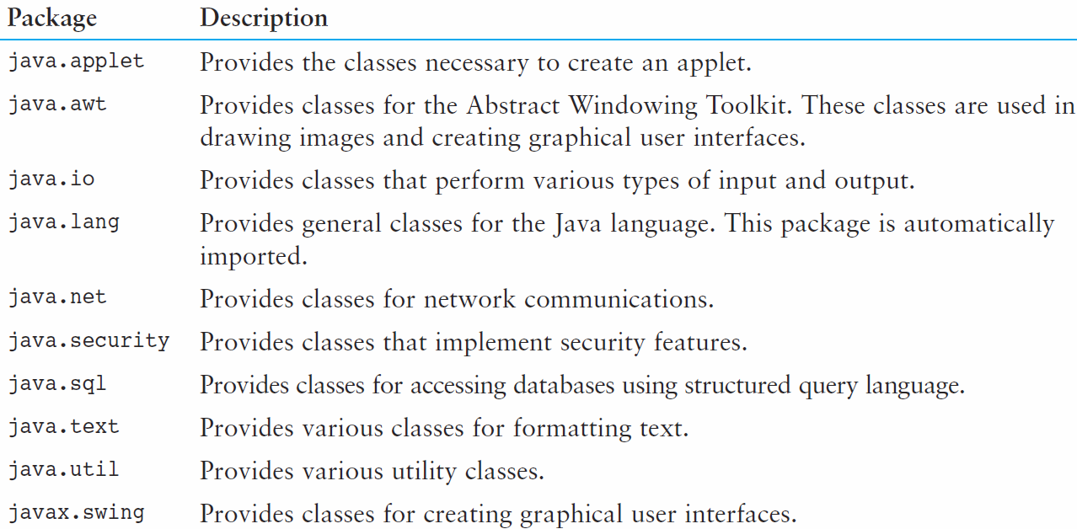
Packages and import Statements
You will use other packages as you learn more about Java.
Table 3-2 lists a few examples.
1-<number>

Slide 49
Object Oriented Design
Finding Classes and Their Responsibilities
Finding the classes
  Get written description of the problem domain
  Identify all nouns, each is a potential class
  Refine list to include only classes relevant to the problem
Identify the responsibilities
  Things a class is responsible for knowing
  Things a class is responsible for doing
  Refine list to include only classes relevant to the problem
3-<number>

Slide 50
Object Oriented Design
Finding Classes and Their Responsibilities
  Identify the responsibilities
    Things a class is responsible for knowing
    Things a class is responsible for doing
    Refine list to include only classes relevant to the problem
3-<number>

