Slide 1
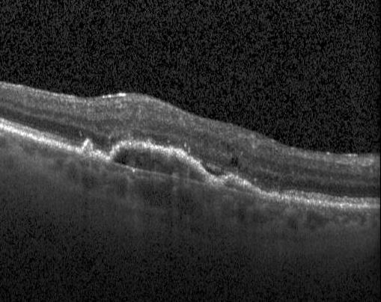
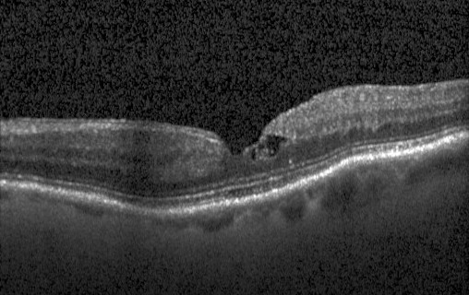
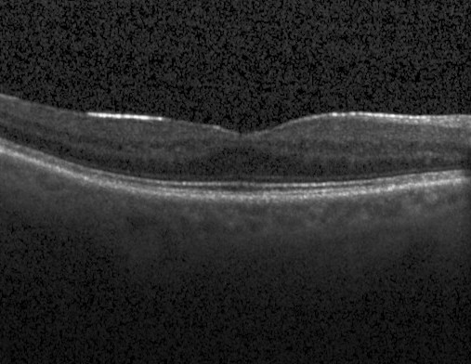
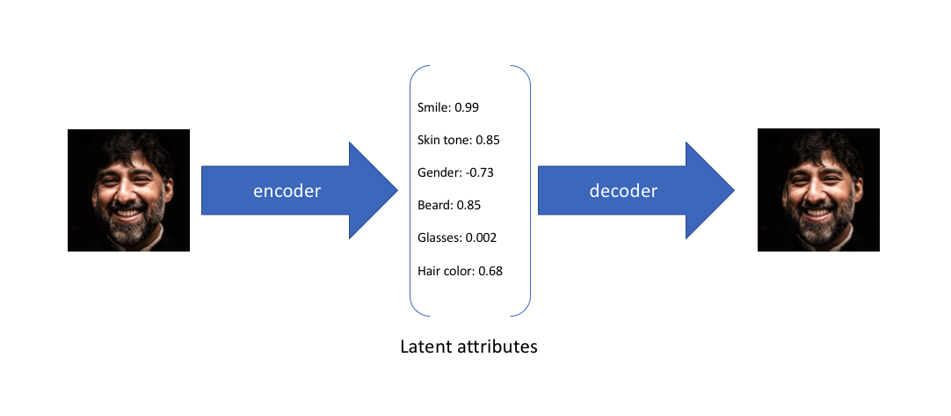
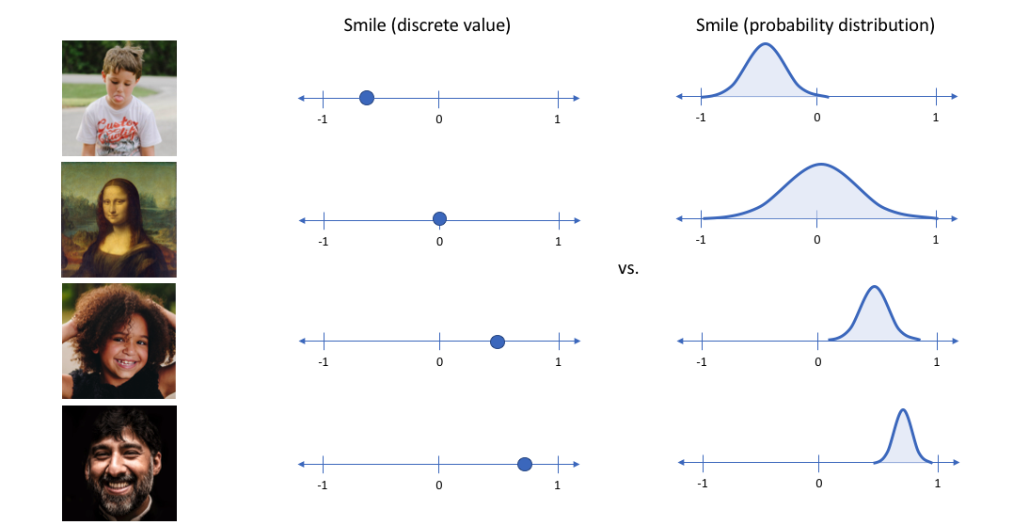
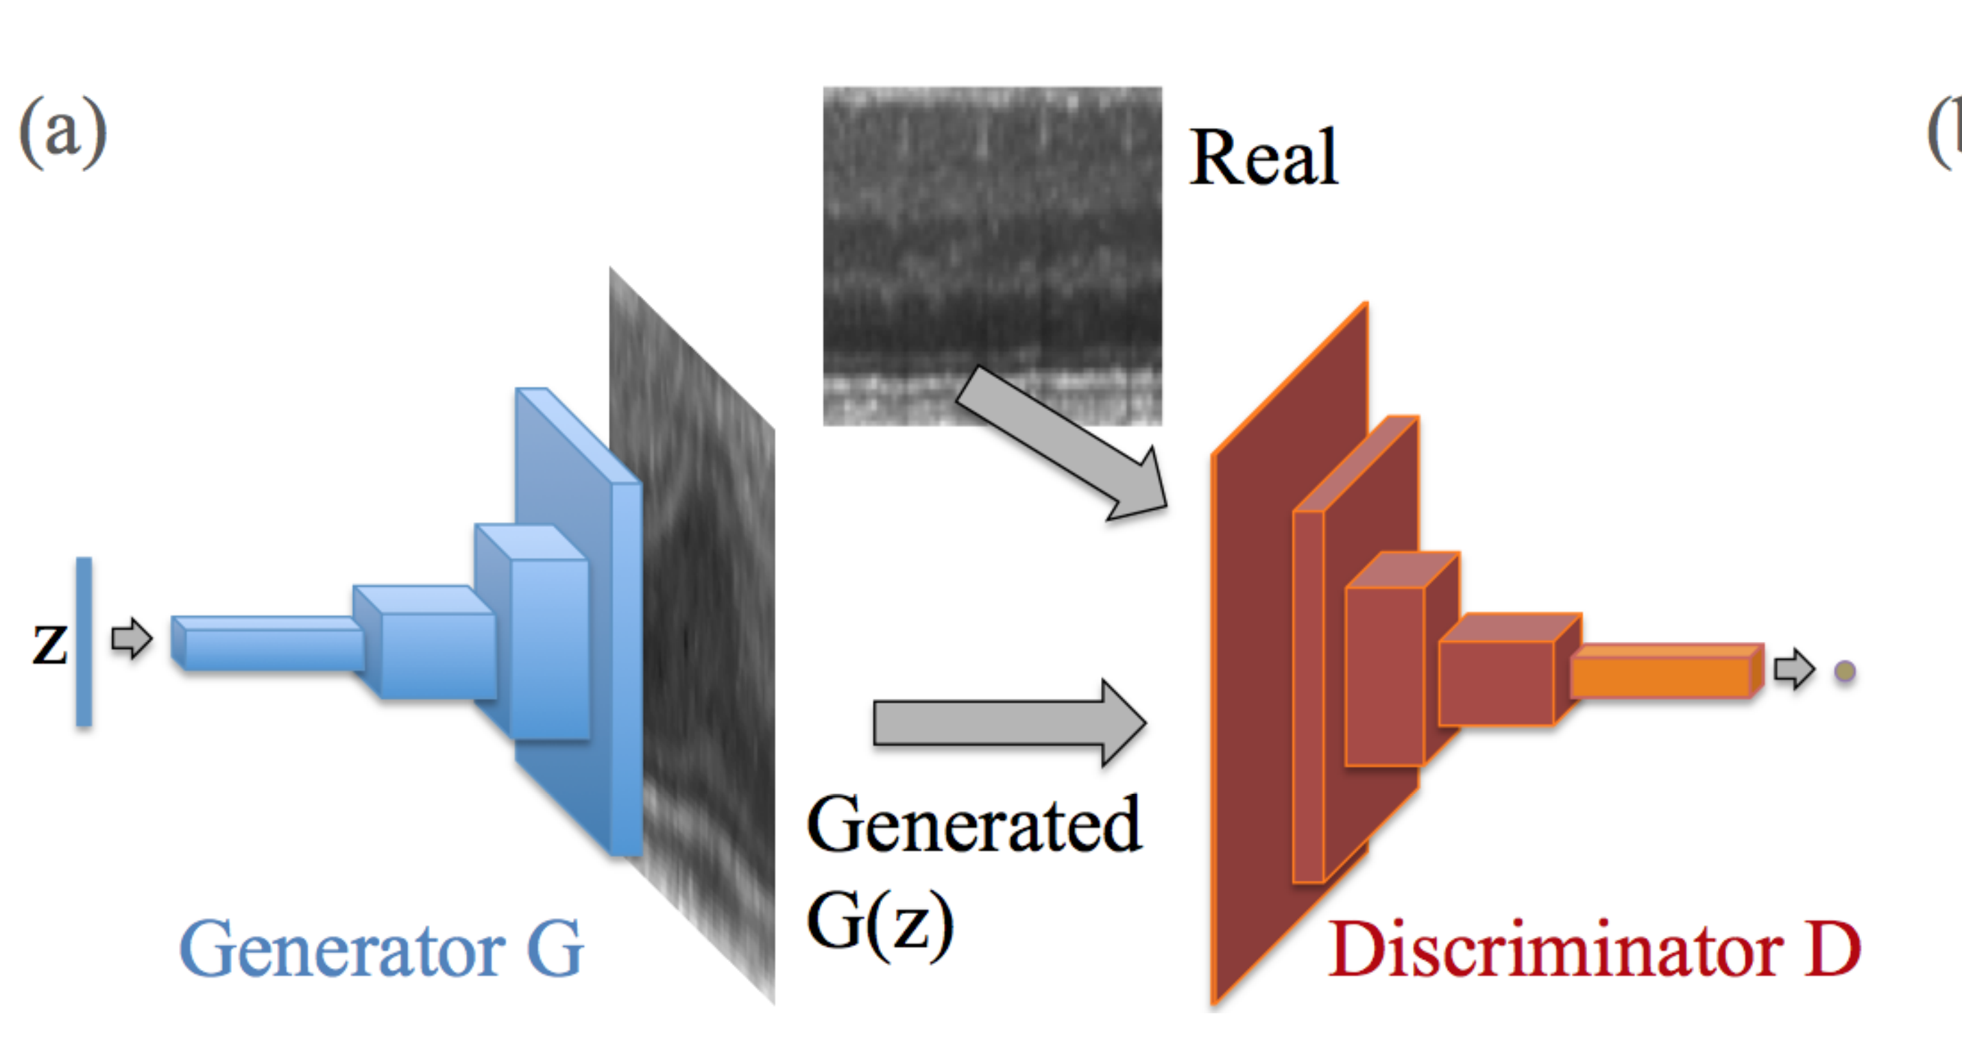
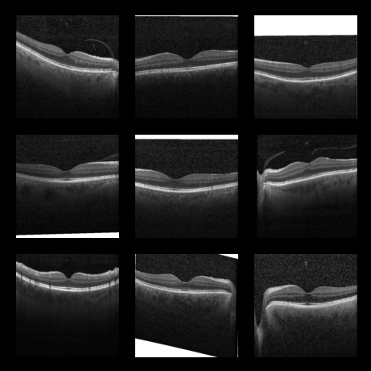

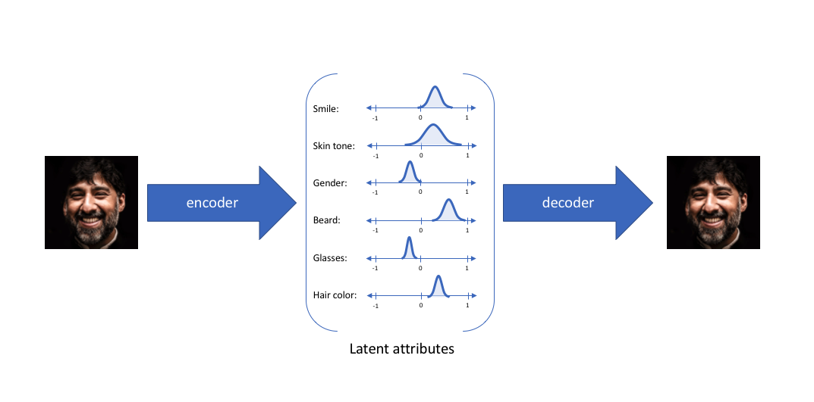
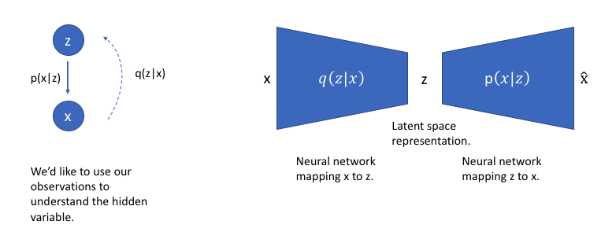
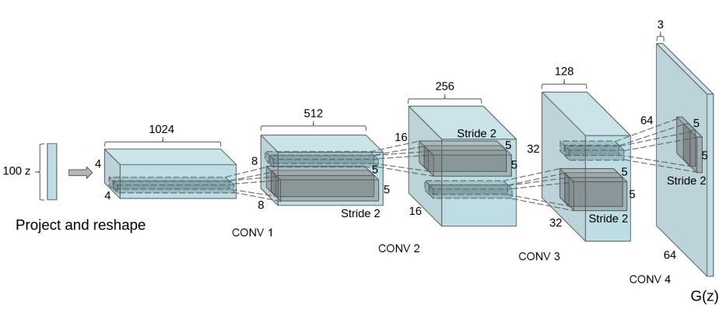
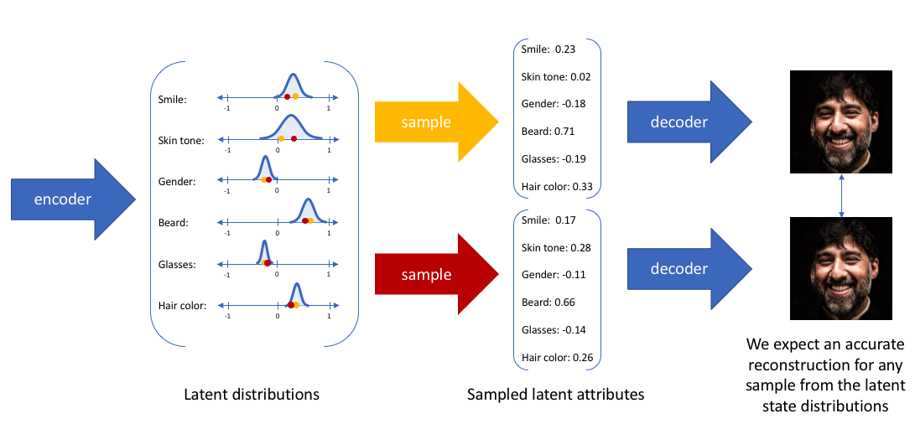
Learning To Identify Diseases From Healthy Medical Images
Introduction
OCT
References
Challenge: to identify diseases like humans by examining normal images to find anomalies
Solution: Deep generative machine learning models VAE and GAN
From OCT images identify those with diseases. Instead of transfer learning we are interested in identifying anomalies. Describe previous work done and data source
Variational Autoencoders (VAE)
Generative Adversarial Networks (GANs)
Anomaly Detection
Actual
Generated
A complicated equation here to show anomaly identification
A complicated equation here to show VAE sampling

Slide 2
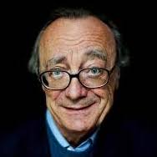
Smile: 0.52
Skin tone: 0.4
Gender: -0.82
Beard: 0.002
Glasses: 0.85
Hair colour: 0.35
Encoder
Decoder
Latent attributes

