Slide 1
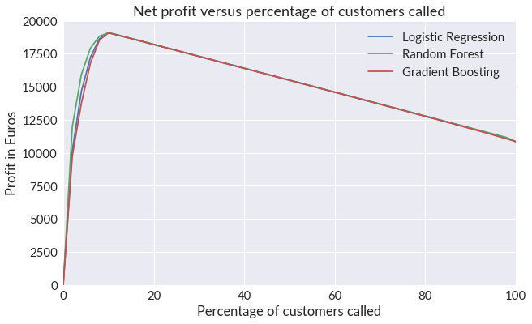
Threshold Method
Calculate profit for each entry in test data
Build classification models using training data with targets 0/1 as previously
Calculate the Expected Profit for each customer X:
E(X) = profit(X) * p(X=1)
Bin the Expected Profit into 20 bins and calculate the profit in each population bin
Plot the cumulative profit as a function of the percentage of customers called
In the test case (9403 customers), the random forest classifier yielded the maximum profit of approximately 18300 Euros when 10% of the customers were called before the cost of unsuccessful calls started to reduce profit
If the total number of customers is 10 million, the expected profit is approximately 20 million Euros

