Slide 1

HEALTHCARE: PERSISTENCY OF DRUG
Intern: Yena Lee
Batch: LISUM16
<Feb 28, 2023>

Slide 2

Background
ABC pharmaceutical company is facing a common challenge shared by many in the industry, which is to effectively monitor the adherence of patients to prescribed medications.
In order to tackle this issue, ABC pharma is exploring automated solutions to accurately identify and track drug persistence as per physician instructions.

Slide 3
Business Problem
The challenge faced by ABC pharma in comprehending drug persistency as per physician prescription
Importance of understanding drug persistency for pharmaceutical companies
The main objective of this model is to automate the process of identifying drug persistency, which would enable ABC pharma to gain better insight into drug usage as per physician prescriptions.

Slide 4
Data Preparation and Cleaning
Preparing and cleaning the data for drug persistency identification
Removing missing values and outliers

Slide 5
Data Exploration
Data shape: (3424, 69)
Number of numerical columns: 2
  Numerical columns: ['Dexa_Freq_During_Rx' 'Count_Of_Risks']
Number of categorical columns: 67
  Categorical columns: ['Ptid' 'Persistency_Flag' 'Gender' 'Race' 'Ethnicity' 'Region'
  'Age_Bucket' 'Ntm_Speciality' 'Ntm_Specialist_Flag'
  'Ntm_Speciality_Bucket' 'Gluco_Record_Prior_Ntm' 'Gluco_Record_During_Rx'
  'Dexa_During_Rx' 'Frag_Frac_Prior_Ntm' 'Frag_Frac_During_Rx'
  'Risk_Segment_Prior_Ntm' 'Tscore_Bucket_Prior_Ntm'
  'Risk_Segment_During_Rx' 'Tscore_Bucket_During_Rx' 'Change_T_Score'
  'Change_Risk_Segment' 'Adherent_Flag' 'Idn_Indicator'
  'Injectable_Experience_During_Rx'...]
There are 0 missing values
There are 0 duplicated records.

Slide 6
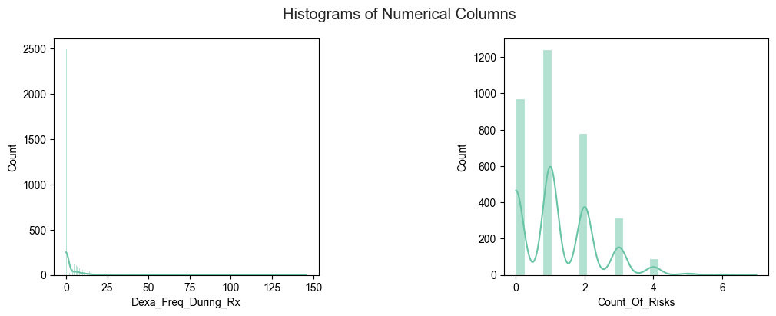
Data Exploration

Slide 7
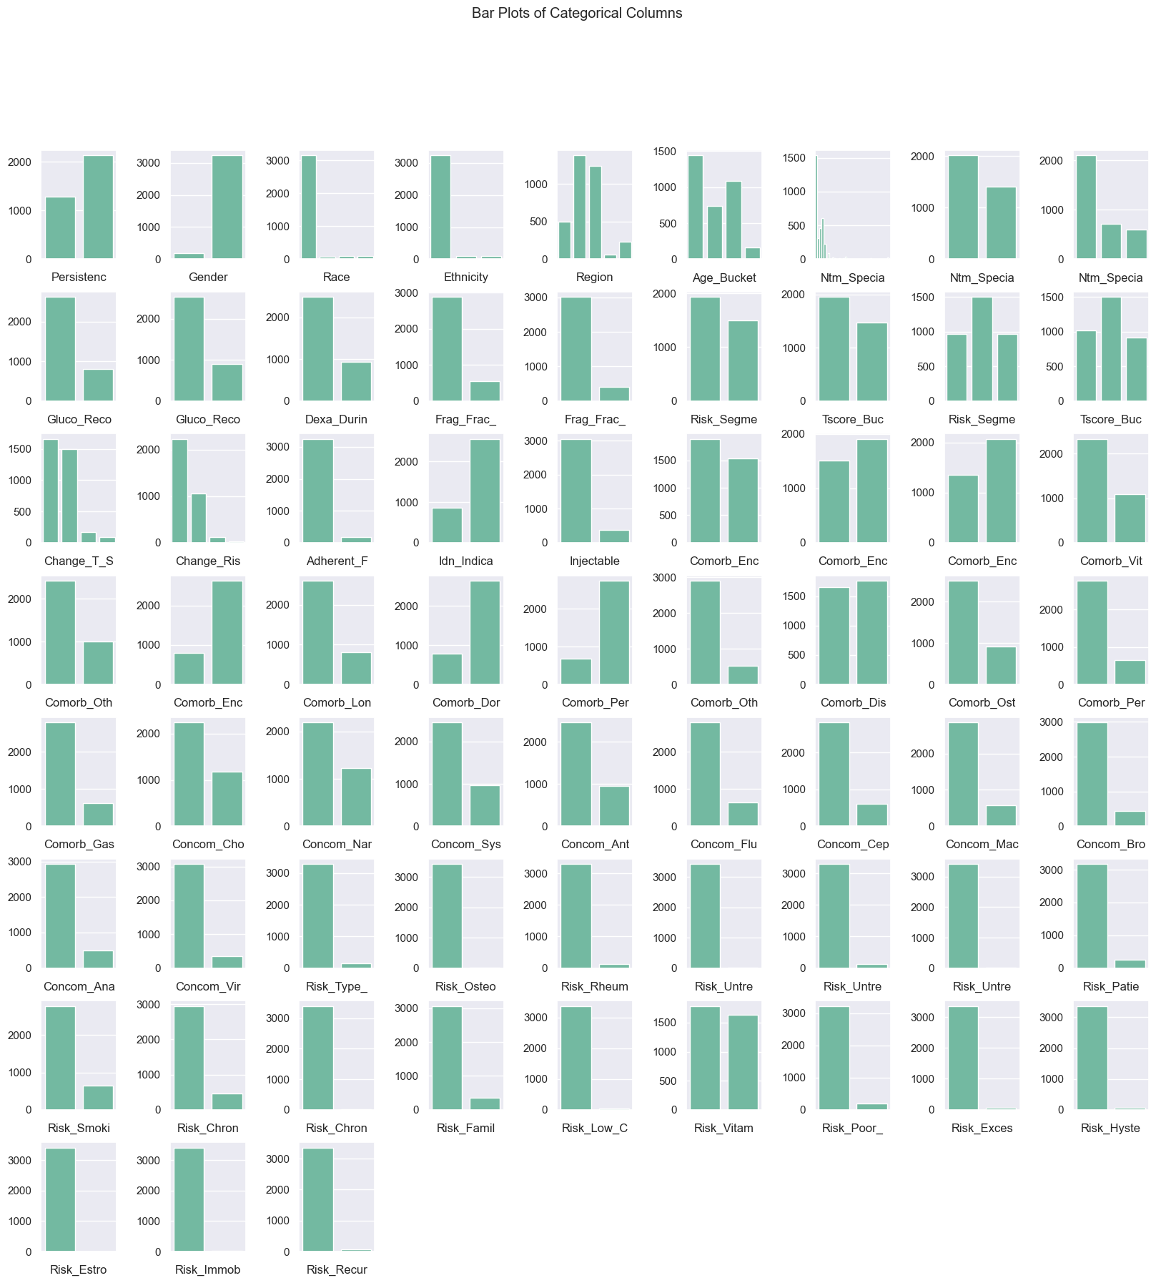
Data Exploration

Slide 8
Data Exploration

Slide 9
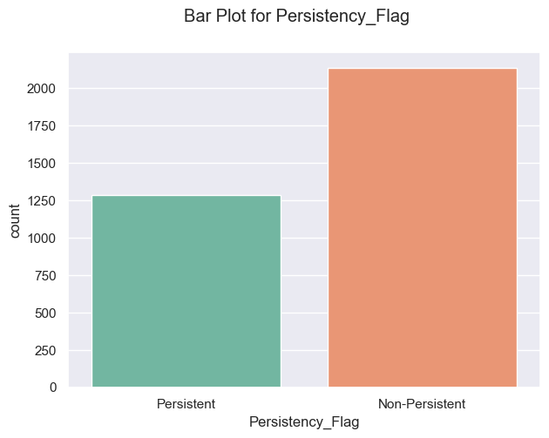
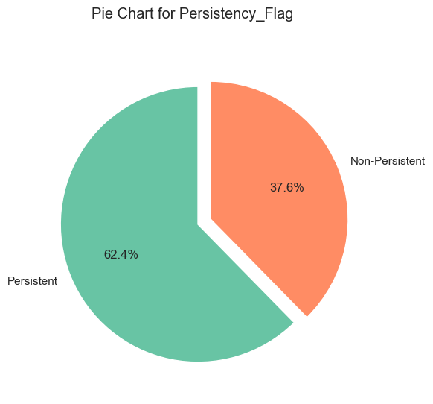
Data Exploration
Non-Persistent 2135
Persistent 1289

Slide 10
Feature Engineering
Identifying and selecting the relevant features/variables for drug persistency identification
Extracting useful information from the data.

Slide 11
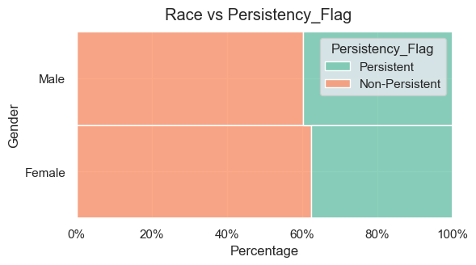
Feature Engineering
Not much difference between female and male

Slide 12
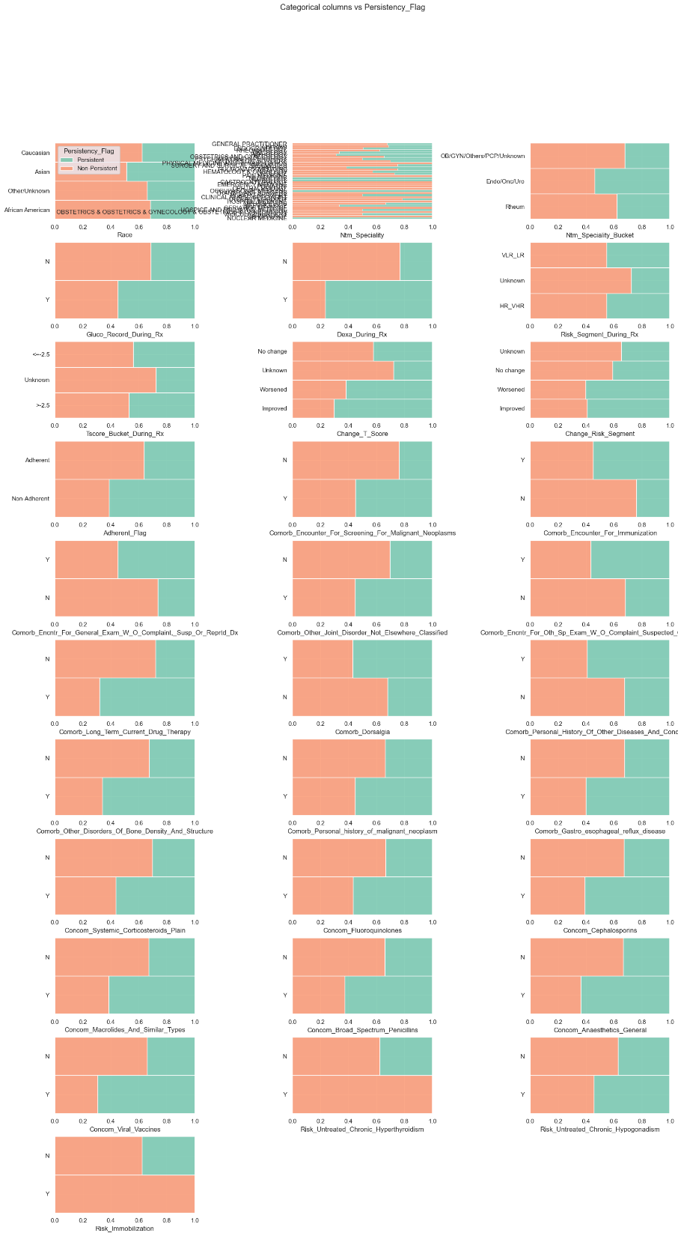
Feature Engineering
Important Features
These are our selected features to build model: ['Race', 'Ntm_Speciality', 'Ntm_Speciality_Bucket', 'Gluco_Record_During_Rx', 'Dexa_During_Rx', 'Risk_Segment_During_Rx', 'Tscore_Bucket_During_Rx', 'Change_T_Score', _Viral_Vaccines', 'Risk_Untreated_Chronic_Hyperthyroidism’, … ]

Slide 13
Classification Model
Suggestions for building an effective classification model for drug persistency identification
Importance of selecting appropriate algorithms and model parameters

Slide 14
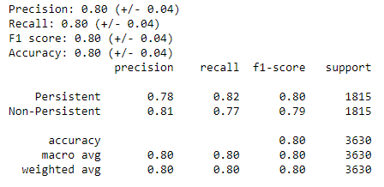
Logistic Regression Model

Slide 15
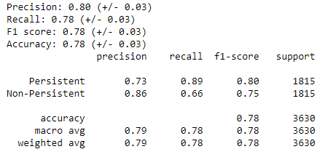
K Nearest Neighbors Model

Slide 16
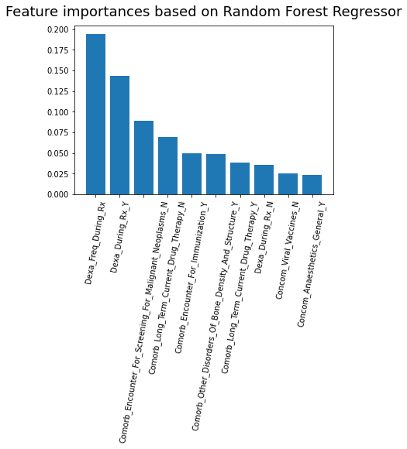
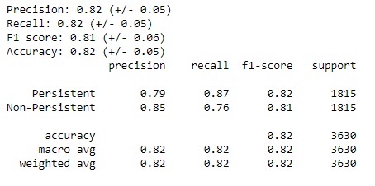
Random Forest Model

Slide 17
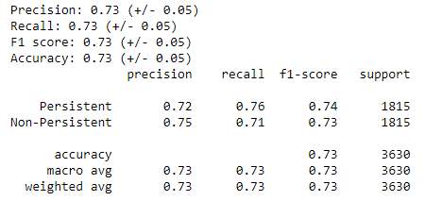
Support Vector Classifier Model

Slide 18
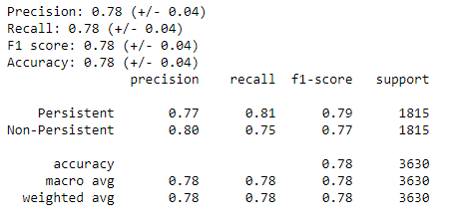
Bernoulli Naïve Bayes Model

Slide 19
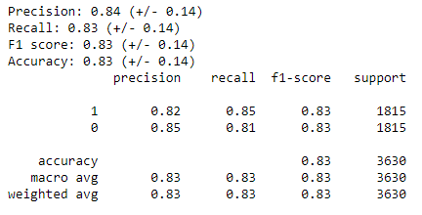
XGBoost Model

Slide 20
Model Performance Metrics
Reporting the accuracy, precision, and ROC-AUC of the classification model
Evaluating the effectiveness of the model in identifying drug persistency

Slide 21
ROC – AUC
ROC-AUC (Receiver Operating Characteristic - Area Under the Curve)
  This metric takes into account both true positive rate (TPR) and false positive rate (FPR), making it a reliable measure of the model's ability to correctly classify drug persistency while minimizing misclassifications.
ROC-AUC is a suitable metric to evaluate the performance of the classification model for drug persistency identification.

Slide 22
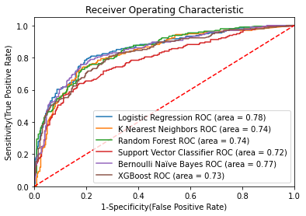
ROC – AUC Curve

Slide 23
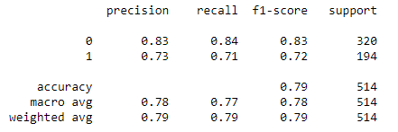


Selected Model
Linear Regression
  Test set result
  AUC = 0.78

Slide 24
Thank You

