Slide 1
Challenges in Using ML for Networking Research: How to Label If You Must
Yukhe Lavinia
University of Oregon
Ramakrishnan Durairajan
University of Oregon
Reza Rejaie
University of Oregon
Walter Willinger
NIKSUN, Inc.
ylavinia@uoregon.edu

Slide 2
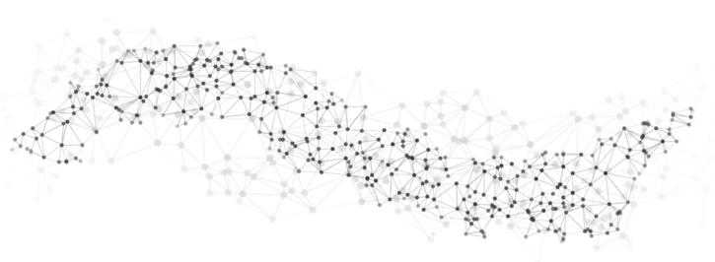

Introduction
Fuel for Machine Learning (ML) research:
data
ML research
labeled
data
ylavinia@uoregon.edu

Slide 3
Outline
Challenges
Contributions
Building blocks
Evaluation
Conclusion
Future work
ylavinia@uoregon.edu

Slide 4



Challenges in using ML in networking
Challenge 1: Lack of labeled networking data
High human cost of labeling
Difficulty in labeling at scale
Networking Data
Label
Lack of agreement in community
?
?
?
Limited number of experts
Large amount of data
Features of good data?
Features of bad data?
Challenge 2: Privacy concern in network data
Collaborate using ML in networking
Safest: avoid a possibility of privacy leaks
Sharing raw or labeled data
Sharing learning models
Challenge 3: Hidden biases in data
Inherent in ML, made complicated by the nature of network data
Lack of representation of minority group, creating a model that does not generalize well
ylavinia@uoregon.edu

Slide 5
Contributions
EMERGE
a framework to dEmocratize the use of ML for nEtwoRkinG rEsearch
Challenge
Solution
Lack of labeled networking data
Create high quality labels at scale in a programmable fashion and at low human labor cost
Privacy concern in network data
Share only learning algorithms
Hidden biases in data
Implement multi-task learning (MTL)
(Future work)
More generalized data representation
Bias reduction
Task 1
Task 2
ylavinia@uoregon.edu

Slide 6

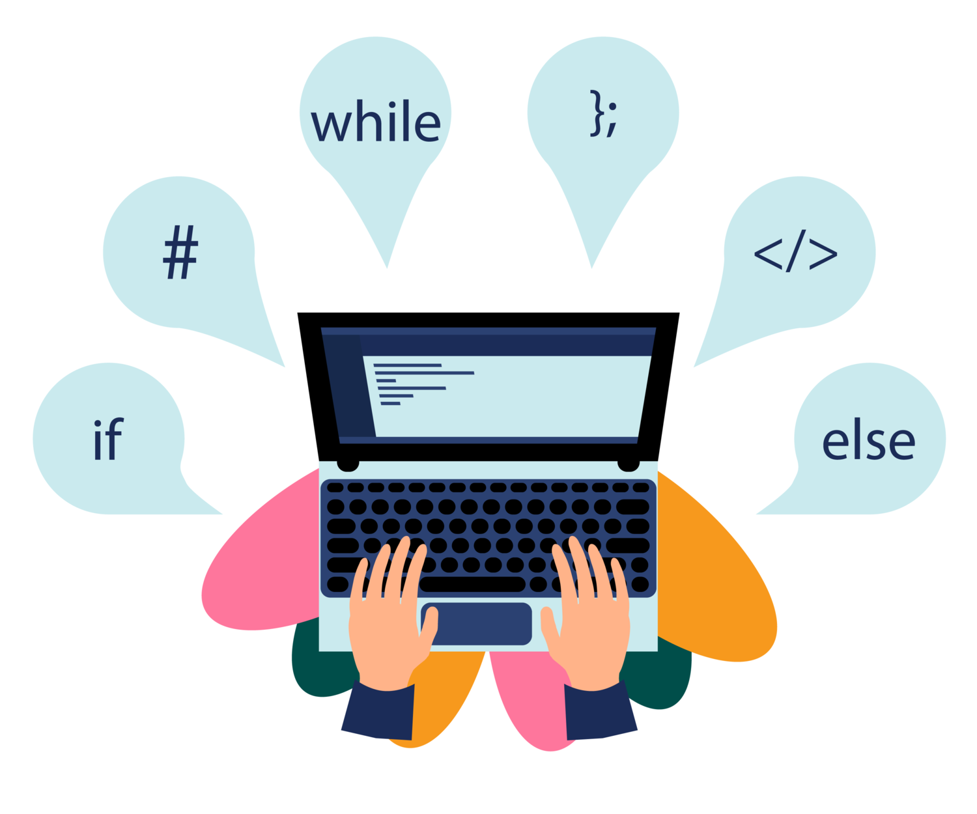
EMERGE
Create high quality networking data labels:
At scale
In programmable fashion
At low human labor cost
Promote:
Privacy-preserving collaboration
Research Group 1
Research Group 2
Research Group 3
Research Group 4
ylavinia@uoregon.edu

Slide 7
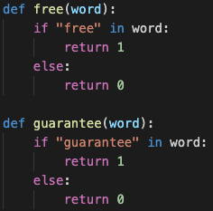

Building Blocks
Labeled data
Low quality, labeled data
Unlabeled data
Weak supervision
Train in supervised setting
Data Programming¹
Data programming framework: Snorkel²
Limitations:
Not specific to networking
Domain
Expert
Scalability issue
Labeling Functions
Probabilistic
Labels
Data amount,
data diversity
Human labor cost
[1] Ratner et al., “Data programming: Creating large training sets, quickly”, Advances in Neural Information Processing Systems (2016) .
[2] Ratner et al., “Snorkel: Rapid training data creation with weak supervision”, VLDB Endowment (2017).
ylavinia@uoregon.edu

Slide 8
Building Blocks
Snuba¹
Low quality, labeled data
Simple ML classifiers
(e.g., logistic regressor, decision tree, nearest neighbor)
Unlabeled data
Probabilistic Labels
Limitation:
Not specific to networking
NoMoNoise²
Solve networking problem: remove noise in latency measurements
Limitation:
Scalability issue
[1] Varma et al., “Snuba: Automating weak supervision to label training data”, Proc. VLDB Endow 2018.
[2] Muthukumar et al., “Denoising internet delay measurements using weak supervision”, ICMLA 2019.
ylavinia@uoregon.edu

Slide 9
EMERGE
Labeled
Data
Data
Prepro-
cessing
Feature
Combi-
Nation
Matrices
Snuba¹
Discriminative
Model
(e.g., LSTM)
Labeled
Data
Unlabeled
Data
Probabilistic
Labels
Optional
Connection
+
Generative
Model
Labeling
Functions
Unlabeled
Data
NoMoNoise²
Goals:
Create high quality labels at scale and at low cost
Promote privacy-preserving collaboration
[1] Varma et al., “Snuba: Automating weak supervision to label training data”, Proc. VLDB Endow 2018.
[2] Muthukumar et al., “Denoising internet delay measurements using weak supervision”, ICMLA 2019.
ylavinia@uoregon.edu

Slide 10
Evaluation
Datasets
Methodology (2 experiments)
Experimental results
Future work
ylavinia@uoregon.edu

Slide 11

Datasets
CAIDA Ark traceroute data
28 source-destination (SD) pairs
75,359 RTT measurements
ylavinia@uoregon.edu

Slide 12
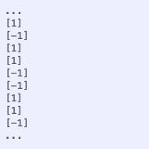
Methodology: Experiment 1
Challenge
Goal
Lack of labeled networking data
Demonstrate that EMERGE can create high quality labels at scale in a programmable fashion and at low human labor cost
Statistical heuristics, outlier detection heuristic, anomaly detection heuristic
Task:
Differentiate good data vs. noise
Naïve
Data preprocessing
LSTM models
F1 score
labels
compare
EMERGE
Data pre-processing
Feature com-bination
LSTM models
F1 score
prob. labels
ylavinia@uoregon.edu

Slide 13
Methodology: Experiment 1
Data Preprocessing
Determine threshold
Record threshold values for the naïve methods
Oversample noise data
Divide data into test, validation, training sets
Create ground truth labels for validation and test data
1
2
3
4
5
Feature Combination
Length
Mean
Median
Variance
Standard deviation
Minimum value
Maximum value
Sum
8 statistical features:
ylavinia@uoregon.edu
13

Slide 14
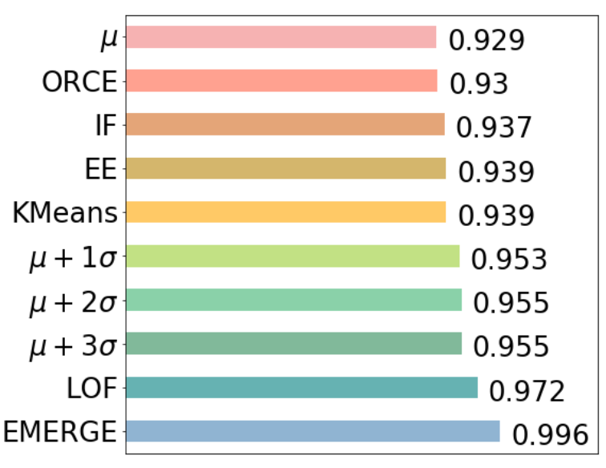

Results: Experiment 1
Unique characteristics in data
More accurate labels
6.7%
Goal:
Demonstrate that EMERGE can create high quality labels at scale in a programmable fashion and at low human labor cost
F1 score
ylavinia@uoregon.edu

Slide 15

Methodology: Experiment 2
Challenge
Goal
Privacy concern in network data
Demonstrate that EMERGE supports privacy-preserving collaboration to advance ML and networking research by sharing only learning algorithms
Task:
Show how researchers from different groups can use EMERGE to collaborate
Research Group 1
Research Group 2
Research Group 3
Research Group 4
LF 1
LF 2
LF 3
LF 4
LFs:
μ
EE
LOF
μ + 2𝞼
LSTM models
F1 score
improve label quality
Combine LFs
prob. labels
ylavinia@uoregon.edu

Slide 16
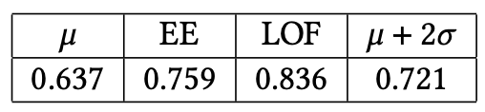
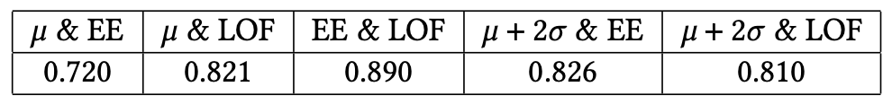
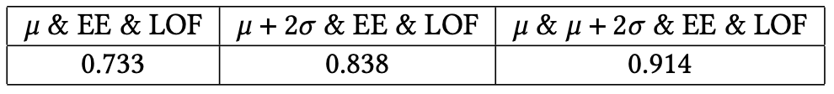
Results: Experiment 2
1 LF
Number of LFs
Learning opportunity
2 LFs
Label quality
3+ LFs
Demonstrate that EMERGE supports privacy-preserving collaboration to advance ML and networking research by sharing only learning algorithms
Goal:
ylavinia@uoregon.edu

Slide 17
Hyperparameter Setup
Different datasets can have different hyperparameter values
Hyperparameter | Values
Batch size | 16, 32, 64, 128, or 256
Learning rate | Between 1e-5 and 1e-2
Number of epochs | 5, 10, 20, 25, or 30
Number of LSTM units | 32, 64, or 128
L2 regularization | Between 0.0 and 0.6
Dropout | 0.0, 0.2, or 0.4
ylavinia@uoregon.edu

Slide 18
Conclusion
Proposed solutions to address the lack of labeled network data, the privacy concern in network data, and the hidden biases in data
Demonstrated:
Create high quality labels at scale, and at low human labor cost
EMERGE
F1 score
>
Naïve
F1 scores
Promote privacy-preserving collaboration that advances ML and networking research
Label quality
LF 1
LF 2
LF 3
LF 4
Combination
Proposed multi-task learning to reduce bias
ylavinia@uoregon.edu

Slide 19
Future Work
Address hidden bias in data using Multi-Task Learning (MTL)
Use other networking data types to assess the versatility of EMERGE
Use different events of interest for EMERGE to detect
ylavinia@uoregon.edu

Slide 20

Thank you!
Code available at https://gitlab.com/onrg/emerge
We thank NSF for funding this project
ylavinia@uoregon.edu

