Slide 1
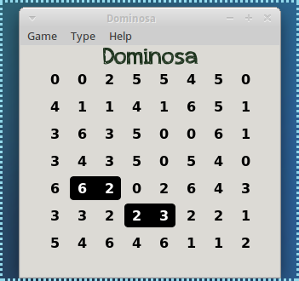
Dominosa
資工所 R04922058 鄭以琳

Slide 2
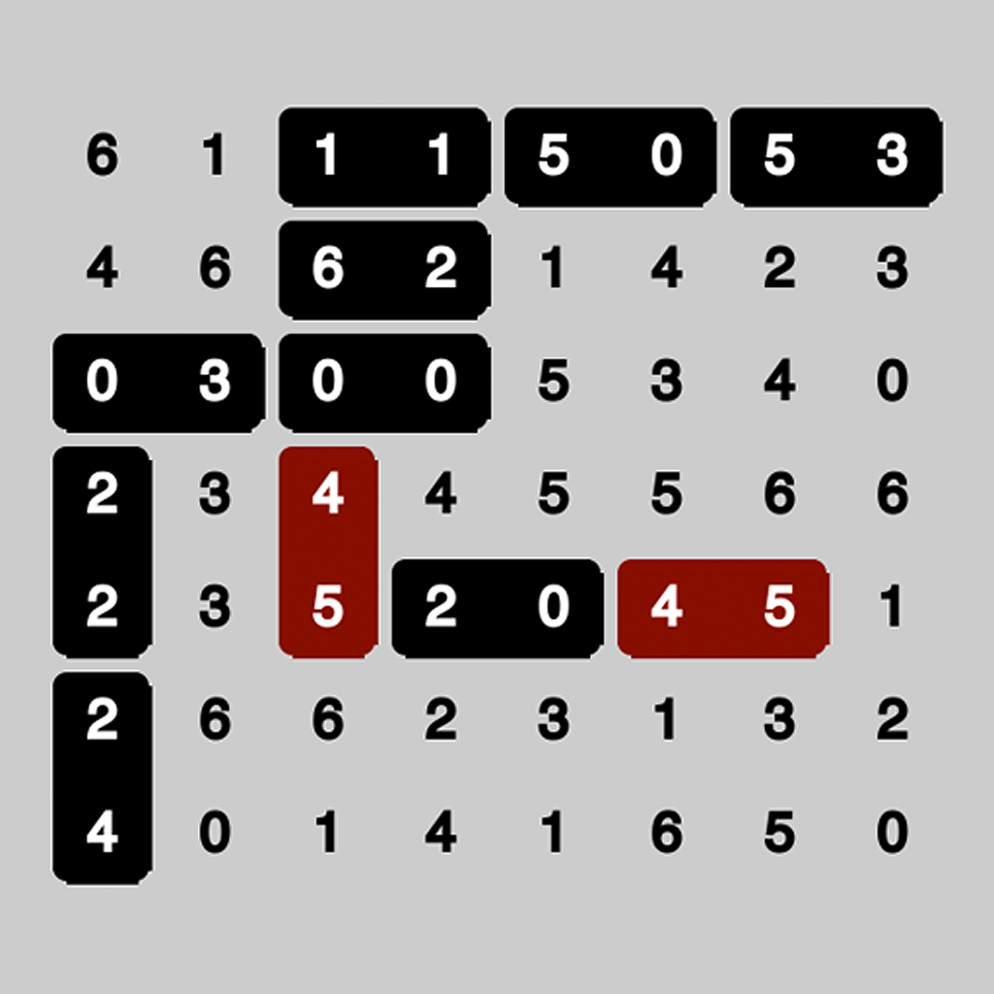
Game Description
Played on an (N+1)*(N+2) board
Circle two adjacent numbers to form a pair
Each possible pair appears exactly once

Slide 3
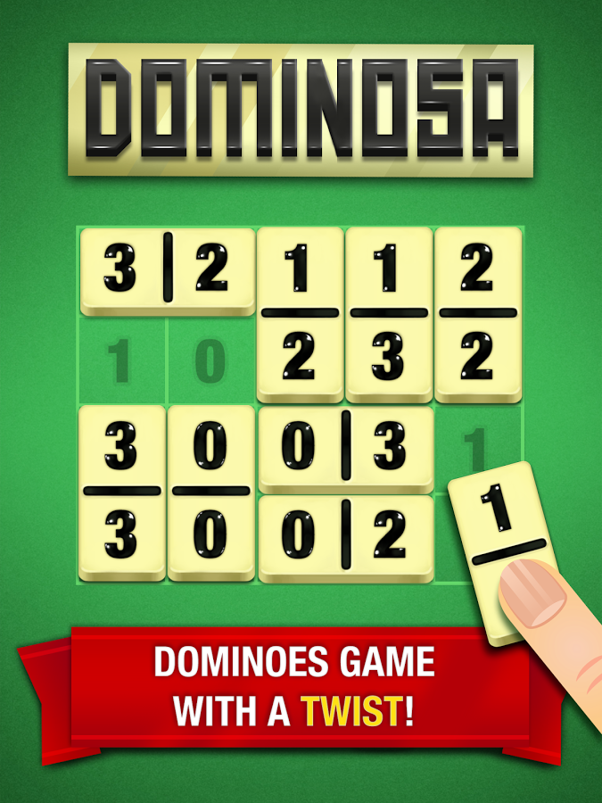
Game History
Created by Richard Osa in 1893
Combine “Domino” with “Osa”

Slide 4
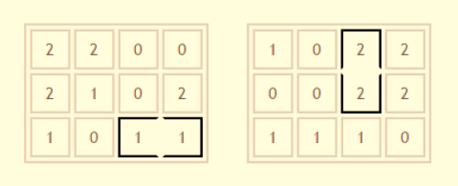
Solving Dominosa Useful Properties
Forced locations
Invalid Circling

Slide 5
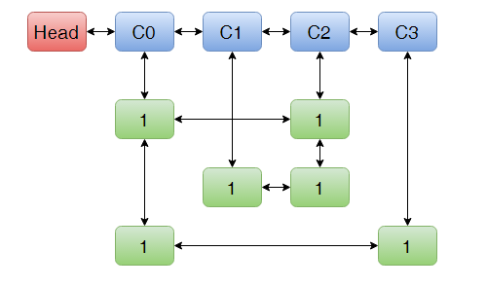
Solving Dominosa Exact Cover Problem
Presented by Donald Knuth
Algorithm X
Dancing Links

Slide 6
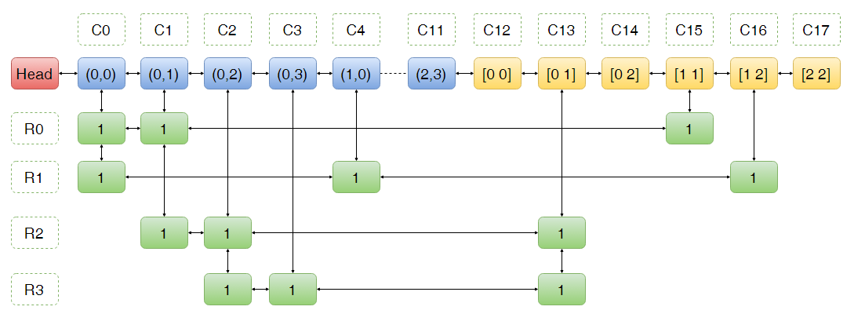
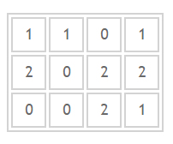
Solving Dominosa Exact Cover Problem
Blue: Grids
Yellow: Pairs
Row: An option of circling

Slide 7
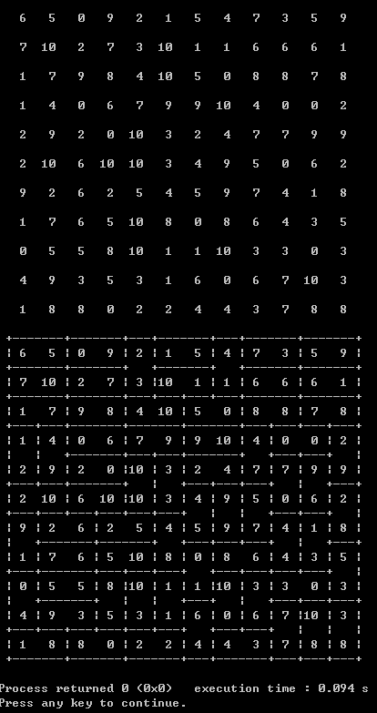
Screen Shot

Slide 8
Demo

