Slide 1
DIGITAL SPEECH PROCESSING
HOMEWORK #1
DISCRETE HIDDEN MARKOV MODEL IMPLEMENTATION
Date: 2016/03/16
Revised by 陳仰德

Slide 2
Outline
HMM in Speech Recognition
Problems of HMM
  Training
  Testing
File Format
Submit Requirement

Slide 3
HMM IN SPEECH RECOGNITION

Slide 4
Speech Recognition
In acoustic model,
  each word consists of syllables
  each syllable consists of phonemes
  each phoneme consists of some (hypothetical) states.
  “青色” → “青(ㄑㄧㄥ)色(ㄙㄜ、)” → ”ㄑ” → {s₁, s₂, …}
Each phoneme can be described by a HMM (acoustic model).
Each time frame, with an observance (MFCC vector) mapped to a state.

Slide 5
Speech Recognition
Hence, there are state transition probabilities ( a_{ij} ) and observation distribution ( bj [ ot ] ) in each phoneme acoustic model.
Usually in speech recognition we restrict the HMM to be a left-to-right model, and the observation distribution are assumed to be a continuous Gaussian mixture model.

Slide 6
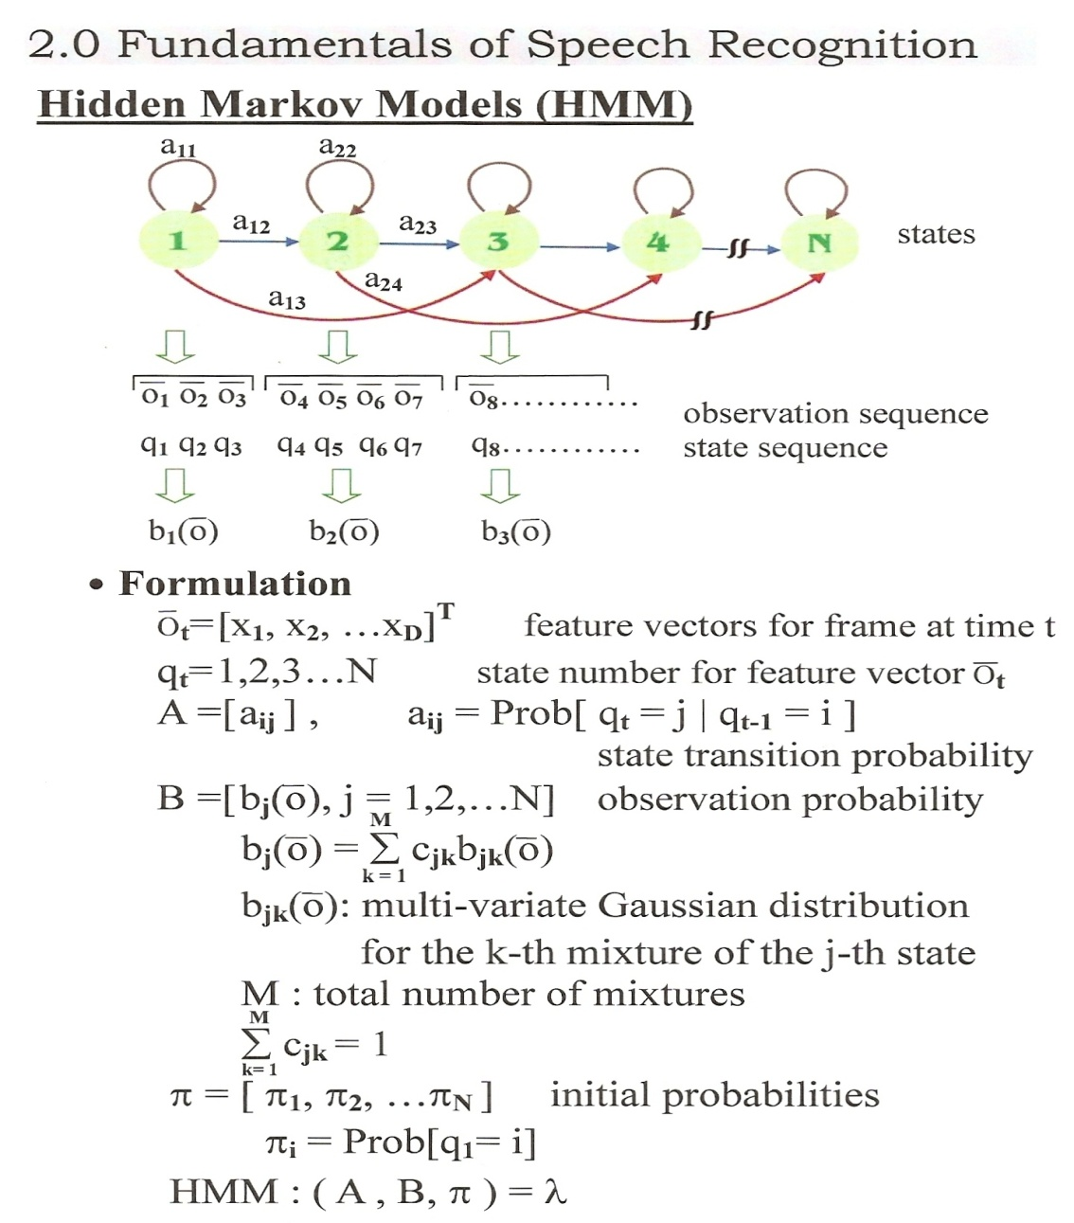
Review
left-to-right
observation distribution are a continuous Gaussian mixture model

Slide 7
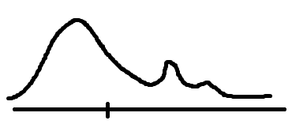
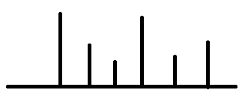


General Discrete HMM
a_{ij} = P ( q_{t+1} = j | q_{t} = i ) ∀ t, i, j .
b_{j} ( A ) = P ( o_{t} = A | q_{t} = j ) ∀ t, A, j .
Given q_{t} , the probability distributions of q_{t+1} and o_{t} are completely determined.
(independent of other states or observation)

Slide 8
HW1 v.s. Speech Recognition
 | Homework #1 | Speech Recognition
λ set | 5 Models | Initial-Final
λ | model_01~05 | “ㄑ”
{o_{t} } | A, B, C, D, E, F | 39dim MFCC
unit | an alphabet | a time frame
observation | sequence | voice wave

Slide 9
Homework Of HMM

Slide 10

Flowchart
testing_data.txt
model_init.txt
model_01.txt
.
.
.
.
seq_model_01~05.txt
train
test
CER
model_05.txt
testing_answer.txt

Slide 11
Problems of HMM
Training
  Basic Problem 3 in Lecture 4.0
    Give O and an initial model λ = (A, B, π), adjust λ to maximize P(O|λ)
    π_{i} = P( q₁ = i ) , A_{ij} = a_{ij} , B_{jt} = b_{j} [o_{t}]
  Baum-Welch algorithm
Testing
  Basic Problem 2 in Lecture 4.0
    Given model λ and O, find the best state sequences to maximize P(O|λ, q).
  Viterbi algorithm

Slide 12
Training
Basic Problem 3:
  Give O and an initial model λ = (A, B, π), adjust λ to maximize P(O|λ)
  π_{i} = P( q₁ = i ) , A_{ij} = a_{ij} , B_{jt} = b_{j} [o_{t}]
  Baum-Welch algorithm
    Calculate α (forward probabilities)
    and β (backward probabilities) by
    the observations.
    Find ε and γ from α and β
    Recalculate parameters λ’ = ( A’ ,B’ ,π’ )
    http://en.wikipedia.org/wiki/Baum-Welch_algorithm

Slide 13
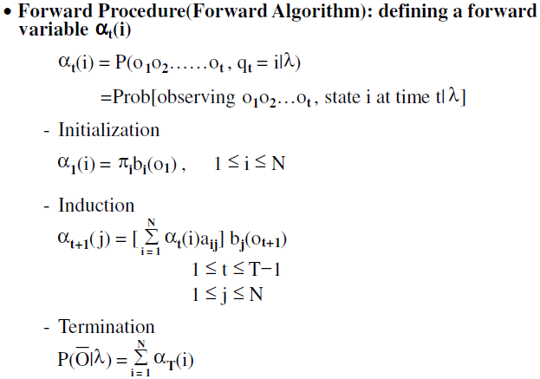
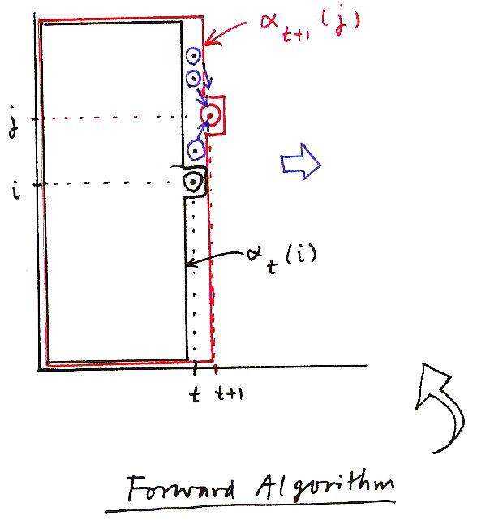
Forward Procedure
α_{t+1}(j)
j
i
α_{t}(i)
t
t+1
Forward Algorithm

Slide 14
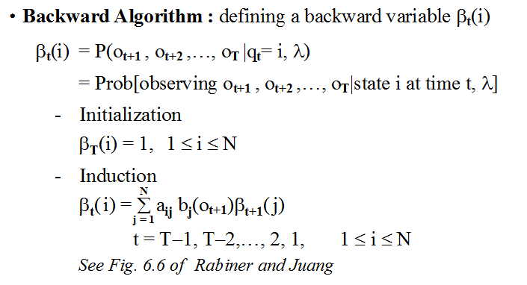
Forward Procedure by matrix
Calculate β by backward procedure is similar.

Slide 15
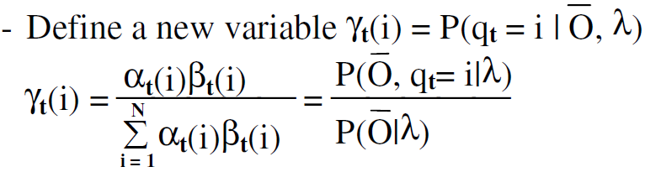
Calculate γ
N * T matrix

Slide 16
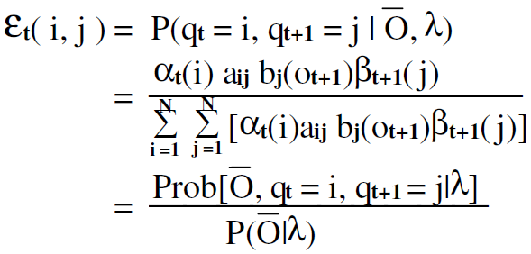
Calculate ε
The probability of transition from state i to state j given observation and model.
Totally (T-1) N*N matrices.

Slide 17
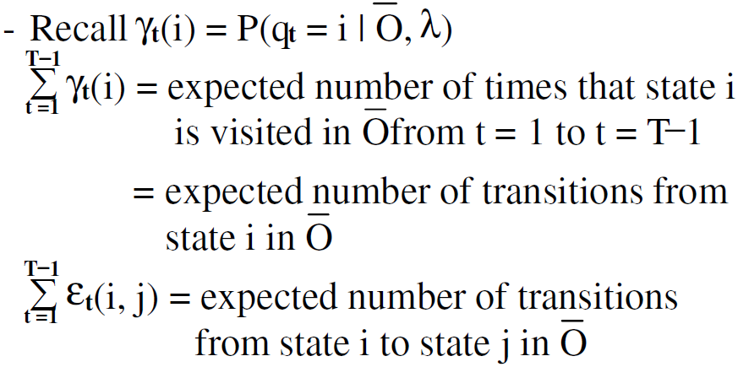
Accumulate ε and γ

Slide 18




Re-estimate Model Parameters
    λ’ = ( A’ ,B’ ,π’ )
Accumulate ε and γ through all samples!!
Not just all observations in one sample!!

Slide 19
Testing
Basic Problem 2:
  Given model λ and O, find the best state sequences to maximize P(O|λ, q).
Calculate P(O|λ) ≒ max P(O|λ, q) for each of the five models.
The model with the highest probability for the most probable path usually also has the highest probability for all possible paths.

Slide 20
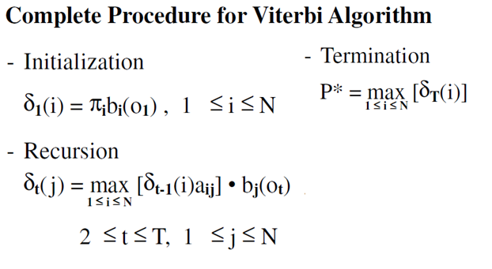
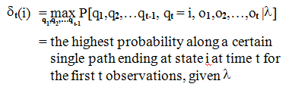
Viterbi Algorithm
http://en.wikipedia.org/wiki/Viterbi_algorithm

Slide 21
Flowchart
testing_data.txt
model_init.txt
model_01.txt
.
.
.
.
seq_model_01~05.txt
train
test
CER
model_05.txt
testing_answer.txt

Slide 22
FILE FORMAT

Slide 23
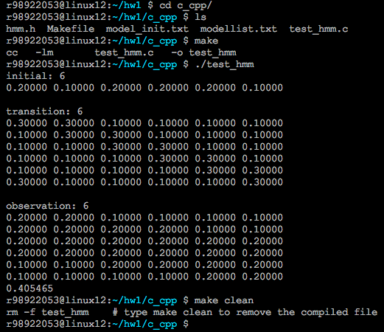
C or C++ snapshot

Slide 24
Input and Output of your programs
Training algorithm
  input
    number of iterations
    initial model (model_init.txt)
    observed sequences (seq_model_01~05.txt)
  output
    λ=( A, B, π ) for 5 trained models
    5 files of parameters for 5 models (model_01~05.txt)
Testing algorithm
  input
    trained models in the previous step
    modellist.txt (file saving model name)
    Observed sequences (testing_data1.txt & testing_data2.txt)
  output
    best answer labels and P(O|λ) (result1.txt & result2.txt)
    Accuracy for result1.txt v.s. testing_answer.txt

Slide 25
Program Format Example
./train iteration model_init.txt seq_model_01.txt model_01.txt
./test modellist.txt testing_data.txt result.txt

Slide 26
Input Files
+- dsp_hw1/
+- c_cpp/
| +-
+- modellist.txt //the list of models to be trained
+- model_init.txt //HMM initial models
+- seq_model_01~05.txt //training data observation
+- testing_data1.txt //testing data observation
+- testing_answer.txt //answer for “testing_data1.txt”
+- testing_data2.txt //testing data without answer

Slide 27
Observation Sequence Format
seq_model_01~05.txt / testing_data1.txt
ACCDDDDFFCCCCBCFFFCCCCCEDADCCAEFCCCACDDFFCCDDFFCCD
CABACCAFCCFFCCCDFFCCCCCDFFCDDDDFCDDCCFCCCEFFCCCCBC
ABACCCDDCCCDDDDFBCCCCCDDAACFBCCBCCCCCCCFFFCCCCCDBF
AAABBBCCFFBDCDDFFACDCDFCDDFFFFFCDFFFCCCDCFFFFCCCCD
AACCDCCCCCCCDCEDCBFFFCDCDCDAFBCDCFFCCDCCCEACDBAFFF
CBCCCCDCFFCCCFFFFFBCCACCDCFCBCDDDCDCCDDBAADCCBFFCC
CABCAFFFCCADCDCDDFCDFFCDDFFFCCCDDFCACCCCDCDFFCCAFF
BAFFFFFFFCCCCDDDFFCCACACCCDDDFFFCBDDCBEADDCCDDACCF
BACFFCCACEDCFCCEFCCCFCBDDDDFFFCCDDDFCCCDCCCADFCCBB
……

Slide 28
Model Format
model parameters.
(model_init.txt /model_01~05.txt )
0 1 2 3 4 5
initial: 6
0.22805 0.02915 0.12379 0.18420 0.00000 0.43481
transition: 6
0.36670 0.51269 0.08114 0.00217 0.02003 0.01727
0.17125 0.53161 0.26536 0.02538 0.00068 0.00572
0.31537 0.08201 0.06787 0.49395 0.00913 0.03167
0.24777 0.06364 0.06607 0.48348 0.01540 0.12364
0.09149 0.05842 0.00141 0.00303 0.59082 0.25483
0.29564 0.06203 0.00153 0.00017 0.38311 0.25753
observation: 6
0.34292 0.55389 0.18097 0.06694 0.01863 0.09414
0.08053 0.16186 0.42137 0.02412 0.09857 0.06969
0.13727 0.10949 0.28189 0.15020 0.12050 0.37143
0.45833 0.19536 0.01585 0.01016 0.07078 0.36145
0.00147 0.00072 0.12113 0.76911 0.02559 0.07438
0.00002 0.00000 0.00001 0.00001 0.68433 0.04579
Prob( q₁=3|HMM) = 0.18420
0
1
2
3
4
5
Prob(q_{t+1}=4|q_{t}=2, HMM) = 0.00913
A
B
C
D
E
F
Prob(o_{t}=B|q_{t}=3, HMM) = 0.02412

Slide 29
Model List Format
Model list: modellist.txt testing_answer.txt
model_01.txt
model_02.txt
model_03.txt
model_04.txt
model_05.txt
model_01.txt
model_05.txt
model_01.txt
model_02.txt
model_02.txt
model_04.txt
model_03.txt
model_05.txt
model_04.txt
…….

Slide 30
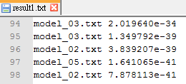
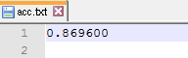
Testing Output Format
result.txt
  Hypothesis model and it likelihood
acc.txt
  Calculate the classification accuracy.
  ex.0.8566
  Only the highest accuracy!!!
  Only number!!!
model_01.txt 1.0004988e-40
model_05.txt 6.3458389e-34
model_03.txt 1.6022463e-41
…….

Slide 31
Submit Requirement
Upload to CEIBA
Your program
  train.c, test.c, Makefile
Your 5 Models After Training
  model_01~05.txt
Testing result and and accuracy
  result1~2.txt (for testing_data1~2.txt)
  acc.txt (for testing_data1.txt)
Document (pdf) （No more than 2 pages）
  Name, student ID, summary of your results
  Specify your environment and how to execute.

Slide 32
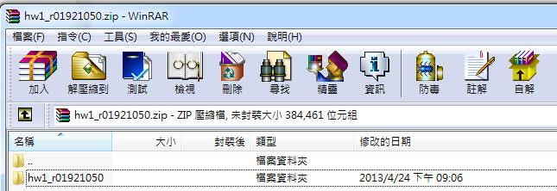
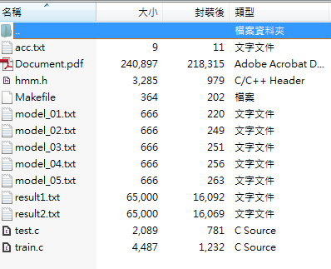
Submit Requirement
Compress your hw1 into “hw1_[學號].zip”
+- hw1_[學號]/
+- train.c /.cpp
+- test.c /.cpp
+- Makefile
  +- model_01~05.txt
+- result1~2.txt
  +- acc.txt
  +- Document.pdf (pdf )

Slide 33
Grading Policy
Accuracy 30%
Program 35%
  Makefile 5% (do not execute program in Makefile)
  Command line 10% (train & test) (see page. 26)
Report 10%
  Environment + how to execute. 10%
File Format 25%
  zip & fold name 10%
  result1~2.txt 5%
  model_01~05.txt 5%
  acc.txt 5%
Bonus 5%
  Impressive analysis in report.

Slide 34
Do Not Cheat!
Any form of cheating, lying, or plagiarism will not be tolerated!
Ｗe will compare your code with others.
(including students who has enrolled this course)

Slide 35
Contact TA
r04942038@ntu.edu.tw 陳仰德
Office Hour: Wednesday 13:00~14:00 電二531
Please let me know you‘re coming by email, thanks!

