Slide 2
Timeline
1960s
Sensorama
1970s
Videoplace
Sword of Damocles
2010s
1980s
1990s
2000s
Cyberspace
Birth of Internet
Term “metaverse” in Snow Crash
(2002) Digital Twins
(2003) Second Life (Online virtual world)
(2009) Bitcoin
(2010) Oculus Rift VR Prototype
(2012) NFT
(2014) Consumer level - VR headset release
(2015) Ethereum
2020s
(2015) Decentraland
(2021) Microsoft Mesh
(2021) Meta Platform

Slide 3
The 7 Layers of the Metaverse
Creator Economy
Human Interface
Infrastructure
Decentralization
Spatial Computing
Discovery
Experience

Slide 4

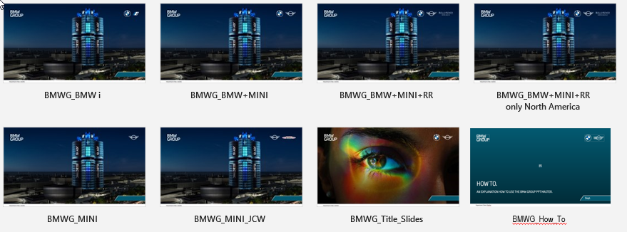
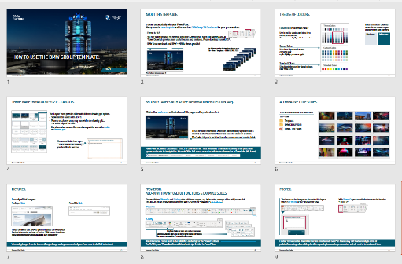
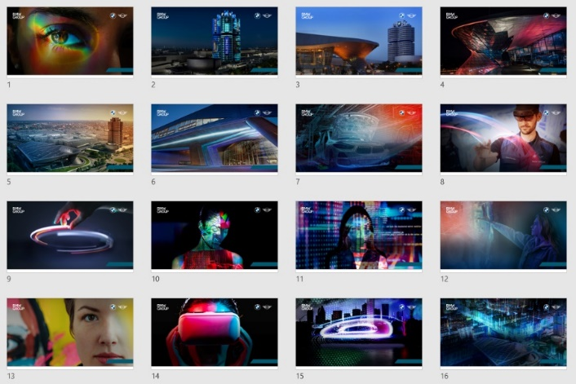

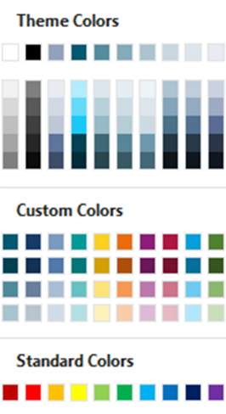
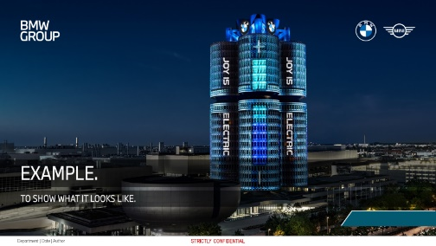

Relevant user information.
Please find additional Masters (for different sender designations), a “How To” document and Title Slides in PowerPoint – file – new…
(Templates)
BMW GROUP 2021:
Use only official imagery.
DAM
Pressclub
BMWG_How_To
BMWG_Title_Slides
With °PowerOn you can easily edit the footer via the function “FOOTER”.
The ribbons °PowerOn, °Gallery and °Chronos offer additional support, e.g. by inserting example slides with just on click. → Get it @ WUSS*
Ocean Blue is our main colour.
If you use text on coloured areas please ensure a good legibility with high contrast.
The blank space is reserved for the Azure Information Protection confidentiality signature which has to be visible on all slides.
White text
Black text
*Search for „PowerOn“

