Slide 1
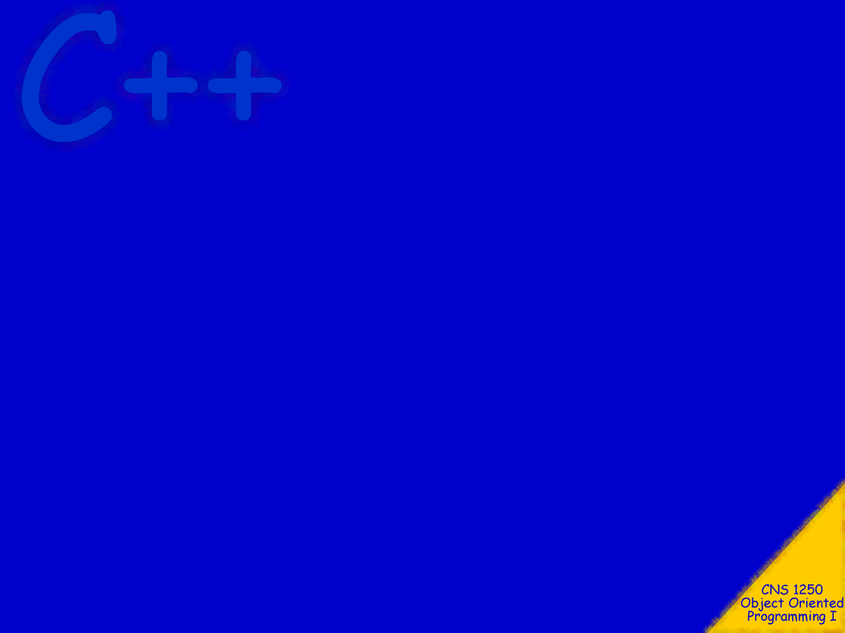
CNS 1250
Storing Data in the Computer

Slide 2
Topics
Computer architecture
Binary Numbers
Data Representation
Computer Instructions

Slide 3
Objectives
After completing this review, students
should be able to:
Convert small integers from binary to decimal notation
Convert small integers from decimal to binary notation
Explain how various types of data are stored in the
computer’s memory.
Explain how and when data conversions occur

Slide 4
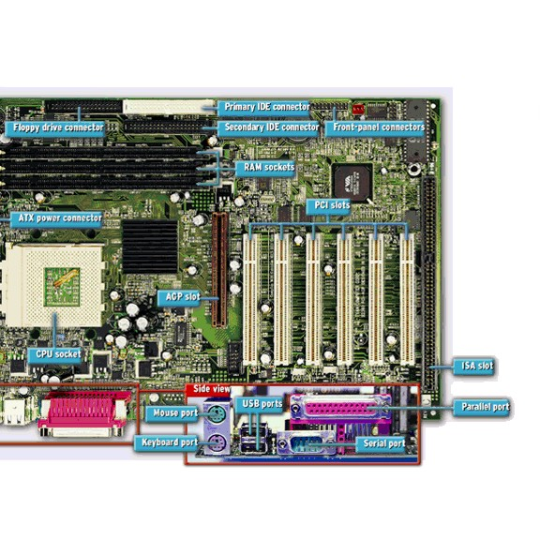
Inside your PC

Slide 5
A Logical View
registers
alu
control unit
CPU
BUS
Secondary
Storage
Main
Memory
Input
Devices
Output
Devices
diskette
hard drive
zip drive
etc
keyboard
mouse
scanner
display
printer
plotter

Slide 6
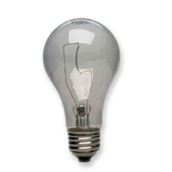

Binary Numbers
computers store information as binary numbers
0
1
Consider a light bulb. It can either be on or off.
Modern digital computers store information in tiny
transistors that are similar, they can either be “on”
or “off”. When a transistor is “on” it represents a
one. When it is “off”, it represents a zero.
This unit of information is called a binary digit, or bit.

Slide 7
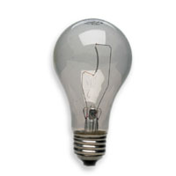
Bytes
a byte is eight bits
7
6
5
4
3
2
1
0
2
2
2
2
2
2
2
2

Slide 8
Bytes
a byte is eight bits
7
6
5
4
3
2
1
0
2
2
2
2
2
2
2
2
0 + 0 + 0 + 0 + 0 + 0 + 0 + 1 x
0
2
= 1 x 1
= 1

Slide 9
Bytes
a byte is eight bits
7
6
5
4
3
2
1
0
2
2
2
2
2
2
2
2
1
0 + 0 + 0 + 0 + 0 + 0 + 1 x
2
+ 0
= 1 x 2
= 2

Slide 10
Bytes
a byte is eight bits
7
6
5
4
3
2
1
0
2
2
2
2
2
2
2
2
1
0
0 + 0 + 0 + 0 + 0 + 0 + 1 x
2
+ 1 x
2
= 1 x 2 + 1 x 1
= 2 + 1
= 3

Slide 11
Bytes
a byte is eight bits
7
6
5
4
3
2
1
0
2
2
2
2
2
2
2
2
What’s this?

Slide 12
Bytes
a byte is eight bits
7
6
5
4
3
2
1
0
2
2
2
2
2
2
2
2
What’s this?

Slide 13
Main Memory
000
001
002
003
004
005
In most modern computers, memory is organized into
sequential memory locations, each holding one byte.
Each byte has an address, used when storing or
retrieving data from that memory location.

Slide 14
Integer Representation
In most modern digital computers, integer numbers are
stored internally in binary. The number of bits used to
store an integer depends on the type of processor in the
computer, but is typically 32 or 64 bits.
Example: the integer 5, when stored
in an Intel Pentium class machine is
00000000 00000000 00000000 00000101

Slide 15
Floating Point Representation
Numbers that contain decimal points are stored
internally in a very different format. The exact
format depends upon the processor used in the
computer, but in general it looks like:
sign
exponent
mantissa or significand
for example, the number 6.045 x 10²³
would have an exponent of 24 and a
mantissa of .6045
The actual binary representation is beyond the
scope of this discussion, but it is somewhat complex.

Slide 16
Character Representation
Characters are stored internally in a coded
format. For example, using the standard
ASCII code, the character ‘A’ would be
stored as 0100 0001.

Slide 17

The ASCII Code Chart

Slide 18
Computer Instructions
Locations in memory can hold both data
and instructions. A special register, called
the program counter points to the next
instruction in memory to be executed. The
computer fetches the next instruction from
memory. The program counter moves to
the next instruction. The computer then
decodes the instruction it just fetched.

Slide 19
Machine Language
We call the instructions stored in computer memory machine language
instructions. They are defined by the chip manufacturer. For example,
the machine instruction
0011001100011010
might mean something like
take the byte stored in memory location 0024 and put
it into register ‘A’.

