Slide 1

Add Two Variables using a Function, add( )
int var1 = 8;
int var2 = 5;
int var3 = add(var1, var2);

Slide 2
Add Two Variables using a Function, add( )
int var1 = 8;
int var2 = 5;
int var3 = add(var1, var2);
The function returns an integer

Slide 3
Add Two Variables using a Function, add( )
The function takes two integers as
arguments
int var1 = 8;
int var2 = 5;
int var3 = add(var1, var2);

Slide 4
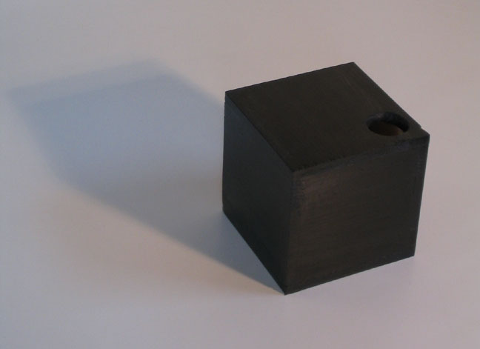

Add Two Variables using a Function, add( )
8
var1
5
var2
var3
add
We will treat the function as a black box

Slide 5

Add Two Variables using a Function, add( )
8
var1
5
var2
var3
add
Make a copy of the variables. We don’t want the
function to touch the original variables.

Slide 6
Add Two Variables using a Function, add( )
8
var1
5
var2
var3
8
add
Make a copy of the variables.

Slide 7
Add Two Variables using a Function, add( )
8
var1
5
var2
var3
8
add
Make a copy of the variables.

Slide 8
Add Two Variables using a Function, add( )
8
var1
5
var2
5
var3
8
add
Make a copy of the variables.

Slide 9

Add Two Variables using a Function, add( )
8
var1
5
var2
var3
5
8
add
Pass the copies of the
Variables to the function

Slide 10
Add Two Variables using a Function, add( )
8
var1
5
var2
8
var3
add
Pass the copies of the
Variables to the function

Slide 11
Add Two Variables using a Function, add( )
8
var1
5
var2
var3
13
add
Get the result

Slide 12
Add Two Variables using a Function, add( )
8
var1
5
var2
var3
13
add
Store the returned value in the
variable that it was assigned to.

Slide 13
Add Two Variables using a Function, add( )
8
var1
5
var2
13
var3
add

Slide 14
Inside of the Black Box
These are the function’s
formal parameters.
int add(int n1, int n2)
{
int sum = n1 + n2;
return sum;
}

Slide 15
Inside of the Black Box
These variables are local to the
function. They only exist inside
of the function.
n1
int add(int n1, int n2)
{
int sum = n1 + n2;
return sum;
}
n2
sum

Slide 16
Inside of the Black Box
5
n1
int add(int n1, int n2)
{
int sum = n1 + n2;
return sum;
}
n2
sum

Slide 17
Inside of the Black Box
5
n1
int add(int n1, int n2)
{
int sum = n1 + n2;
return sum;
}
n2
sum

Slide 18
Inside of the Black Box
8
5
n1
int add(int n1, int n2)
{
int sum = n1 + n2;
return sum;
}
n2
sum

Slide 19
Inside of the Black Box
5
n1
int add(int n1, int n2)
{
int sum = n1 + n2;
return sum;
}
8
n2
sum

Slide 20
Inside of the Black Box
5
n1
int add(int n1, int n2)
{
int sum = n1 + n2;
return sum;
}
8
n2
13
sum

Slide 21
Inside of the Black Box
5
n1
int add(int n1, int n2)
{
int sum = n1 + n2;
return sum;
}
8
n2
13
13
sum

