Slide 1
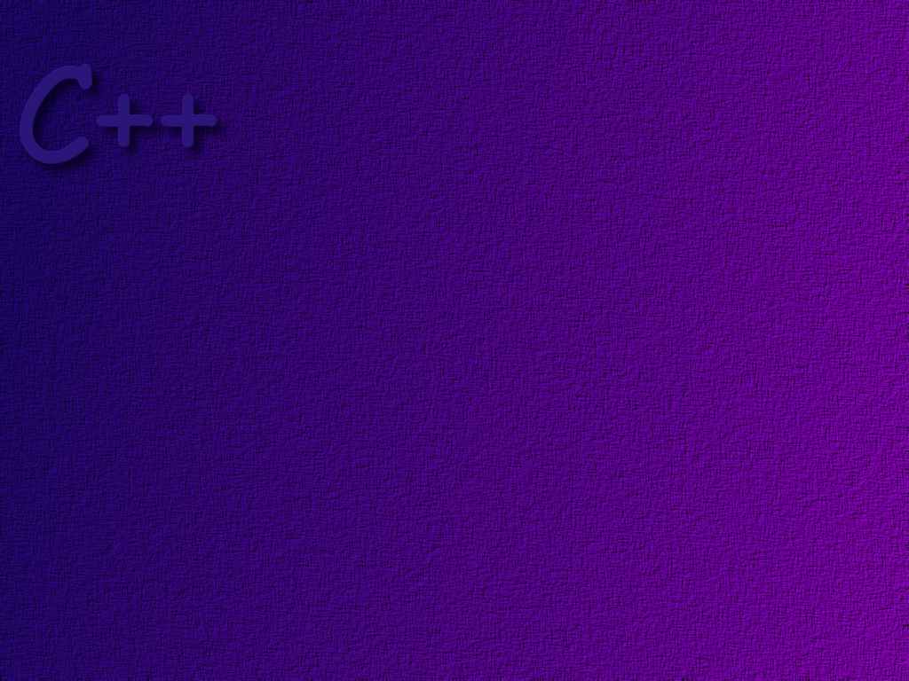
Object Oriented Programming
An Introduction

Slide 2
Topics
Review of Computer Systems
Object Oriented Programming
C++ Structure
Course Style Guidelines
C++ Compiler Demonstration

Slide 3
Objectives
At the completion of this topic, students should be able to
Describe the way that data is stored in the computer
Describe the object model of programming
Describe the basic elements of a C++ program
Create, compile, and execute a simple C++ program
Write programs that conform to the style guide
Describe the use of the data segment, the stack and the
heap to store program data.

Slide 4
Question . . .
Assume that you are able to peek into the memory of your
computer, and you see the bit pattern
00000000 00000000 00000000 01100010
What does this bit pattern mean?

Slide 5
Integer Representation
In most modern digital computers, integer numbers are
stored internally in binary. The number of bits used to
store an integer depends on the type of processor in the
computer, but is typically 32 or 64 bits.
Example: the integer 5, when stored
in an Intel Pentium class machine is
00000000 00000000 00000000 00000101

Slide 6
Floating Point Representation
Numbers that contain decimal points are stored
internally in a very different format. The exact
format depends upon the processor used in the
computer, but in general it looks like:
sign
exponent
Mantissa or Coefficient
for example, the number 6.045 x 10²³
would have an exponent of 24 and a
mantissa of .6045
The actual binary representation is beyond the
scope of this lesson, but it is somewhat complex.

Slide 7
Character Representation
Characters are stored internally in a coded
format. For example, using the standard
ASCII code, the character ‘A’ would be
stored as 0100 0001. Most modern computer
languages support a multiple byte character
code called Unicode.

Slide 8
Computer Instructions
Locations in memory can hold both data
and instructions. A special register, called
the program counter points to the next
instruction in memory to be executed. The
computer fetches the next instruction from
memory. The program counter moves to
the next instruction. The computer then
decodes the instruction it just fetched.

Slide 9
Machine Language
We call the instructions stored in computer memory
machine language instructions. They are defined by
the chip manufacturer. For example, the machine
instruction
0011001100011010
might mean something like
take the byte stored in memory location
0024 and put it into register ‘A’.

Slide 10
Summary
Integers straight binary representation
Real Numbers split into exponent and coefficient
Characters coded bytes – ASCII or Unicode
Instructions coded bytes – machine language

Slide 11
The following data is stored in the computer’s
Memory. Please tell me what the value of the
data is.
0 0 0 1 1 0 0 1 0 0 0 1 1 1 1 0 0 0 1 1 0 0 1 0 1 1 1 1 1 0 0 1
You can’t decipher the data unless you know what
kind of data it is! C++ makes sure that every piece
of data has a well defined type.

Slide 12
Question . . .
What is an Object Oriented Programming Language?

Slide 13
High Level Languages
High level programming languages allow us to
solve computing problems without worrying about
the details of the underlying hardware. Languages
such as C++ use English-like words and normal
arithmetic operator to represent operations we want
to perform.

Slide 14
Procedural Programming
Early programming languages were procedural; Fortran, Pascal, C
Each statement in a procedural program tells the computer to do something.
In simple procedural programs, the computer executes each statement in turn – it is like following a recipe

Slide 15
Functions
A single long list of computer instructions gets quite difficult to manage
Procedural languages provide a way of breaking the program into smaller blocks, where each block does a specific task
These blocks are called functions in C and C++. Other languages use terms like method, procedure, or subroutine

Slide 16
Global Data
y
functions usually declare the data
elements that they need inside of the
function. This is called local data. It
only exists during the time that the
function is being executed.
x
z
Function A
sum
x
y
if two functions need to access
the same piece of data, we have
to make the data global by declaring
it outside of any of the functions.
z
Function B

Slide 17
for example, assume we start out
with a simple integer to represent
a part number, but as our inventory
grows we find we need to use a
string of characters, like 123-ax-4.
when you have many functions
and lots of global data, it is easy
to lose track of what functions
do what to which data
s1
s4
this makes it difficult to
keep a clear picture in your
mind of how the program
works, and makes it very
difficult to make changes
to the program.
s3
s2
s5
z
y
partNo
x
s7
Function A
z
y
x
Function E
z
y
x
z
y
Function B
x
z
y
Function D
x
can you be sure that you
make the change in every
function that uses that data?
Function C

Slide 18
Separating Data and Functions
Separating functions and data into different pots does
not do a very good job of modeling many of the real-
world things we create programs to deal with.
Real-world objects have both data (attributes) and
functions (behavior).

Slide 19

for example, a car has attributes
* it is black
* it has a 200 hp engine
* it has 2 doors
* it was built in 1943
* etc
object-oriented programming
encapsulates the data and the
functions that operate on that
data into an object.
it also has behaviors
* when you turn the key it starts
* when you press the brake it stops
* when you push the horn it beeps
* etc

Slide 20

an object’s functions
manage specific pieces
of data inside the object.
functions outside of
the object cannot see
or manipulate the object’s
data, which is private.
However, they can call
public functions inside
the object to access
the data.
size
color
getSize ( )
function C
getColor( )

Slide 21
Classes
Later on, we will spend much more time talking
about objects and classes. For now, just think
of a class as a blueprint that the computer uses
when creating objects. When we write an object
oriented program, much of our time is devoted to
designing and writing classes.

Slide 22
Languages that primarily deal with objects
are called object-oriented languages.
Pure object oriented languages, like Java,
treat everything as an object.
C++ is sometimes called a hybrid language,
because it has elements of a procedural
language and an object-oriented language.

Slide 23
The C++ Language
Bjarne Stroustrup of Bell Labs
developed the C++ language
in the early 1980’s by adding
object oriented capabilities to
C.
The C Language
The C language is a pure
procedural language. It was
developed at AT&T’s Bell Labs
in the 1970s by Brian Kernihan
and Dennis Ritchie. It was first
used for writing and maintaining
the Unix operating system.

Slide 24
Basic C++ Structure
// Example One – basic program structure
#include <iostream>
using std::cout;
int main( )
{
cout << “Every age has a language of its own.”;
return 0;
}

Slide 25
Comments
// Example One – basic program structure
#include <iostream>
using std::cout;
int main( )
{
cout << “Every age has a language of its own.”;
return 0;
}
Often times we want to add comments to
our C++ code. Comments add clarity to
the code, making it easier to maintain.
In C++ we add comments in two ways:
// begins a one line comment
/* multiple line comments
end with */

Slide 26
Preprocessor Directives
// Example One – basic program structure
#include <iostream>
using std::cout;
int main( )
{
cout << “Every age has a langua
return 0;
}
Pre-processor directives are instructions to
the compiler. The #include is one of the
most often used pre-processor directives.
It tells the compiler to insert the named
file into your source code before compiling
it. In this case we include a header file
for the iostream library. The iostream
library is necessary to do input and output.

Slide 27
using directive
// Example One – basic program structure
#include <iostream>
using std::cout;
int main( )
{
cout << “Every age has a lang
return 0;
}
The using directive is also an instruction to
the compiler. In this case, it tells the compiler
that we are going to use the name cout from
the standard namespace. All of the standard
libraries used with modern C++ compilers put
names used in the library in the standard
namespace, std.

Slide 28
main( )
// Example One – basic program structure
#include <iostream>
using std::cout;
int main( )
{
cout << “Every age has a lan
return 0;
}
When a C++ program is executed, the computer
looks for a function named main( ), and begins
execution there. The program may have many
other functions and classes, but execution always
starts with main( ). If there is no function called
main( ), then an error occurs.

Slide 29
Function Body
// Example One – basic program structure
#include <iostream>
using std::cout;
int main( )
{
cout << “Every age has a language of its own.”;
return 0;
}
The body of a function is enclosed in curly
braces { }. The curly braces must always
be there when writing a function. Otherwise
the function will not compile correctly.

Slide 30
Statements
// Example One – basic program structure
#include <iostream>
using std::cout;
int main( )
{
cout << “Every age has a language of its own.”;
return 0;
}
The statement is the fundamental building block
in a C++ program. This program has 2 statements.
Each statement ends in a semi-colon. Most statements
tell the computer to do something. You could compare
a statement to a sentence in written English.

Slide 31
Return statement
// Example One – basic program structure
#include <iostream>
using std::cout;
int main( )
{
cout << “Every age has a language of its own.”;
return 0;
}
Functions often times return some value to the
caller. In the case of main( ), we return a value of
zero to the operating system. A value of zero tells
the operating system that all is well, the program
terminated normally.

Slide 32
Style
When writing programs in any programming
language, it is helpful to use a consistent
style. Good software development organizations
will often dictate that programmers use a specific
style. This makes it easier for everyone to read
the code that is being developed.
In this course, you are expected to follow certain
style guidelines. They are available on the course
web site.

Slide 33
Style - Identifiers
Use names that have meaning. Avoid single character, very short,
or very long names.
Examples: Meaningful Names Baffling Names
amount a
isFinished xl
Constants
All upper case with words separated by an underscore
Example: SIZE
Classes
Title case (capitalization of the first letter in each word)
Example: SimpleCalc
Function names and Variables
Lower case for the first word and title case for every word thereafter.
Example: makeDeposit( )

Slide 34
Style - Braces
Even though the C++ language does not always require braces
for some statements it is good programming practice to provide
them. Use braces liberally to visually delimit the beginning and
end of code blocks. Including braces now avoids the possibility
of errors creeping into your code when you add additional
statements at the last minute.
Place the opening (left) brace { so that it lines up with the left
side of class headers, function headers, conditional statements,
or repetitive statements. Place the closing (right) brace } in the
same column as the opening brace. Always enter braces in
opening/closing pairs to avoid forgetting to add one or the other
or both. For braces that span more than three to five lines,
comment the ending brace to indicate its nature (e.g., // end if ).

Slide 35
Indentation
As you moved from block to block, indent
at least three spaces. Indentation makes code
much more readable.

Slide 36
Example
void reviewCode( )
{
if ( meetsGuidelines )
{
cout << “Proceed to the next assignment”;
}
else
{
cout << “Rework your documentation”;
} // end if/else
} // end reviewCode( )

Slide 37
Source File Prologue
All source code files should include a prologue of the following form:
// Author: studentName
// Assignment: pNumber
// File: fileName.cpp
// Instructor: InstructorName
// Class: CNS 1250 Section: sectionNumber
// Date Written: the Date
// Description: the description
// --------------------------------------------------------

Slide 38
Your Own Code Declaration
Every source code file must contain the following
declaration. Code that does not contain this
declaration will not be graded!
"I declare that the following source code was written
solely by me. I understand that copying any source code,
in whole or in part, constitutes cheating, and that I will
receive a zero on this project if I am found in violation
of this policy.

Slide 39
Magic Numbers
A magic number is any numeric literal other than 1, 0, or –1
used in your program. However if 1, 0 and –1 are used to
represent something other than the integers 1, 0, or –1 they
will be considered magic numbers. Unfortunately, most code
you will see in C++ books or programming books in general
will include magic numbers because it’s easier to code in the
short run. In the long rung, six months from today, you will
be clueless as to what the number means. Therefore,
DON’T USE MAGIC NUMBERS in your assignments.

Slide 40
Question . . .
How is the memory space inside of your computer organized?
Does it matter to you?

Slide 41
Loading Into memory
the stack keeps track
of the current state of
the program. Local
variables go on the stack.
Parameters are passed on
the stack.
executable instructions
generated by the compiler
go in the program segment
program A
global data is stored
in the data segment
program B
the instruction
register points
to the next
instruction to
be executed
program
segment
program C
data
segment
the heap is left over
memory, not being used
by any program. It is
managed by the O/S.
the heap
stack
reserved for
operating
system

Slide 42
int a = 5;
int b = 3;
main ( )
{
int c;
c = a + b;
}
…
load reg a
add reg b
sto reg c
program
segment
5
a
5
data
segment
5
3
3
b
stack
c
register
8

Slide 43
Practice
Here is some data stored in the memory of the
computer.
0000 0000 0000 1001
What is it’s value?

Slide 44
Practice
Suppose that you needed a Student object
in a course registration program.
What attributes might a Student have?

Slide 45
Practice
What kind of language is C++?
* Object Oriented
* Procedural
* Hybrid

Slide 46
Practice
How do you write a comment in C++?

Slide 47
Practice
What is meant by the term “source code”?
What file extension is used in a C++ source
code file?

Slide 48
Practice
In which part of computer storage is
each of the following stored?
* A global variable
* A local variable
* A dynamic variable
* a constant

Slide 49
Assignment
To complete this discussion, you should complete
Laboratory One that is available on the course web
site. This lab will familiarize you with the use of the
C++ compiler and the process for submitting a project to
webCT for grading.
Lab One is located under the Projects tab on the
CNS 1400 Web Page.

Slide 50

Compiler Demo

