Slide 1
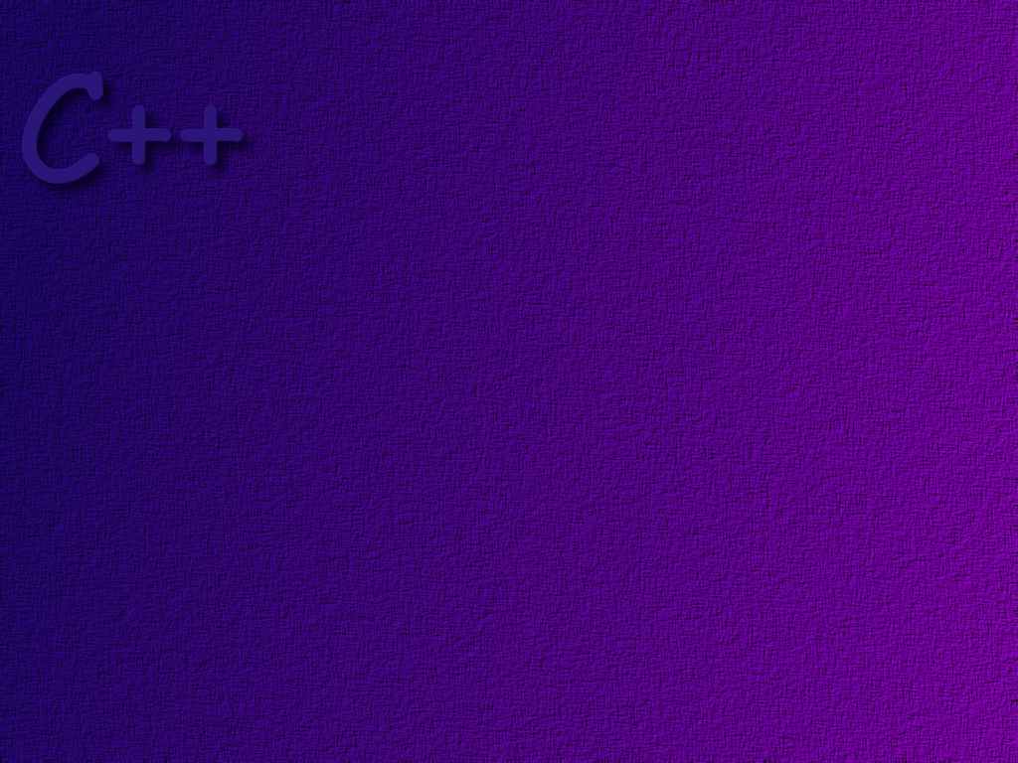
Pointers

Slide 2
Topics
Pointers
Typedef
Pointer Arithmetic
Pointers and Arrays

Slide 3
Objectives
on completion of this topic, students should be able to:
Correctly use pointers in a C++ program
* Take the address of a variable
* Dereference a pointer
* Do pointer arithmetic
Explain the relationship between an array and a pointer
* Use pointers to access array elements

Slide 4
Pointers are one of the most powerful
but most difficult concepts to master in C++.

Slide 5
Assume that we have declared an integer variable
v1, and that the compiler has assigned the memory
location 000032 for that integer value.
000032
v1 is the name of the variable.
We can access the variable by
simply using its name.
v1 = 34;
if integer variables take up 4 bytes
of memory on this computer, then
the address of the first byte of the
integer is 000032.

Slide 6
The address of the variable is 000032.
000032
We can store the address of a variable in a
special data type called a pointer.

Slide 7
The address of the variable is 000032.
000032
The name of the variable is v1.

Slide 8
this statement declares the integer
variable v1. Let us assume that the
address of v1 is 000032.
int v1;
int *v1Ptr;
v1Ptr = &v1;
this statement declares v1Ptr to
be a variable of type integer pointer.
That is, v1Ptr can contain a pointer
to (the address of) an integer.
Note that pointers are typed. This pointer
points to an integer.
this statement stores the address of the variable
v1 in the variable v1Ptr.
The & is called the address-of operator.
To declare a pointer variable, place an
asterisk in front of the variable name.

Slide 9
000032
v1
000036
0 0 0 0 3 2
v1Ptr
v1Ptr is said to point to v1.

Slide 10
int v1;
int *v1Ptr;
v1Ptr = &v1;
*v1Ptr = 45;
cout << v1;
the asterisk used as shown here is
called the de-referencing operator.
This statement says store the value
45 in the variable pointed to by v1Ptr.

Slide 11
000032
4 5
v1
000036
0 0 0 0 3 2
v1Ptr

Slide 12
Be careful when declaring pointers!
int *aptr, bptr;
but bptr is an int!
aptr is a pointer

Slide 13
you must declare them this way!
int *aptr, *bptr;

Slide 14
Assignment
v1
45
000032
int v1, v2;
int *v1Ptr, *v2Ptr;
v1Ptr = &v1;
*v1Ptr = 45;
v2Ptr = v1Ptr;
*v2Ptr = *v1Ptr;
v2
000036
v1Ptr
000032
000040
v2Ptr
000032
000044

Slide 15
Some Other Examples
char *pc; // a pointer to a character
char **pc; // a pointer to a pointer to a character
char *pc[10]; // an array of pointers to characters

Slide 16
void Pointer
Recall that pointers are typed.
int x = 3;
int *xPtr;
float *yPtr;
xPtr = &x;
yPtr = xPtr;
this assignment won’t work
because the pointer types
are not the same!

Slide 17
The void pointer is a generic pointer type. That is, it can
hold the address of any data type. So, we could use a void
pointer to write
int x = 3;
int *xPtr;
void *yPtr;
xPtr = &x;
yPtr = xPtr;
Now this statement will compile
and execute with no errors because
yPtr is a generic pointer.

Slide 18
int x = 3;
int *xPtr;
void *yPtr;
xPtr = &x;
yPtr = xPtr;
cout << *yPtr;
However, this statement will not work.
Because a void pointer is generic, it
does not keep track of what kind of
data it points to. Therefore, the
computer cannot do the conversion
necessary to print out the data pointed to
by the void pointer.

Slide 19
Casting
int x = 3;
int *xPtr;
void *yPtr;
xPtr = &x;
yPtr = xPtr;
cout << *(static_cast<int*>(yPtr) );
If we know what the data type
is that the pointer points to, we
can cast the pointer to the correct
type to make the statement work.
The type we are casting to, in this case an int*
appears in parenthesis in front of the variable
name.

Slide 20
Type Definitions
In C++, you can assign a name to a type definition
and than later use that name to declare variables.
the typedef statement should be
placed outside of any function so
that it is global.
typedef int* IntPtr;
later, when we declare xPtr and yPtr, the name IntPtr is
an alias for int*. Thus, xPtr and yPtr are declared as int pointers.
IntPtr xPtr, yPtr;
typedefs provide no additional function. They are strictly
for style and readability.

Slide 21
Call by Value
Using a pointer as a call-by-value parameter can
be troublesome. Consider the following example
…

Slide 22
typedef int* IntPointer;
void sneaky (IntPointer temp)
{
*temp = 99;
cout << “Inside sneaky! *temp = “
<< *temp << endl;
}
Since this is a pass by value,
you might not expect any side
effects.

Slide 23
int main ( )
{
IntPointer p;
p = new int;
*p = 77;
cout << “Before calling sneaky! *p = “
<< *p << endl;
sneaky ( p );
cout << “After calling sneaky! *p = “
<< *p << endl;
return 0;
}

Slide 24

p
int main ( )
{
IntPointer p;
p = new int;
*p = 77;
cout << “Before calling sneaky! *p = “
<< *p << endl;
sneaky ( p );
cout << “After calling sneaky! *p = “
<< *p << endl;
return 0;
}
77
77

Slide 25
p
temp
77
99
void sneaky (IntPointer temp)
{
*temp = 99;
cout << “Inside sneaky! *temp = “
<< *temp << endl;
}
77
99

Slide 26
p
int main ( )
{
IntPointer p;
p = new int;
*p = 77;
cout << “Before calling sneaky! *p = “
<< *p << endl;
sneaky ( p );
cout << “After calling sneaky! *p = “
<< *p << endl;
return 0;
}
99
99
99

Slide 27
Pointer Arithmetic
Since a pointer is just a normal variable
we can do arithmetic on it like we can for
any other variable. For example …
int *myPtr;
myPtr++; // increment the pointer
myPtr--; // decrement the pointer
myPtr += 4; // add four to myPtr

Slide 28
address
int x, y;
int *aPtr;
aPtr = &x;
*aPtr = 5;
aPtr++;
*aPtr = 8;
x
5
000016
y
8
000020
aPtr
000016
000024
000020
Note: When we increment a pointer, we increment it
by the size of the data type it points to!

Slide 29
Pointers and Arrays
The name of an array is really a const pointer to the first
element in the array!
myArray
int myArray [4];
* myArray is an integer pointer.
* myArray is a const pointer
( so that the address of myArray is
not accidentally lost!)
* myArray can be assigned to a pointer
variable.

Slide 30
#include <iostream>
using namespace std;
int main ( )
{
int intArray[ ] = {1, 3, 5, 7, 9};
cout << "\nintArray = " << intArray;
cout << endl;
system("PAUSE");
return 0;
}
what will this
statement display?

Slide 31
#include <iostream>
using namespace std;
int main ( )
{
int intArray[ ] = {1, 3, 5, 7, 9};
cout << "\nintArray = " << intArray;
cout << “\n*intArray = “ << *intArray;
cout << endl;
system("PAUSE");
return 0;
}
what will this
statement display?

Slide 32
Note the following interesting use of pointers and arrays.
int myArray [4];
int* arrayPtr;
arrayPtr = myArray;
myArray [3] = 125;
*(arrayPtr + 3) = 125;
*(myArray + 3) = 125;
arrayPtr [3] = 125;
the assignment works because
myArray is an int pointer.
use pointer arithmetic to move
the pointer to the 4th element
in the array (3 times size of int)
these are all
equivalent.
aha … you can also use pointer
arithmetic on the array name.
and index notation on the pointer.

Slide 33
Great care should be taken when using
pointer arithmetic to be sure that the
pointer always points to valid data.

Slide 34
Pointers and Strings
Recall that C-style character strings are just
arrays of characters.
Therefore we can use pointer arithmetic to move
through a C-style character string as shown …
char *colorPtr = “blue”;
…
colorPtr++;
…

Slide 35
Functions that Return Arrays
A function cannot return an entire array,
that is, the following is illegal:
int [ ] someFunction ( );
To create a function that achieves the desired
result, write the function so that it returns a
pointer of the base type of the array, for example:
int* someFunction ( );

Slide 36
Practice….

Slide 37
variable
name
address
value in memory
x
1000
int x;
int y;
int *p = &x;
int *q = &y;
*p = 35;
*q = 98;
y
1004
p
1008
q
1012

Slide 38
variable
name
address
value in memory
x
1000
int x;
int y;
int *p = &x;
int *q = &y;
x = 35;
y = 46;
p = q;
*p = 78;
y
1004
p
1008
q
1012

Slide 39
Given the definitions
double values[ ] = {2, 3, 5, 17, 13};
double *p = values + 3;
Explain the meaning of:
values[1]
values + 1
*(values + 1)
p[1]
p + 1
p - values

Slide 40
Suppose that you had the char array
T h i s i s g o o d .
and you put a null
terminating character here
if you had a pointer,
cPtr, that pointed here
then the statement
cout << *cPtr;
would display the word is

Slide 41
Dynamic Memory Allocation
Review: Consider the following code:
int valueOne = 10;
int someFunction( )
{
int valueTwo = 5;
. . .
}
int main ( )
{
. . .
this is a global variable
it is stored in the data segment.
this is a local variable
it is stored on the stack.

Slide 42
Dynamic Memory Allocation
Review: Consider the following code:
int valueOne = 10;
int someFunction( )
{
int valueTwo = 5;
. . .
}
int main ( )
{
. . .
valueOne exists for the entire life
of the program.
valueTwo comes into existence when it
is declared, and disappears when the
function ends.

Slide 43
What if you want to control when a variable
comes into existence, and when it goes away!

Slide 44
This is a pointer.
This variable is stored on the heap.
Storage from the heap is allocated dynamically
as your program executes,
int* a = new int;
CoinBank* myBank = new CoinBank(5,3);
These variable come into existence when they are declared.

Slide 45
delete
Dynamically allocated variables will stay around until you explicitly
delete them. Thus, they are completely under programmer control.
To delete a dynamically allocated variable you would write
delete a;
where a was a pointer to the variable.

Slide 46
Dynamic Arrays
Recall that when we talked about arrays, we noted that the
array size given in the array declaration had to be a constant
value. That is, the array size had to be fixed at compile time.
This presents some difficulties:
* either we guess too low and the array is not big enough
to hold all of the data required, or
* we guess to high and we waste space because elements
of the array are not used.

Slide 47
One approach to solving this problem is to allocate
the storage required for the array at run-time.
int size;
cout << “How big is the array?”;
cin >> size;
int *myArray;
myArray = new int [size];
since we are allocating storage at run-time,
we are allowed to use a variable as the array
size.

Slide 48
Now, remembering the relationship between an array name
and a pointer, we can use the dynamic array just like a normal
array…
myArray [5] = 15;
cout << myArray[n];

Slide 49
delete [ ]
Whenever you use [ ] with new to allocate an array dynamically,
you must use the corresponding form of the delete, delete [ ].
That is, if you write
int *myArray;
myArray = new int [10];
You must write
delete [ ] myArray;
to delete the array!

Slide 50
The -> Operator
When we dynamically storage for an object or
a struct, we no longer use the dot operator to
access its data members. Instead we use the
-> operator.
piggyBankPtr = new PiggyBank;
piggyBankPtr->moneyInBank = 12.45;

Slide 51
The this Pointer
Every object that you create has an implicit data member that
carries the address of the object. This pointer is called the
this pointer. The this pointer can be used by member functions
that need the address of the calling object.
void CoinBank::displayMoney( )
{
cout << this->moneyInBank;
}
note that we seldom use the this pointer this way.
It is simpler to write
cout << moneyInBank;

Slide 52
variable
name
address
value in memory
p
1008
int *p;
int *q;
p = new int;
q = p;
*p = 46;
*q = 39;
delete p;
cout << *p << “ “ << *q;
q
1012

Slide 53
int *p;
int *q;
p = new int[5];
*p = 2;
for (int j = 1; j < 5; j++)
p[j] = j + 3;
q = p;
delete [] p;
for (int j = 0; j < 5; j++)
cout << q[j] << “ “;
variable
name
address
value in memory
p
1008
q
1012

Slide 54
Find the mistakes…
int *p = new int;
p = 5;
*p = *p + 5;
Employee e1 = new Employee(“Hacker”, “Harry”, 34000);
Employee e2;
e2->setSalary(38000);
delete e2;
Time *pnow = new Time( );
Time *t1 = new Time(2, 0, 0);
delete *t1;
cout << t1->getSeconds( );

