Slide 1
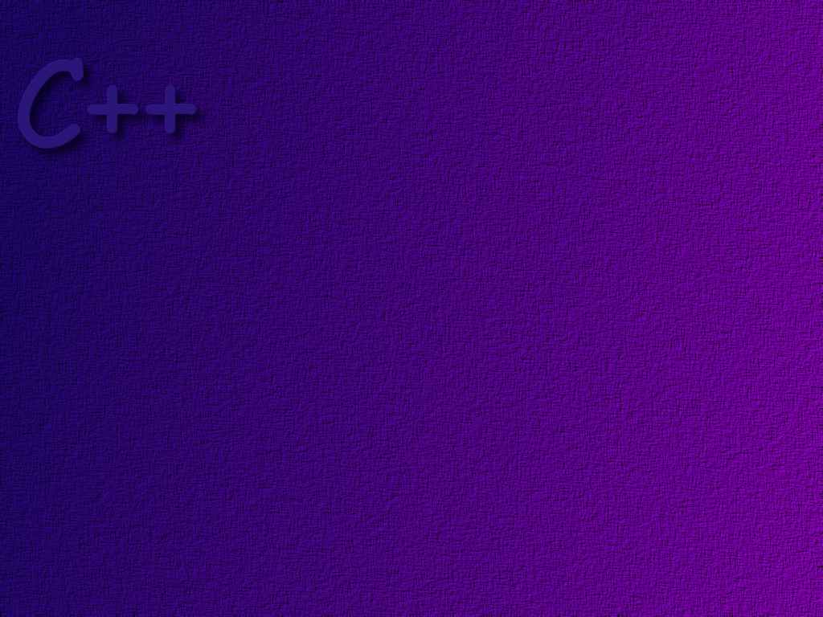
Working With Primitive Data

Slide 2
Topics
Primitive data types
Variables and constants
Declarations
Assignment
input and output

Slide 3
Objectives
At the completion of this topic, students should be able to:
Create proper identifiers in a C++ program
Describe the difference between an object and primitive data
Describe the primitive data types in the C++ language
Write C++ programs that correctly
* Use declarations
* Use assignment statements
* use literal data
* use cin and cout
* format simple floating point data

Slide 4
Identifiers
The name that you use to refer to a piece of data
or a function in C++ is called an identifier.
A C++ identifier must begin with either a letter
or an underscore character.
The remaining characters may be letters, digits, or
the underscore character. All other characters are
invalid.
Identifiers can be of any length.
Identifiers are case sensitive.

Slide 5
Keywords
C++ has a set of built in keywords that are considered to
be part of the language. You cannot use any of these as
identifiers in your program. A complete list can be found
in your book. Examples include
bool
break
char
class
const
do
…

Slide 6
A C++ program manages two general
kinds of information
Primitive Data
the most basic forms of data - numbers and characters
Objects
more complex data – usually composed of
many pieces of primitive data

Slide 7
Primitive Data
Primitive data elements all have a data type
The data type defines the possible set of values
that a primitive data element can have, and the
operations that can be performed on the data.

Slide 8
Numeric Data Types
The amount of storage allocated to various
data types is not defined by the C++ language,
but is dependent upon the underlying hardware.
The following are examples only, and may differ
on your computer.
Type Storage Max Value
short 16 bits -32,766 to 32,767
int 32 bits - 2,147,483,646 to 2,147,483,647
long 32 bits - 2,147,483,646 to 2,147,483,647
float 32 bits over 10³⁸
double 64 bits over 10³⁰⁸
integer
types
real
types
there are unsigned version of each of these.

Slide 9
Integer Numbers
Integers are whole numbers they have no
fractional part.
The most common integer data type is int
Integer operations include
addition
subtraction
multiplication
division
remainder
assignment

Slide 10
Real Numbers
Real numbers have fractional parts
Real numbers are often written in scientific format
The most common real data type is double
Operations on real numbers include
addition
subtraction
division
multiplication
assignment

Slide 11
Character Data
When interpreted as a character, certain bit patterns
represent printable characters and control characters.
Different standards exist for encoding characters
The ASCII standard, finalized in 1968, uses 7 bits for each character.
In the ASCII standard, 1000001 is interpreted as the character ‘A’.
7 bits only allows for the definition of 128 unique characters. Subsequent
standards (ISO8859 and ISO10646) define much larger, multi-national
character sets. However, both are supersets of ASCII.
Character data is defined by the keyword char

Slide 12
Control Characters
Control characters are characters that do
not print, but cause some action, such as moving
to a new line, to occur. In C++ we write control
characters as a backslash, followed by a character
that denotes the action to be taken.
\b backspace
\t tab
\n new-line
\r carriage return

Slide 13
Boolean Data
A Boolean piece of data can only have one
of two values:
true
false
Boolean data is defined by the keyword bool

Slide 14
Variables and Constants
A variable is a name for a memory location
that holds some piece of data. The value
stored in that location may change during
execution of the program.
A constant is a name for a memory location
that holds some piece of data, where the
value of the data will not change during
execution of the program.

Slide 15
Declarations
In C++, all variables and constants must be declared
before they are used in the program.
C++ is what is known as a strongly typed language.
This means that we must tell the compiler what the
data type is for every variable. The compiler then
checks all operations to make sure that they are
valid for the given type of data.

Slide 16
Declaring a Variable
this statement reserves
space in computer memory
for an integer. We can then
refer to the data in this location
using the name “someNumber. ”
C++ does not initialize variables.
int someNumber;
char firstLetter;
bool theAnswer;
float density = 12.45;
int hoursWorked = 14;
char key = ‘g’;
this statement reserves
space in computer memory
for a character. The bit pattern
for ‘g’ is then stored in that
location. We can now refer to the
data in this location using the name
“key”

Slide 17
Declaring a Constant
The keyword const means that this is a constant.
You cannot change the value after it is declared.
const float PI = 3.1416;
const int SCALE_VALUE = 14;
We normally use all upper case
letters when writing the name of
a constant.

Slide 18
Floating Point Constants
Consider the following declaration:
const float PI = 3.14159F;
the decimal signals that this
is a real number
the F signals that this literal
value is a float data type and
not a double (the default).

Slide 19
Assignment
The easiest way to change the value of a variable
is to use an assignment statement.
temperature = 68.4;
note that all statements
end with a semicolon.
the expression on the right
side of the operator is evaluated
and the resulting value is stored
in the storage location allocated
to the variable “temperature”
the right hand side of the assignment
statement may be a literal value, or
an expression involving variables, literal
values, and operators, or even function.
calls.
lvalue
rvalue

Slide 20
Assignment Compatibility
In general, it is invalid to assign a variable of one type
to a variable of another. For example,
int a = 6.52;
Compiler will issue the warning
“conversion from 'double' to 'int', possible loss of data”
This means that the code will compile, but may not produce
the results expected.

Slide 21
Un-initialized Data
In C++, no initialization is done when a data element is
declared. The value of that data element will be based
on whatever bits happen to be in that storage location
when your program starts execution. It will likely be
something left over from another running program!
So …… always initialize data when it is declared.

Slide 22
Initializing Data
int numOne = 5, numTwo = 4, numThree = 17;
int numOne (5), numTwo (4), numThree (17);
int numOne = 5;
int numTwo = 4;
int numThree = 17;

Slide 23
Literal Data
In the statement
sum = a + 5;
the value 5 is what is called literal data.
It is good programming practice to use constants
instead of literal data in your program.
Exceptions are 1 and 0
const int MAX = 5;
.
.
.
sum = a + MAX;

Slide 24
Some Convenient Objects
We introduced the notion of an object in the last slide set.
C++ has built in to it some objects that will make our
programming tasks much easier. The first of these we
will introduce are cin and cout

Slide 25

cin
cin an object of the istream class (#include iostream),
this object represents the standard input stream. The
cin object is created automatically for you.
keyboard buffer
keyboard buffer
cin
program

Slide 26

cout
cout an object of the ostream class, this object
represents the standard output stream.
display buffer
output buffer
cout
program

Slide 27
The Stream Insertion Operator, <<
a binary operator
the left hand operand must be an output stream
the right hand operand
  is converted into text
  the text data is then copied into the stream

Slide 28
the integer 5
int a = 5;
a
0000 0000 0000 0101
cout << a;
the character 5
0000 0000 0011 0101
display buffer
5
cout

Slide 29
multiple pieces of data are output by
cascading the << operator …
cout << “The answer is “ << a;

Slide 30
special characters are added to the stream
using the escape character \
\t
\n
etc …
cout << “The answer is “ << a << ‘\n’;

Slide 31
the endl stream manipulator can be added to the output
stream. It does two things:
It adds a new line to the stream.
It forces the buffer to be output
cout << “Hello” << endl;

Slide 32
Formatting Numbers
When outputting numbers with fractional parts
we have to take care to make the output appear
just as we would like it. This does not happen
automatically.

Slide 33
To display a double or a float in standard decimal notation
The default formatting, is the
“general” format. In this case
precision defines the number of
digits in total to be displayed
cout.setf(ios::fixed);
cout.setf(ios::showpoint);
cout.precision(2);
setf( ) is a function in the cout object. It is responsible for
setting formatting flags. We will study these in much more
detail in a later section. In this case, we are setting the
ios::fixed flag. This makes the output appear as a normal
decimal number instead of in scientific notation.
the ios::showpoint flag guarantees that a decimal point
will be displayed in the output.
the cout.precision( ) function determines how many digits
will be displayed after the decimal point.

Slide 34
Example
double price = 78.5;
cout.setf(ios::fixed);
cout.setf(ios::showpoint);
cout.precison(2);
cout << “The price is $” << price << endl;

Slide 35
The stream extraction operator, >>
Also a binary operator
The left operand must be an input stream
Any initial white space is skipped, then the stream is read up to the
next white space character ( tab, space, new-line )
If necessary, the text just read is converted to match the type of the right operand. An error occurs if the conversion cannot be done.
The data is stored in the right operand

Slide 36
a
0000 0000 0000 0101
int a;
cin >> a;
the character 5
0000 0000 0011 0101
keyboard buffer
cin
5 72 hello
reading stops when white space is encountered

Slide 37
you can also cascade the stream extraction operator:
cin >> a >> b;

Slide 38
You can control the size of an input field with
the setw( n ) stream manipulator.
cin >> setw(5) >> title;

Slide 39
cin.get
The get function of the istream class works similar
to the stream extraction operator. With no parameter,
it gets one character from the input stream.
cin.get( );
This following will read at most MAX-1 characters from the
input stream, or until a newline character is encountered.
The text is stored in the character array cha. The newline
character remains in the stream.
cin.get(cha, MAX, ‘\n’);

Slide 40
cin.getline( )
This function works like cin.get, except that the
newline character is read from the buffer. It is then
discarded.
cin.getline(cha, MAX, ‘\n’);

Slide 41
Practice
Name the basic C++ data types.

Slide 42
Practice
Name two objects that we have learned about in this
lesson. To what class do they belong?

Slide 43
Practice
Which operator is used to convert data into its
character representation and output it to the
standard output device?

Slide 44
Practice
Write a program that prints the message
“Hello, my name is Hal”.
Then the program will prompt the user for his
or her first name. It then Will print
“Hello, user name, how are you?”

Slide 45
Practice
Write a program that prints the message
“Hello, my name is Hal”.
Then the program will prompt the user for his or her name.
It then Will print
“Hello, user name, how are you?”
Prompt the user to type in their age. Then print
“user name, you are n years old”

Slide 46
Practice
Write a program that prints the message
“C++ Rocks!”.
Inside a rectangle. Use |, +, and – to draw the rectangle.
Your output should look like
+-------------+
| C++ Rocks |
+-------------+

Slide 47
Practice
Write a program that prints out the sum of the reciprocals
of the first ten positive integers.
We use + to add.
The reciprocal of an integer is one divided by the integer,
So, for example, the reciprocal of 5 would be 1/5.
Check the answer with a calculator.

