Slide 1
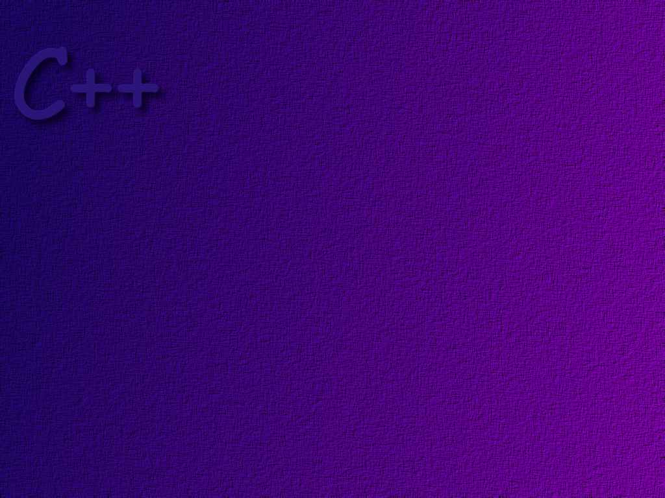
Expressions

Slide 2
Topics
Arithmetic expressions
Conversions
Operator precedence
String class

Slide 3
Objectives
At the completion of this topic, students should be able to:
Correctly use all arithmetic operators in a C++ program
Correctly write arithmetic expressions in a C++ program
and be able to explain how expressions are evaluated
Explain how and when data type conversions are done in C++
Correctly use type casting in a C++ program
Understand how operator precedence affects the evaluation
of an expression in a C++ program, and know the precedence
of arithmetic operators in C++
Correctly use objects of the string class in a program

Slide 4
Arithmetic Expressions
Expressions are combinations of operators and
operands that define some operation to be
performed by the computer.
sum = numOne + numTwo;
area = PI * radius * radius;
we usually put a space on either side of the
operator to make the expression more readable.

Slide 5
Arithmetic Operators
operator meaning example
+ plus c = a + b;
- minus c = a – b;
* times c = a * b;
/ divide by c = a / b;

Slide 6
Remainder Operator
The remainder operator is the % symbol
It only works with integers
Sometimes called the modulus operator
int a = 5;
int b = 3;
int c = a % b;
the result is 2 … divide 5 by 3, the remainder is 2.
The sign of the result is the same as the sign of the numerator,

Slide 7
Arithmetic Assignment
Instead of writing
total = total + 3;
we can use the arithmetic assignment operator
total += 3;
the expression is the same as
total -= 3; total = total -3;
total *= 3; total = total * 3;
total /= 3; total = total / 3;
total %= 3; total = total % 3;

Slide 8
Increment Operator
Adding one to a variable is done so often in
programs that a shortcut method has been
provided in C++ to write it.
Instead of writing
total = total + 1;
we can write
total++;

Slide 9
pre- and post-increment
Using the increment operator is complicated by the
fact that you can do a pre-increment or a post-increment.
total++ post-increment
++total pre-increment
What’s the difference? This is best illustrated by example.

Slide 10
Consider the following statements:
int height = 5;
int length = 4;
int total = height * length++;
total
height
length
20
5
4
5
The increment is done after the multiplication.

Slide 11
Consider the following statements:
int height = 5;
int length = 4;
int total = height * ++length;
total
height
length
25
5
4
5
The increment is done before the multiplication.

Slide 12
Decrement Operator
Instead of writing
total = total – 1;
we can write
total--;
There is a pre and a post-decrement.

Slide 13
Mixed Data Types
area = width * height;
an operator, like * has two operands.
It is called a binary operator.
long double
double
float
long
int
short
char
the operands may not be of the same type.
If they are not, C++ tries to make sense of
the operation by converting one operand so
that it matches the other. It will always convert
to a ‘higher’ data type if required.

Slide 14
Example
int count = 7;
float avgWeight = 155.5F;
double totalWeight = count * avgWeight;
totalWeight
avgWeight
count
=
155.5
7
1088.5
*
avgWeight
155.5
*
7.0
temporary float variable
1088.5
temporary float variable

Slide 15
Data Conversion
Remember that all data in C++ is typed
Sometimes it is necessary to change data from one
data type to another.
There are two types of conversions:
Widening Conversions
the new type uses an equal or greater amount of storage
for example, converting a byte to an int.
Narrowing Conversions
the new type uses less storage

Slide 16
Widening Conversions
From To
char short, int, long, float, double, long double
short int, long, float, double, long double
int long, float, double, long double
long float, double, long double
float double, long double
note: converting an int to a float or a long
to a double may result in a loss of precision.

Slide 17
Narrowing Conversions
From To
short char
int short, char
long short, char, int
float short, char, int, long
double short, char, int, long, float

Slide 18
Conversions Occur
When a value of one type is assigned to a variable
of a different type.
When a value must be promoted to a different type
in order for an operation to work correctly.
When the programmer explicitly casts a value to
a different type.

Slide 19
Assignment Conversion
Assignment conversions only work
if the conversion is a widening conversion!
int dollars = 42;
float money;
money = dollars;
float money = 42.50;
int dollars;
dollars = money;
compiler warning!

Slide 20
Arithmetic Promotion
float sum = 25.50;
int count = 5;
result = sum / count;
In order for the computer to do this division,
both numerator and denominator must be
real numbers. So, count is first promoted to
a float, then the division is performed.

Slide 21
Type Casting
Casting is used to explicitly convert from one
data type to another. Casts can do both widening
and narrowing conversions.
int dollars;
float money = 35.50;
dollars = (int) money;
the data type in parentheses tells the computer
what data type money is to be converted to.
In this case, the value of 35.50 will be converted
to an integer. This results in the .50 being truncated.
The resulting integer is then assigned to dollars.

Slide 22
C++ Casts
In C++ we usually use the more modern type casts.
int dollars;
float money = 35.50;
dollars = static_cast<int>(money);
machine readable and easier to recognize by sight
a static_cast is checked at compile time

Slide 23
Other Type Casts
For now, the static_cast will do everything that
we need. However, in the future we will run
across other type casts which we will only
mention here.
const_cast
dynamic_cast
reinterpret_cast

Slide 24
Operator Precedence
What is the result of the expression
x = 14 + 8 / 2;
It depends upon whether we do the addition
first or the division first!
14 + ( 8 / 2 ) = 14 + 4 = 18
(14 + 8 ) / 2 = 22 / 2 = 11

Slide 25
In C++, multiplication, division, and the remainder
operator have the same precedence.
Addition and subtraction have the same precedence.
Multiplication, division and remainder are always done
before addition and subtraction.
If two operators have the same precedence they are
evaluated left to right.
You can change the order of evaluation by using
parentheses.

Slide 26
Integer Division
int varOne = 5;
int varTwo = 7;
float result = varTwo / varOne;
the answer is 1.0. Why?
When doing integer division, the result
will always be an integer. Any fractional
part is truncated, even when it is stored
in a real variable.

Slide 27
The String Class
In C++, we represent strings of text data using objects of
the string class.
You may also see programs where strings of text data
are represented as arrays of characters. This is an older
style of coding that comes from the C language. Because
you may see programs that store text data in character
arrays, we will discuss this briefly in a later section.

Slide 28
Because String objects are used so frequently
C++ provides a shorthand notation for creating and initializing a string object
#include <string>
using std::string;
string course = “CNS 1250”;
we could also write
string course (“CNS 1250”);

Slide 29
String Functions
Two strings can be concatenated using the + operator
string s1 = “hello”;
string s2 = “ world”;
string s3 = s1 + s2;
We will look at other string functions later.

Slide 30
Inputting Strings
The >> operator is overloaded to work with string objects.
However, we must be careful. Consider the following:
string str1;
cin >> str1;
What happens when the user types “cat”
and hits the enter key?

Slide 31

string str1;
cin >> str1;
str1
c a t
keyboard buffer
cat\n
keyboard buffer
cin
reading stops when white space is encountered
note that the buffer pointer is now pointing at
the new line character. It remains in the buffer.

Slide 32
string str1;
cin >> str1;
What happens when the user types
“The yellow cat”?
str1
The
keyboard buffer
The yellow cat\n
keyboard buffer
cin
reading stops when white space is encountered
note that the buffer pointer is now pointing at
the space character. The rest of the string stays
in the buffer.

Slide 33
In order to read the entire string from the keyboard
buffer, we must use the getline function that works
with the string class. It looks like this:
string response;
getline (cin, response);

Slide 34
String Functions
Constructors
string str; default constructor, creates an empty string
string str (“hello”); creates a string object with the data “hello”
string str (astring); creates a string object with the data that is
a copy of the data in the string object astring.

Slide 35
String Functions
Element Access
str[ i ] returns the character at position i in the string str.
str.at(i) returns the character at position i in the string str.
str.substr(pos, len) returns the substring from str that begins with
pos and having len characters.
str.length( ) returns the length of the string.

Slide 36
String Functions
Assignment/Modifiers
str1 = str2; copies the
data from str2 into str1. The length of
str1 is set to that of str2.
str1 += str2; the data from str2 is concatenated to str1
and str1’s length adjusted accordingly.
str.empty( ); returns true if str is an empty string.
str.find (str1); returns the index of the first occurrence
of str1 in the string str.

Slide 37
Practice
Given:
int a = 12;
int b = 5;
What is
int c = a % b;

Slide 38
Practice
Given:
float a = 6.5;
float b = 5.0;
What is
int c = a % b;

Slide 39
Practice
Given:
int a = 10;
int b = 2;
After
int c = a++ * b;
int d = ++a * b++;
What are the values of a, b, and c?

Slide 40
Practice
Given:
float a = 6.5;
int b = 5;
What is
int c = a * b;

Slide 41
Practice
Given:
float a = 6.5;
int b = 5;
What is
float c = a * b;

Slide 42
Practice
Given:
int a = 14;
int b = 5;
What is
float c = a / b;

Slide 43
Practice
double w = 12.0;
double y = 3.0;
double z = 5.0
a = w / z;
b = w – z / y;
c = (w – z) / y;
d = w – ( z * y );
e = w – z * y;
f = (w – z) * y;
2.4
10.333
assume that these
are all declared
as doubles.
2.333
-3.0
-3.0
21.0

Slide 44
Practice
Given:
int a;
When executing the statement
cin >> a;
what stops the read operation?

Slide 45
Joe Clockwatcher

