Slide 1
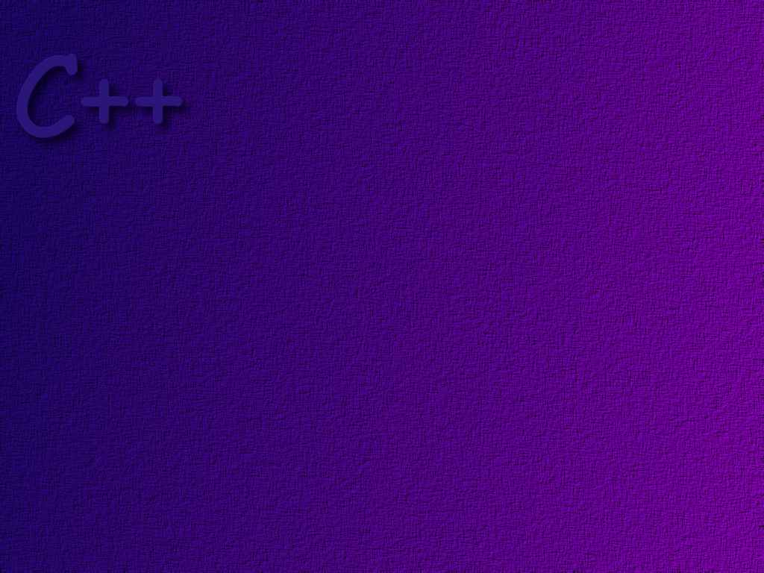
Control Statements

Slide 2
Topics
Normal execution order
Conditional statements
Relational operators & Boolean expressions
Enumerations

Slide 3
Objectives
At the completion of this topic, students should be able to:
Describe the normal flow of control through a C++ program
Describe what happens when a function is invoked
Correctly use if statements in a C++ program
Explain how to use relational operators to write a boolean expression
and use them correctly in a C++ program
Correctly use if/else statements in a C++ program
Correctly use blocks in if/else statements
Correctly use a switch statement in a C++ program
Describe enumerations and use them in a C++ program
Correctly use the logical operators to make complex boolean expressions

Slide 4
The order in which statements in a program are
executed is called the flow of control.
A C++ application begins with the first line
in the main( ) function, and normally continues
line by line until it reaches the end of main( ).

Slide 5
We can alter the flow of control
through a program with
conditional statements
loops

Slide 6
Conditional statements allow us to
select which statement will be executed
next, based on some condition that is
either true or false

Slide 7
The if Statement
The if statement allows us to execute a
statement only if the condition is true.
this is called a boolean expression
is
total <
amount
?
total =
total + 1;
yes
if ( total < amount )
total = total + 1;
no
note how we have indented
the statement to be executed
when the condition is true. Although
the compiler doesn’t care about indentation,
it makes it easier to read the code.

Slide 8
// Demonstrate the if statement
int main ( )
{
// We will test to see if someone is a minor with this constant
const int MINOR = 21;
int age;
// Ask the user to enter an age, then read it in
cout << "How old are you?\n“;
cin >> age;
if ( age < MINOR )
cout << "Youth is a wonderful thing ... enjoy it!\n";
cout << "Thanks for coming in.\n";
}

Slide 9
Relational Operators
relational operators are used in Boolean expressions
Operator Meaning
== equal
!= not equal
< less than
<= less than or equal
> greater than
>= greater than or equal
(not greater than)
(not less than)
Note: The precedence of relational operators
is lower than arithmetic operators, so arithmetic
operations are done first.

Slide 10
Note: internally, C++ represents true as a non-zero integer,
usually 1. It represents false internally as 0. C programmers
have historically used these internal values to do interesting
things. However, in C++ we should always use the values true
and false, and not write code that depends upon the internal
representation.

Slide 11
The if/else statement
This construct allows us to do one thing if a condition
is true, and something else if the condition is false.
is
height > MAX
?
adjustment =
MAX - height
if (height > MAX)
adjustment = MAX – height;
else
adjustment = 0;
cout << adjustment;
adjustment
= 0

Slide 12
// Demonstrate the if/else statement
int main ( )
{
// We will test to see if someone is a minor with this constant
const int MINOR = 21;
int age;
// Ask the user to enter an age, then read it in
cout << "How old are you? ";
cin >> age;
if ( age < MINOR )
cout << "Youth is a wonderful thing ... enjoy it!\n";
else
cout << "Old age is a state of mind ...!\n";
cout << "Thanks for coming in.\n";
}

Slide 13
Executing a Block of Statements
Sometimes we want to execute more than one
statement when a condition is true ( or false ).
In C++, we can use a block of statements, delimited
by { and } anyplace where we would normally use a
single statement.
if ( a < b )
{
a = 0;
b = 0;
cout << “Sorry …”;
}
. . .

Slide 14
// Using a block
int main ( )
{
// We will generate numbers between 0 and 10
const int MAX = 10;
int answer, guess;
randomize ( );
answer = rand( ) % 11;
cout << "I am thinking of a number between 0 and ";
cout << MAX << " What is it? ";
cin >> guess;
if ( guess == answer )
cout << "Congratulations. You guessed it.\n";
else
{
cout << "That is not correct, sorry. ";
cout << "The number was " << answer << ‘\n’;
}
cout << "Thanks for playing.\n";
}
to use the rand( ) function, you
must #include <cstdlib>

Slide 15
Nested if/else Statements
In C++, the statement to be executed as the
result of an if statement could be another if
statement.
In a nested if statement, an else clause is
always matched to the closest unmatched if.

Slide 16
// Nested if/else statements
// main class declaration
int main ( )
{
// declare some variables
int a, b, c, min = 0;
cout << "Enter three integers: ";
cin >> a;
cin >> b;
cin >> c;
if ( a < b )
if ( a < c )
min = a;
else
min = c;
else
if ( b < c )
min = b;
else
min = c;
cout << "The minimum value entered was " << min << “\n”;
}
keep track of which if an else goes with!

Slide 17
Another Example
char direction;
cout << “Press a direction key (n, s, e, or w) and hit Enter: “;
cin >> direction;
if (direction == ‘n’)
cout << “\nYou are now going North.”;
else if (direction == ‘s’)
cout << “\nYou are now going South.”;
else if (direction == ‘e’)
cout << “\nYou are now going East.”;
else if (direction == ‘w’)
cout << “\nYou are now going West.”;
else
cout << “\nYou don’t know where you are going!”;

Slide 18
The Switch Statement
The switch statement allows a program to take one of several different paths, based on the value given to the switch statement.
switch ( numValues )
{
case 0:
cout << “No values were entered”;
break;
case 1:
cout << “One value was entered”;
break;
case 2:
cout << “Two values were entered”;
break;
default:
cout << “Too many values were entered”;
}
must be an integer or a character
without the break statement, execution would continue on to the statements in case 1.
if numValues is not
0, 1, or 2, execution
goes here.

Slide 19
Enumerations
An enumeration type is a user defined data type whose
valid values are defined by a list of constants of type int.
enum dayOfWeek { SUN=0, MON=1, TUE=2, WED=3, THU=4, FRI=5, SAT=6 };
if values are not explicitly given, then the first constant is
assigned zero, and then each is incremented by one. So the
following is equivalent to the above example:
enum dayOfWeek { SUN, MON, TUE, WED, THU, FRI, SAT };

Slide 20
Given the enumeration just described, you could actually
now declare a variable of type dayOfWeek and assign
valid values to it. For example
dayOfWeek today;
today = MON;

Slide 21
Enumerations are often used to label the cases in a switch statement:
enum days { MON, TUE, WED};
. . .
switch ( whichDay )
{
case MON:
cout << “Today is Monday”;
break;
case TUE:
cout << “Today is Tuesday”;
break;
case WED:
cout << “Today is Wednesday”;
break;
default:
cout << “What day is it?”;
}

Slide 22
Logical Operators
Operator Description Example
! logical NOT !a
&& logical AND a && b
|| logical OR a || b
the results of logical operations are defined in truth tables

Slide 23
Logical NOT
a !a
false true
true false

Slide 24
Logical AND
the evaluation of &&
is short circuited if a
is false.
a b a && b
false false false
false true false
true false false
true true true

Slide 25
Logical OR
the evaluation of ||
is short circuited if
a is true.
a b a || b
false false false
false true true
true false true
true true true

Slide 26
Operator Precedence (again)
higher precedence
:: scope resolution operator
. dot operator
-> member operator
[ ] array indexing
( ) function call
++ postfix increment operator
-- postfix decrement operator
++ prefix increment operator
-- prefix decrement operator
! not
- unary minus
+ unary plus
* dereference
& address of
new allocate memory
delete de-allocate memory
sizeof( ) size of object
( ) type cast
lower precedence

Slide 27
higher precedence
* multiply
/ divide
% remainder
+ addition
- subtraction
<< stream insertion
>> stream extraction
< less than
> greater than
<= less than or equal
>= greater than or equal
== equal
!= not equal
&& and
|| or
lower precedence

Slide 28
higher precedence
= assignment
+= add and assign
-= subtract and assign
*= multiply and assign
/= divide and assign
%= modulo and assign
?: conditional operator
throw throw an exception
, comma operator
lower precedence

Slide 29
Comparing Characters
Characters in the ASCII standard are arranged so
that they compare in alphabetical order. Lower case
characters are not equal to their upper case counterparts.

Slide 30
Comparing Real Numbers
Because of the way that real numbers are represented
in the computer, you cannot be guaranteed that two
real numbers are exactly equal to one another.
The best way to handle this situation is to subtract one
number from the other and see if the absolute value of
their difference is smaller than some tolerance value.

Slide 31
The Conditional Operator
The conditional operator is written as
?:
It is sort of an abbreviated if/else, and is used like this
total = (total > MAX ) ? total + 1: total * 2;
this first expression
must be a boolean
if the boolean expression
is false, total = total * 2
if the boolean expression
is true, then total = total + 1

Slide 32
Practice
What is the value of the following, given that the value of count = 0,
and the value of limit = 10? We don’t know what x and y are.
(count == 0 ) && (limit < 20)
true
count == 0 && limit < 20
true
(limit > 20 ) || (count < 5)
true
!(count == 12)
true
(count == 1) && (x < y)
false
(count < 10 ) || (x < y)
true
((limit / count) > 7) && (limit < 0)
divide by zero error!
(limit < 20 ) || ((limit / count) > 7)
true

Slide 33
Practice
Problem: Allow the user to type in two integers.
Print out the value of the highest number. Numbers
may be negative. If they are equal, say so.

Slide 34
Practice
Write a short program that determines whether or not you
will go to school based on the outside temperature and the
day of the week. Here are the rules:
Don’t go to school on week-ends
Don’t go to school if the temperature is below 0.

Slide 35
Practice
Could you modify this program so that it prints out the
“stay at home” message and quits when you type in
saturday or sunday. That is, it does not ask you for the
temperature on those days.

Slide 36
Practice
Write a tollbooth program that calculates the toll required
to use the highway, based on the class of vehicle.
Passenger cars $2.00
Busses $3.00
Trucks $5.00
Use a switch statement and an enumeration.

