Slide 1
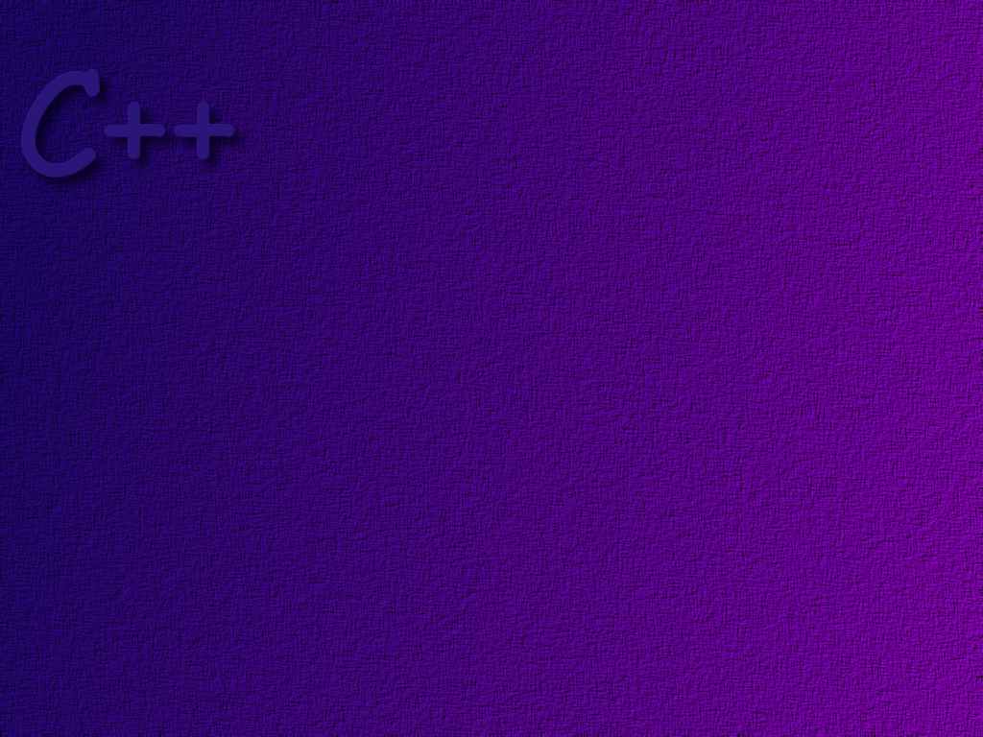
Functions

Slide 2
Topics
Built-in functions
Functions that return a value
Void functions
Random number generators
Programmer defined functions
Program structure
Scope

Slide 3
Objectives
At the end of this topic, students should be able to:
Write programs that use built-in functions
Know how to use functions in the math library
Correctly write code that generates random numbers
Correctly write and use stand-alone functions in a program
Explain the term function prototype
Describe what scope is and how it affects the execution
of a C++ program.

Slide 4
We often write a program as a series of pieces
because it is easier to understand what goes on
in a small piece of code.
because we can re-use the same piece of code
many times from within our program
we call this functional decomposition
-- breaking the program down into more
manageable pieces.
in C++ these smaller pieces are called functions

Slide 5
Built-in Functions
In general, if you can find some written and tested code that
does what you want, it is better to use that already existing
code than to re-create the code yourself.
saves time
fewer errors
Most programming languages, including C++, include
libraries of pre-written and tested functions that do
common programming tasks.

Slide 6
We will discuss two broad categories of functions:
those that return some value
those that don’t

Slide 7
Functions that return a value
As an example of a function that returns a value, consider
the sqrt function
To set a value to the square root of the number 9, we would
write
result = sqrt (9);
this is called a function invocation.
It can be used anywhere an expression
can be used.
this is the function’s argument.
The argument may be a literal value,
a variable, a constant, or an expression.
Some functions may take more than one
argument. If so, they are separated by
commas.
the value returned by the function
is called its return value.
A function can only have one
return value.

Slide 8
The cmath library
The sqrt function is found in the cmath library. To use
the sqrt function you must write
#include <cmath>
using std::sqrt;
Other common functions in cmath:
name function return type
pow (int x, int y) calculates x^{y} double
fabs (double n) absolute value of n double
ceil (double n ) smallest integer >= n double
floor (double n) largest integer <= n double

Slide 9
Rounding
When we round a number, we pick the closest integer value.
For example,
if a = 2.7, then the rounded value of a is 3
if a = 2.4, then the rounded value of a is 2.
The ceil and floor functions given in the previous slide
don’t do rounding. For example,
floor (2.9) returns 2.0, while
ceil (2.3) returns 3.0.

Slide 10
Functions that don’t return a value
functions that don’t return a value are called void functions.
void functions are written as statements, they cannot be used
as an expression.
void functions can have any number of arguments.

Slide 11
An example of a built in void function is the exit function.
exit ( int n );
When the exit function is invoked, the program immediately
terminates. By convention, if a value of 0 is used as the
argument to exit, the program is considered to have exited
normally. Otherwise, the exit is considered an error.
The exit function is in the cstdlib library. To use it we write
#include <cstdlib>
using std::exit;

Slide 12
Random Number Generator
Another often used function in <cstdlib> is the rand function.
The rand function generates a pseudo-random integer value
between zero and a system determined maximum.
To get a random number within a specific range we scale
the result …. for example, to get a number between 0 and 10,
inclusive
int n = rand( ) %11;
*
To get a repeatable sequence of pseudo-random numbers,
use the same seed when calling the function
int n = rand(5) %11;
* same machine, same compiler

Slide 13
The function randomize ( )
seeds the random number generator with a random number.
The function srand ( int )
seeds the random number generator with a specific seed.

Slide 14
Programmer Defined Functions
Programmer defined functions can be put in the same
file as main, or in separate files. Putting them in
separate files makes it easy to share functions across
many programs.
In the following example, we will put them in the
same file.

Slide 15
Program Structure
// file prologue
#includes
// function prologue
function prototype
main ( )
{
}
function body
{
}
functions must be declared before
they are used. The common method
is to put the prototype first, then
the main, then the function body as
shown in this example.

Slide 16
// Example 3.5 from Absolute C++
// Illustrates user written functions
// CNS 1400 ……………………………..
// #includes
#include <iostream>
using std::cin;
using std::cout;
using std::ios;

Slide 17
The function prototype tells us
everything we need to know to
use a function.
As a user of a function we don’t
care how the function is implemented.
// Function Prototypes
// totalCost -----------------------------------------------------
// Purpose: calculates total cost of some number of items
// includes tax
// Parameters: numberParameter - the number of items
// priceParameter - the price of the item
// Returns: the total cost
// Pre-condition: Valid price and number of items exist
// Post-condition: total cost is returned
double totalCost (int , double);
function prologue
this is called the function prototype,
the function signature, or the function
declaration. Note the semicolon.
the function name
formal parameters – it is common
to only state the data types required
when writing the prototype.
the type of value returned
by the function

Slide 18
int main( )
{
double price, bill;
int number;
cout << "Enter the number of items purchased: ";
cin >> number;
cout << "Enter the unit price: ";
cin >> price;
bill = totalCost (number, price);
cout.setf(ios::fixed);
cout.setf(ios::showpoint);
cout.precision(2);
cout << number << " items at " << price << " each\n";
cout << "Final bill, including tax is $" << bill << "\n";
system(“PAUSE”);
return 0;
}
here is where the totalCost
function is invoked.

Slide 19
The function definition consists
of the function header followed
by the function body.
This is the function header. Notice that it
looks much like the prototype. Two notable
exceptions: we have supplied names for the
formal parameters and there is no semicolon.
These variables
are local to the
function.
// The totalCost function
double totalCost (int numberParameter, double priceParameter)
{
const double TAX_RATE = 0.05;
double subTotal;
subTotal = priceParameter * numberParameter;
return (subTotal + subTotal * TAX_RATE);
}
This is the function body.
It contains the
instructions to be
executed when the
function is invoked.
The return statement is required in functions that
return values.

Slide 20
Revisit The Rounding Issue
C++ does not provide a function that rounds.
Let’s write a function that rounds a double to
the nearest integer, using the floor function.

Slide 21
for any value n, in this range
floor (n ) = 3.
3
3.5
4
but … in this range
floor(n + 0.5) = 4.0

Slide 22
So, we can write the function round( ) as follows:
int round (double number)
{
return static_cast<int>(floor(number + 0.5));
}

Slide 23
Test program ….
#include <iostream>
#include <cmath>
using std::cin;
using std::cout;
int round (double);
int main ( )
{
double doubleValue;
cout << “Enter a double value: “;
cin >> doubleValue;
cout << “rounded value is “ << round (doubleValue) << ‘\n’;
system(“PAUSE”);
}

Slide 24
Functions That Return a Boolean
The return type for a function can be the type bool.
Writing functions to evaluate complex Boolean expressions
often makes a program much easier to read.
Instead of writing
if (((rate >= 10) && (rate < 20)) || (rate == 0))
{
…
}

Slide 25
write
if (appropriate(rate))
{
…
}
where we have written the function
bool appropriate (int rate)
{
return (((rate >-10) && (rate < 20)) || (rate == 0));
}

Slide 26
Defining void Functions
the keyword void says the function
will not return a value.
void showResults (double fDegree, double cDegree)
{
cout.setf (ios::fixed);
cout.setf (ios::showpoint);
cout.precision(2);
cout << fDegree << “ Degrees fahrenheit = “;
cout << cDegree << “ degrees centigrade ”;
}
… and there is no return statement.

Slide 27
Scope
Scope has to do with where a variable can be seen.
global variables
local variables

Slide 28
A related term is storage class or lifetime, which defines how long
a variable exists within a program.
automatic variables – exist during the lifetime of the
function in which they are declared.
static variables – exist for the lifetime of the program

Slide 29
Example
global variables must be declared outside
of any function. Usually the only global
variables we use in a program are constants.
string globalValue = "I was declared outside any function";
void someFunction( );
int main( )
{
cout << "Entering main( ) ...\n";
string localValue = "I was declared in main( )";
someFunction( );
cout << "Local value = " << localValue << "\n";
system(“PAUSE”);
return 0;
}
void someFunction ( )
{
cout << "Entering someFunction( )...\n";
string localValue = "I was declared in someFunction( )";
cout << "Global value = " << globalValue << "\n";
cout << "Local value = " << localValue << "\n";
}
the name localValue
is used twice. In this case
the scope of localValue
is inside of main( ). It is
a local variable.
localValue is also declared
in this function, but its
scope is just inside the
function. It cannot be seen
outside of the function. It
is a different variable than
the one declared in main( ).
It is a local variable.

Slide 30
Blocks
Anytime we use curly braces to delineate a piece of code,
that code is called a block. We can declare variables that
are local to a block.
Local variables declared in a nested block are only
known to the block that they are declared in.
When we declare a variable as part of a loop, for example
for (int j = 0; j< MAX; j++)
…
the variable should be considered to have the loop as its
scope.

Slide 31
Static Local Variables
A static local variable comes into existence the first time the
function in which it is declared is executed. It then lives until
the program ends.
The scope of a local variable is the same as an automatic local
variable, that is, it’s scope is within the function where it is
declared.
Static local variables are used where it is important to remember
the value of a variable between calls to the function in which it
is declared.

Slide 32
Practice
Write the function prototype for a function named
calcRatio that takes two integer parameters and
returns a float.

Slide 33
Practice
Now write the function prologue for this function.

Slide 34
Practice
Write the implementation for this function. The ratio
is found by dividing the first parameter by the second.

Slide 35
Practice
Write a complete program that
(1) gets two input values from the user
(2) passes those values to the calcRatio function
(3) displays the result

Slide 36
Practice
Write a program that converts dollar values into another currency. The program should work as follows:
(1) Prints an introduction to the program
(2) Gets a currency conversion factor and currency name from user
(3) Gets a dollar value
(4) Calls a function calcConvertedValue( ) and displays answer
(5) Asks if the user wants to do another conversion
(6) If the answer is yes, go back to step 3
(7) Ask if the user wants to do a different conversion
(8) If the answer is yes, go back to step 2

