Slide 1
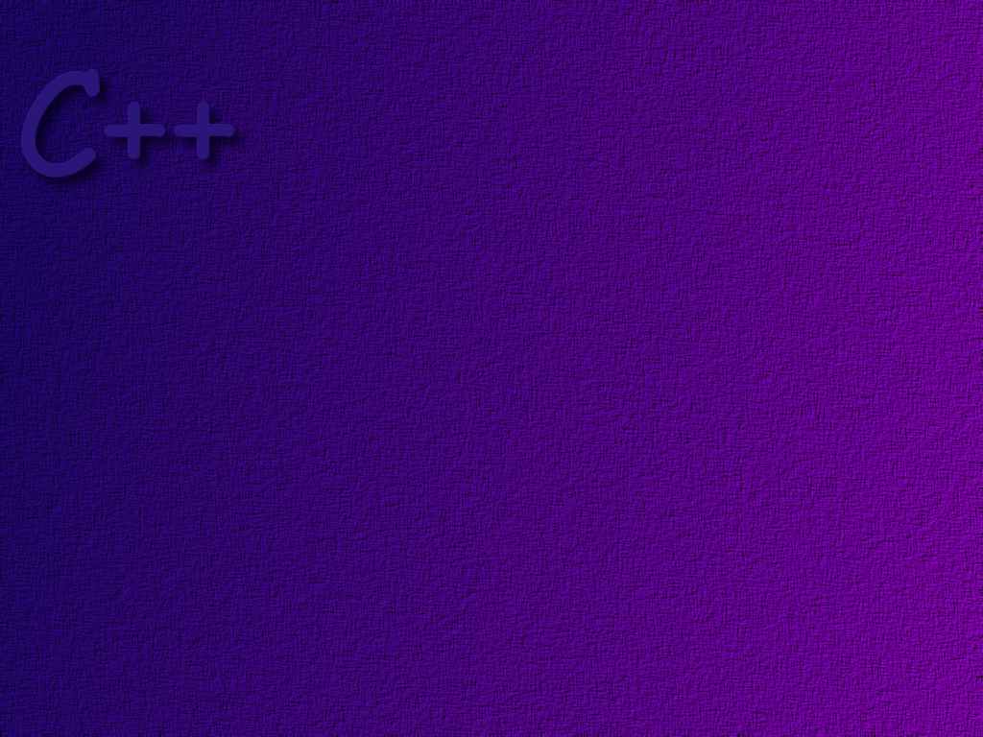
Parameters and Overloading

Slide 2
Topics
Call-by-value
Call-by-reference
Constant parameters
Function overloading
Default arguments
The assert macro
Stubs and drivers

Slide 3
Objectives
At the completion of this topic, students should be able to:
Correctly write functions that use pass by value
Correctly write functions that use pass by reference
Correctly pass constant references
Explain what a side effect is
Explain what function overloading is, and correctly use
function overloading in a program
Explain how type conversion affects function overloading
Correctly write functions that use default values for some arguments
Explain what a Driver and a Stub are, and use them in programs

Slide 4
The following examples are meant to illustrate
what happens when parameters are passed by
value and by reference. The animations may not
match the code generated by a specific C++
compiler …

Slide 5
Pass By Value
When a parameter is passed by value, a copy
of the value is made and passed to the function
on the run-time stack.

Slide 6
These are variables that are local to
the function divide( ). The parameters
passed to the function
are stored in these local variables.
double divide (int n, int d)
{
double r = static_cast<double>(n)/d;
n++;
d++;
return r;
}

Slide 7
int main( )
{
int num, den;
do
{
cout << "Enter in two integer values:\n";
cout << "numerator = : ";
cin >> num;
cout << "denominator = (0 to end): ";
cin >> den;
if ( den != 0)
{
num and den are called the
actual parameters, or arguments.
double result = divide (num, den);
cout << num << "/" << den << " = " << result << "\n";}
}
} while ( den !=0);
return 0;
}

Slide 8
num
9
9
den
7
7
let the value of num = 9
and the value of den = 7
run time stack
double result = divide (num, den);
rtn
cout << num << "/" << den << " = " << result << "\n";
}
} while ( den !=0);
return 0;
}
the return address goes on the stack
a copy of the variable num goes on the stack
a copy of the variable den goes on the stack

Slide 9
num
9
9
Notice that the original
values don’t change!
r
1.28
den
7
7
d
8
7
n
9
10
double divide (int n, int d)
{
double r = static_cast<double>(n)/d;
n++;
d++;
return r;
}
rtn
run time stack
The variable name d is associated with the top
element on the stack (it is like a local variable)
The variable n is associated with the next
element on the stack
Space is allocated on the stack for the local
variable r

Slide 10
Pass By Reference
When a parameter is passed by reference, a reference
to the value is made and passed to the function
on the run-time stack.

Slide 11
the ampersand denotes that this
parameter is passed by reference!
double divide (int& n, int& d)
{
double r = static_cast<double>(n)/d;
n++;
d++;
return r;
}

Slide 12
num
&num
9
den
&den
7
let the value of num = 9
and the value of den = 7
run time stack
double result = divide (num, den);
rtn
cout << num << "/" << den << " = " << result << "\n";
}
} while ( den !=0);
return 0;
}
the return address goes on the stack
a reference to num goes on the stack
a reference to den goes on the stack

Slide 13
num
10
Notice that the original values are
changed! This is what is called a
side effect. Side effects are usually
not wanted.
9
den
r
1.28
7
8
d
&den
n
&num
double divide (int &n, int &d)
{
double r = static_cast<double>(n)/d;
n++;
d++;
return r;
}
rtn
run time stack
The reference num is associated with
the variable n
The reference den is associated with
the variable d
Space is allocated on the stack for the
local variable r

Slide 14
Pass By Reference
Under the Hood
As your program compiles and executes, the
computer keeps track of the location in memory
where each variable is stored.
name
type
address
num1 int 2000
num2 int 2004
total float 2008
… … …

Slide 15
void functionOne( int& num1 );
When the compiler sees that a function is to be invoked,
it looks at the function prototype. If the function prototype
specifies that parameters are to be passed by reference, then
code like the following gets generates by the compiler:
push the return address onto the stack
push the address of num1 onto the stack

Slide 16
void FunctionOne (int& num1)
{
num1 = 5;
}
When the compiler generates the code for the
function, since it is taking a reference parameter,
it would look something like this:
use the value stored on the stack as
the address where the data is to be stored.
go to the address pointed to, and
and store the value of 5 there

Slide 17
Rule of Thumb
If you are passing primitive data to a function,
you should use pass-by-value
avoids side effects!
If you are passing large amounts of data,
for example an array or an object, you
should use pass-by-reference
passing by value requires copying all
of the data onto the stack. This is time
consuming and can overload the stack

Slide 18
Example of Using a Side Effect
Problem: Write a function that exchanges the values
of two variables.

Slide 19
The exchange code ………
for exchanging integers
value1 = value2;
value2 = value1;
int temp = value1;
value1 = value2;
value2 = temp;

Slide 20
Using pass by value …
5
num1
7
num2
int num1 = 5;
int num2 = 7;
swap (num1, num2);
void swap (int n1, int n2)
{
int temp = n1;
n1 = n2;
n2 = temp;
}
5
n1
7
n2

Slide 21
Only the local variables allocated to
hold the parameter values get swapped.
The original values are not changed.
To make the swap work, pass the parameters
by reference.

Slide 22
Using pass by reference …
5
num1
7
num2
int num1 = 5;
int num2 = 7;
swap (num1, num2);
void swap (int& n1, int& n2)
{
int temp = n1;
n1 = n2;
n2 = temp;
}
n1 ->num1
n1
n2 -> num2
n2

Slide 23
Constant Reference Parameters
As we noted earlier, when passing large pieces of
data (for example an object) to a function, the data
should be passed by reference. How can you pass data
by reference and avoid side effects?
use the const keyword ….
void FunctionOne (const int& num1 );

Slide 24
Mixed Parameter Lists
It is perfectly valid to mix pass-by-value and
pass-by-reference parameters in the same function:
void functionTwo (int& num1, int num2);

Slide 25
Function Overloading
In C++ you can give two different functions
the identical function name.
This is called function overloading.
When a function is invoked, the compiler figures
out which of the functions to use, based on the
function name and the number and type of parameters.

Slide 26
Example
this function has three parameters
int max (int n1, int n2, int n3)
{
if ( n1 < n2 )
if ( n2 < n3 )
return n3;
else
return n2;
else
if ( n1 < n3 )
return n3;
else
return n1;
}
this function has two parameters
int max (int n1, int n2)
{
if ( n1 < n2 )
return n2;
else
return n1;
}
int biggest = max (5, 3);
int largest = max (5,3,7);
this code will invoke this function
this code will invoke this function

Slide 27
Function Signature
A function’s signature refers to the function name
and the sequence and type of parameters.
A function name is overloaded when the functions
have different signatures.

Slide 28
Type Conversion and Overloading
double mpg (double miles, double gallons)
{
return (miles / gallons);
}
if this function is called with the following code …
int m = 15;
int g = 3;
double result = mpg (m, g);
m and g will be converted to doubles
when they are passed to the function.

Slide 29
So … what happens if you also have this
function in your program?
int mpg (int goals, int misses)
{
return ( goals – misses);
}
and you make the function call
int miles = 2;
int gallons = 8;
int result = mpg (m,g);
?

Slide 30
Rules for Resolving Overloading
If there is a function whose signature exactly matches the parameters in the function call, than that function is selected first.
Otherwise, if there is a function whose signature matches the parameters of the function call, after doing some type conversion, then that function is selected.

Slide 31
Default Arguments
If you are passing parameters by value, and you leave a parameter out, the compiler will use a default value that is specified in the function prototype.
Default parameters must be the rightmost parameters in the parameter list.

Slide 32
notice that the default values are
only specified in the function
prototype.
Example:
double getVolume (int, int = 1, int = 1);
int main( )
{
cout << getVolume (5);
cout << getVolume (5,3);
cout << getVolume (5,3,4);
}
double getVolume ( int length, int width, int height)
{
return ( length * width * height);
}
when the function is invoked
here, the value of 1 is used for
the width and the height.
when the function is invoked
here, the value of 1 is used for
the height.
notice that you can’t default width but not height …
cout << getVolume (5,,4); is illegal.

Slide 33
Overloading and Default Parameters
What happens if you have the following functions all defined
in your program?
int functionOne ( int );
int functionOne (int, int=1);
The compiler gives you
an ambiguity error. It
does not know which
function to call.
and you make the following function call?
int result = functionOne ( 5 );

Slide 34
The assert macro
An assertion is a statement that is either true or false.
When expressed precisely in C++, an assertion is a
Boolean expression.
When the assert macro is invoked, the assertion parameter
is evaluated. If it is true, then nothing happens. If it is
false, then your program terminates.

Slide 35
Example
In the following code, we test the assertion that length
and width are positive non-zero values, before we
attempt to calculate the area
#include <cassert>
…
int calcArea ( int length, int width)
{
// pre-conditions: length and width are positive
non-zero values
assert ((length > 0 ) && (width > 0));
return ( length * width);
}

Slide 36
You can turn assertions on when debugging your code
and turn them off when it is fully debugged.
adding this statement
turns all assertions off.
#define NDEBUG
#include <cassert>
…

Slide 37
Drivers
When programming a large project, it is common
to code each function independently and then write
a driver that tests that function. A driver is simply a
piece of code that invokes the function in different ways
to test that the function works as expected.
Drivers are temporary code that are not part of the
finished program, so they don’t have to be fancy.

Slide 38
Example
// calcArea function
// purpose: calculate the area of a rectangular region
// parameters: a integer length l and an integer width w
// returns: an integer result = l * w
// pre-conditions: l and w are positive, non-zero integers
// post-conditions: area is calculated
int calcArea (int l, int w)
{
return l * w;
}

Slide 39
int main( )
{
int height, width, area;
char yes_no;
do
{
cout << "--------------------------\n";
cout << "Enter an integer height: ";
cin >> height;
cout << "Enter an integer width: ";
cin >> width;
area = calcArea (height, width);
cout << "\nThe area = " << area << '\n';
cout << "Test another pair of values (y or n): ";
cin >> yes_no;
}
while (yes_no == 'y');
cin.get( );
return 0;
}
the Driver

Slide 40
Once a function has been debugged and you are
satisfied that it contains no errors, then move on
to creating and testing the next function.
Each function should be tested in a program where
it is the only untested component in the program.
Thus, if the program fails, you know where to look
for the error.

Slide 41
Stubs
Sometimes it is impossible to test one function
without using some other function which may not
yet be written or debugged.
In these cases you can write a simplified version of
the required function that only delivers sufficient
data to test the other function. These simplified
functions are called stubs.

Slide 42
Example
If we were testing some function that depended on
the calcArea function, and the calcArea function had
not yet been written and tested, we could provide
a stub that might look like
int calcArea ( int w, int l)
{
return 100;
}
the function does not calculate the area
correctly, but just getting some data
returned might be sufficient to test the
other function.

Slide 43
Practice
Write the function prototype for a function, add( )
that takes two integer parameters. The parameters
are passed by value. The function returns an integer.

Slide 44
Practice
Write the function prototype for a function, add( )
that takes two integer parameters. The parameters
are passed by reference. The function returns an integer.
Write the prototype so that side effects are avoided.

Slide 45
Practice
Write a main( ) function that gets two values from the user
and then calls the add function. Pass the parameters by value.
Then get two more values from the user. Call the add function
but this time pass the parameters by reference.

Slide 46
Practice
Write a program that converts time in 24 hour notation to
its equivalent time in 12 hour notation. For example, 13:20
would convert to 1:20pm. Write a function that does the
conversion. How will you pass the parameters? Could you
have used this function in the first project that you did?

Slide 47
Practice
We want to write a program that tells what coins to give for
any amount of change from 1 to 99 cents. For example, for
86 cents, the program should output something like
86 cents can be given as
3 quarter(s) 1 dime(s) and 1 penny(pennies)
Only use coin denominations of 25 cents ( quarters ), 10 cents
( dimes ), and 1 cent ( pennies ).
Your program should use a function of the following form:
void computeCoins ( int coinValue, int& number, int& left );
For example, if the amount left is 86 cents, and the coinValue is 25,
the value of number will be 3 and the new amount left will be 11.

