Slide 1
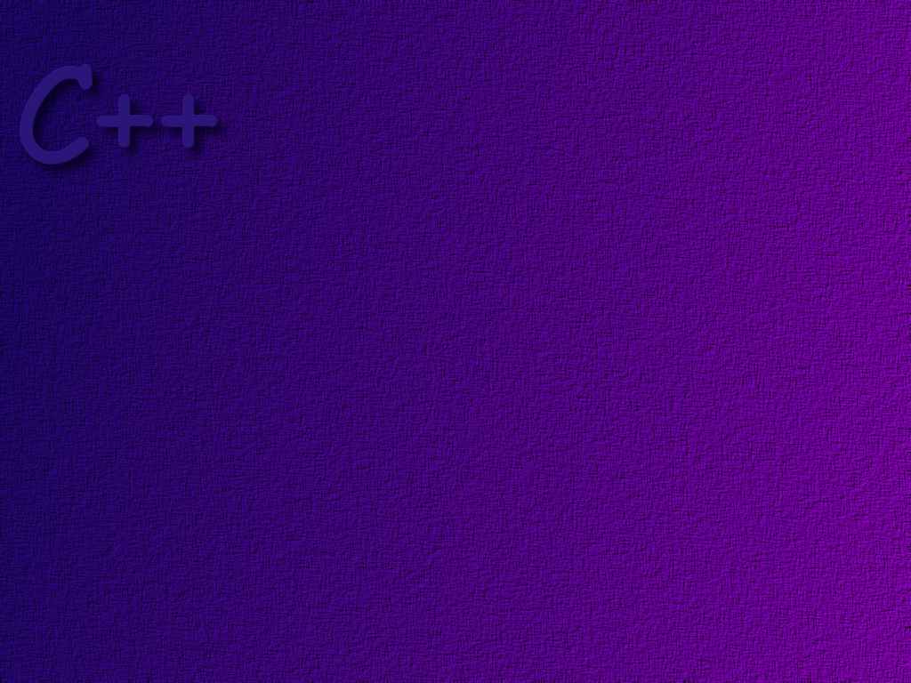
Arrays and Vectors

Slide 2
Topics
Arrays
Linear and Binary Searches
Selection Sort
Bubble Sort
Multi-dimensional Arrays
Vectors

Slide 3
Objectives
At the completion of this topic, students should be able to:
Write programs that correctly
* Declare and use arrays
* Use loops to manipulate array elements
* Pass arrays to functions
Explain what an out of bounds error is
Explain the difference between a linear and a binary search
Write a bubble sort
Declare and use 2-dimensional arrays in a program
Use the Vector from the Standard Template Library

Slide 4
An array is a list of values
All values must be of the same type
examScores
89
0
Values are stored in consecutive
memory locations
1
94
78
2
The position where a value is stored
in an array is given by the its index.
We sometimes refer to this as the
subscript.
93
3
75
4
99
5
82
6
Indexing always begins with zero
77
7
To access an element of an array, we
use the array name, followed by the index
inside of square brackets
53
8
87
9

Slide 5
index
examScores
array name
89
0
94
1
78
2
93
3
75
4
value of examScores[4]
99
5
you can also use an expression, such as
examScores[n+1];
6
82
77
7
53
8
87
9

Slide 6
index
examScores
base address
1200
89
0
1204
94
1
1208
78
2
examScores[4]
1212
93
3
1216
75
4
Array elements are stored in consecutive memory
locations. The compiler calculates the address
of a specific array element using the equation
address = base address + index * element size
99
5
82
6
77
7
53
8
1200 + 4 * 4
9
87

Slide 7
Declaring an Array
examScores
array size
0
data type of array elements
1
int examScores[10];
2
3
the declaration
4
5
6
Good programming style uses a constant for the
array size. For example
const int SIZE = 10;
int examScores[SIZE];
7
8
9

Slide 8
Accessing Array Elements
examScores
12
0
examScores [ 0 ] = 12;
1
2
3
array name
4
index
(must be an integer value )
5
6
7
cout << examScores[0];
8
9

Slide 9
Arrays and Loops
examScores
int main ( )
{
const int SIZE = 10;
const int MULTIPLE = 3;
int examScores [ SIZE ];
for ( int i = 0; i < SIZE; i++ )
{
examScores[ i ] = i * MULTIPLE;
}
}
0
0
3
1
6
2
9
3
12
4
5
6
7
8
9

Slide 10
Out of Bounds Errors
When a C++ program is executing, it does not notice
when a calculation results in an array index that is
out of bounds. The address of the element is calculated
using the equation given previously, and that place
in memory is accessed, even if it does not belong to
the array!

Slide 11
index
someInts
0
0
someInts +4
1
1
int someInts[5], badNum;
badnum = 100;
for ( int indx = 0; indx <=5; indx++)
{
someInts[indx] = indx;
}
someInts +8
2
2
someInts +12
3
3
someInts +16
4
4
badNum
100
5
Notice that we over-wrote the variable
badNum with the value of 5! This destroys
the original value in badNum.

Slide 12
Initializer lists
int examScores [ ] = { 87, 83, 94, 99, 74, 66, 88 };
the array size is automatically determined by the
number of items in the initializer list

Slide 13
Array Elements as Parameters
Array elements can be passed just as any other parameter…
for example
given the function
void printInteger (int n);
we can pass an element of an integer array as
printInteger (someData[n]);

Slide 14
Arrays as Parameters
the square brackets tell the compiler
that an array will be passed.
void printEm( int r[], int size )
{
for( int i = 0; i < size; i++ )
{
cout << r[i] << “\n”;
}
}
int main( )
{
int mine[ ] = { 1, 2, 3, 4, 5 };
printEm ( mine, 5 );
}
}
it is normal to also pass the size
of the array as a parameter.
the array is passed in what is often
called a simulated pass-by-reference,
because it is just a pointer to the
array that gets passed..

Slide 15
const array parameters
void printEm( const int r[], int size )
{
for( int i = 0; i < size; i++ )
{
cout << r[i] << “\n”;
}
}
int main( )
{
int mine[ ] = { 1, 2, 3, 4, 5 };
printEm ( mine, 5 );
}
}
the const modifier prevents
the function from changing
any data in the array.

Slide 16
Partially Filled Arrays
Often in a program, you don’t know how much data
will be stored in an array. So, you make the array
some very large maximum size, and then keep track
of how much data is in the array.

Slide 17
Searching an Array
Linear Search
Binary Search

Slide 18
Linear Search
examScores
72
0
Problem: Determine which element in the array
contains the score 87.
98
1
56
2
int thisOne = -1;
for (int index = 0; index < SIZE; index++)
{
if (examScores[index] == 87)
thisOne = index;
}
…
87
3
64
4
83
5
77
6
91
7
66
8
70
9

Slide 19
Binary Search
examScores
In general, a binary search is much, much faster than a linear search, but requires that the array be sorted.
98
91
87
83
Start in the middle
77
Is this the one you are looking for (87)?
72
If not, is this number smaller than 87?
70
In this case it is. Therefore, we can elminate
the entire bottom half of the array. Why?
66
64
Now try again, picking the middle of the
remaining array elements.

Slide 20
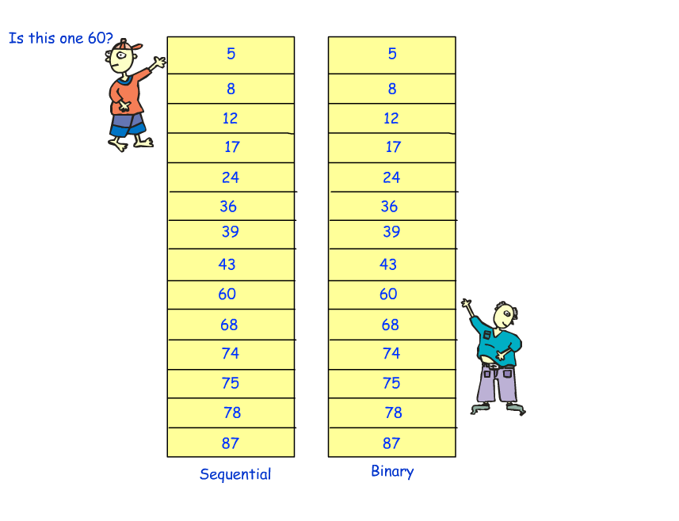
Linear vs. Binary Search

Slide 21
Sorting
Sorting means to put data into some specified order.
There are many, many algorithms that have been developed
to sort data. In this section we will mention two of them:
Selection Sort
Bubble Sort

Slide 22
Selection Sort
Algorithm Development

Slide 23
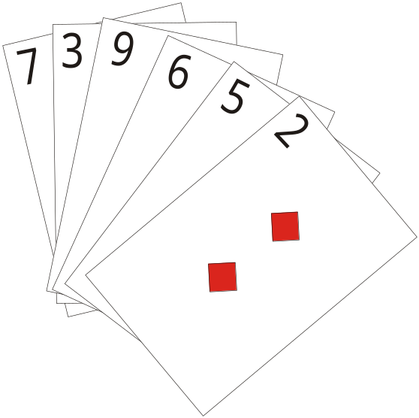
Selection Sort
Step one:
find the lowest card
in the hand

Slide 24
Selection sort
Step two:
Swap the lowest card with
the left-most card
left-most card

Slide 25
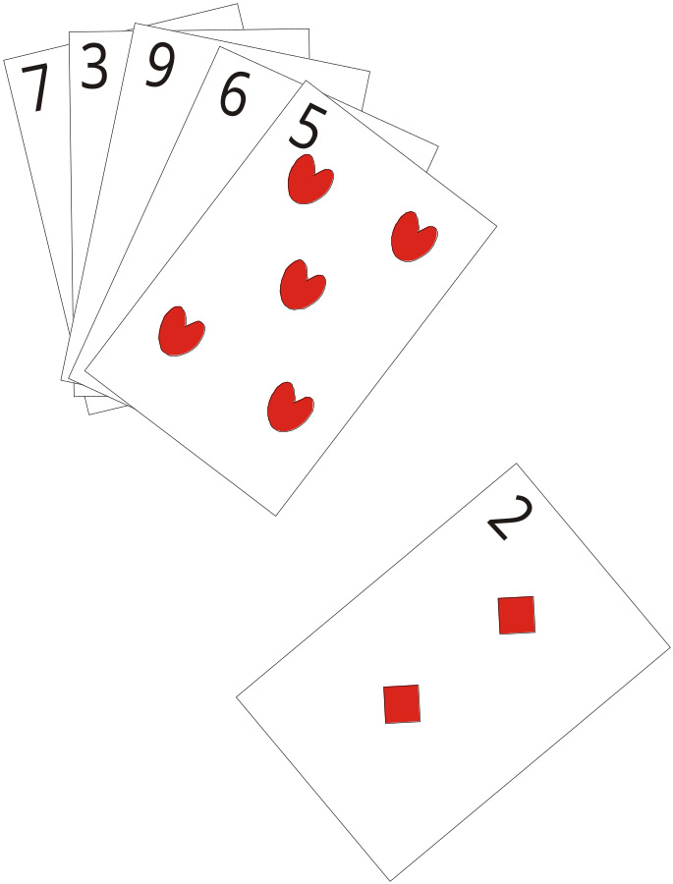
Selection Sort

Slide 26
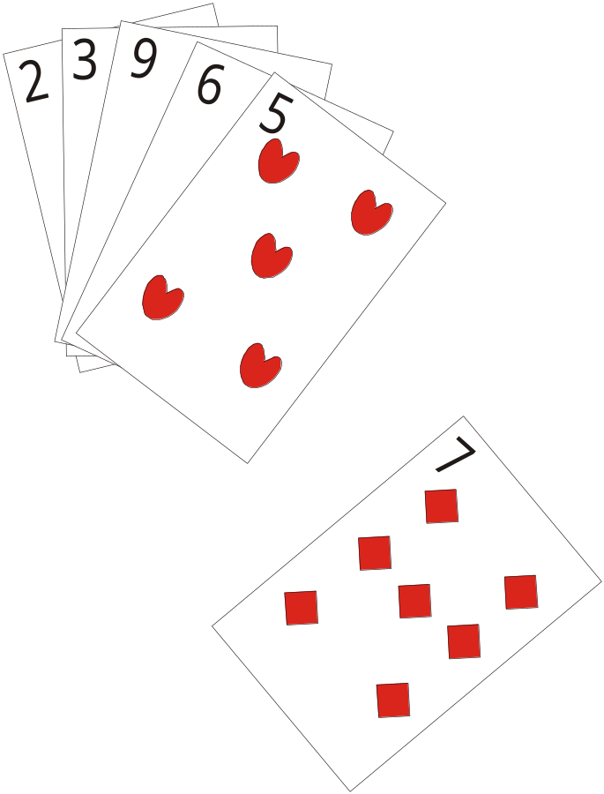
Selection Sort

Slide 27
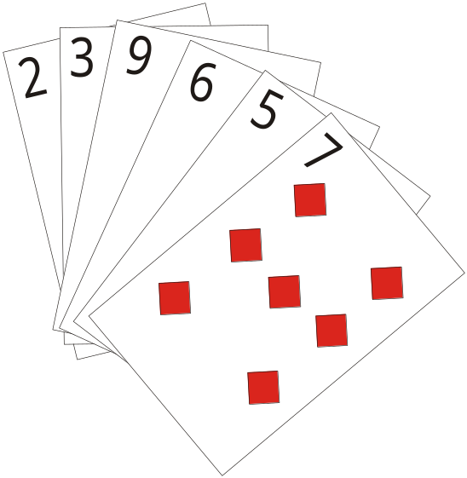
Selection Sort

Slide 28
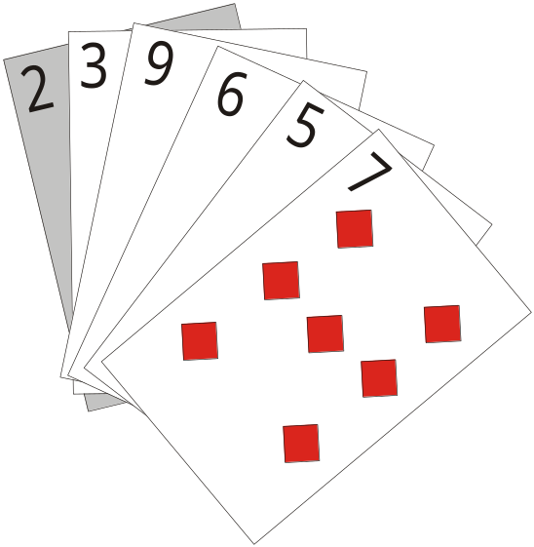
Selection Sort
Now …
Make the second card
The left-most card
left-most card

Slide 29
Selection Sort
Find the lowest card
in the remaining cards

Slide 30
Selection Sort
It is already the
left-most card, so
no swap is required
left-most card

Slide 31
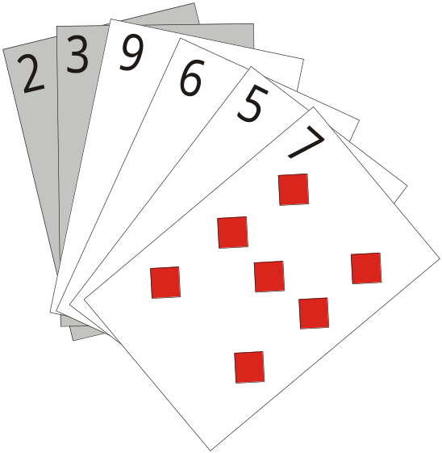
Selection Sort
Now make the third
card the left-most card
Left-most card

Slide 32
Selection Sort
And find the lowest card
In the remaining cards

Slide 33
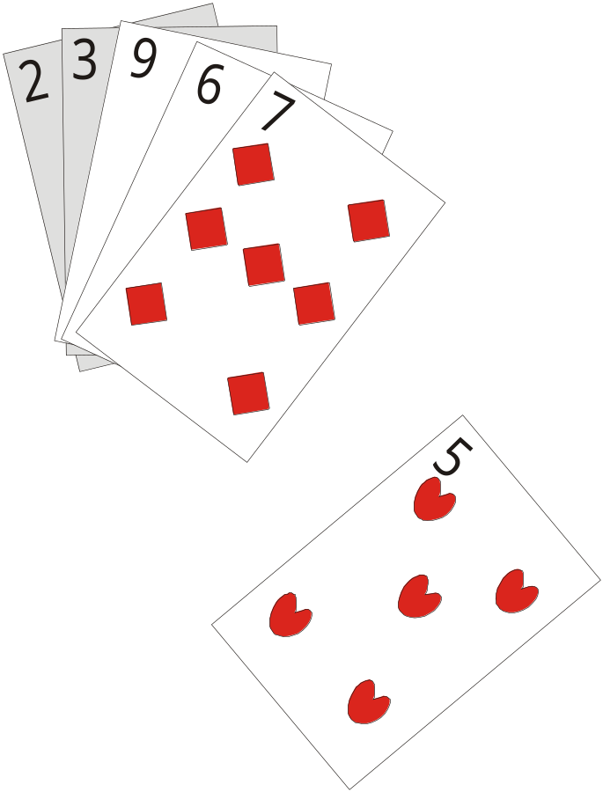
Selection Sort
Swap it with the
left-most card

Slide 34
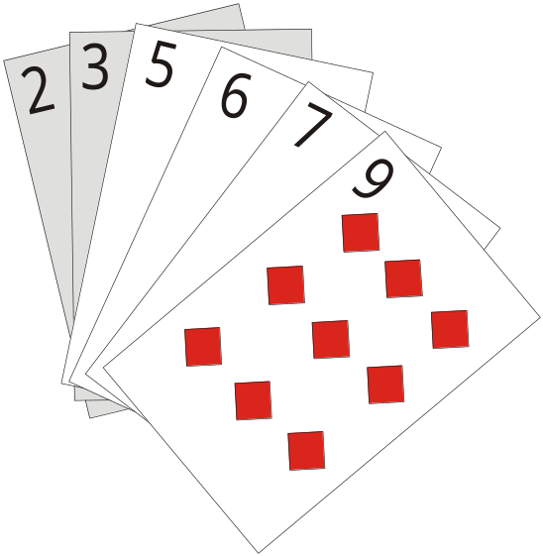
Selection Sort

Slide 35
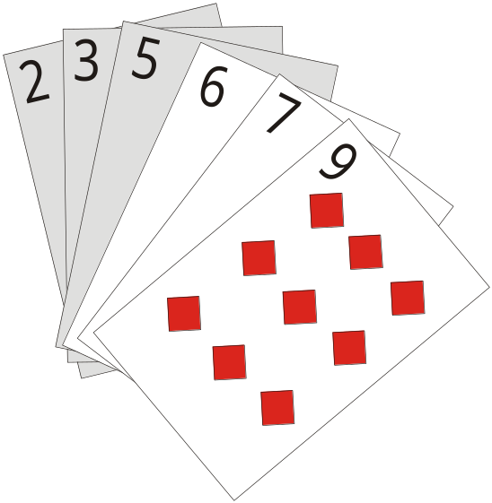
Selection Sort
Make the 4th card
the left-most card

Slide 36
Selection Sort
Find the lowest card
in the remaining cards

Slide 37
Selection Sort
The lowest card is the
left-most card, so no
swap is necessary

Slide 38
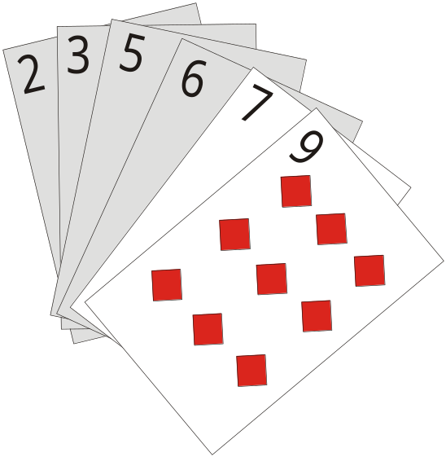
Selection Sort
Make the next card
the Leftmost-card

Slide 39
Selection Sort
Lowest remaining card
is the left-most card so
no swap is necessary

Slide 40
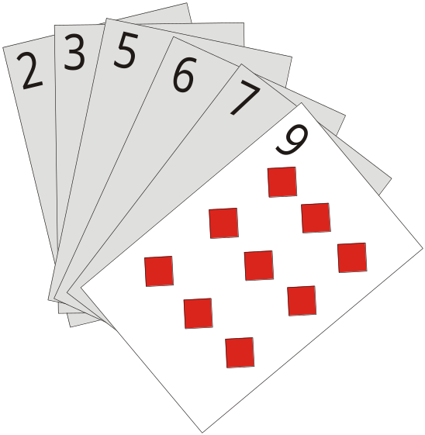
Selection Sort
Make the next card the left-most
card. It is the last card, so we are
done

Slide 41
Activity Diagram
High Level View
start
Make the left-most card the card to the right of the current left-most card
Find lowest card in hand
Swap it with the left-most card
yes
Is this the last card?
end
Find the lowest card
In the set of cards to the right of the current left-most card
no

Slide 42
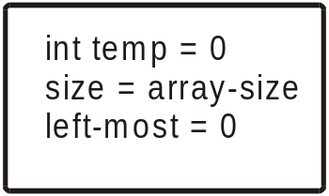
The Activity Diagram
Initialize some local variables.
Keep in mind that the array is
Zero-indexed. Left-most card is the first element in the array

Slide 43
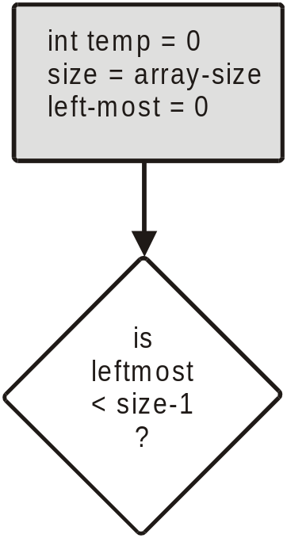
The Activity Diagram
If left-most = size-1
we are done.

Slide 44
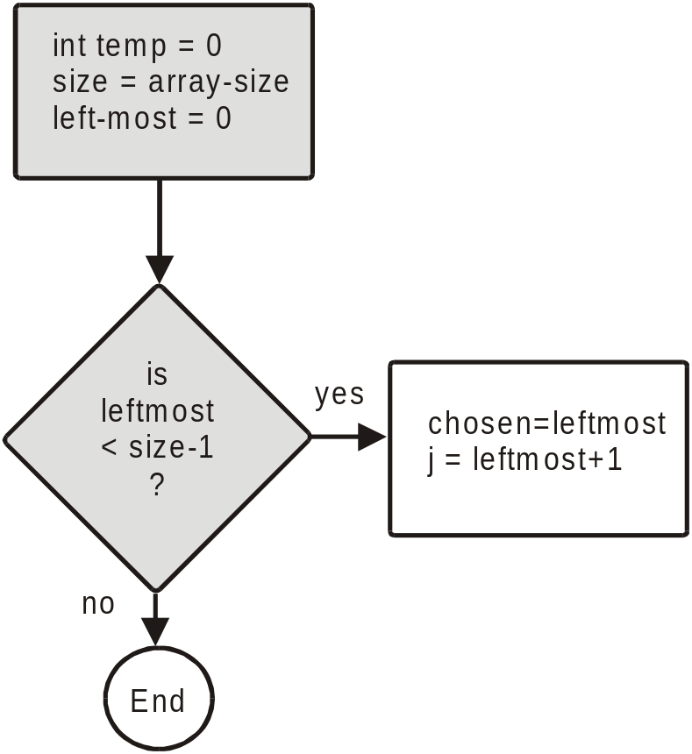
The Activity Diagram
yes
no
Otherwise start with the card
Just to the right of the left-most
card

Slide 45
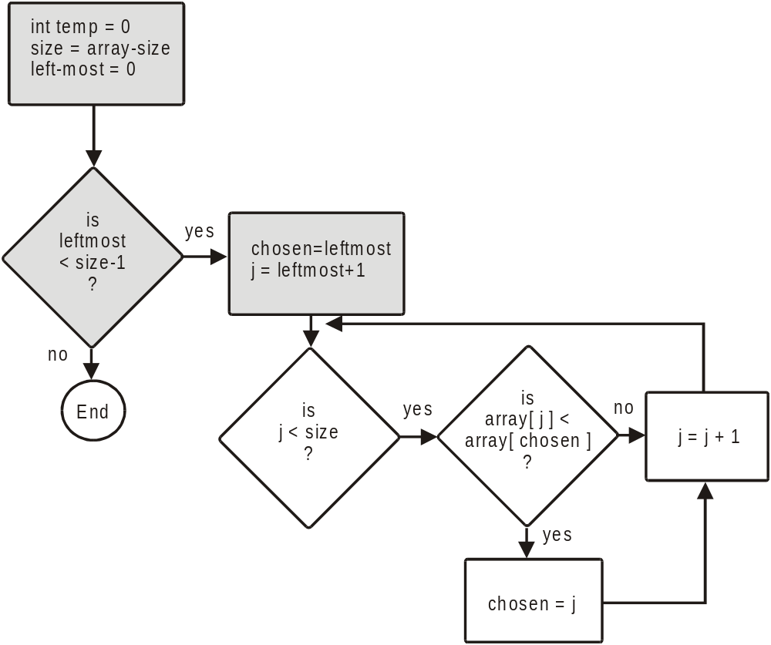
The Activity Diagram
Find the smallest card
In the remaining cards.
It’s index will be = “chosen”
yes
no
yes

Slide 46
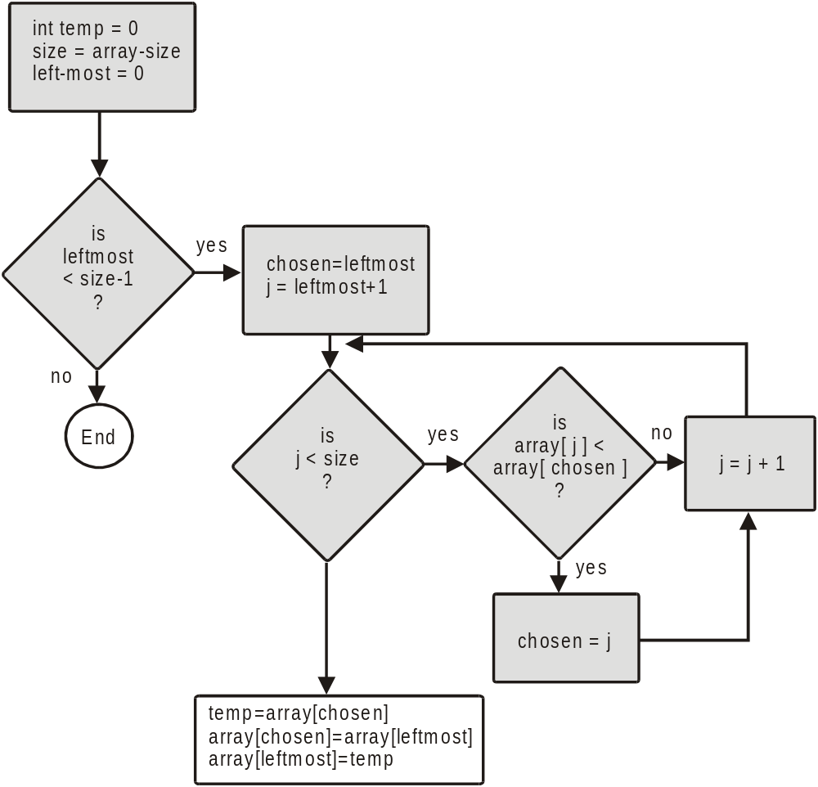
The Activity Diagram
Swap it with the
leftmost card

Slide 47
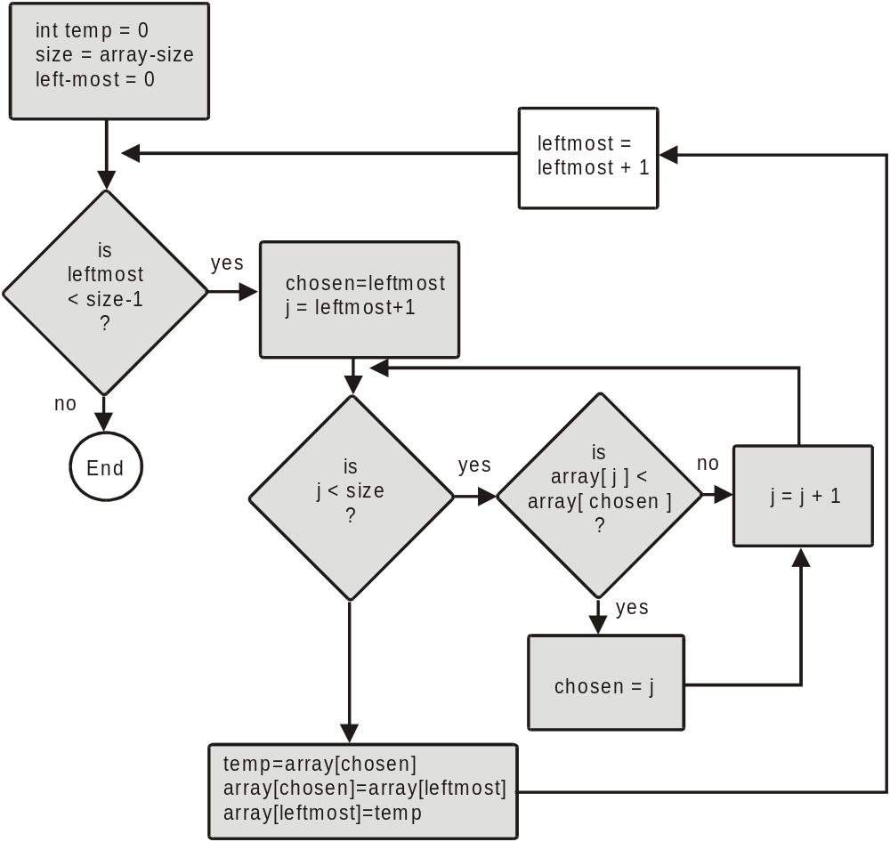
The Activity Diagram
Make the next card to
The right the left-most
Card.

Slide 48
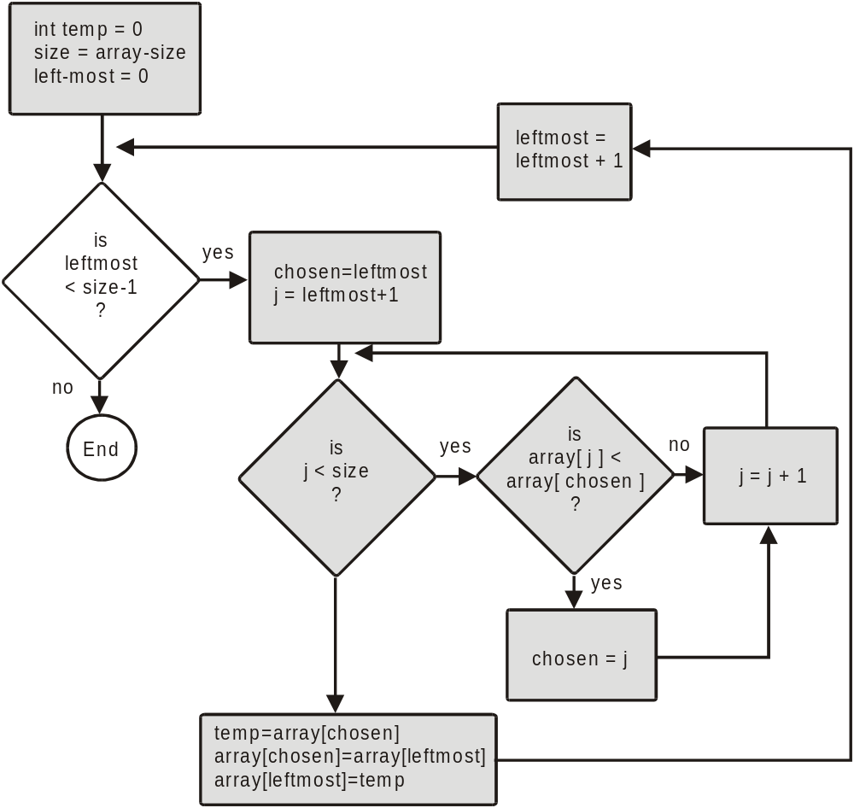
The Activity Diagram
And do it again!

Slide 49
int main( )
{
int examScores[ ] = {72, 98, 56, 87, 64, 83, 77, 91, 66, 70};
int chosen, temp;
for ( int leftmost = 0; leftmost < 10; leftmost++ )
{
chosen = leftmost;
for ( int j = leftmost + 1; j < 10; j++ )
if (examScores[j] < examScores[chosen])
chosen = j;
temp = examScores[chosen];
examScores[chosen] = examScores[leftmost];
examScores[leftmost] = temp;
}
// print the sorted array
for ( int i = 0; i < 10; i++ )
cout << examScores[i] << " " ;
getch( );
return 0;
}

Slide 50
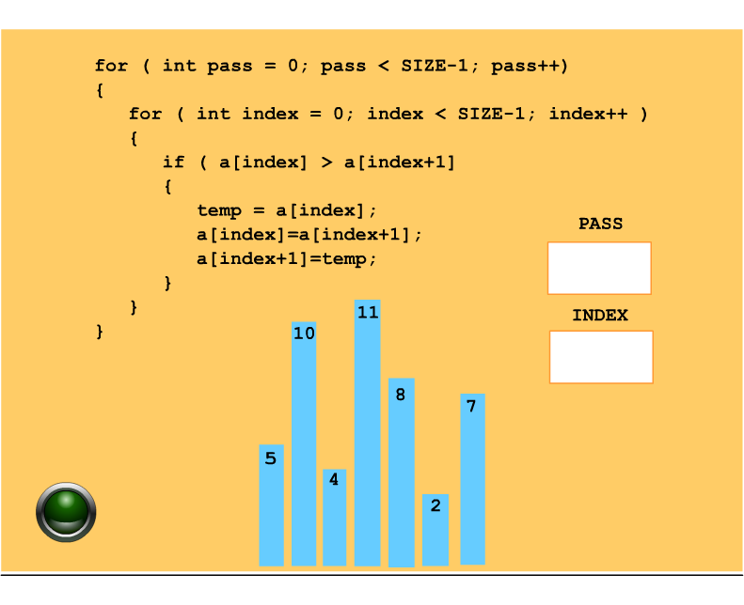
Bubble Sort
Considered to be one of the least efficient algorithms,
but one of the easiest to understand

Slide 51
Two Dimensional Arrays
columns
rows
How we think of a two dimensional array

Slide 52
examScores
student 1
78
89
65
97
student 2
76
79
82
85
student 3
83
89
91
90
exam 1
exam 2
exam 3
exam 4

Slide 53
An Array of Arrays
student 1
78
89
65
97
student 2
76
79
82
85
student 3
83
89
91
90
exam 1
exam 2
exam 3
exam 4

Slide 54
int main( )
{
// declare an array 3 x 4
int examScores[ ][4]= { {78, 89, 65, 97},
{76, 79, 82, 85},
{83, 89, 91, 90} };
const int STUDENT = 3;
const int EXAMS = 4;
for ( int i = 0; i < STUDENT; i++ )
{
int sum = 0;
for ( int j = 0; j < EXAMS; j++ )
sum = sum + examScores [ i ][ j ];
float avg = ((float)sum)/EXAMS;
cout << “Student # “ << (i+1) << “: “ << avg << “\n”;
}
}

Slide 55
Multi-dimensional array as a parameter…
We do not give the size of the first dimension of an
array when passing it, but we do give the sizes of
the remaining dimensions. The size of the first dimension
is passed as a separate argument.
void getPage (char p[][100], int sizeOne);

Slide 56
Vectors
Vectors can be thought of as arrays that grow as
required, while a program is executing.
Vectors are formed from a template class in the
Standard Template Library (STL). We will study
templates and the Standard Template Library in
some detail in CNS 1350.

Slide 57
Declaring a Vector
#include <vector>
using namespace std;
. . .
vector <int> v;
the notation <int> defines the type of vector.
In this case, we have declared a Vector of integers.

Slide 58
Accessing Vector Elements
You can use the square bracket notation [ ] to access
elements of a vector, just as you do for an array. Note
however, that you can only access existing Vector
elements this way, you cannot initialize them!

Slide 59
Initializing Vector Elements
To add an element to a Vector for the first time, you
must use the push_back function. push_back adds an
element in the next available position.
v.push_back ( 23 );

Slide 60
The size of a Vector
As noted, the size of a Vector changes as needed, to
accommodate new elements. The current size of a
Vector ( the number of elements in the Vector ) can be
found by
unsigned int n = v.size( );
note that the size( ) function returns an unsigned int.
This can be automatically converted to an int by most
compilers. To be safe, do an explicit cast or use the
unsigned int data type, as shown above.

Slide 61
Example

Slide 62
#include <iostream>
#include <vector>
using namespace std;
int main ( )
{
vector<int> v;
cout << “Enter a list of positive numbers.\n”;
cout << :End the list with a negative number.\n”;
int next;
cin >> next;
while ( next > 0 )
{
v.push_back( next );
cout << next << “ added to the Vector\n.”;
cout << “v.size( ) = “ << v.size( ) << endl;
cin >> next;
}
cout << “You entered:\n”;
for ( unsigned int i = 0; i < v.size( ); i++ )
cout << v[ i ];
return 0;
}

