Slide 1
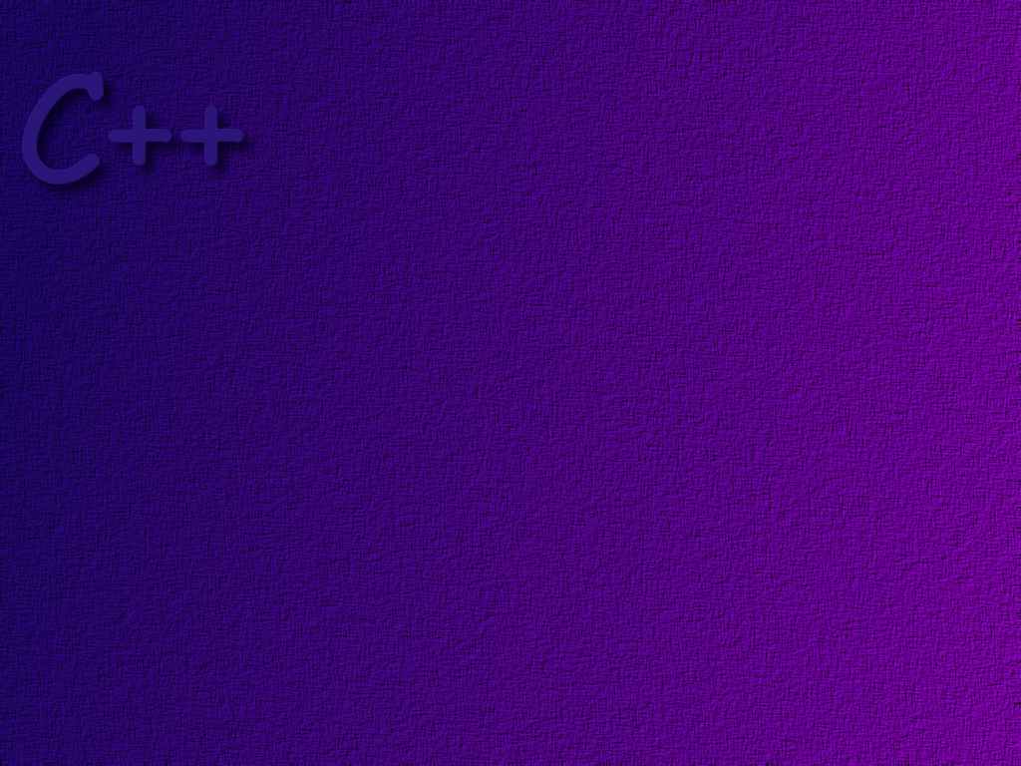
Constructors and Other Tools

Slide 2
Topics
Constructors
Composition
const Parameter Modifier
const objects
const functions
In-line functions
Static data and member functions

Slide 3
Objectives
After completing this topic, students should be able to:
Correctly write and use constructors in a program
Use an initializer list in a constructor
Describe the use of the default constructor
Understand and use composition relationships in programs
Correctly use the const modifier
Know what static data is and correctly use static data
in a program
Know what a static function is and correctly use a static
function in a program

Slide 4
Constructors
Creating objects with un-initialized member data can be dangerous.
If that member data is used somewhere later in the program, it will
be garbage.
Constructors provide us with a handy way to initialize member data
when an object is created.

Slide 5
Important Note: Constructors don’t create
objects! They are used to initialize data
in an object.

Slide 6
Constructor Definitions
A constructor is a member function of a class, but it has
two unique qualities:
* It must have the same name as the class
* It has no return type ( not even void)

Slide 7
This is the constructor for the CoinBank class.
Notice that it has the same name as the class
and has no return type.
class CoinBank
{
private:
double moneyInBank;
public:
CoinBank ( );
double howMuchMoney ( );
void addMoney (double);
void takeMoney (double);
};

Slide 8
The implementation of the CoinBank constructor
looks like this. Like any member function, we use the
class name and the scope resolution operator when writing
the implementation.
CoinBank::CoinBank( )
{
moneyInBank = 0;
}
This is the code to be executed
when the constructor is called.
In this case we initialize the
money in the bank to zero.

Slide 9
A slightly more complicated constructor might take a
parameter and use the parameter to set the initial value.
By overloading the constructor we can provide both
definitions.
CoinBank::CoinBank (double n)
{
if (n <0.0)
moneyInBank = 0.0;
else
moneyInBank = n;
}

Slide 10
Using the Constructor
The constructor is called when an object is declared.
This declaration calls the default (non-parameterized)
constructor. Notice that there are no parentheses used
when invoking the default constructor.
CoinBank myBank;
CoinBank billsBank (5.00);
This declaration calls the parameterized
constructor, passing in the value of 5.00.

Slide 11
Using an Initializer List
The initializer list initializes the data members. This
technique is preferred because initialization occurs as
memory is being allocated for the data members.
CoinBank::CoinBank (double n)
: moneyInBank (n)
{
}
The initializer list goes between the parameter list
and the opening brace for the function. Each element
of the list is made up of the data member name
followed by the value, in parentheses, to be assigned
to that data member.

Slide 12
CoinBank::CoinBank (double n)
: moneyInBank (n)
{
if (moneyInBank < 0)
moneyInBank = 0.0;
}
You can add error checking or other
code inside the body of the constructor.

Slide 13
Default Constructor
By default constructor, we mean a constructor that
takes no parameters.
When a class is defined, the compiler automatically
creates a non-parameterized constructor. This
constructor does no initialization.
If you write a parameterized constructor in your
class definition, the compiler then does not create a
default constructor. If you want one, you must write
it yourself.

Slide 14
Explicit Constructor Calls
Normally a constructor is only used when declaring an
object. However, we can make an explicit constructor
call to re-initialize the data members of an object as
follows:
myPiggyBank = CoinBank ( );
The right hand side of this expression creates an anonymous (nameless)
object and then calls the constructor to initialize its data members. The
assignment statement then copies the values of the anonymous objects
data members into myPiggyBank’s data members. The anonymous object
is then destroyed. Note that in this case you must include the parentheses
when using the default constructor.

Slide 15
Composition
A class may have a data member that is itself
an object of another class. This unique class
relationship is called composition.

Slide 16
Composition Example
The Soda Machine

Slide 17


Slide 18
Soda Machine
$
$
Change Unit
Vending Unit

Slide 19
VendingUnit
someCans : int
+VendingUnit ( :int )
+VendingUnit ( )
+giveOne( ): bool

Slide 20
$
$
ChangeUnit
change: int
+ ChangeUnit ( )
+ChangeUnit ( :int )
+ void giveIt ( :int )

Slide 21
Soda Machine
SodaMachine
+ selection : int
changer : ChangeUnit
vendor : VendingUnit
+ SodaMachine ( int, int )
+ run ( ) : int
- buy ( ) : void

Slide 22
3
Soda Machine
Functions
Select = 1
4
User I/F
user
buy
menu
2
5
$
$
1
giveOne
6
Main
{
…
…
}
run
giveIt
Change Unit
Vending Unit

Slide 23
main
SodaMachine
sodaMachine
ChangeUnit
changer
VendingUnit
vendor
run
menu
selection
buy
deposit $
inMoney
giveOne
giveIt ( inMoney )
A Sequence Diagram

Slide 24
int SodaMachine::run ( )
{
while ( true )
{
cout << “\n\n\nRoger’s Soda Machine\n”;
cout << “MENU (Type a number and hit ENTER:\n”;
cout << “1 – buy a soda\n”;
cout << “2 – stop simulation\n”;
cin >> selection;
if ( selection == 1 ) buy ( );
else if ( selection == 2 ) break;
else cout << “Invalid selection …\n”;
}
return;
{

Slide 25
Void SodaMachine::buy ( )
{
int inMoney;
bool okay;
while ( true )
{
cout << “Soda’s cost 25 cents\n”;
cout << “How many cents are you putting in?\n:”;
cin >> inMoney;
if ( inMoney >= 25 ) break;
cout << “Not enough … try again.\n”;
}
okay = vendor.giveOne ( );
if ( okay ) changer.giveIt ( inMoney );
}

Slide 26
Principle of Least Privilege
A function should have the least possible access to data
required to do its job.

Slide 27
The const Parameter Modifier
Call by reference is more efficient than call by value.
When using call by reference, and you know that a function
should not change the value of a parameter, mark the
parameter so that the compiler knows it should not be
changed.
bool isLarger (const BankAccount& acct1, const BankAccount& acct2);

Slide 28
Rules for Function Parameters
1. For basic data type parameters, e.g., int, float, etc,
pass the parameters by value
2. For non-basic data type parameters, e.g. objects and
structs, pass the parameters by reference.
3. When passing by reference, if the function should not
change the value of the parameter, use the const
modifier.

Slide 29
Constant Objects
You can use the const modifier when declaring an object,
to make all of the data members of the object constant.
Note that constantness is a property of an object, not a class!

Slide 30
Example
Consider a Time class whose data members are
hours, minutes, and seconds.
You might declare a Time Object to keep track of the
wake up time for an alarm clock. Since you may change
the time you wake up each day, the Time object would
not be declared as constant.
However, if you wanted a Time object to represent the time
of 12 noon, then you would make the object constant, since
the time at which noon occurs never changes.
const Time noon (12, 0, 0);

Slide 31
const Functions
Most C++ compilers will not allow member functions for
const objects unless the functions themselves are declared
as const. Member functions declared as const cannot modify
the object.
A function is declared as const both in its prototype and
in the function implementation.
void Time::displayTime( ) const
{
…
}
the const keyword follows
the function’s parameter list.

Slide 32
In-Line Functions
You can give the complete implementation of a function
within the definition of its class.
class PiggyBank
{
public:
PiggyBank( );
double getMoneyInBank( ) const
{
return moneyInBank;
}
…
};

Slide 33
When the implementation of a function is written in-line in the
class definition, the compiler treats the code differently.
Under normal circumstances, whenever a function is invoked,
the compiler generates a call to the function code, which is
written into memory just once.
When a function is in-line, the compiler inserts the machine
code for the function everyplace that the function is called.
Putting a function inline does not guarantee that
inline code will be generated!

Slide 34
Normal Function call
save environment
put parameters on the stack
pass control to function
get return value off of stack
restore environment
int getStuff ( )
{
return stuff;
}
main ( )
{
getStuff( );
…
…
getStuff( );
…
…
getStuff( );
}
compiler
compiler
save environment
put parameters on the stack
pass control to function
get return value off of stack
restore environment
compiler
machine code
for getStuff
…
save environment
put parameters on the stack
pass control to function
get return value off of stack
restore environment
compiler

Slide 35
machine code
for main( )
save environment
put parameters on the stack
pass control to function
get return value off of stack
restore environment
getStuff( )
getStuff( )
getStuff( )
machine code
for getStuff( )
memory

Slide 36
In-Line Function Call
int getStuff ( )
{
return stuff;
}
main ( )
{
getStuff( );
…
…
getStuff( );
…
…
getStuff( );
}
compiler
machine code
for getStuff( )
compiler
compiler
machine code
for getStuff( )
machine code
for getStuff
…
machine code
for getStuff( )
compiler

Slide 37
machine code
for main( )
in-Line functions eliminate the
overhead of calling a function
but …
the executable code takes more
space in memory because the
code for the function is repeated
over and over again.
machine code
for getStuff( )
machine code
for getStuff( )
machine code
for getStuff( )
memory

Slide 38
Static Data Members
Normally, each object of a class keeps its own copy of the
data members defined in the class.
PiggyBank myBank;
class PiggyBank
{
private:
int moneyInBank;
…
}
moneyInBank
$3.50
PiggyBank yourBank;
PiggyBank bigBank;
moneyInBank
$17.25
moneyInBank
$1345.95

Slide 39
When a data member is declared as static, only one copy is
created, nor matter how many objects are created. All objects
share this single copy of the data member.
PiggyBank myBank;
class PiggyBank
{
private:
float moneyInBank;
static float interestRate;
…
}
.0525
interestRate
moneyInBank
$3.50
PiggyBank yourBank;
PiggyBank bigBank;
moneyInBank
$17.25
moneyInBank
$1345.95

Slide 40
Initializing Static Data Members
Static data members are initialized outside of the
class definition, but typically in the same file as the
class definition. Static data members can only be
initialized once.
float PiggyBank::interestRate = .0525;
This initialization works even if the data is
declared private.

Slide 41
Static Member Functions
Member functions of a class can also be declared as static.
A static member function can be invoked without an object
of the class ever having been created.
As a result, static member functions cannot do anything that
depends on there being a calling object. In particular, a static
function cannot use non-static member data.
Static member functions are usually invoked using the class name:
PiggyBank::setRate (0.325);

Slide 42
class Dumb
{
private:
static int number;
public:
static getNumber( );
};
Dumb::getNumber( )
{
return number;
}
int Dumb::number = 5;
int main( )
{
cout << Dumb::getNumber( );
cin.get( );
return 0;
}
Static Function!

Slide 43
Practice
Consider the Integer class we
examined in the last set of slides.

Slide 44
Design a class that represents “Integer” objects.
Suppose we want functions to
set the integer value in the object
retrieve the integer value in the object
retrieve the reciprocal of the value in the object

Slide 45
Write a non-parameterized constructor.
What should the default value of an Integer be?

Slide 46
Write a parameterized constructor.
Write it with and without an initializer list.

Slide 47
Define the class such that one if its
data members keeps track of how
many Integer objects have been created.

Slide 48

Here is an Example of Composition
A Wheel
Object
An Engine
Object
A Drive Train
Object

Slide 49
What other real world objects could we
model using composition relationships?

Slide 50
What are the benefits of an in-line function?
What are the problems with in-line functions?

