Slide 1
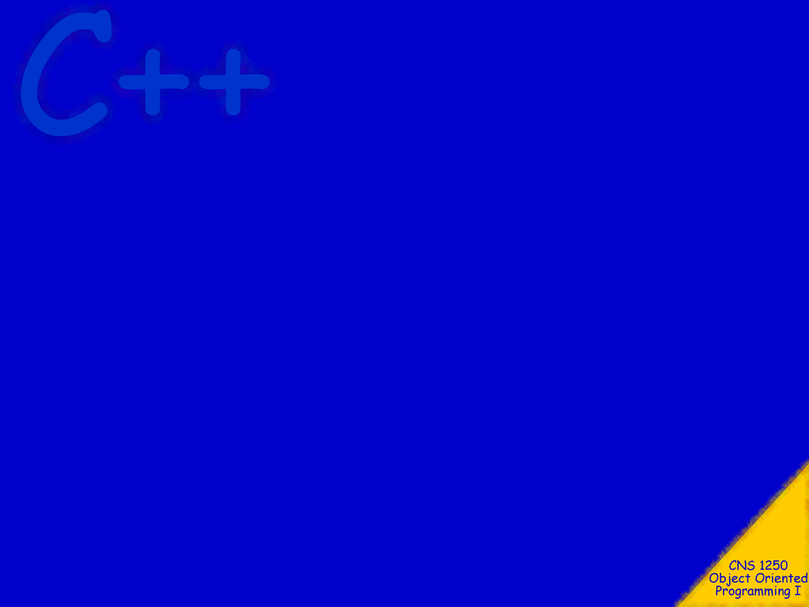
Character Arrays

Slide 2
Topics
char arrays
Character I/O
Character manipulation functions

Slide 3
Objectives
At the conclusion of this topic, students should be able to:
Correctly use char arrays in a C++ program
Correctly use character I/O in a C++ program
Use the character manipulation functions provided
in the standard library

Slide 4
We have been using the C++ String
class to represent strings of characters.
Although this is the most convenient way
to represent character strings, the C++
language also represents character strings
as arrays of type char.

Slide 5
someText
The terminal character in the array is the
null terminating character, \0.
h
0
e
1
This is called a null terminated string, or
a C-string (this is the only way that a
character string could be represented
in the C language).
l
2
l
3
o
4
Functions that operate on C-strings look for the
null terminating character to know where the end
of the string is.
\0
5
When creating an array to store a character string,
always be sure that there is room for the null
terminating character.

Slide 6
firstName
J
0
lastName
o
1
S
0
Note that is possible to have an array
of characters that is not a C-String.
h
2
m
1
n
3
i
2
char firstName[20] = “John”;
\0
4
t
when initialized this way, the
null terminating character is
automatically added at the end.
3
?
5
h
4
?
?
5
char lastName[20] = {‘S’,’m’,’i’,’t’,’h’};
?
?
when initialized this way, no null
terminating character is added.
This is just a simple array of
characters. It is not a C-String!
. . .
?
. . .

Slide 7
Char Arrays and Loops
You can treat a char array exactly like any other array.
You can use index notation to access individual array elements
lastName[n] = ‘t’;
You can use loops to manipulate arrays elements.
for (int n = 0; n < SIZE; n++)
{
lastName[n] = ‘-’;
}
Be careful not to accidentally replace the null terminating character with some other character.

Slide 8
Assignment
Although you can use the assignment operator
when initializing an array, you cannot use the
assignment operator anywhere else with a
character array. For example, the following is
illegal:
char aString[10];
aString = “Hello”;

Slide 9
strcpy Function
The easiest way to assign a value to a C-String
is to use the strcpy function.
To use strcpy you must use the include directive
#include <cstring>
No using statement is required, the definitions
in <cstring> are in the global namespace.

Slide 10
Security Issues
Incorrect use of string functions has caused many security problems because of buffer over-runs. To prevent these problems use:
“n” versions of functions, like strncpy – you must ensure that string is null-terminated. If it is not, do it manually after the copy.
“l” versions of functions, like strlcpy – these are not part of the standard library, but source code is available from BSD
“_s” versions of functions, like strcpy_s – available with Microsoft development tools, might be included in standard libraries later.

Slide 11
Examples
strcpy (aString, “Hello”);
copies the char string Hello into aString.
includes a null terminating character.
strcpy (aString, bString);
copies the contents of bString into aString.
by making the last parameter one
less than the size of aString, you
can make the copy safe … i.e. it
will not over-run the array.
strncpy (aString, bString, 9);
copies at most 9 characters from
bString into aString.

Slide 12
Equality
Comparing two C-Strings using the equality
operator will compile without errors and will
execute, but will not give you the results you
expect.
char aString[ ] = “abc”;
char bString[ ] = “abc”;
if ( aString == bString )
{
…

Slide 13
strcmp Function
To compare two C-Strings, use the strcmp
function.
You must #include <cstring> to use this
function.
strcmp(strng1, strng2);
returns a value of zero if the strings are equal
returns a negative value if strng1 < strng2
returns a positive value if strng1 > strng2
comparison is done in lexicographic order.

Slide 14
Other <cstring> functions
strcat (strng1, strng2);
concatenates strng2 to the end of strng1.
strlen (aString);
returns the length of aString
does not include the null terminating character

Slide 15
C-String Input and Output
You can use >> and << operators to
input and output C-Strings.
To input a string containing blanks, you
must use
cin.getline (a, n);
where a is a char array and
n is an integer that indicates the max
number of characters to read. Note that
the null terminating character fills one
of these character positions.

Slide 16
These techniques work on files as well
as standard input and output.

Slide 17
Character I/O
Sometimes it is useful to input and output
one character at a time.
cin.get(aChar);
reads one character into aChar.
cout.put (aChar);
writes the character in aChar to
cout.
These work on any character, including
spaces and new-line characters.

Slide 18
Example
The following code will read one character
at a time from standard in and write it to
standard out, until a new-line character is
encountered.
char symbol;
do
{
cin.get (symbol);
cout.put (symbol);
} while (symbol != ‘\n’);

Slide 19
cin.putback (aChar);
places the value in aChar back into the input stream.
It will be the next character read.
cin.peek (aChar);
reads the next char in the input stream, but
leaves it in the stream.
cin.ignore (80, ‘\n’);
reads and ignores the next 80 chracters in the
input stream, or until a new-line is encountered.

Slide 20
Character Manipulation Functions
The following functions operate on characters. To use
any of these you must
#include <cctype>
No using statement is required. The definitions in
<cctype> are in the global namespace.

Slide 21
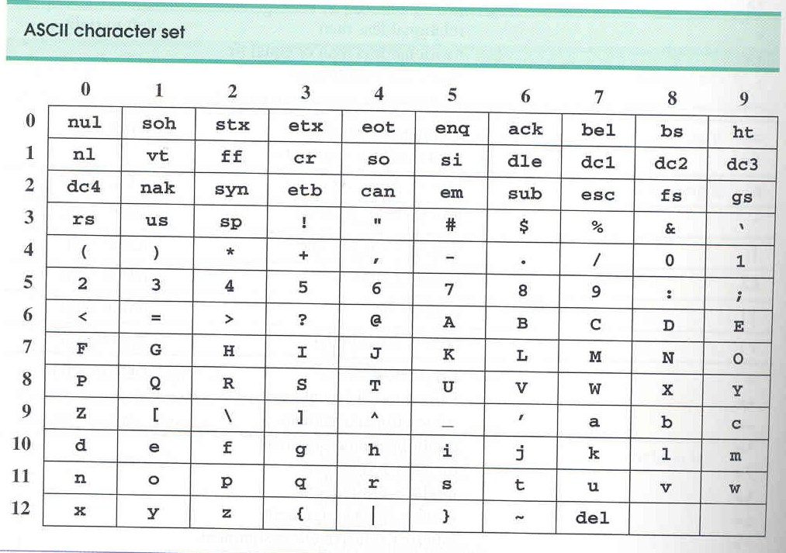
The ASCII Code Table

Slide 22
toupper (aChar);
returns the upper case value of aChar as an integer.
tolower (aChar);
returns the lower case value of aChar as an integer.
islower (aChar);
returns true of the value in aChar is lower case.
isalpha (aChar);
returns true if the value in aChar is a letter.

Slide 23
isdigit (aChar);
returns true if the value in aChar is a digit 0 through 9
isspace (aChar);
returns true if the value in aChar is white space.

Slide 24
String Conversion Functions
double atof (const char *nptr);
converts the string nPtr to a double
returns zero if the string cannot be converted
int atoi (const char *nptr);
converts the string nPtr to an int
returns zero if the string cannot be converted
note: the notation char *nptr is another
way of saying that nptr is a char array.
We will learn about this notation when
we study pointers

Slide 25
String Search Functions
char *strchr (const char *s, char c);
locates the first occurrence of the character c
in the string s. If found, a pointer to c is returned,
otherwise a NULL pointer is returned.
there are many more …

Slide 26
Memory Functions
void *memset (void *s, int c, size_t n);
copies the character c (converted to an unsigned int)
into the first n chaacters of the array s.
there are many more …

