Slide 1
Chapter 1
Primitive Java

Slide 2
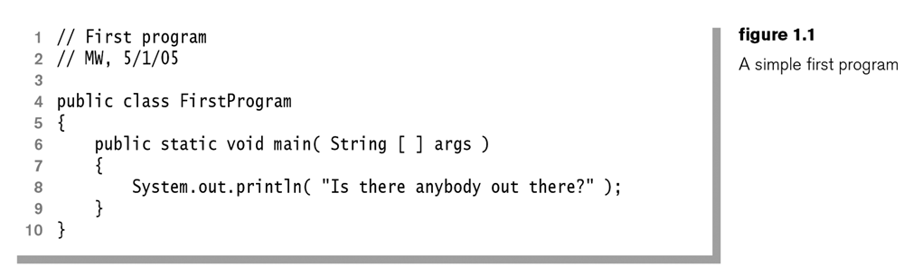
1-<number>
Copyright © 2006 Pearson Addison-Wesley. All rights reserved.

Slide 3
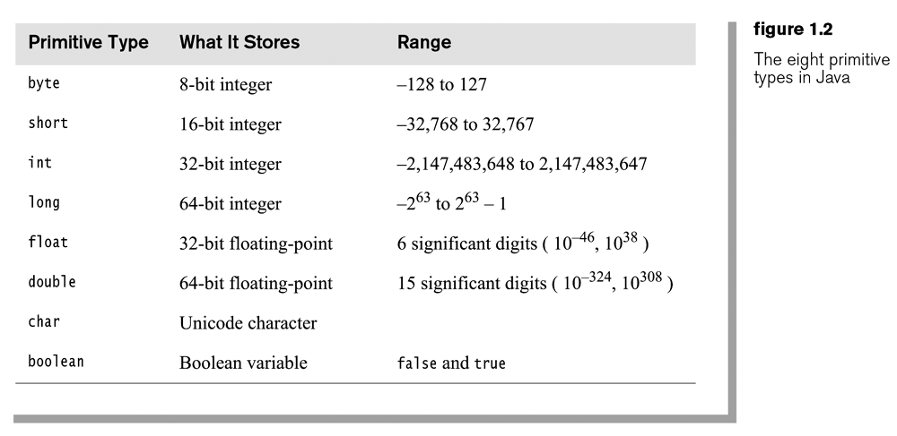
1-<number>
Copyright © 2006 Pearson Addison-Wesley. All rights reserved.

Slide 4
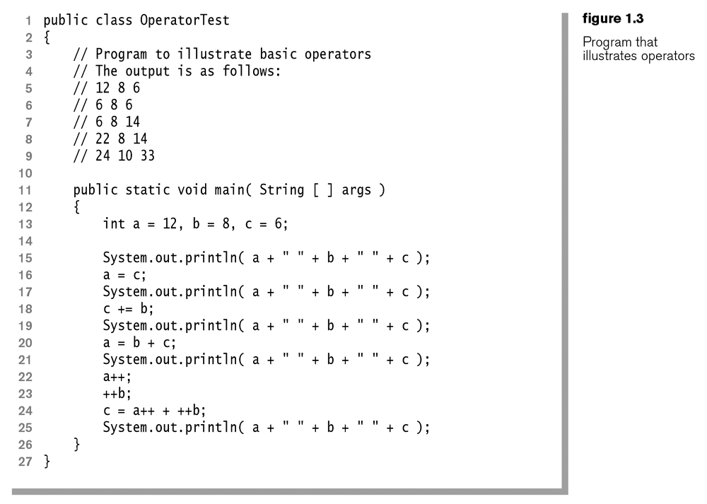
1-<number>
Copyright © 2006 Pearson Addison-Wesley. All rights reserved.

Slide 5
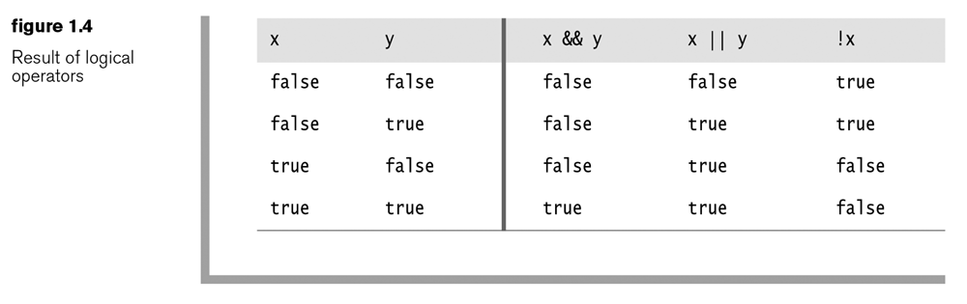
1-<number>
Copyright © 2006 Pearson Addison-Wesley. All rights reserved.

Slide 6
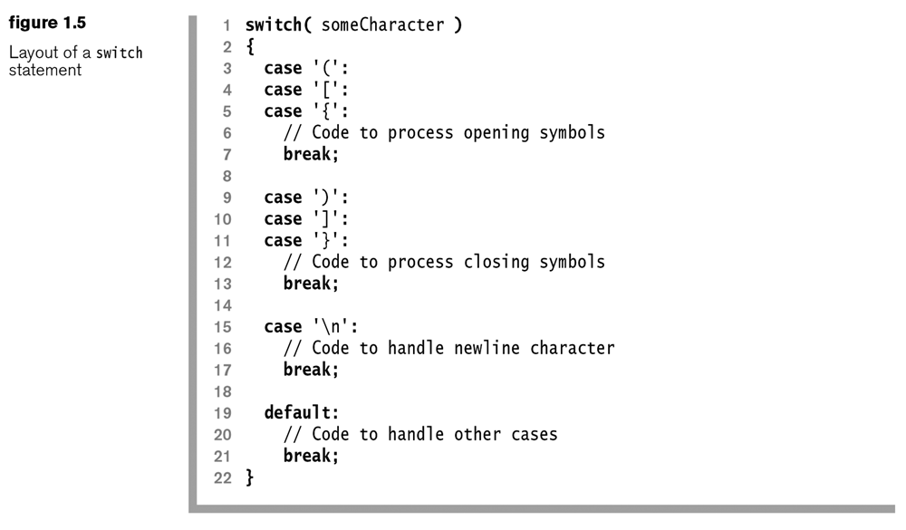
1-<number>
Copyright © 2006 Pearson Addison-Wesley. All rights reserved.

Slide 7
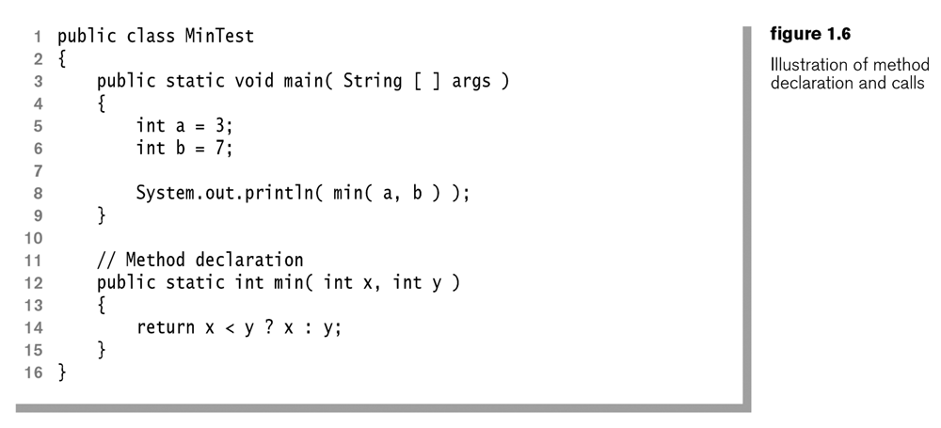
1-<number>
Copyright © 2006 Pearson Addison-Wesley. All rights reserved.

