Slide 1
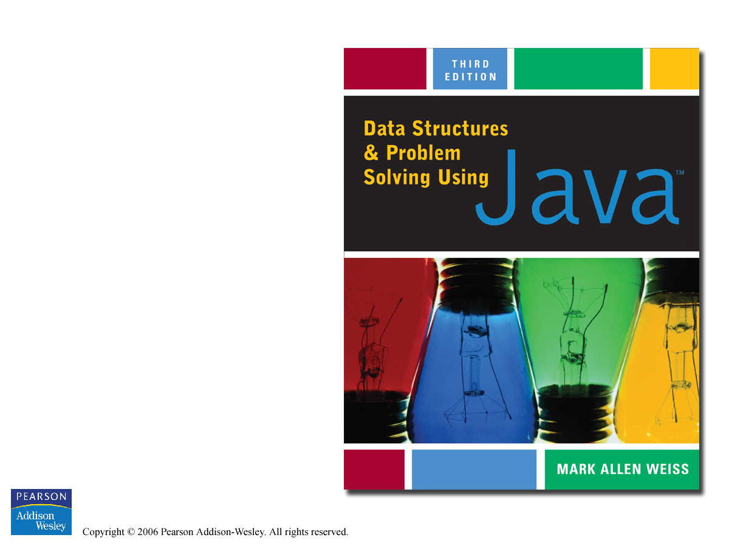
Appendix C
Bitwise Operators

Slide 2



