Slide 1
Extreme Honeymoons
Popular Excursions

Slide 2
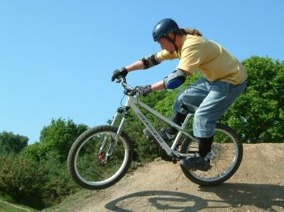

Mountain Biking
Cost w Bikes: $200.00
Cost w/o Bikes: $150.00
Location: Moab, Utah
Itinerary:
Travel to Moab
Evening at the Slick Rock Bed and Breakfast
Jeep transfer to Red Rock trail
20 mile trail ride
Lunch on the trail
Pickup late afternoon

Slide 3
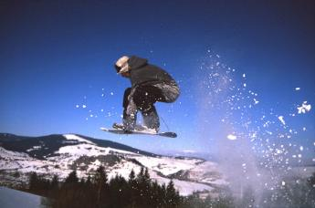
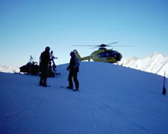
Heliskiing
Cost w Skis: $500.00
Cost w/o Skis: $400.00
Location: Kings Peak, Utah
Itinerary:
Travel to Park City
Evening at the Inn at Prospector Square
Helicopter transfer to Kings Peak
5 ski or snowboarding runs
Lunch on the Mountain
Helicopter pickup late afternoon

Slide 4

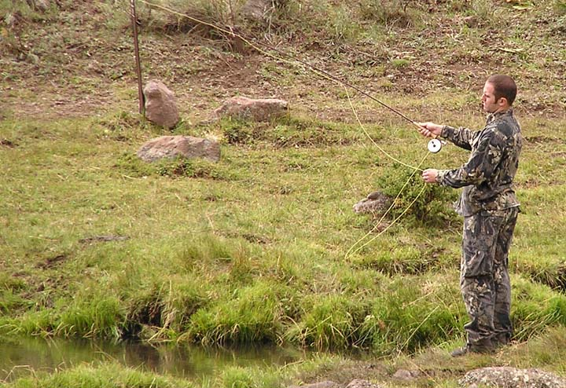
Flyfishing
Cost w Gear: $200.00
Cost w/o Gear: $150.00
Location: Deep Lake, 12 Mile Canyon, Mayfield, Utah
Itinerary:
Travel to Mayfield
Evening at the Palisade Bed and Breakfast
Jeep and ATV transfer to Deep Lake
Flyfishing Lessons
Lunch at the lake
Pickup late afternoon

Slide 5
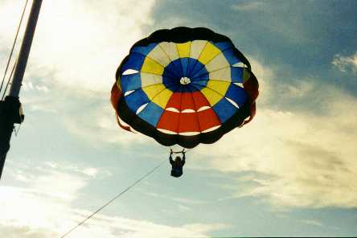
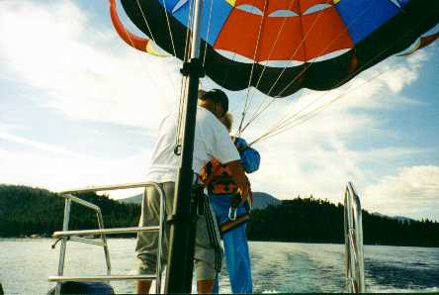
Parasailing
Cost w Skis: $500.00
Cost w/o Skis: $450.00
Location: Lake Powell, Utah
Itinerary:
Travel to Bullfrog Marina
Evening on honeymoon house boat
½ day waterskiing
½ day parasailing
Lunch on the lake
Pickup late afternoon

Slide 6
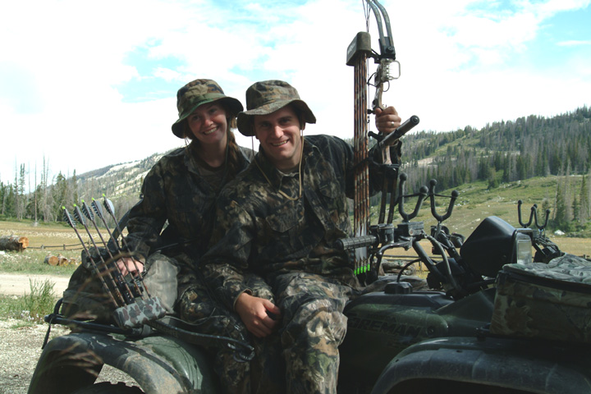
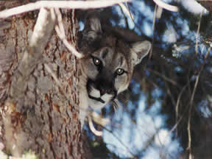
Cougar Hunting
Cost w Bows: $600.00
Cost w/o Bows: $500.00
Location: 6 Mile Canyon,
Manti Lasal National Forest, Utah
Itinerary:
Travel to Mayfield
Evening at the Palisade Bed and Breakfast
Jeep and ATV transfer to 6 Mile Canyon
Archery Lessons
Afternoon cougar hunt
Lunch on the trail
Pickup late afternoon

Slide 7

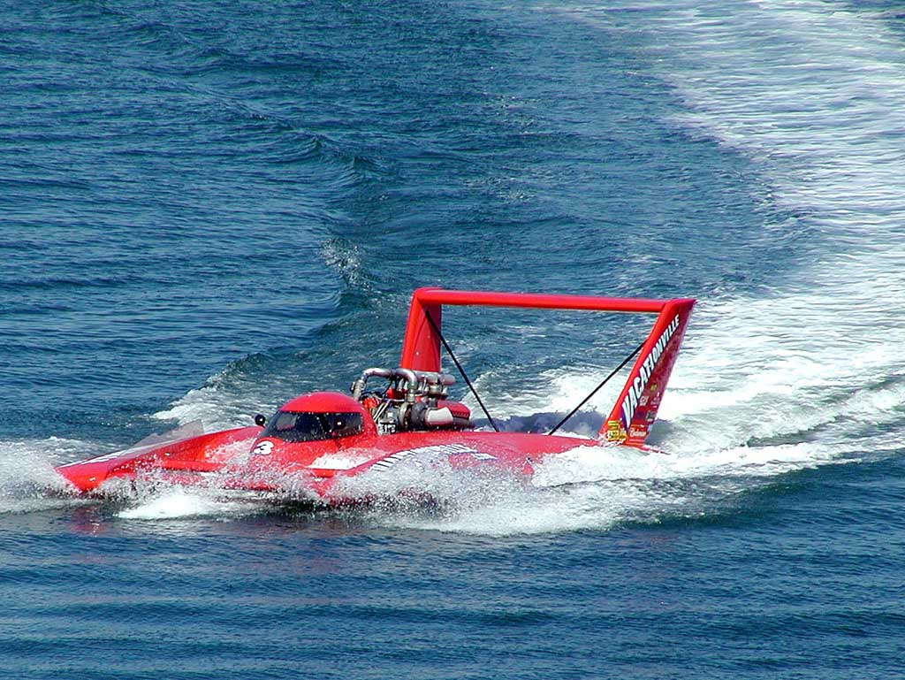
Speed Boating
Cost w Jet Skis: $600.00
Cost w/o Jet Skis: $500.00
Location: Willard Bay, Utah
Itinerary:
Travel to Ogden
Evening at the Royal Canadian Bed and Breakfast
Jeep transfer to Willard Bay
Boat driving lessons
Mock time trials with video
Lunch on the bay
Pickup late afternoon

Slide 8
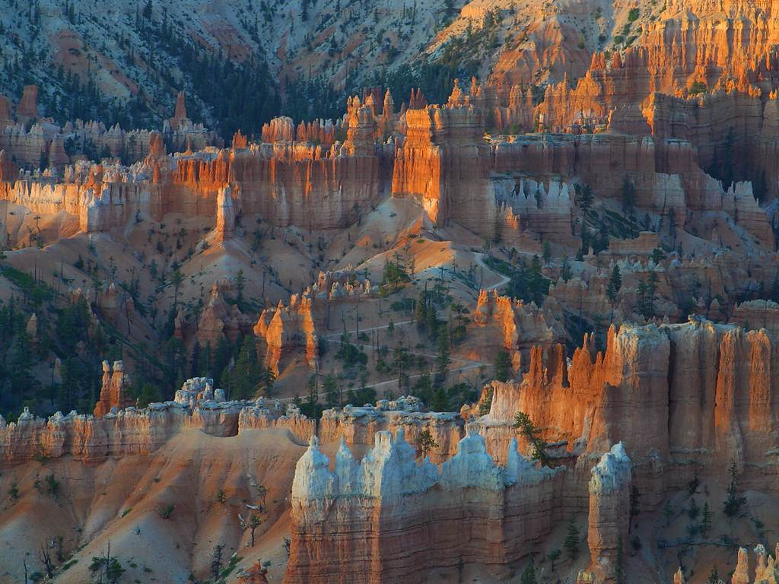
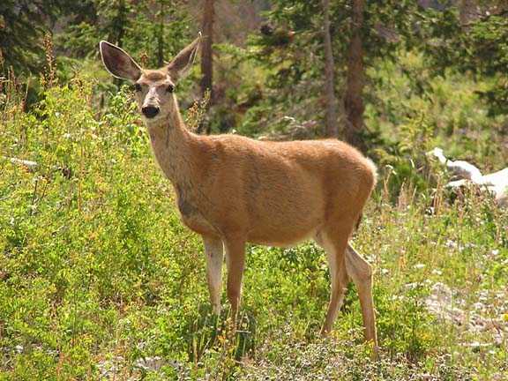
Horseback Riding
Cost w Horses: $400.00
Cost w/o Horses: $300.00
Location: Bryce Canyon, Utah
Itinerary:
Travel to Bryce Canyon National Park
Evening at the Ruby’s Inn
Jeep transfer to the park
Riding lessons
½ day trail riding
Lunch on the trail
Pickup late afternoon

Slide 9
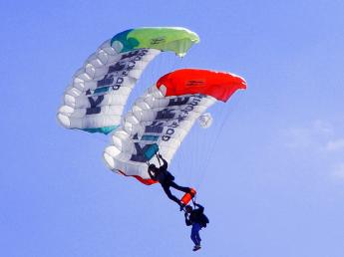
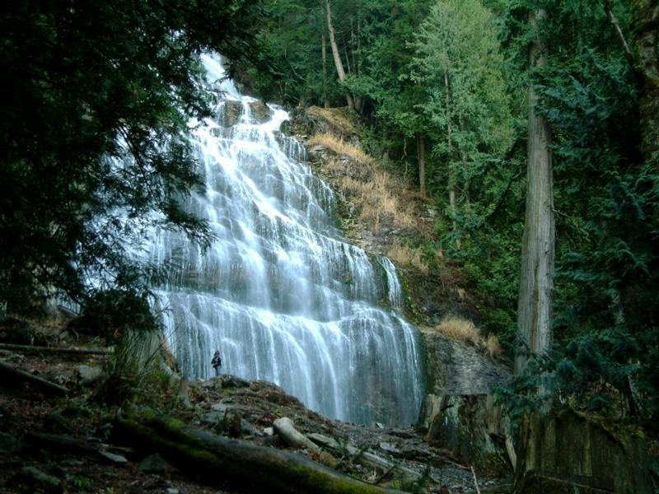
Skydiving
Cost w Insurance: $600.00
Cost w/o Insurance: $1,500.00
Location: Mount Timpanogos, Utah
Itinerary:
Travel to Provo
Evening at Somewhere Inn Time Bed and Breakfast
Jeep transfer to Aspen Grove trailhead
4 hour hike to top of Timp
1 jump from the top
Pickup late afternoon in Rock Canyon

Slide 10
Extreme Honeymoons
Thanks for Your Patronage!!!

