Slide 1
Adding Images, Color and Backgrounds
Teach Yourself Web Publishing
with HTML and CSS: Lesson 7

Slide 2
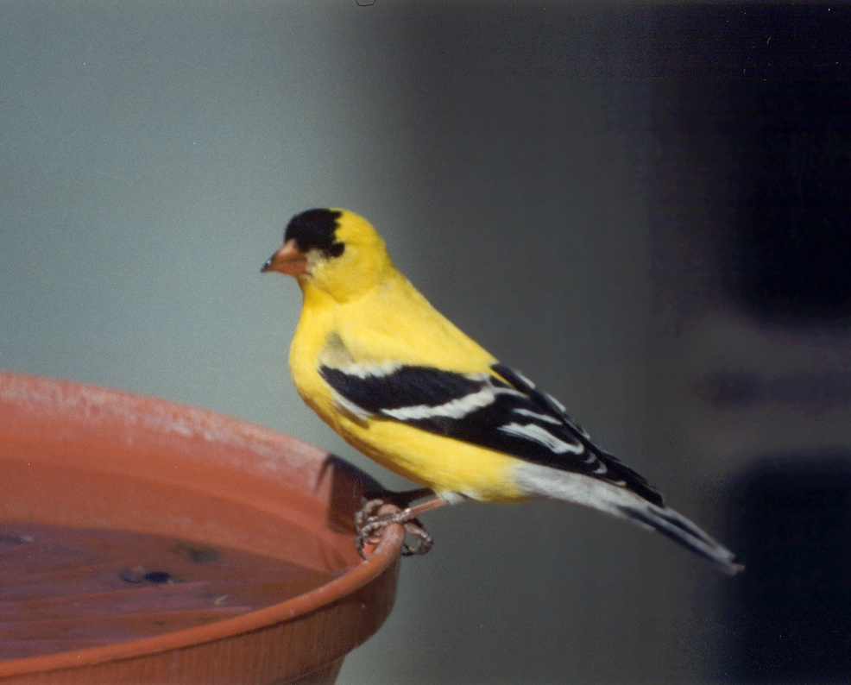
Using a Graphic

Slide 3

Using a Graphic
Use as a simple graphic
Used as a static image
  To add illustration:
  ex. A company logo
  To add decoration
Used to link to other documents
Used as a spacer, visible or invisible
Used as an imagemap

Slide 4

Web Acceptable Graphics
Two types of images
  Vector graphics
    Mathematical description of data
    to be displayed
    Not resolution dependent
    Can be scaled
  Raster Graphics (Bit-mapped)
    Image or pixel data
    Data describes the color,
    intensity of each pixel on
    the screen
    Will lose resolution if enlarged

Slide 5
Displaying Color
Web color is grouped by its
Red, Green, and Blue elements (RGB)
Newer monitors use 24 bit color:
sometimes called true color
  8 bits for Red, 8 bits for Green
  and 8 bits for Blue
  Can display millions of colors using this combination

Slide 6
Bit Depth
1 - bit 2 colors
2 - bits 4 colors
3 -bits 8 colors
4 – bits 16 colors
5 – bits 32 colors
6 – bits 64 colors
7 – bits 128 colors
8 – bits 256 colors
16 – bits 65,536 colors
24 – bits 16, 777, 216 colors
(Usually referred to as “millions of colors”)

Slide 7
Color Name or Number
A color can have a name
  These are names recognized by the browser
  User-friendly way of giving a color attribute value
  Ex: “forestgreen”, “aquamarine”, “indianred”
A color can have a number
  Uses a hexadecimal value to represent the
  RGB color
  The # symbol designates this as a hexadecimal number to the browser
  Ex: aqua = “#00FFFF”, darkviolet=“#9400D3”

Slide 8
Web Safe Palette
The number of colors that can be correctly, safely displayed on the Web is 216
These colors will not dither on PCs or Macs
These colors are not chosen for how they will look
  They are a result of combining RBG light at 20% increments
  Web colors are light-based
  Cannot accurately represent them in print because they have florescent tones

Slide 9
Web-Safe Hexadecimal
You can tell if a color is web-safe by examining its hexadecimal number value
If all pairs of digits are the same, the color is web-safe
Example:
  #00CCFF – is web-safe
  #9400D3- is not web-safe

Slide 10
Dithering
Combines colors to produce colors not in the web-safe palette
  Mixes colors in the palette on adjoining pixels
  Dithering flat areas is distracting or undesirable
  Speckles in areas of solid colors results in larger files
You can decrease the size of a gif image by limiting dithering
Most graphics tools allow you to turn dithering off, or have a sliding scale you can use to adjust your image

Slide 11
Anti-Aliasing
When rendering an edge at an angle, it will look “jagged” because of the nature of pixels
This technique tries to make the edges look smoother by giving the boundary pixels a color between the image and the background image
The human eye then blends the two colors on either side
Good for text in graphics
Adds to the file size

Slide 12
Graphics File Formats
GIF: Graphical Interchange Format
JPEG: Joint Photographic Experts Group
PNG: Portable Network Format

Slide 13
GIF Format
One of the most popular formats supported by every browser
Originally developed by Compuserve
Used to represent images with flat color
  Line drawings
  Logos
  Illustrations

Slide 14
GIF Compression
Uses Lempel-Zev-Welch (LZW) Compression
Takes advantage of long runs of color
Does not handle lots of color change well
New version adds transparency and animation

Slide 15
Tips for Creating GIFs
Limit the number of colors
Keep images as small as possible
Design flat areas of colors- don’t use gradients
Use web-safe colors
Don’t use for photographic images

Slide 16
JPEG Format
Uses lossy compression:
Information is lost after compression
Always uses 24 bit color
Used mainly for photographic images

Slide 17
JPEG Compression
Looks at rectangular areas of color and represents brightness and color as a mathematical formula
Can get as much at 20:1 compression
Can vary levels of compression in most tools
As compression ratio is increased:
  Resulting file size is smaller
  More data is lost

Slide 18
PNG Format
Not widely supported by all browsers
Supported by newer Netscape and IE
Uses 8 bit palette
Supports 16 bit grayscale
Up to 48 bit true color
Uses lossless compression! No information is lost in the compression.
Supports 8 or 16 bit transparency

Slide 19
Adding Images to a Page
<img> This tag is used to insert an image
The image tag is a self-terminating tag
  Add a forward slash before the closing >
<img src= “myfolder/mypet.jpg” alt=“Cat” />

Slide 20
<img> Attributes
src=“path”
  This is the source of the image
  The value is the path to the image
alt=“describing text”
  Alternative text that describes the image
  Needed for accessibility issues, required by the Americans with Disabilities Act (ADA)
  Must be included in order to validate!!!!
<img src=“images/bird1.jpg” alt=“American Goldfinch” />

Slide 21
Other <img> Attributes
border= “0” : pixelsize
height=“0” : pixelsize or percentage
width=“0” : pixelsize or percentage
height and width can be specified to optimize the load time of the graphic
Without this information, the page must wait until the graphic is loaded before doing the rest of the page

Slide 22
Resizing the Image
A smaller or larger pixelsize will stretch or shrink the image
You could just modify the width attribute pixelsize, the height will adjust appropriately
The image file is still the same size
Note: Try to do your adjusting of image size in a graphics program

Slide 23
Alignment Attributes
align=“bottom” :
bottom|top|middle|left|center|right
left alignment: text flows around the right of the image
right alignment: text flows around the left of the image

Slide 24
Spacing Attributes
hspace=“0” : number of pixels
adds horizontal space around the image
vspace=“0”: number of pixels
adds vertical space around the image
<br clear=“all” /> : stops wrapping of text around the image

Slide 25
Linking Images
Use the <a href> tag in conjunction with the <img src> tag
Uses a default blue border unless you include: border=“0” attribute
<a href=”document.htm”>
<img src=”/isys2450/Images/books.gif”
alt=“Books” />
</a>

Slide 26

Background Images
To set the background of a page to display an image, use the
<body background=“path”> tag
Allows designer to create a consistent look among all pages of the site
Once the image is cached, subsequent pages can be displayed without incurring a time penalty

Slide 27

Some Background Pointers
Soften the image so it has little contrast or color change as to not detract from the text on the site
A smaller image can be used to fill the screen with a “tiled” image

Slide 28
Link Colors
The <body> tag had three attributes that can be used to control link color on your page:
  link: this is the regular link color
  vlink: this is the visited link color
  alink: this is the active link color
  <body link=“red” vlink=“blue” alink=“green”>

Slide 29
Storing Images on Site
You should get in the practice of creating a separate folder for your images on your site
This folder is usually called Images
You can create other folders within your images folder
  Thumbnails
  Fullsize etc.

Slide 30
Where should Graphics Reside?
Advantages of storing graphics on your web server:
  They will load faster
  You have control of the files
  You can optimize graphics for your usage
Disadvantages of storing graphics on your web server:
  They take up room on the server
  Makes your site organization more cluttered

Slide 31

Stealing Images
Its poor form, not to mention illegal to use images that are copyrighted if you have not paid for them
Don’t borrow an image from another site and call it your own
Look for the words: “unrestricted” or “royalty-free” if you want to use a found image

Slide 32

Fireworks Studio 8
We will be using Fireworks as a tool to create and edit images for the Web
Concepts like compression ratios, dithering, anti-aliasing and web-safe colors will be examined with this tool
For the time being we will provide you with images for your assignments

Slide 33
Summary
Graphics are an important tool of a web designer
There are many graphics formats which can display on the web
Make sure you choose most appropriate graphic format and compression scheme for the web graphic
The <img> tag and its attributes are used to display graphics on a web page.
There are ethical and performance issues related to using and storing graphics on a web site.

