Slide 1
Formatting Pages with
Cascading Style Sheets
Web Publishing with HTML and CSS: Lesson 9 and Appendix C

Slide 2
Cascading Style Sheets
The first implementation was known as CSS1
Next generation is CSS2
  Allows specifying of font colors, background colors and graphics, margins, spacing, type style and more
  Many CSS2 tags are supported by the latest browser versions

Slide 3
CSS Support in Browsers
Most modern browsers support CSS1 and some support CSS2.
You can check the support various browsers have for CSS1 and CSS2 styles at: http://www.w3schools.com/css/css_reference.asp

Slide 4
Validating CSS
The W3C provides a CSS validator at:
http://jigsaw.w3.org/css-validator/
You can use this tool to make sure your CSS syntax is correct
You could validate your .css file always, but especially if your styles are not performing as you wish

Slide 5
Learning about CSS
You could spend an entire class studying CSS
The best use of CSS is through the use of an external style sheet
You can use any text editor to create your external .css file
Later in the semester we will also use the ASP.Net design environment to help us generate and link an external style sheet

Slide 6
About Cascading
This refers to the ability to combine style information from more than one source
External style sheets can be linked to more than one page
Embedded styles can be applied to a single page
Inline styles apply rules to specific page elements

Slide 7
Cascading Order of Styles
The styles of external style sheets are applied first
The styles of embedded styles sheet are applied second and override the external styles
The inline styles override both external and embedded style sheets
HTML formatting tags override any CSS styles

Slide 8
Inline Styles –
Covered in HTML Lesson 5
Allows the attachment of style rules to an individual element instead of across an entire page or site
<span> allows applying of style over any amount of text
Use the style attribute to set the inline style rules
  <p><span style=“color:red; font-weight:bold”>
  font will be small and bolded</span> </p>

Slide 9
Embedded Styles -
Page level styles
These are styles that are used within a given page
Use the <style> and </style> tag in the head of the page
Needs the type attribute type=“text/css”

Slide 10
Example of Embedded CSS
  <head>
  <style type=“text/css”>
  body
  {
  background-color: #330066;
  }
  .bigger
  {
  font-size: 16pt;
  }
  </style>
  </head>

Slide 11
Using Embedded Styles
Simply use the redefined HTML style or class style within the page
These styles are only seen within the page where they are created
  Ex.
  <p class=“bigger”>Bigger text</p>

Slide 12
External Style Sheets
These keep style rules as a separate file
Allows use of many styles with a single file
Modifications to style sheet file will change all the associated pages
Uses the .css file extension

Slide 13
Attaching an External Sheet
Like an HTML page, a style sheet is just an ASCII text file
Usually this file is placed in your site folder
Attach the style sheet by using the <link> tag in your page header

Slide 14
<link> tag
Example:
<link rel=“stylesheet” href=“mystyles.css” type=“text/css” />
This creates a persistent style that is applied to your page regardless of the user’s local selections
The name of the stylesheet linked in this case is: mystyles.css

Slide 15
Selectors in CSS
Any existing HTML tag can serve as a CSS selector
Be sure this is what you want to do…
  The rules set in the selector will be applied to all instances of that tag on the page where the CSS is linked
  Creating a <p> selector will apply the rules to all the <p> tags on your page.

Slide 16
Example: h1 selector
Ex. h1{ color: #996633;
padding-top: 10px;
padding-bottom: 5px;
background-color:#FFFDCC;
}
Uses the HTML tag you are redefining and { }
Each attribute is separated by a ;
These rules will be applied to all <h1> tags on this page

Slide 17
Contextual Selectors
These are used to apply styles to elements, but only when they are nested.
Ex. div ol {
color: blue;
}
Would only apply the color blue to <ol> elements nested inside <div> elements

Slide 18
Classes and IDs
Sometimes you want to create your own user-defined style for use anywhere on the page.
The class attribute is used for assigning this user-defined style to groups.
The id attribute is used for assigning a user-defined style to specific elements.

Slide 19
Creating a User-Defined Class
Begins the class style with a . and then the name of the new class
  Ex. .bigger { font-family: Arial;
  font-size: larger;
  }
This new class allows you to group several styles and apply them to text anywhere on your page.
  <p class=“bigger”> Text inside p </p>

Slide 20
Use IDs for Unique Styles
When you want a specific style for one element on a page, assign it to an ID.
To create a rule to work with an ID, use the # character when you define the style
  Ex. # footer {
  font-size: small;
  }
To identify the footer on your page, use the id attribute:
  <div id=“footer” > Copyright 2006 </div>

Slide 21
Units of Measure in CSS
em – Relative: height of the element’s font
ex – Relative: height of x character in the element’s font
px – Relative: pixels
in - Absolute: inches
cm – Absolute: centimeters
mm - Absolute: millimeters
pt – Absolute: points
pc – Absolute: picas

Slide 22
Common Style Sheet Properties
Margin and padding
Backgrounds, colors and images
Border appearance
Font Appearance and Style
Text Alignment

Slide 23
Box Properties
CSS box properties work on box-shaped regions of a page and can be used to:
  Position elements
  Control white-space around elements
  Apply effects to borders
Once you master the use of box properties, you no longer need to use tables to layout a page.

Slide 24
Controlling the Size of a Box
Two properties that can be used to control the size of a box element:
width and height.
Unlike tables that, unless otherwise specified, are only as large as the widest bit of content, many other block-level elements are as wide as the browser window by default.

Slide 25
Borders
The border property around elements can be seen as a box.
There are three values associated with the border property, any of which can be eliminated.
  border: width style color;

Slide 26
Border Values
width can use any unit of measurement to specify the border width
width can also use the thin, medium, thick options
style can use the dotted, dashed, solid, double, grove, ridge, inset and outset options
color specifies the color of the border and can be a hexadecimal or name color value

Slide 27
Using Individual
Border Properties
Additional border properties allow you to set styles for the border’s sides individually…
  border-top
  border-right
  border-bottom
  border-left

Slide 28
Supplying Border Values
If you provide only one value for a border property
  the property will be applied to all four sides of the box.
If you supply only two values
  the first will be applied to the top and bottom
  The second will be applied to the sides
Supply three values
  First goes to the top
  Second to the sides
  Third to the bottom

Slide 29
Margins in CSS
Any element can have a margin.
A margin is the space between an element and the adjacent elements to its top, left, bottom and right.
The margin properties are:
  margin
  margin-top
  margin-left
  margin-bottom
  margin-right

Slide 30
Use of Margins
Margins can be used to achieve similar effects to the positioning properties and padding
Margins can be specified as either a percentage, a length or using the keyword auto.

Slide 31
Margin Percentages
Percentage margin values set the affected margin to that percentage of the width of the parent element
  Ex. a margin-right: 20% sets the width of the right margin to 20% of the width of the element which contains the element.

Slide 32
Margin Lengths
Length margin values can be absolute or relative to the containing element.
  Use of absolute values such as px will ensure the actual length of the margin will always be the same.
  Use of relative values, like em will ensure the size of the margin will always be proportional to the calculated size of the content of the element.

Slide 33
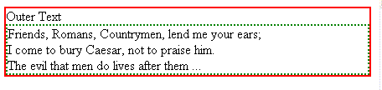
Nested <div> tags with no margins and padding
/*-Styles in mystyles.css file */
.outer { border: 2px solid red;}
.inner { border: 2px dotted green;
margin: 0px;
padding: 0px; }
<head>
<link rel=“stylesheet” href=“mystyles.css” type=“text/css” />
</head>
<body>
<div class="outer">
Outer Text
<div class="inner">
Friends, Romans, Countrymen, lend me your ears; <br/>
I come to bury Caesar, not to praise him. <br />
The evil that men do lives after them ...
</div>
</div>

Slide 34
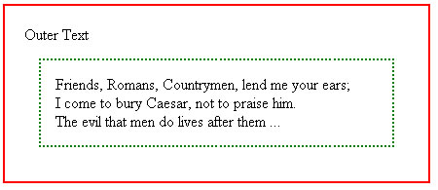
Nested <div> tags with padding and inner margin
/* Styles in mystyles.css file */
.outer { border: 2px solid red;
padding: 20 px; }
.inner { border: 2px dotted green;
margin: 15px;
padding: 15px; }
<head>
<link rel=“stylesheet” href=“mystyles.css”
type=“text.css” />
</head>
<body>
<div class="outer">
Outer Text
<div class="inner">
Friends, Romans, Countrymen, lend me your ears; <br/>
I come to bury Caesar, not to praise him. <br />
The evil that men do
lives after them ...
</div>
</div>

Slide 35
Float
Normally elements flow down the page from left to right and top to bottom
If you want to alter this normal flow, you can use absolute positioning or the float property.
Float is used to indicate that an element should be placed as far as possible to the left or right on the page and other content should wrap around it

Slide 36
Float Right Example
/* Styles in mystyles.css file */
.right { border: 3px solid green;
padding: 10px;
margin: 10px;
float: right;
width: 30%; }
.bottom { clear: both; }
<head>
<link rel=“stylesheet” href=“mystyles.css” type=“text.css” />
</head>
<body>
<p class = "right” > This is a test of the float right property. We will see where this paragraph shows up on the page. Did you guess correctly?
</p>
<p> This is text should be in the normal flow of the page. We will see where this paragraph shows up on the page. Did you guess correctly?
</p>
<p class="bottom"> This is text that should clear around the lowest element in the page flow. In this case it should go to the bottom of the page.
</p>

Slide 37
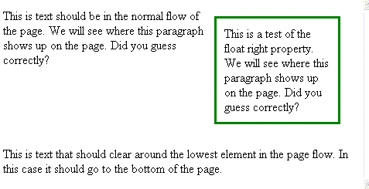
Float example

Slide 38
CSS Positioning
There are 4 position schemes you can use to try to control how elements are laid out on a page:
  static – The default, normal flow
  relative – Positions relative to element that precedes it
  absolute –Allows positioning in any location on the page.
  fixed – not well supported, similar to absolute

Slide 39
Position Properties of Schemes
There are 4 position properties you can use for any position scheme:
  top
  left
  bottom
  right
These values are specified as the distance from the named side of the enclosing block.

Slide 40
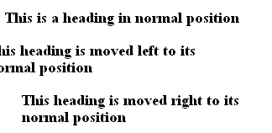
Relative Positioning Example
/* Styles in mystyles.css file */
h2.moveleft
{ position: relative;
left:-20px; }
h2.moveright
{ position: relative;
left:20px; }
<head>
<link rel=“stylesheet”
href=“mystyles.css”
type=“text.css” />
</head>
<body>
<h2>This is a heading in normal position</h2>
<h2 class=“moveleft">This heading is moved left to its normal position</h2>
<h2 class=“moveright">
This heading is moved right to its normal position </h2>

Slide 41
Absolute
Positioning
Example
/* Styles in the mystyles.css file */
#topleft { position: absolute; top: 0px; left: 0px; }
#topright { position: absolute; top: 0px; right: 0px; }
#bottomleft { position: absolute; bottom: 0px; left: 0px; }
#bottomright { position: absolute; bottom: 0px; right: 0px; }
.box { border: 3px solid red; background-color: #ccccff;
padding: 0px; margin: 10px; }
<head>
<link rel=“stylesheet” href=“mystyles.css”
type=“text.css” />
</head>
<body>
<div class="box" id="topleft"> Top left corner. </div>
<div class="box" id="topright"> Top right corner. </div>
<div class="box" id="bottomleft">Bottom left corner. </div>
<div class="box" id="bottomright">Bottom right corner. </div>
<p> This is a the first paragraph in the normal flow of text.
You can see that this is just a simple paragraph. </p>
<p> This is another paragraph in the normal flow of text.
Again, you can see that this is just a simple paragraph. </p>
<p> This is another paragraph in the normal flow of text.
Again, you can see that this is just a simple paragraph. </p>

Slide 42
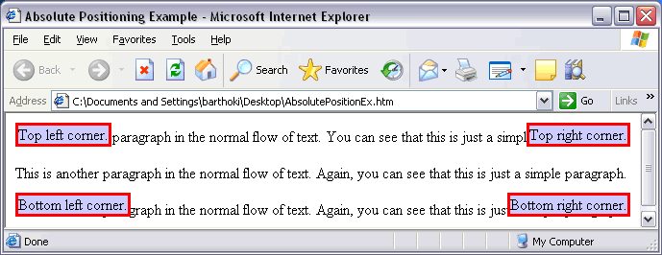
Absolute Positioning Example

Slide 43
The <body> Tag
The margin, padding and border of a page can be adjusted by adding styles to the <body> tag
The default page font family and background color can also be set in the <body> tag
The text-align for the entire page can also be set in the <body>

Slide 44
Links and CSS
Links exist in multiple states: unvisited, visited, active, and hover.
Using CSS you can change the color and appearance of a link in these states.
a: link { color: blue;}
a: active { color: red; }
a: visited { color: green; }
a: hover { color: yellow; }

Slide 45
Creating Layouts in CSS
Using an external CSS file, all formatting for the page layout can be placed in the .css file
The web page would just contain the content of the page, no layout formatting
This allows the designer to separate format from content

Slide 46
CSS File for a
Two Column
Page
/* Styles placed in the mystyles.css file */
body { font-family: Georgia; margin: 0px; background-color:#ff9900; }
#header { font: bold 48px Trebuchet MS;
padding-left: 30px;
border-bottom: 3px solid black;
background-color: #CC0000;
margin-bottom: 0px; }
#content { float: right;
padding: 1px 20px 1px 10px;
width: 70%;
margin: 0px;
border: none;
background-color: #ffffff; }
#nav { float: left;
width: 20%;
margin-top: 0px;
font-weight: bold;
padding: 10px;
border: none;
font-family: Trebuchet MS; }
#nav a { text-decoration: none; color: #000066; }
#nav a: hover{ color: green; text-decoration: underline; }
h2 { margin-top: 10px; }

Slide 47
HTML File for a
Two Column
Page
<body>
<div id="header"> The Star</div>
<div id="content">
<h2> Curly Bill</h2>
<h3>The Noted Desperado: Gets it in
the Neck at Galeyville</h3>
<p> This is another paragraph
in the normal flow of text.
Again, you can see that this is
just a simple paragraph. </p>
…
<p>Again, you can see that this is just a simple paragraph. </p>
</div>
<div id="nav">
<a href=" ">News</a> <br />
<a href=" ">Sports</a> <br/>
<a href=" ">Weather</a> <br />
<a href=" ">Business</a><br />
<a href=" ">Classified</a><br />
</div>
</body>
</html>

Slide 48
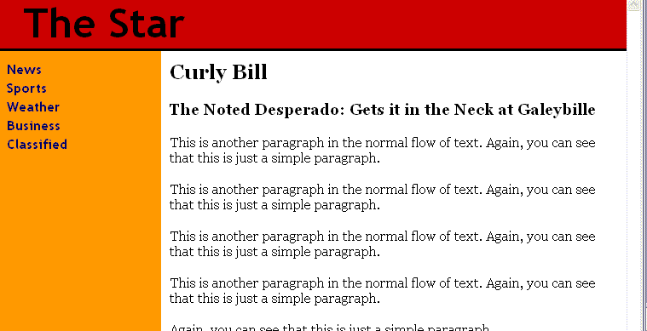
Two Column Page
Example

Slide 49
Sources for CSS Info
Tutorials on the W3C Web site on CSS- http://www.w3schools.com/css/
Insight from the Web Design Group-
http://www.htmlhelp.com/reference/css
W3C’s CSS Home Page-
http://www.w3.org/Style

Slide 50
3 Approaches to Style Sheets
External Style Sheets
Embedded Style Sheets
Inline Styles
All these styles are supported in most web development enviroments like Dreamweaver and ASP.Net
We will focus on External Style Sheets from now on in this course

