Slide 1
Writing Good Web Pages:
Do’s and Don’ts
Teach Yourself Web Publishing
with HTML and CSS: Lesson 16

Slide 2
Writing for Online Publication
Write clearly and be brief
Organize your pages for quick scanning Use headings to summarize topics
  Use lists
  Don’t forget link menus
  Don’t bury information in text
  Write short, clear paragraphs

Slide 3
The Page Stands Alone
Write so that each page stands on its own merits
  Use descriptive titles
  Provide navigation links to previous
  as well as to a home page
  Avoid sentences that begin with pronoun references. Your reader might not have seen previous information

Slide 4
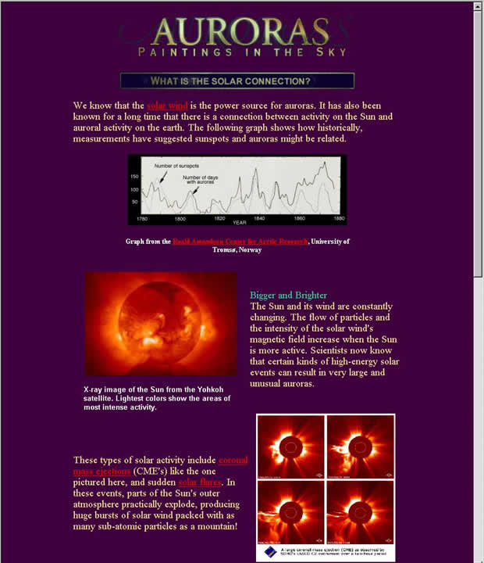

Slide 5
Be careful with Emphasis
Use emphasis sparingly, or it will
not have the affect you desire
Paragraphs with a lot of boldface, italics
and all caps are hard to read
Link text can be used to add emphasis-
Use phrases for hypertext
Animation, marquees, sound and
blinking text are annoying if misused
Less is More

Slide 6
Don’t Use
Browser-Specific Terminology
Avoid references like:
  “Click here”
  “To save this page, pull down the File menu and …”
  Use the Back button to return …”

Slide 7
Spell Check and Proofread
Your reputation is on the line when your pages are online
Many pages are posted without checking these things
Think of creating Web pages like publishing a book or a paper
  Thousands of people may be reading your content
  These errors reflect badly on you or your company
  Have someone else go over your work before you post it, they can see errors you might miss

Slide 8
Design and Page Layout
KISS – Keep it Simple Stupid
(don’t take it personally)
Use Headings as Headings
Group related Information Visually
Use a consistent layout
  Consistent page elements
  Consistent navigation
  Use external style sheets for whole site
  (more on this when we cover CSS)

Slide 9
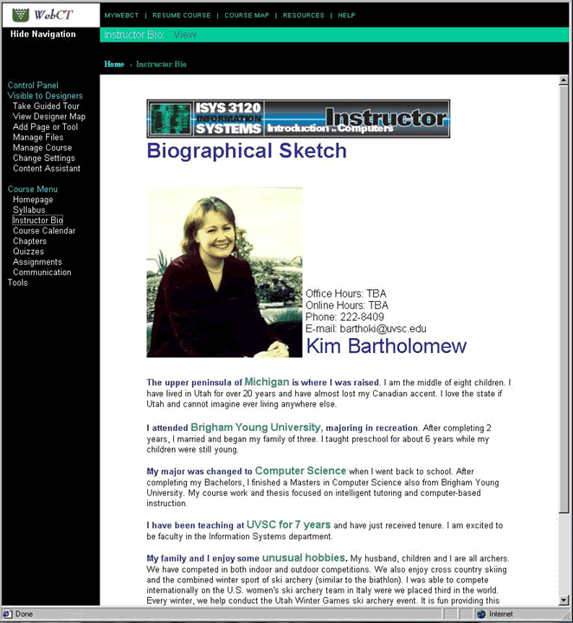

Slide 10
Using Links
Without links, our pages would be dull indeed
Use link menus and descriptive text
Use links in text
Avoid the “Here” syndrome
Choose wisely- to link or not to link, that is the question

Slide 11
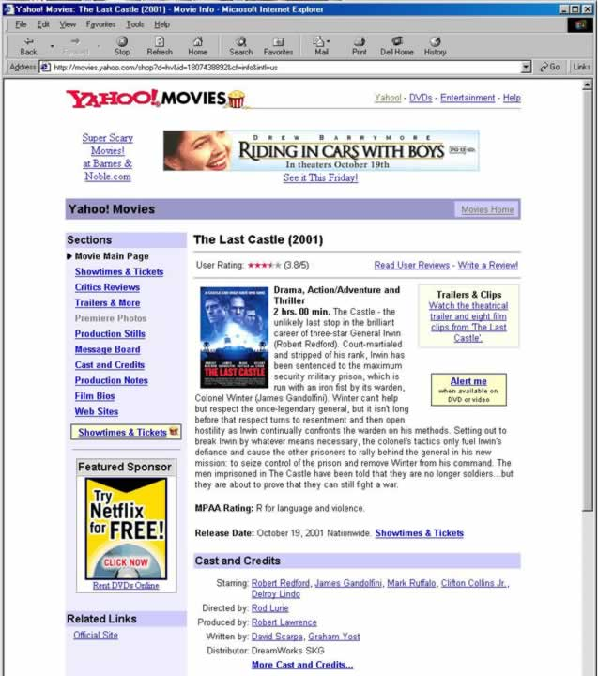

Slide 12
Using Images
Think about the need for every image you are tempted to use
Is it worth the load time to add it to your page?
Would a smaller images fulfill the need?
Use alternative text for every image

Slide 13
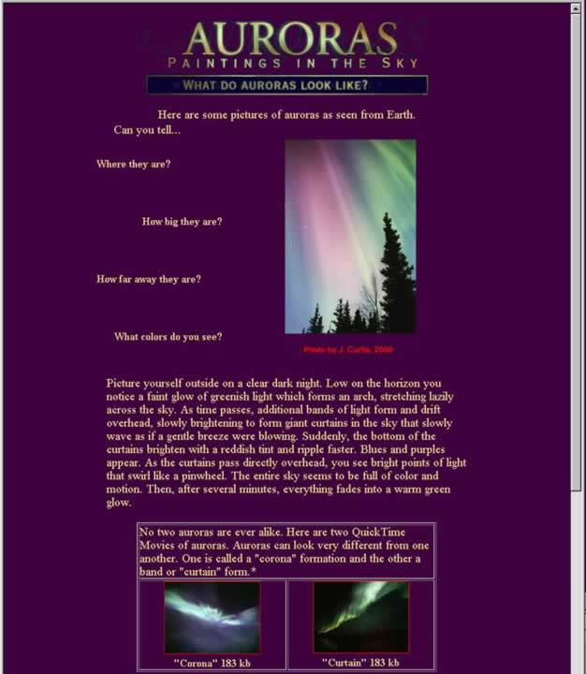

Slide 14
Don’t Make Assumptions about your Visitor’s Hardware
Careless assumptions can turn viewers away if content is not available to them
  Don’t assume everyone is using your same resolution
  Don’t assume they have the same full-color displays
  Don’t require special plug-ins unless you are targeting a select, knowledgeable few

Slide 15
Watch Backgrounds and Link Colors
Poor use of background colors and images can make your text or links unreadable
Make sure you have enough contrast between background and foreground
Often, increasing font size can make a world of difference
Subtle patterns and colors are best

Slide 16
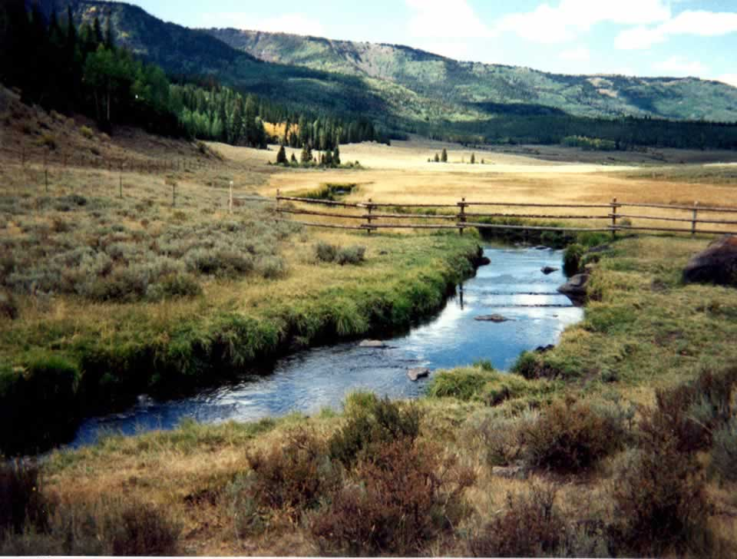
The Psychology of Colors
Colors can have an impact on a viewer
Color has long been
the subject of study
for advertisers,
print designers and artists
How do we feel about the use of
one color over another?
Consider the following…

Slide 17
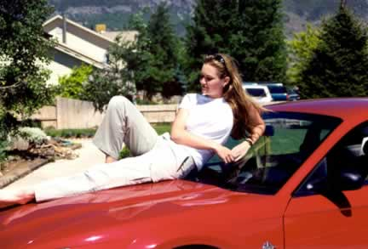
Red
The most arrogant, attention-grabbing, energetic color
Often associated with love and passion
Advertisers use it to
catch our attention:
  Red tag specials
  Fast sports cars
  Lipstick on
  beautiful women

Slide 18

Orange
Is the marriage of red and yellow
Considered happy and lively
Used in autumnal landscapes and fire’s flame
Captures our attention:
ex. Signs on roads and highways

Slide 19

Yellow
A warm, bright
and vibrant color
that represents
many things to us:
the color of the sun,
gold, goodness and joy.
Also represents caution
Yellow roses are the symbol of friendship

Slide 20

Green
The color of the natural world, represents freshness and
growing things
Represents life and hope
Its cool quality sooths,
calms, and has healing powers

Slide 21

Blue
The most sedate of all colors
Used to represent ice and minty freshness
Symbolizes heaven and divinity
Color of choice
for business
logos and suits

Slide 22

Violet/Purple
The most exotic color
Used for royalty, and wealth
It is a deep, mysterious hue,
mystical and meditative

Slide 23

White
Represents perfect
balance and perfection
It symbolizes purity,
truth and goodness
Good guys wear white
Suggests cleanliness

Slide 24

Black
The absence of white light
The antithesis of white, bad guys wear black
Represents funerals, death and mourning
Can bring feelings of despair and loneliness
Mysterious, evil, and intriguing

Slide 25
The Practical Side of Color
Knowing colors affect us emotionally can aid us in choosing how and where to place color on our pages
Use the symbolic meanings of colors to create a subtle, deeper meaning for your content
Use bright colors to grab attention
Use calm colors to encourage the viewer to stay and relax

Slide 26
Other Hints
Link back to Home
Don’t split topics across pages
Don’t create too many or too few pages
Sign your pages, provide contact information
Think about providing non-hypertext versions of your pages for printability

Slide 27
The Good, the Bad and the Ugly of Web Design:

Slide 28
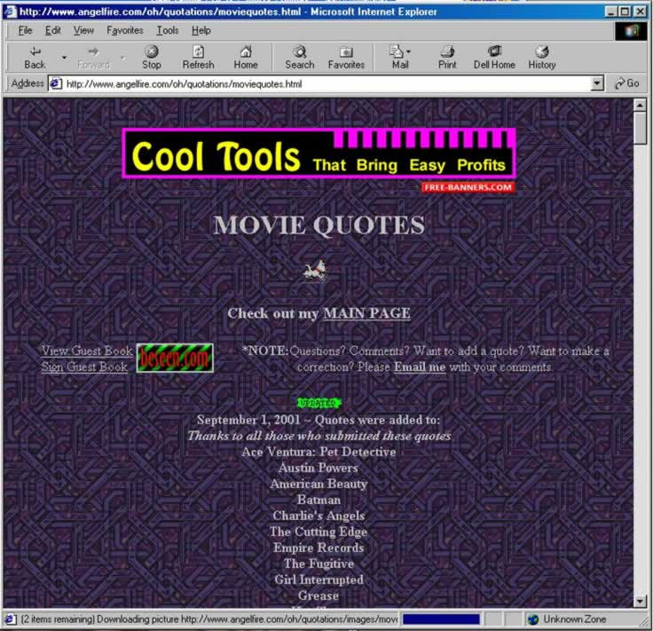

Slide 29
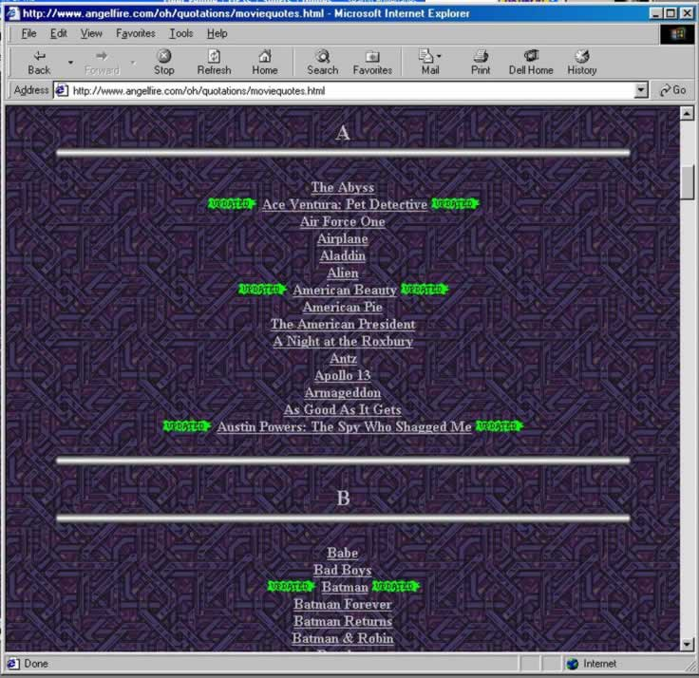

Slide 30
Movie Quote Site
Poor background choice
Annoying animations: dog and flashing message board
Poor listing of categories
  Required scrolling to see alphabetical listing of movies
  Poor color choice of updated symbol

Slide 31
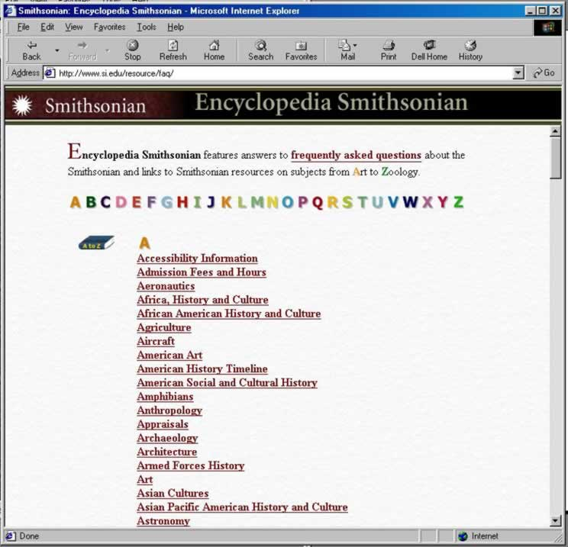

Slide 32
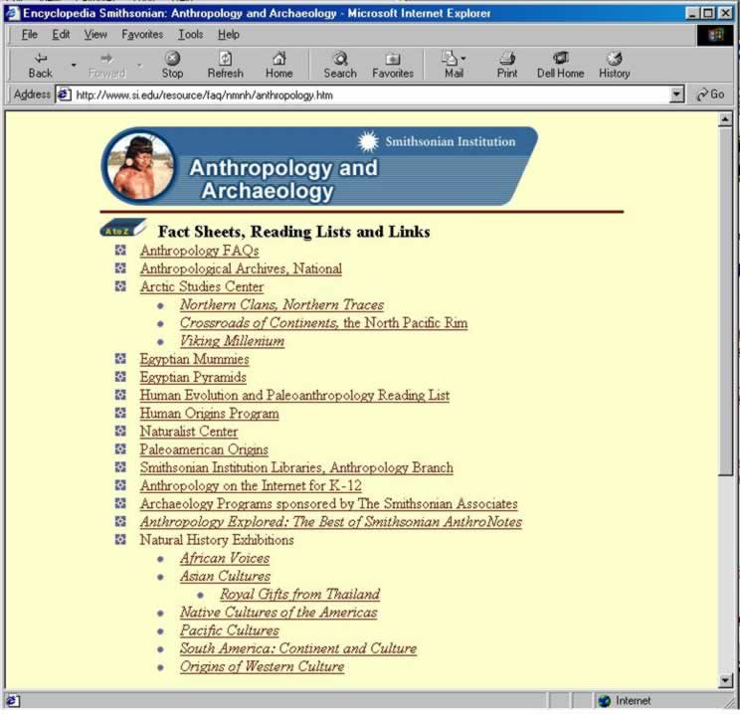

Slide 33
The Smithsonian Encyclopedia
Good Navigation Scheme
  Alphabetical organization for rapid access
Professional use of color and images
Subtle background texture and colors
A bit boring, but very readable and accessible

Slide 34
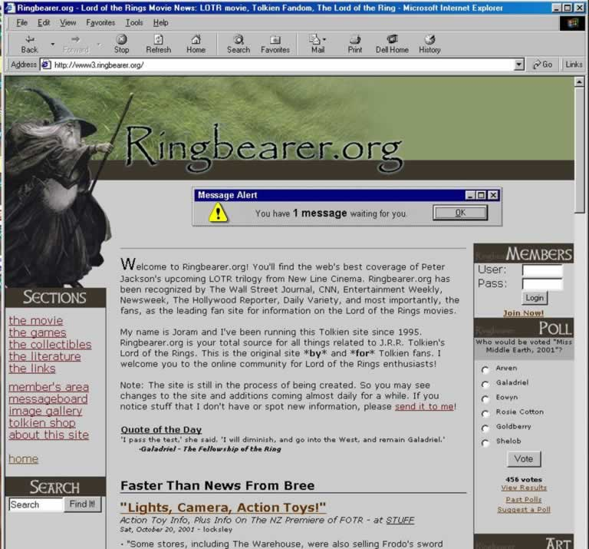

Slide 35
Entertainment Site
Used three column format
Annoying flashing Alert message
Subdued gray background
Used “above the fold” organization
Navigation links on the left helpful

Slide 36
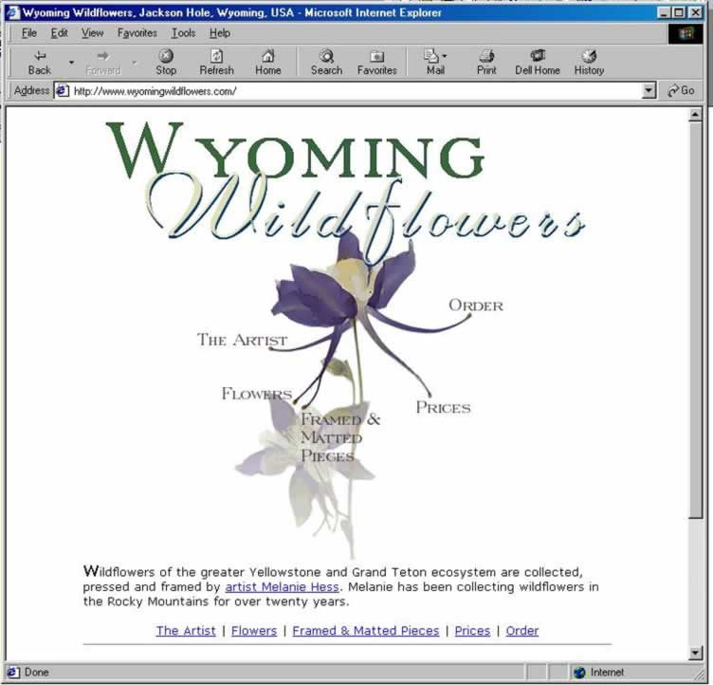

Slide 37
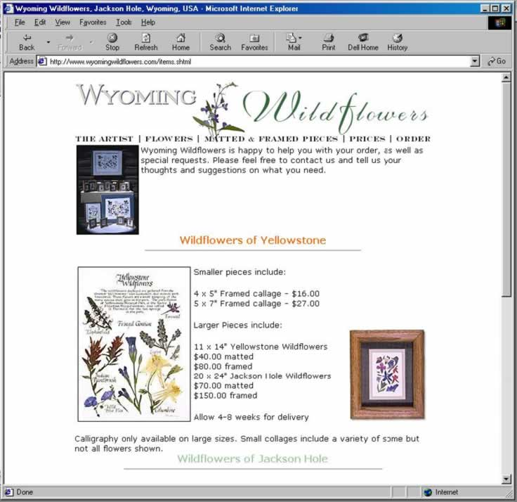

Slide 38
Wyoming Wildflowers-
Online Shopping
Good use of whitespace
Sparing use of images
Nice image map
Good navigation
Good use of headings
Wonderful font graphics and image for company Logo

Slide 39
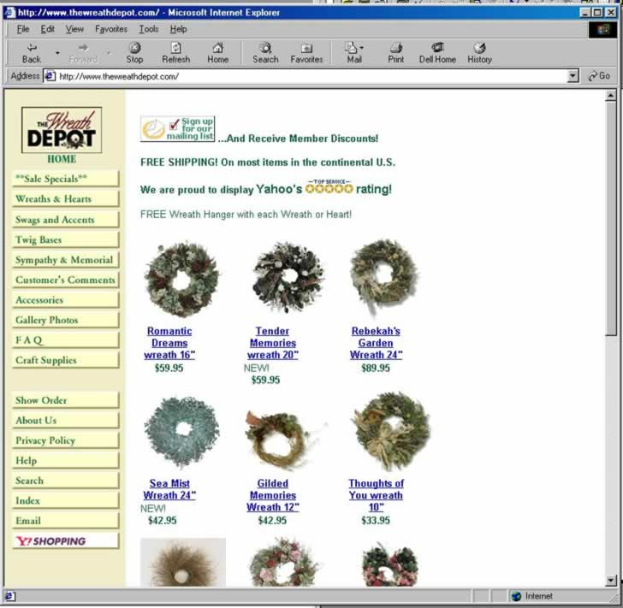

Slide 40
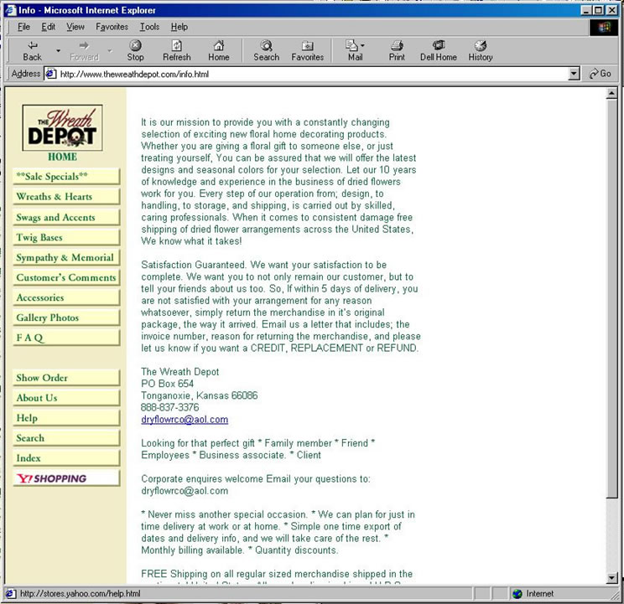

Slide 41
The Wreath Depot-
Online Shopping
Consistent site look and feel
Good navigation
Nothing special – boring layout
Poor graphic design
Green text hard to read for
long paragraphs
Poor use of titles and headings

Slide 42
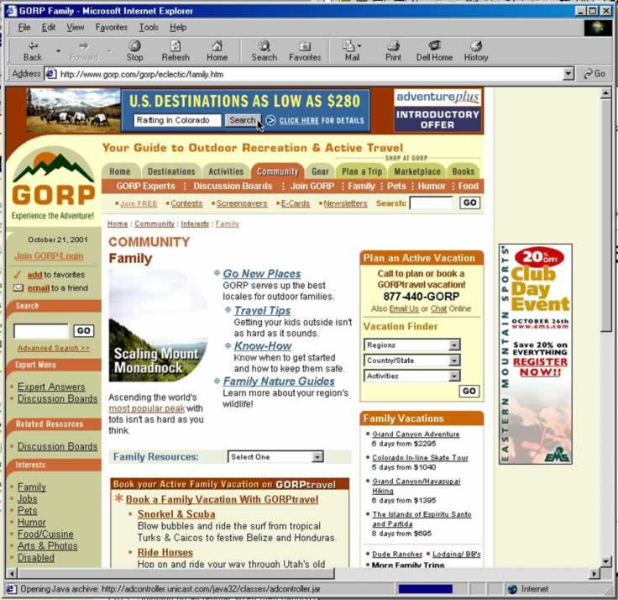

Slide 43
GORP Travel Site-
Too Much!!!
Information Overload
Seen it all before:
  Tabs, Links, Navigation bars, advertising, and several search engines
Interesting color scheme
Not a soothing site

Slide 44
Summary
There are many different approaches to Web Design
Anticipate the needs of your visitors and address them as broadly as possible
Not every site need be filled with multimedia and implement the latest Web technologies.
Keep navigation as simple as possible

