Slide 1
Getting Started with ASP.Net
ASPNet Lesson 1:
Supplemental Material:
Modifying web pages in the ASP.Net environment

Slide 2
What is ASP.Net?
ASP.Net is part of the Visual Studio development environment
The different windows or panes provide support to your web designing process
ASP.Net is mainly used to create server side applications, but will support work with HTML and CSS
Visual Studio is available to students as part of the MSDNAA license

Slide 3
More about ASP.Net
ASP.Net is a complete Web Authoring environment which integrates web page development and web file management.
It provides a Design View which has a simple graphical (WYSIWYG – what you see is what you get) interface.
A Source View is also provided which allows for direct code manipulation.

Slide 4
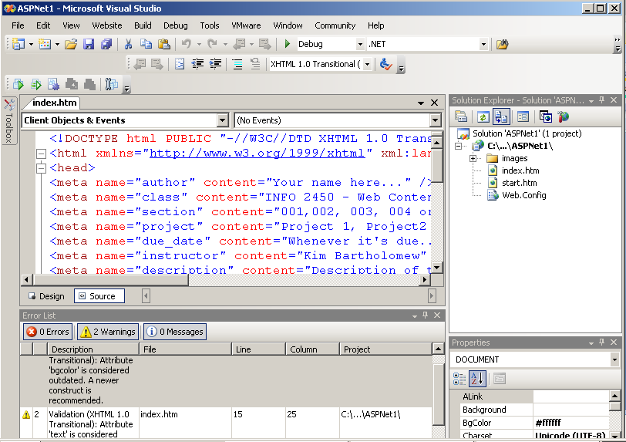
The ASP.Net Environment
Menu Bar
Toolbar
Toolbox
Editor
Solution Explorer
Properties
Editor
Error List

Slide 5
Toolbars in ASP.Net
You can add or delete items from the Toolbar.
Many of the Toolbar options allow for file or project features like save, copy, cut and paste, and Undo and Redo.
You can run your page as if it were located on a web server using the green arrow (Debug mode)
  You may be asked to allow creation of a Web.config file.
  Say yes and it will just add this file to your web site.
Notice the validation standard defaults to XHTML 1.0 Transitional, which is our standard for the class

Slide 6
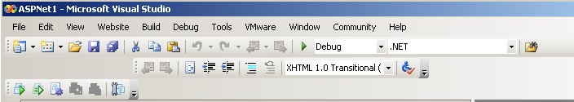
ASP.Net Toolbar
Mouse over to see the purpose of icons in the Toolbar
Many of these items are also available in the menu

Slide 7
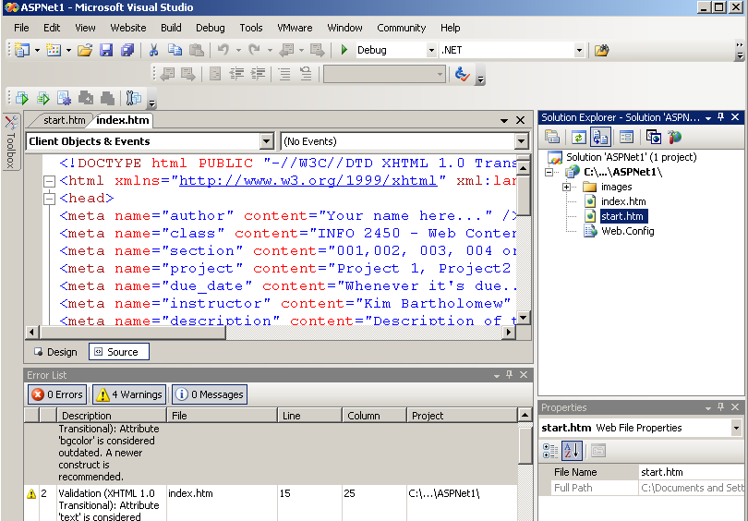
The ASP.Net Environment
Page Tabs: Allows for working with multiple pages at once
Editing Area:
Design View is the WYSIWYG view
Source View is the code view
View Toggle:
Choose the Design or Source View

Slide 8
The ASP.Net Environment
Solution Explorer: Allows for viewing Site Folders and Pages
Status Bar:
HTML tag hierarchy of selected element in Page Area

Slide 9
Setting Up a Project in ASP.Net
1. Create a Project folder on your computer as we have done all semester
2. Copy any other existing files needed to the Project folder
Always begin a page with the start.htm file
5. Create an Images folder inside the Project folder to hold project images
6. Copy any needed images to the Images folder

Slide 10
Opening a Website
Use the File Menu->Open->Website and choose your project folder.
The website folders and files will be shown in the Solution Explorer dialog
Click on a file to open it for modification
You can drag files or folders or delete them via the Solution Explorer

Slide 11
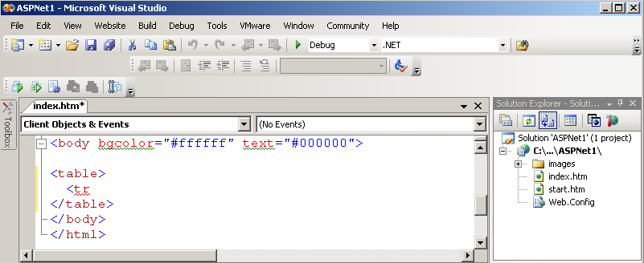
Solution Explorer

Slide 12
IntelliSense
The Visual Studio integrated development environment supports IntelliSense in the Code View
IntelliSense generates an automated autocomplete pop up list as the user begins to type characters of an HTML tag, attribute, or value
The user can click on the item in the list and complete their element.

Slide 13
IntelliSense = Productivity
IntelliSense speeds up software development by reducing the amount of keyboard input required.
It also allows less reference to external documentation as documentation on many functions appears with the function name.
Think of it as just-in-time documentation.

Slide 14

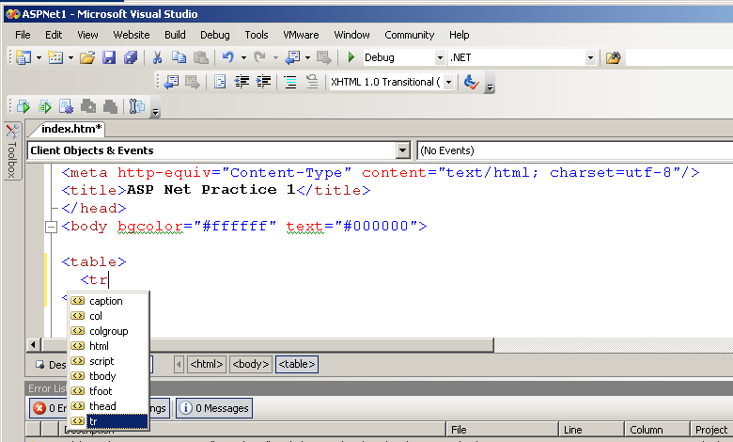
Intellisense – Pop Up List

Slide 15
Using the CSS Style Editor
ASP.Net makes use of a CSS Style Editor to help you in creating either your inline styles or styles in your external stylesheet
The CSS Style Editor can be opened as you begin the style by going to the Properties dialog and clicking on the Style … to open the editor

Slide 16
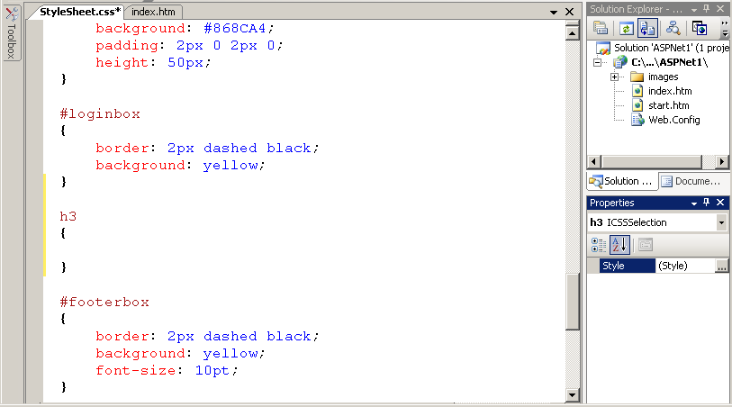
Opening the CSS Style Editor

Slide 17
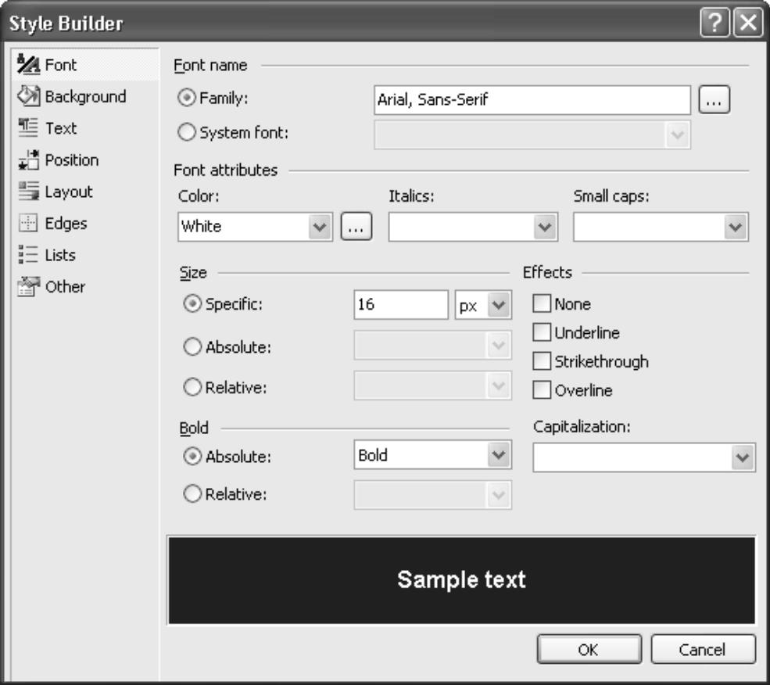
The CSS Style Editor
Click on the Style in the Properties dialog to open the Style Editor
You can select a category of style

Slide 18
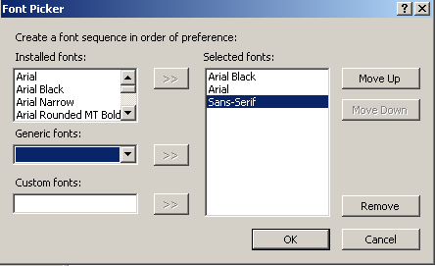
Example: font-family
Choose the Font category
Expand the Family … to open the Font Picker
Add font families with the >>
Usually end with the generic font

Slide 19
Automatic Validation
ASP.Net provides built-in validation of your code
The DOCTYPE tag in your source code is used to determine the validation standard
A list of warnings and errors is generated and listed in the Error List
If the Error List is not displayed, choose it from the View menu

Slide 20
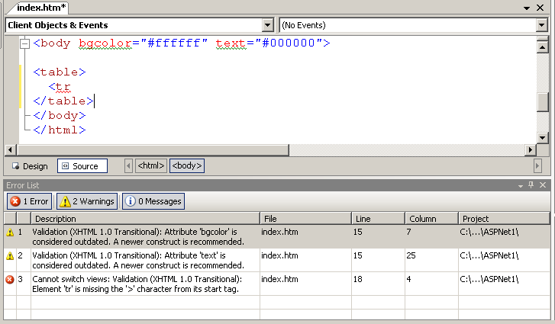
Error List from Auto Validation

Slide 21
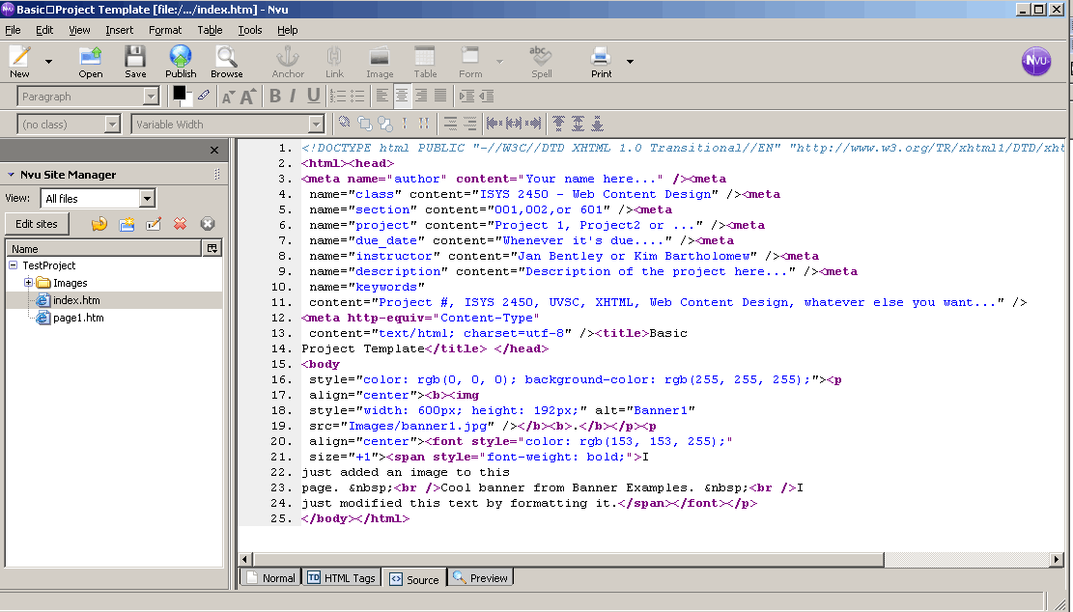
Switch to Source View in Nvu
The Source view allows you to see the HTML source code.
You can edit a file’s source code directly.

Slide 22
Final Comment
There are many different web development environments that allow for management of complex web sites, creation of templates and full support of CSS
The reason ASP.Net was chosen for this course is that this software is already licensed by the institution and students continuing in IS or IT will be using Visual Studio and ASP.Net in future courses.
Hope you will enjoy the additional environment support and capability of this environment

