Slide 1
Introduction to Layers
GIMP Lesson 2:
Chapter 3: Beginning GIMP from Novice to Professional

Slide 2

What is a Layer?
Every image in GIMP
is made by combining
one or more images
called Layers laid on top of each other.
Because GIMP is a bitmapped graphics program, when you draw or place other images together, they just become a bunch of pixels
If you want to keep things separate and modifiable, use a layer for each object

Slide 3
Stacking Layers
The simplest way to use layers is in normal mode
  Anything in the top layer that is opaque (not transparent) will be what you see in the final image
If a Layer includes transparency, you can put one image on top of another and everywhere a Layer is transparent it will allow you to see through to the next layer down.

Slide 4

Benefits of Layering
Layers allow you to stack
objects in your file and
make changes to them
separately
If objects are layered,
you should use the Layers
Panel to select the layer you want to work on
You can also change the order the objects are stacked

Slide 5
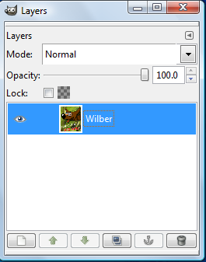
The Layers Panel (Keep open!)
Layers are essential to any image created in GIMP
You should always keep the Layers Panel opened
If it accidentally closes open with Dialog=>Layers menu option

Slide 6
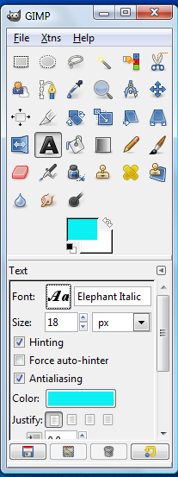
Setting Font Styles
Click on the Text Tool in the toolbar
You can now set the following in the Text Options:
  Font
  Size
  Color
  Alignment
  Antialiasing

Slide 7
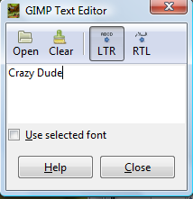
Creating a Text Layer
Click once on the Text Tool in the toolbox
Clicking on the image opens the GIMP Text Editor
Enter the text you want
It should now be styled
according to the choices
you set in the
Text Options dialog

Slide 8
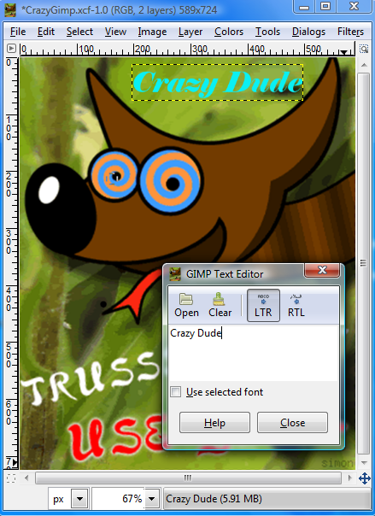
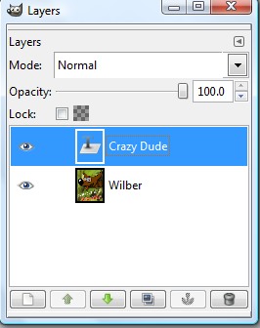
Text Layer Added

Slide 9
Working with Layers
Click Eye To Show
or Hide
Click to
Activate a Layer
Add New Layer
Delete a Layer

Slide 10
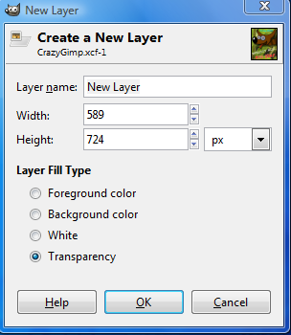
Adding a New Layer Dialog
Name the New Layer
Set the Color Fill Type
Set the Width
and Height

Slide 11
Order of Layers
The Web Layer is always first and its order cannot be changed
Other layers are organized top to bottom
The layer at the top of the Layer Panel has its objects on top.
The very last layer has its objects underneath all other layers

Slide 12
Ordering of Layers
GIMP Text
Top Layer
Background
Bottom Layer

Slide 13
Rearranging Layers
To change the ordering of layers
  Select the layer you want to move
  Hold down the mouse button
  Drag the layer to the new place
If the move is not correct
  Choose Undo from the Edit Menu
  Or just try again to move it

Slide 14
Rearranging Layers
Move Down
Move Up

Slide 15
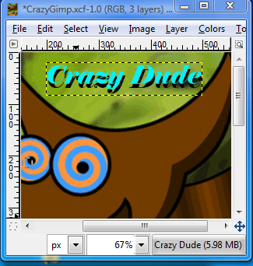
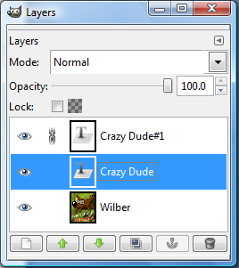
Drop Shadow with Layers
Duplicate the text layer
Change the color to black
Use the Move Tool to offset the black text layer

Slide 16
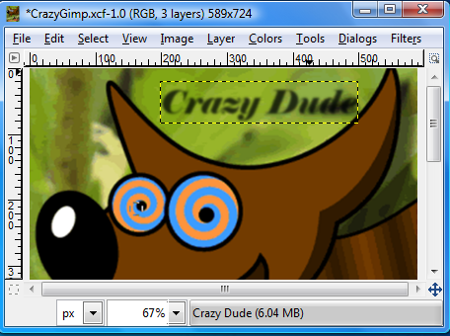
Blur Shadow
Hide the blue text layer
Select the black text layer
Select Filter=>Blur=>
Blur from the menu
Decrease opacity of black text layer

Slide 17
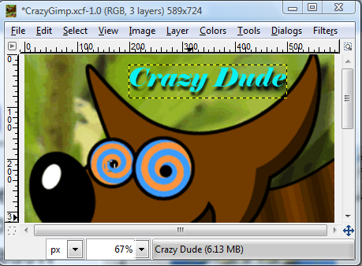
Final Drop Shadow
Combined text layers for a drop shadow effect

Slide 18
Chaining Layers
If you want to apply the same effect of modification to more than one layer, you can chain them together
The chain is between the eye and the icon of the layer
Applied Free Rotation to black and yellow text layers

Slide 19
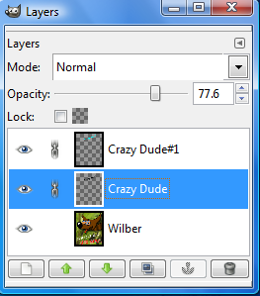
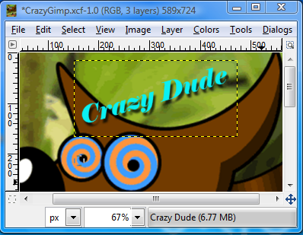
Final Rotated Layers
Chained Layers

Slide 20
Flatten the Image
There may come a point where you want to combine all the layers
You should first save your unflattened image as a GIMP XCF file
Use the Image=>Flatten Image menu option
Now you can see there is only one
layer left in this image

Slide 21
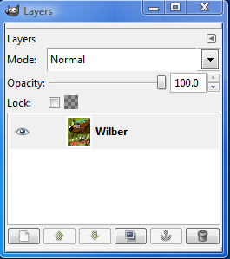
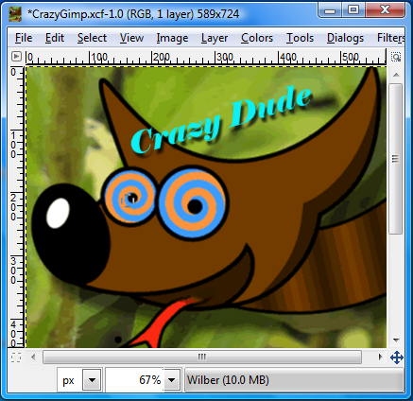
Flattened Image
Flattened Layer

Slide 22

The Power of Layers – Use Them!

