Slide 1
Tables
Teach Yourself Web Publishing
with HTML and CSS: Lesson 8

Slide 2
Tables in HTML
Creating Tables
Types of Tables
  Data Table
  Text Alignment
  Page Template
  Multipart Image Container

Slide 3
Basic Structure
Tables are made up of cells arranged into rows and columns
Column A Column B Column C
Row 1
Row 2
Cell 1A Cell 1B Cell 1C
Cell 2A Cell 2B Cell 3C

Slide 4
Table HTML Tags
< table> </table> -
Defines a new table
<tr> </tr> -
Defines a new row
<th> </th> -
Defined a heading cell
<td> </td> -
Defines a new cell

Slide 5
Table in Code
Ending tags are required for tables,
rows and cells to meet XHTML standards
<table>
<tr>
<tr>
</table>
</tr>
</tr>
<td> Cell 1A </td> <td> Cell 1B </td>
<td> Cell 1A </td> <td> Cell 2B </td>

Slide 6
Empty Cells
Some browsers display cells that have nothing in them
  <td></td>
Some browsers treat empty cells as if they don’t exist at all
To be safe, use a <br /> or an &nbsp; in the cell if you want it to be displayed
  <td> <br /></td>

Slide 7
Captions
Tells a viewer the purpose of your table
Use the <caption> tag
These are optional for a caption
  Use the valign attribute to place
  the caption above or below the table:
  valign=“top(default) or bottom”
  Use the align attribute to place change position of the caption relative to the table
  align=“top|bottom|left|right|center”

Slide 8
Table
Example:
<table border= “1”>
<caption> Vital Statistics </caption>
<tr>
<th> Name </th>
<th> Height </th>
<th> Weight </th>
</tr>
<tr>
<td> Alison </td>
<td> 5’4” </td>
<td> 140 </td>
</tr>
<tr>
<td>Tom </td>
<td> 6’0” </td>
<td> 165 </td>
</tr>
</table>

Slide 9
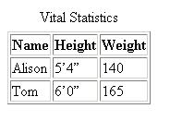
Table Browser
Example:
Caption
Heading
Table Data
Table Cells

Slide 10
Table Level Controls
Attributes entered in the table tag affect every cell in the table
At the table level you can control the
  Width
  Alignment
  Border thickness
  Spacing within cells
  Spacing between cells

Slide 11
Table Attribute - width
width = “number or percentage”
Specifies the width of the entire table
By default the table will be sized to fit the needs of its contents
With an absolute value(number), the table will not change according to screen resolution
With a relative value (percentage), the table will grow or shrink depending of the screen resolution

Slide 12
Note:
The table height attribute has been deprecated.

Slide 13
Table Attribute - align
align= “left(default)|center|right”
Aligns the table within the text flow

Slide 14
Table Attributes- bgcolor and border
bgcolor= “#rrggbb or color name”
  Specifies a background color for the entire table
border=“number”
  Specifies the thickness of the border
  Without a value, defaults to 1
  Only specifies the outer border of the table

Slide 15
Note:
The table bordercolor and background attributes have been deprecated.

Slide 16
Table Attributes- cellpadding and cellspacing
cellpadding= “number”
Controls the amount of space between cell contents and its border
cellspacing= “number”
Controls the amount of space
between cells

Slide 17
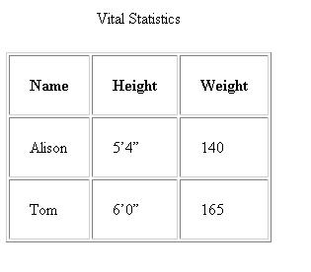
Cellpadding Example:
cellpadding= “20”

Slide 18
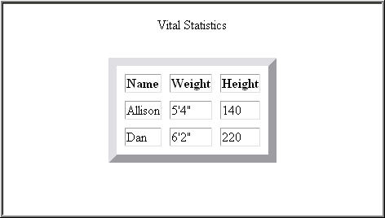
Cellspacing
Example:
<table
cellspacing= “10”
border = “10” >

Slide 19
Row Level Controls
align= “left(default)|center|right”
Horizontal alignment of text in all cells of row
valign = “top|middle(default)|bottom|baseline”
Vertical alignment of text in all cells of row
bgcolor=“#rrggbb or colorname”
Specifies background color for all cells of row

Slide 20
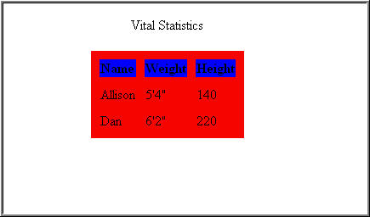
Row bgcolor
Example:
<table bgcolor=“red”>
<tr bgcolor=“blue” >

Slide 21
Cell Level Controls
Much of the table’s structure and look is controlled at the individual cell level
Within a cell you can control:
  Alignment horizontally
  Alignment vertically
  Background color
  Width of cell
  Height of cell
  Columns for cell to span
  Rows for a cell to span

Slide 22
Cell Attributes- align and valign
align=“left(default)|center|right”
Horizontal alignment of text in one cell
valign= “top|middle(default)|bottom|baseline”
Vertical alignment of text in one cell

Slide 23
Cell Attribute - bgcolor
bgcolor= “#rrggbb or colorname”
Specifies a background color for one cell
A cell must contain some data for a background and border to display-
if there is no data, add a &nbsp; inside the <td> tag

Slide 24
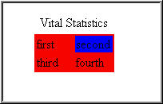
Cell bgcolor
Example:
<td bgcolor=“blue”
border=“1”>

Slide 25
Cell Attributes- width and height
width=“number or percentage”
Specifies the width of one cell
First or largest width will affect the width of the entire column
Width is usually needed in only first row
height=“number or percentage”
Specified the height of one cell
First or largest height will affect the height of the entire row.
Height is usually needed only in first column

Slide 26
Cell Attribute - colspan
Specifies the number of columns for a cell to span
<td colspan=“2”> -
Tells the browser to fill the horizontal space of two cells

Slide 27

Table colspan
Example:
<html>
<body>
<table border="1">
<tr>
<td colspan="2">Cell 1</td>
</tr>
<tr>
<td>Cell 2</td>
<td>Cell 3</td>
</tr>
</table>
</body>
</html>

Slide 28
Cell Attribute - rowspan
Specifies the number of rows for
a cell to span
<td rowspan=“2”> -
Tells the browser to fill the vertical space of two cells

Slide 29

Table rowspan
Example:
<html>
<body>
<table border="1">
<tr>
<td rowspan="2">Cell 1</td>
<td>Cell 2</td>
</tr>
<tr>
<td>Cell 3</td>
</tr>
</table>
</body>
</html>

Slide 30
Hint: Add comments for clarity
<table border="1">
<tr>
<td rowspan="3">Cell 1</td>
<td>Cell 2</td>
</tr>
<tr>
<! Cell 1 from above -->
<td>Cell 3</td>
</tr>
</table>

Slide 31
Having Trouble Planning?
Sketch your table before trying to create it
Indicate where the rows and columns will fall
Mark the cells that span multiple rows or columns

Slide 32
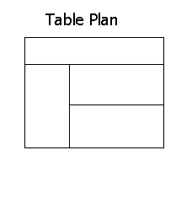
What would this table look like?
How many rows?
How many columns?
Row1 colspan?
Row2 Cell1 rowspan?

Slide 33
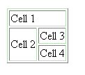
Planning
Solution:
<html>
<body>
<table border="1">
<tr>
<td colspan="3">Cell 1</td>
</tr>
<tr>
<td rowspan="2">Cell 2</td>
<td>Cell 3</td>
</tr>
<tr>
<! Cell 2 from above -->
<td>Cell 4</td>
</tr>
</table>
</body>
</html>

Slide 34
Priority Levels of Controls
Cell Level attributes have highest priority
Row Level attributes have next highest priority
Table Level attributes have next to the lowest priority
Outside Table Level attributes have lowest priority

Slide 35
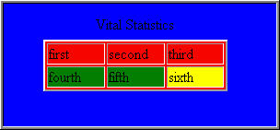
<body bgcolor="blue" text="#000000">
<table border="2" bgcolor="red" width="200" align="center">
<caption> Vital Statistics</caption>
<tr>
<td width ="33%"> first</td>
<td width ="33%"> second</td>
<td width ="33%"> third</td>
</tr>
<tr bgcolor="green">
<td>fourth</td>
<td>fifth
<td bgcolor="yellow">sixth</td>
</tr>
</table>
Very Lowest Priority
Lower Priority
Higher Priority
Highest Priority

Slide 36
Advanced Table Enhancements
Grouping and Aligning Columns
Grouping and Aligning Rows
Using Frame and Rule Attributes
Other Table Elements and Attributes

Slide 37
Grouping and Aligning Columns
Allows the creation of structural divisions of table columns
Use the <colgroup></colgroup> element to enclose one or more columns
Allows the column group to share attributes

Slide 38
Colgroup Attributes
Use these to modify the <colgroup>
  span=“number of columns”-
  Must be an integer larger than 0
  width=“number or percentage or 0*”-
  Number is pixel value, percentage of the group, 0*makes width the minimum that will hold the data of the column

Slide 39
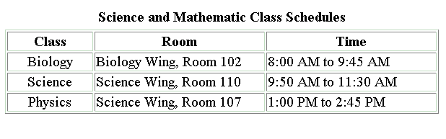
Table with Colgroups:

Slide 40
Colgroup
Code:
<table border="1" width="100%“
summary="Grouping Columns">
<caption><b>Science and Mathematic Class Schedules</b></caption>
<colgroup width="20%" align="center" valign="top"></colgroup>
<colgroup span="2" width="40%" valign="top"></colgroup>
<tr> <th>Class</th>
<th>Room</th>
<th>Time</th> </tr>
<tr> <td>Biology</td>
<td>Biology Wing, Room 102</td>
<td>8:00 AM to 9:45 AM</td> </tr>
<tr> <td>Science</td>
<td>Science Wing, Room 110</td>
<td>9:50 AM to 11:30 AM</td> </tr>
<tr> <td>Physics</td>
<td>Science Wing, Room 107</td>
<td>1:00 PM to 2:45 PM</td> </tr>
</table>

Slide 41
Varying Colgroup Attributes
Use <col> element if you don’t want all the columns in the group to have the same width or appearance
  Enclose <col> tags in an <colgroup></colgroup>
  <col> is a self-terminated tag

Slide 42
Grouping and Aligning Rows
You can group rows in a table into three sections:
  <thead>-Table Heading
  <tfoot>-Table Footer
  <tbody>-Table Body

Slide 43
Table Heading
Requires an opening <thead> and a closing </thead> tag
Appears right after the <table> tag
or <colgroup> tags
Must include at least one row in the group

Slide 44
<thead> Example:
<table border=“1” width=“100%”>
<caption><b>Science and Mathematic Class Schedule</b></caption>
<colgroup width=“20%” align=“center” valign=“top”>
<colgroup span= “2” width=“40%” valign=“top”>
<thead>
<tr>
<th>Class</th>
<th>Room</th>
<th>Time</th>
</tr>
</thead>

Slide 45
Table Footer
Defines the footer of the table
Requires an opening <tfoot> and a closing </tfoot> tag
Appears right after the table heading if one exists
Browser must know about the footer section before the body of the table is defined

Slide 46
<tfoot> Example:
<tfoot>
<tr>
<th>Class</th>
<th>Room</th>
<th>Time</th>
</tr>
</tfoot>

Slide 47
Table Body
After the table head and footer are defined, you define the rows in the table body
Use the opening <tbody> and closing </tbody> tags
Is required if the table has a head and/or foot section or the table had more than one body

Slide 48
<tbody> Example:
<tbody>
<tr> <td>Biology</td>
<td>Biology Wing, Room 102</td>
<td>8:00 AM to 9:45 AM</td>
</tr>
<tr> <td>Science</td>
<td>Science Wing, Room 110</td>
<td>9:50 AM to 11:30 AM</td>
</tr>
<tr> <td>Physics</td>
<td>Science Wing, Room 107</td>
<td>1:00 PM to 2:45 PM</td>
</tr>
</tbody>

Slide 49
Frame and Rules Attributes
Frame attributes affect how the border of the table is rendered
Rules attributes act similarly to frame attributes, except it defines rules that appear between cells within a table

Slide 50
Frame Attributes
void-No sides of border are visible (default)
above- Renders only the border top
below- Renders only the border bottom
hsides-Renders top and bottom sides
lhs-Renders left side of border
rhs- Renders right side of border
vsides- Renders right and left sides
box- Renders all four sides
border- Renders all four sides

Slide 51
Rules Attributes
none- No rules are drawn around cells (default)
groups- Rules will appear between row groups and column groups
rows- Rules will appear between rows
cols- Rules will appear between columns
all- Rules will appear between all rows and columns

Slide 52
Frame and Rules Code:
<table border="1" width="100%"
frame="hsides" rules="groups”>
<caption><b>Science and Mathematic Class Schedules</b></caption>
<colgroup width="20%" align="center”
valign="top"></colgroup>
<colgroup span="2" width="40%"
valign="top"></colgroup>

Slide 53
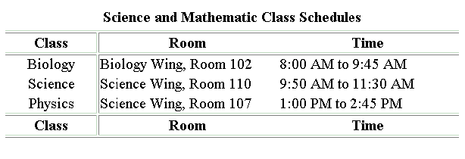
Frame and Rules for Table Example:

Slide 54
Tables within Tables
You can nest tables within other tables
The inner table must be placed within a <td> open and a </td> close
You will be able to achieve more complicated tables with this method

Slide 55
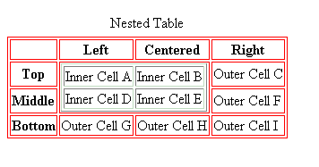
Nested Table Example:

Slide 56
Text Alignment Tables
Used to help align text when other tags cannot accomplish the same task
Usually the border attribute
is set to 0 so no borders are shown
Empty cells are used to force indentations and spaces

Slide 57
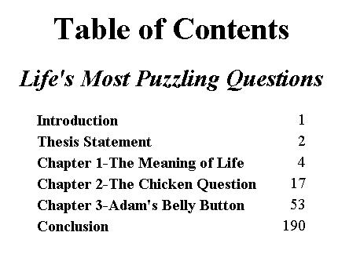
A Text Alignment Table:

Slide 58
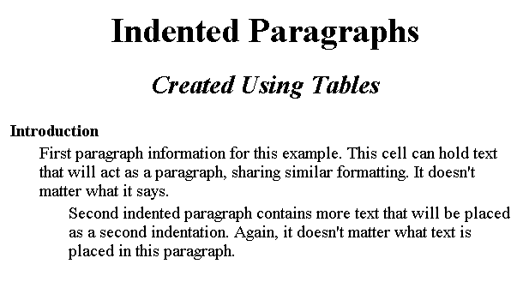
Indenting the Easy Way:

Slide 59
Indented paragraphs with Tables:
<table border="0">
<tr>
<td colspan="3"><b>
Introduction</b></td>
</tr>
<tr>
<td width="30">&nbsp;</td>
<td colspan="2">First paragraph information
for this example.
This cell can hold text that will act as a paragraph,
sharing similar formatting. It doesn't matter
what it says. </td>
</tr>
<tr>
<td width="30">&nbsp;</td>
<td width="30">&nbsp;</td>
<td>Second indented paragraph contains more text
placed as a second indentation. Again, it doesn't
matter what text is placed in this paragraph.</td>
</tr>
</table>

Slide 60
Page Template Tables
Tables can be used to layout or structure a page.
This concept is not new to the print industry.
Before the advent of style sheets and frames, tables provided the only way to lay out elements of a page other than straight down the middle

Slide 61
Layout Types
There are two common grid layouts:
  Horizontal Layout – Most important design elements are aligned horizontally across the row.
  Vertical Layout- Allows a clear delineation of content areas. Left column is usually used for navigation. Center column usually contains the main body of the site. And the right column might contain advertisements.

Slide 62


Horizontal Layout Example
Kim’s Home Page
Western Movies
Main text of the information to be displayed on the row
My Review
*****
My Bird Watching Vacation
By Kim Bartholomew

Slide 63
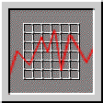



Typical Newspaper Layout
The Daily Herald
Local News
Sports
National News
Heading
By Kim Bartholomew
This is the story about the
rare Indian tribe found in
the Wasatch Mountains
last
weekend
by local
hunters.
Just some text for the graphic here
Americas Cup
Winners were awarded the coveted trophy on Monday.

Slide 64
Layout Steps
Choose the fonts for the page
  Serif fonts usually used for headings and Mastheads, also Graphic captions
  Sans-serif fonts usually used for large areas of text
Choose the color scheme for your page
Choose the general layout style
Decide if your page will be browser specific
Consider the issue of accessibility

Slide 65
Image Slicing
Technique is used to control loading of an image in the browser
Image is broken up into pieces that are placed in a table
When rendered, the image appears as one image
You can make each slice a link so the table works like an imagemap

Slide 66
Hints for Image Slicing
Set cellpadding, cellspacing and border attributes all to 0-
Without these settings, there will be space between your pieces in the table
Make sure there is no whitespace between the <img> tag and the </td> tag
The order of the images as you place them
in the table is important
Create a table that mirrors the structure of the cut up image

Slide 67





Slice Up Your Image

Slide 68
Placing Images in the Table:
Create a Table with
the Correct Structure
Add Image Pieces to the Cells of the Table

Slide 69
Table Summary
Tables are made up of rows and cells
You can format at the table level, row level and at the cell level
Colgroups and Rowgroups are advanced table topics
Nested tables are possible by placing the inner table within a cell
Tables can be used to contain data, align text, for page layout, and to display sliced images as a whole graphic

