Slide 1
Formatting Text with HTML and CSS
Teach Yourself Web Publishing
with HTML and CSS: Lesson 6

Slide 2
Lesson Overview
Learn how to specify the
appearance of individual characters
Learn to add special characters
to your text
Learn to create preformatted text
Learn to change font and font size
Learn to create other text elements
Learn how to apply inline CSS

Slide 3
Inline Elements
Text Formatting tags are the inner most level of tags that you will use in your documents
Two types: Logical and Physical
Careful nesting of these elements must ensure that an inline tag does not contain a block-level element
  <b><p>My paragraph </p></b>
  This is illegal nesting

Slide 4
Logical Character Styles
Used to convey meaning of the text within the tag, not how it should be presented
The browser determines the presentation of the text
Each character tag has both opening and closing tags – the affected text is placed between these tags

Slide 5
Logical Styles in HTML
<em> - emphasize characters, usually italicized
<strong> - more strongly emphasized than em, usually bolded
<code> - Used for code segments, displayed in fixed-length font like Courier
<samp>- sample text, usually fixed-length
<kbd> indicated what the user is to type, usually fixed-length

Slide 6
More Logical Styles
<var>- name of a variable, italicized or underlined
<dfn>- definition, used to highlight, usually italicized
<cite>- used for a short quotation
<abbr>- used for an abbreviation of a word
<acronym>- designates a word formed by combining letters from several words

Slide 7
Logical Styles Example
<p> The anteater is the <em>strangest</em> looking animal, isn't it?</p>
<p>Take a <strong>left turn</strong> at <strong>Dee's Hop Stop</strong></p>
<p> <code>#include "myfile.cpp”</code></p>
<p>The URL for that page is <samp> http://www.cern.ch/ </samp> </p>
<p> <cite>Eggplant has been known to cause nausea in some people</cite> </p>
<p>Use the standard abbreviation for California <abbr>CA</abbr> </p>
<p> World Wide Web <acronym>WWW</acronmy> </p>

Slide 8
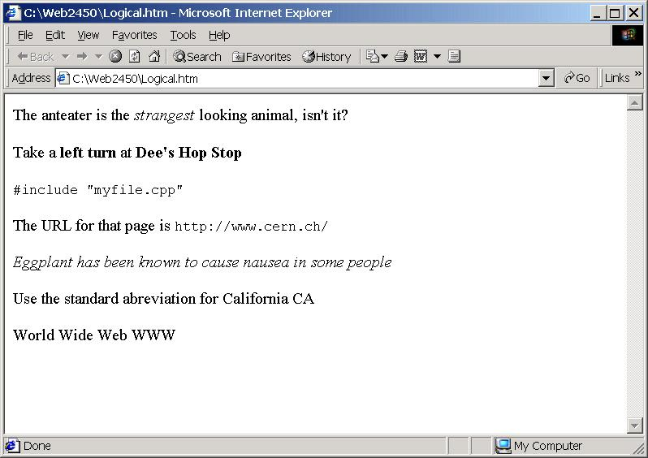

Slide 9
Physical Styles
These tags can be used to alter the appearance of text on your page
These tags are deprecated in favor of style sheets
You should still know about these tags
  They are allowed in our XHTML standard
  They appear in legacy code
  You may still want to use them

Slide 10
Some Physical Styles
<b> - bold
<i> italic
<tt> - monospaced type font
<u> - underline
<s> - strikethrough

Slide 11
More Physical Styles
<big>- bigger than surrounding text
<small>- smaller that surrounding text
<sub> - subscript
<sup>- superscript
<pre> - preformatted text
(this is a block-level element)
  Spacing between characters is kept
  Can be used to line up columns
  ASCII art
  Break lines with hard return (Enter)

Slide 12
<p> This is some regular text. <br />
<b> This is bolded text.</b> <br />
<i> This is italicized text. </i> <br />
<tt> This is monospaced text. </tt> <br />
<u> This is underlined text. </u> <br />
<s> This is strikeout text. </s> <br />
<big> This is big text. </big> <br />
<small> This is small text. </small> <br />
This is some subscript text, 2<sub>4</sub> <br />
This is some superscripted text, 2<sup>4</sup> <br />
</p>
<pre>
This is pre formatted text Second column
More text in first column More in second column
</pre>
Code Sample with Physical Styles

Slide 13
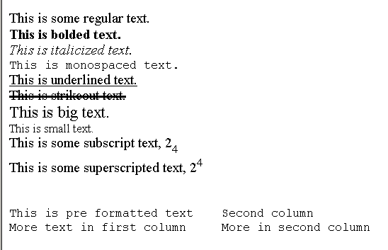
Browser Display of Physical Styles

Slide 14
Inline CSS Styles
Allows the attachment of style rules to an individual element instead of across an entire page or site
<span> allow applying of style over any amount of text
Use the style attribute to set the inline style rules
  Ex. <p><span style=“color:red;
  font-weight:bold”>font will be small and bolded</span> </p>

Slide 15
CSS Text Decoration
Used to apply a decoration to text within the affected tag: underline, over-line, line-through, and blink
Some examples:
  <p><span style=“text-decoration: underline”>Some underlined text</span></p>
  <p><span style=“text-decoration: line-through”>Some line-through text</span></p>

Slide 16
HTML Formatting or CSS???
Choosing between an <u> or the style text-decoration is mostly the same
You should stay with either HTML formatting or CSS formatting and not mix them
Both formatting approaches require you to add or remove each and every instance
CSS style sheets are a better solution
  This process will be covered in a later lesson!!!

Slide 17
CSS Font Properties
The font-style property modifies the style
  Ex. <p><span style=“font-style: italic”>some italicized text</span></p>
The font-weight property modifies the weight
  Ex. <p><span style=“font-weight: bold”>some bolded text</span></p>
The font-family property changes the general family of the text
  Ex. <p><span style=“font-family: monospace”>some monospaced text</span></p>

Slide 18
<body>
<p> <span style="text-decoration: underline">Here is some underlined text</span></p>
<p> <span style="text-decoration: overline">Here is some over-lined text</span></p>
<p> <span style="text-decoration: line-through">Here is some line through text</span></p>
<p> <span style="text-decoration: blink">Here is some blinking text</span></p>
<p> <span style="font-style: italic">Here is some italicized text</span></p>
<p> <span style="font-style: oblique">Here is some oblique text</span></p>
<p> <span style="font-weight: bold">Here is some bold text</span></p>
<p> <span style="font-weight: bolder">Here is some bolder text</span></p>
<p> <span style="font-weight: lighter">Here is some lighter text</span></p>
<p> <span style="font-family: monospace">Here is some monospaced text</span></p>
<p> <span style="font-variant: small-caps">Here is some small caps text</span></p>
</body>
</html>

Slide 19
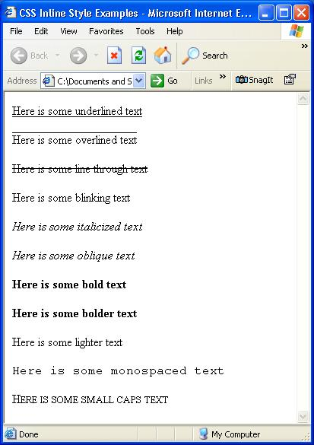
Text Styles
Using CSS

Slide 20
Horizontal Rule
<hr/> - horizontal line
  This is a self-terminating tag
  Attributes
    size – size in pixels
    width- in pixels or percentage
    align- center(default), left, right

Slide 21
Other Inline elements
<br /> - line break, self-terminating tag
<address>-italicizes the text
<blockquote>- used to set apart longer text blocks
  Indents both the left and right margin
  Note: Should only be used for quotes
Special characters – begin with &
  Ex. &nbsp; non-breaking space
  Ex. &cop; &quot; &agrave;
  Ex. &lt; &gt; &amp;

Slide 22
Aligning Blocks of Text
<div> - division groups a block of text
You can use this to group tags as well as text
Align will apply to all the contained tags
Any aligns that appear within the <div> tags will override the <div> align

Slide 23
<div align="right">
<h3> First Title </h3>
<hr width= "300" />
<h3> Second Title </h3>
<hr width = "300" />
<p align = "left">
inner paragraph text.
</p>
</div>
Code Sample Text Alignment

Slide 24
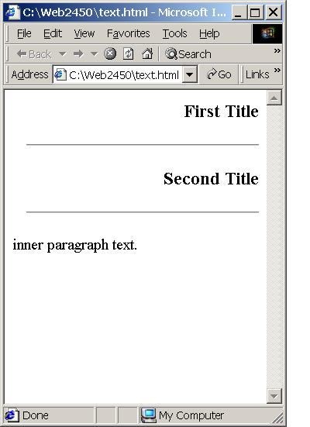
Browser Display of Text Alignment

Slide 25
HTML Fonts and Font Sizes
Used to control the characteristics
of a set of characters- <font>, </font>
This tag is deprecated
Most common attribute is size:
1(smallest)….…7(largest)
  The base(default) font size is level 3
  <font size=“2”> is level 2
  <font size=“+2”>
  is two levels larger than the base font

Slide 26
<p>
<font size="1"> Font Size 1 <br /> </font>
<font size="2"> Font Size 2 <br /> </font>
<font size="3"> Font Size 3 <br /> </font>
<font size="4"> Font Size 4 <br /> </font>
<font size="5"> Font Size 5 <br /> </font>
<font size="6"> Font Size 6 <br /> </font>
<font size="7"> Font Size 7 <br /> </font>
<hr />
<font size="-2" > Font Size Base-2 <br /> </font>
<font> Font Size Base Size <br /> </font>
<font size="+2"> Font Size Base+2 <br /> </font>
</p>
Code Sample Font Size

Slide 27
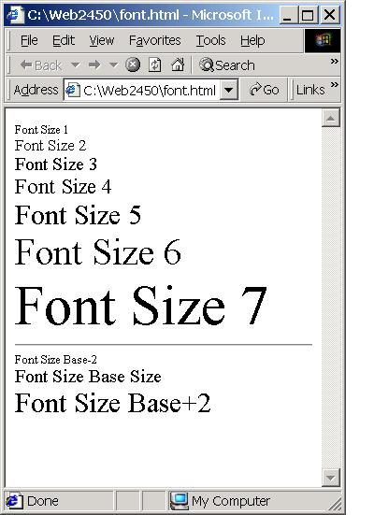
Browser Display of Font Size

Slide 28
Font Face
This attribute takes the name of a font as a value:
Ex. <font face=“Arial”>
Often a list of fonts is given:
Ex. <font face=“Futura,Helvitica”>
The first font face found will be displayed
If not found, the second font will be displayed
If none are found, the default font is shown

Slide 29
Serif Vs. Sans-Serif Fonts
Serif type fonts have the little tick marks (serifs) at the end of the lines:
This is Serif text.
Sans-Serif type fonts have no ticks at the end of the lines:
This is Sans-Serif text.
You might want to list font faces that are used by different OSs but are the same type:
Ex. <font face=“Arial, Helvetica,sans-serif”>

Slide 30
Modifying Fonts Using CSS
The font-family property can be used to set “general” font families
More specific font faces can also be set with this property
  <p><span style=“font-family: Veranda”>
  Veranda is a sns-serif font </span></p>
  <p><span style=“font-family: Courier”>
  Courier is a monospace font </span></p>
Often a list of fonts is given for different platforms like: PC font, Mac font, general font
<p><span style=“font-family: Arial, Helvitica, sans-serif”>
  Arial is a well known PC font </span></p>

Slide 31
Modifying Font Size Using CSS
Specifying font size is more complicated in CSS than with the <font> tag in HTML
There are many units of measure available for CSS font sizes, some of which are:
  Pixel size- px
  Point size – pt
  Inches – in
  Centimeters – cm
  Percent - %

Slide 32
CSS Font Sizes (cont.)
Use the font-size property to change the font size
For example:
  <p> This font is normal sized</p>
  <p> <span style=“font-size: 200%”> This font is twice as tall</span></p>
  <p> <span style=“font-size:12pt”> This font is 12 pixels tall</span> </p>

Slide 33
Cascading Style Sheets
The first implementation was known as CSS1
Next generation is CSS2
  Allows specifying of font colors, background colors and graphics, margins, spacing, type style and more
  Many CSS2 tags are supported by the latest browser versions

Slide 34
3 Approaches to Style Sheets
External Style Sheets
Embedded Style Sheets
Inline Styles
All these styles are supported in Dreamweaver
Later in the semester we will focus on External Style Sheets

Slide 35
Sources for CSS Info
W3C Web site on CSS-http://www.w3.org/Style/CSS/
Info on how web browsers implement CSS-
http://www.webreview.com/style/index.shtml
Insite from the Web Design Group-
http://www.htmlhelp.com/reference/css
W3C’s CSS Home Page-
http://www.w3.org/Style

Slide 36
Lesson Summary
HTML provides many tags for text formatting and styles
Many of these HTML formatting tags have been deprecated (phased out)
Test the result of using formatting in your target browser
Advanced formatting should be done with Cascading Style Sheets, CSS

