Slide 1
How to Validate and Upload
Web Publishing with
HTML and CSS:
PP 500 – 504 and Lesson 18

Slide 2
Validation
Most Web documents are written using markup languages, such as HTML or XHTML.
Validation is a process of checking your documents against a formal Standard, such as those published by the World Wide Web Consortium (W3C) for HTML and XML-derived Web document types.
Validation serves a similar purpose to spell checking and proofreading for grammar and syntax, but is much more precise and reliable than any of those processes because it is dealing with precisely-specified machine languages.

Slide 3
Validation (cont.)
These languages are defined by technical specifications, which usually include a machine-readable formal grammar (and vocabulary).
The act of checking a document against these constraints is called validation, and this is what the Markup Validator does
The Markup Validator is a free service by W3C that helps check the validity of Web documents.

Slide 4
Why Should You Validate???
Validating Web documents is an important step which can dramatically help improving and ensuring their quality, and it can save a lot of time and money.
Validation is, however, not a full quality check. A web page could still be poorly designed or hard to read.

Slide 5
Start at the Beginning
Every web page created will begin with the start.htm file
  Contains the <!DOCTYPE> DTD tag
  Contains the <meta> tag for the character code
  Contains other <meta> tags for documentation

Slide 6
XHTML 1.0 Transitional
Our validation standard for this course will be XHTML 1.0 Transitional.
This standard applies some of the requirements of XML and still allows use of some style and formatting HTML
After creating each web page this semester, you will try to see if it is valid…

Slide 7
Checking Your Page
Save your html/xhtml document
Go the the validation site:
http://validator.w3.org
Do not type in the www in the URL

Slide 8
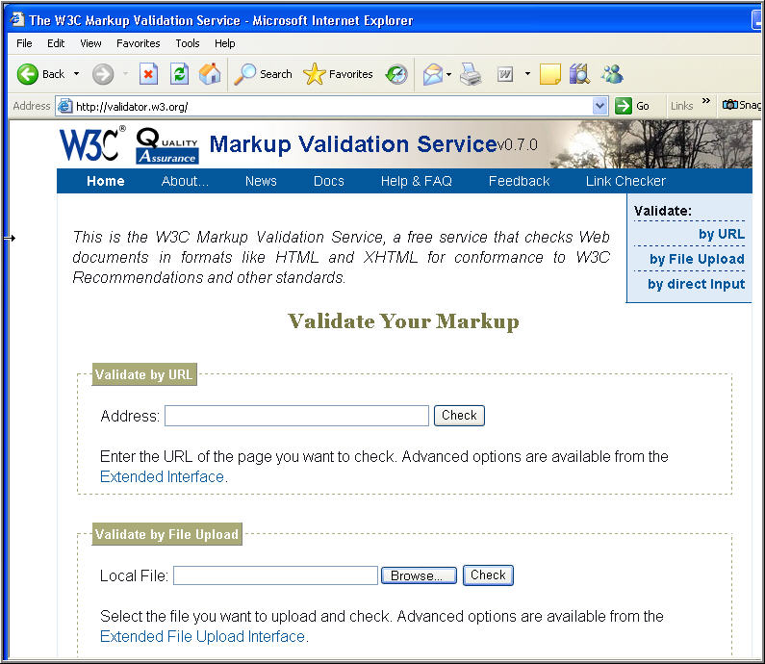

Slide 9
Validating Files
You can validate a file that is still local on your computer
  You should validate your file locally before uploading it to a web server
  Make any needed changes locally
You can also validate a file that has been uploaded to a web server
  Always test you files for validation once you have uploaded them!

Slide 10
Validating Your Local File
For pages located on your client machine choose the “Validate by File Upload”
Look downward on the W3C validation home page until you see the text box for: Local File

Slide 12
Find the Page to Upload
Click on the Browse button and find the file you wish to validate
When the correct file appears in the text box, click on the : Check button
Your local page will then be uploaded to the W3C’s validator

Slide 13
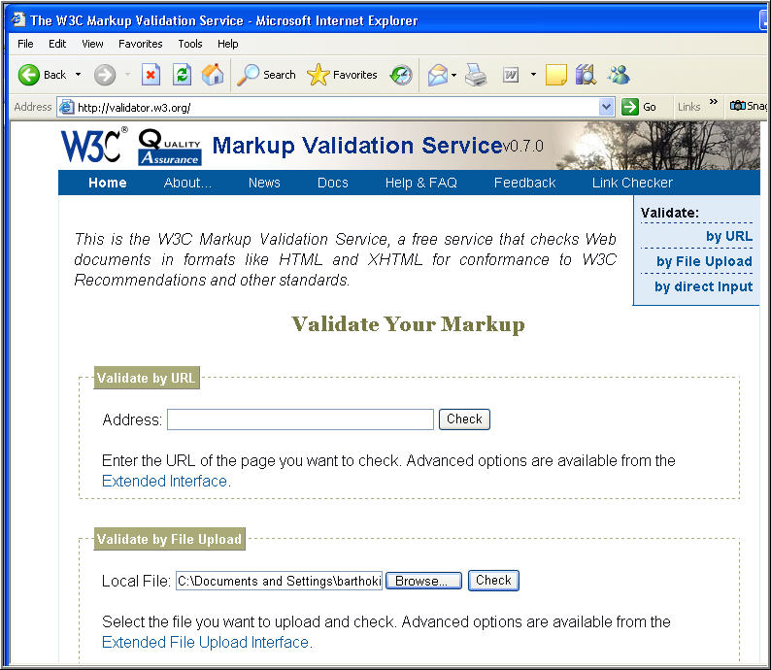

Slide 14
Your Page was GREAT!
If your page was “well-formed” you will receive a This Page is Valid XHTML 1.0 Transitional report from the validator.
You can then add the graphic you see on the page to your document to show your page was validated.

Slide 15
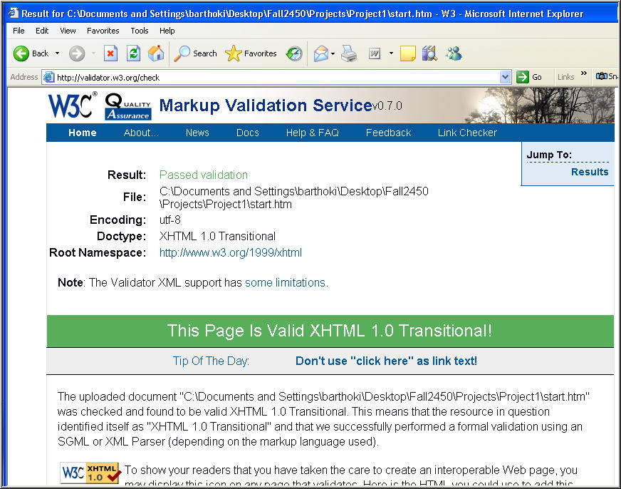

Slide 16
Copy the XHTML 1.0 Code
After validating, copy the code provided to add the validation graphic and link to your web page
Be sure to place the code just before the closing </body> tag of your page
This graphic will link back to the validator site when uploaded

Slide 17
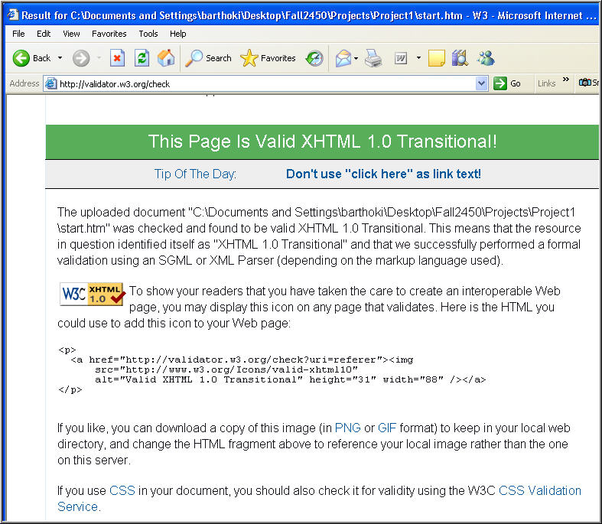
Copy this code to your file!!!

Slide 18
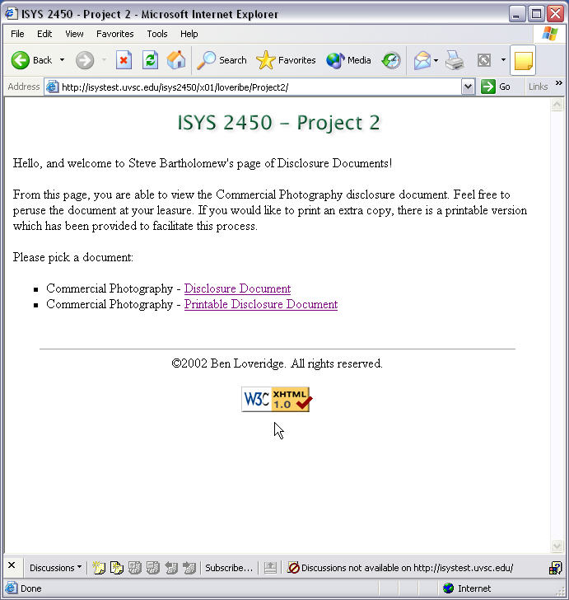
A Completed
Project Page

Slide 19
Validating a File on the Web Server
Use the “Validate by URL” option for pages uploaded on a web server.
Look downward on the W3C validation home page until you see the text box for: Address
If your page had errors, you should fix them, check the file locally and then re-upload the file to web server again.

Slide 21
Your Page is not Valid
If your page does not have a <!DOCTYPE> DTD tag, the validator will not be able to check your file
Use the start.htm file given to you by your instructor because it contains the needed <!DOCTYPE> as well as a <meta> tag that defines the character code of the file

Slide 22
Errors were Found
If you are not so lucky and errors are found in your document …
  You will be given line numbers and help to fix the errors.
  It is up to you to solve these problems
  This process is known as Debugging
You must fix errors, and retry the validation until you are 100% successful
Explanations for some common validation errors can be found at this page in the W3C website: errors.html

Slide 23
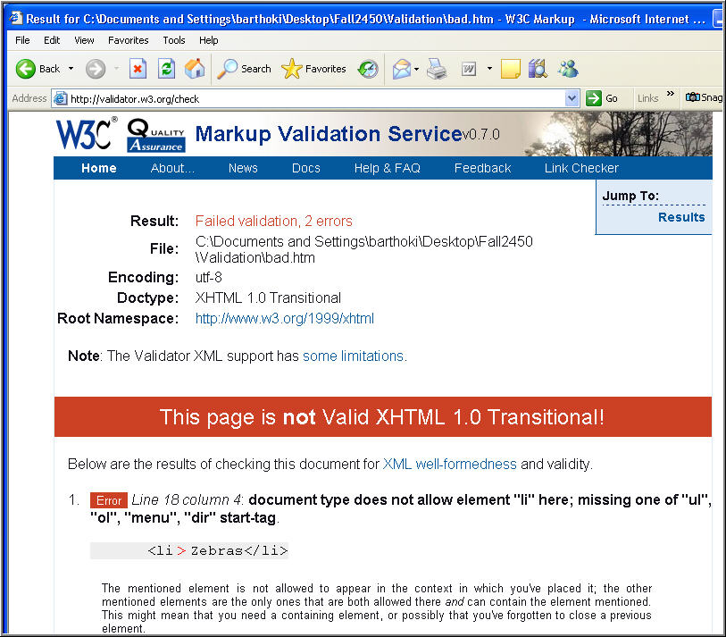

Slide 24
What was Wrong?
The first error in this document was related to the <li> tag
  The <li> tag was missing the closing </li>
  The error has a line and column number
  Notice the explanation given by the validator matched this error
The second error is also related to this missing </li> tag
  Sometimes the validator gives more than one reason for an error
  If you fix the problem both errors will go away

Slide 25
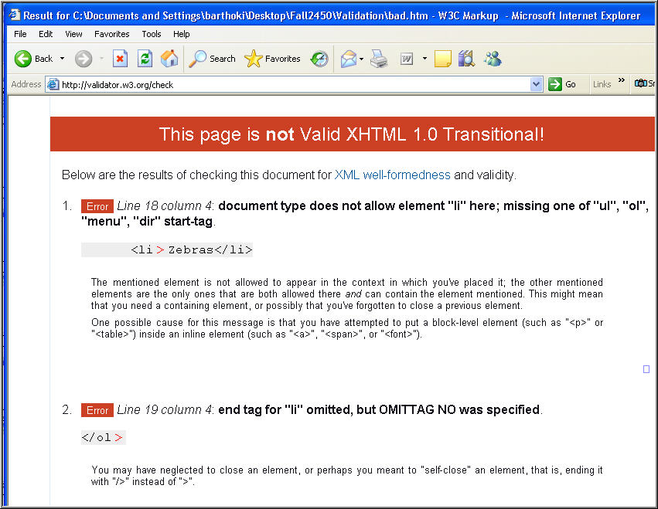

Slide 26
Debugging your Code
To find the problem in your code:
  Read the validator message for the error
  Look at the code shown
  This will help you to see just where the error has occurred
  Go back to your file and fix the error
  Repeat if necessary

Slide 27
XHTML 1.0 Transitional
With this coding standard we can use some of the newer web features like:
  JavaScript (must be lowercase)
  Cascading Style Sheets
  FrameSets
  Etc.
We can still use many tags and attributes that have been deprecated

Slide 28
“Well-Formed” XHTML Code
Some things to check when your code fails to validate:
  <!DOCTYPE> tag is correct
  Every non-empty has a closing tag
  Self-terminating tags have closing /
  Attributes are quoted
  Tags and Attributes are lowercase
  Use proper nesting
Good Luck!!!

Slide 29
Finding Uploading Projects and Finding a Web Host
Web Publishing with
HTML and CSS: LESSON 1
Teach Yourself Web Publishing
with HTML and XHTML: Day 20

Slide 30
Web Server
This is a computer that
is used to store your web pages
Has special software that allows you to connect to the server and request a page
Transmits the page to your own machine called the client
Allows trusted users to upload websites, pages, or other web resources

Slide 31
What is a VPN???
A Virtual Private Network, or VPN, is a private communications network
A VPN is usually used within a company, or by several different companies or organizations, communicating over a public network.
VPN message traffic is carried on public networking infrastructure (e.g. the Internet) using standard protocols.

Slide 32
Authentication in a VPN
A firewall sits between a remote user's workstation or client and the host network or server.
The firewall may pass authentication data to an authentication service in a host network.
A known trusted person with privileged access, sometimes only using trusted devices, can be allowed to access resources not available to general users.
That's why the user feels that the network is private, even though it is not.

Slide 33

What is a Firewall???
It is a piece of hardware and/or software
which functions in a networked environment to prevent some communications forbidden by the security policy, analogous to the function of firewalls in building construction.
A firewall is also called a Border Protection Device (BPD) or a packet filter.
A firewall has the basic task of controlling traffic between different zones of trust. Typical zones of trust include the Internet (a zone with no trust) and an internal network (a zone with high trust).
The ultimate goal is to provide controlled connectivity between zones of differing trust levels through the enforcement of a security policy and connectivity model based on the least privilege principle.

Slide 34
Using the CSEVPN
The School of Technology and Computing (formerly CSE) has created a VPN for students to access servers in the school which are located behind a firewall
  vpc-web.csevpn.local – web server
  citesql.csevpn.local – web server and database server
  csemedia.csevpn.local – streaming media server
  cseftp.uvsc.edu/IST/barthoki/- ftp download area

Slide 35
Login to the CSEVPN from Home
There is a one-time setup to use the VPN from your office, laptop or home
Follow the setup instructions found in this file:
ftp://cseftp.uvsc.edu/VPN%20Connection%20Instructions.pdf
  Make sure you create a desktop shortcut to use the VPN
Double-Click the CSEVPN Icon on the computer desktop
Provide the login info given by your instructor i.e.
  User Name: UVID@csevpn.local
  Password: emailed to you by your instructor
  (this is case sensitive)

Slide 36
Login to the CSEVPN from a CS Lab
Double-Click the CSEVPN Icon on the computer desktop
Provide the login info given by your instructor i.e.
  User Name: UVID@csevpn.local
  Password: your emailed password
  - only first time, must change this
  - (this is case sensitive)

Slide 37
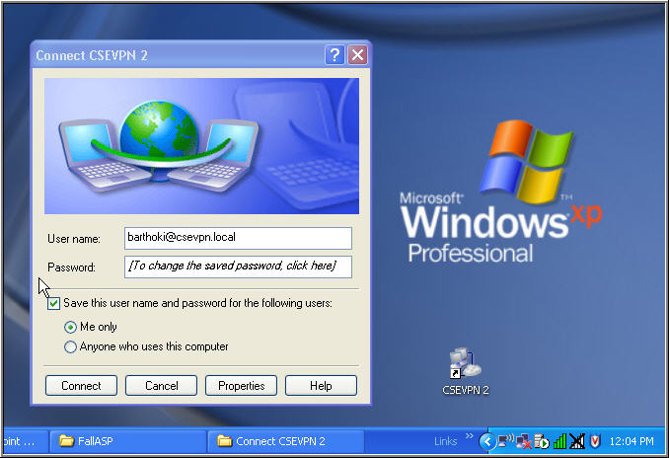
Login to the CSEVPN
CSEVPN Login
CSEVPN Icon

Slide 38
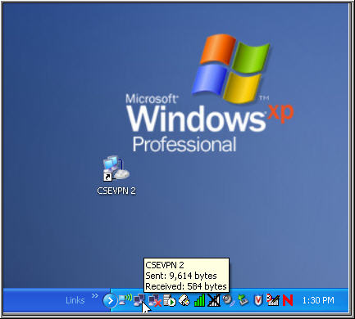
The Active CSEVPN connection
CSEVPN in
the System Tray

Slide 39
Creating a New Password
You will be prompted to change your password the first time you login
For security reasons, the password you chose must use 3 of these 4 character types:
  Lowercase characters
  Uppercase characters
  Numbers
  Special characters (@!#$%^*)
  For example: MyNam2!sBob

Slide 40
Connecting to Charlie
Once logged into the VPN…
Start Menu->All Programs->Accessories
->Communications->Remote Desktop Connection
Enter the computer name: charlie.csevpn.local
Set the Options:
  On the General Tab, set your VPN username and password
  On the Local Resources tab, click the Disk Drives box
Click the Connect button

Slide 41
Placing Your Project Folders
Each student has their own private desktop and My Documents area on Charlie
Create or copy your project folder to the My Documents area on Charlie.
Do not nest your project folders inside any other folders

Slide 42
Check Files After Uploading
You should always check your pages in the web browser after uploading your project
  Make sure colors and format is correct
  Check links work
  Check graphics display correctly
  Etc.

Slide 43
Logging Out of Charlie
When you are finished with your work on Charlie, shut down from the Charlie start menu
Next, disconnect from the VPN as shown in the next slide

Slide 44
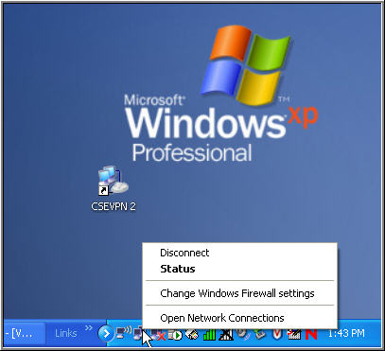
Disconnect from the VPN
Right-Click on the CSEVPN icon in the System Tray
Choose Disconnect
Disconnect
from CSEVPN

Slide 45

After this Class if Over…
How do You Publish a Web Site???
There are many types
of web sites
  Non-Profit
  Personal
  Entertainment –
  may need multimedia capabilities
  Commercial – needs shopping cart or form processing capabilities
Match your needs with an appropriate web hosting option

Slide 46
Getting a Domain Name and IP Address
You can register the right to own a given Internet domain name
Usually requires a search for a unique name
Can be purchased for as low as $8.00/year
www.dotster.com
www.register.com
www.godaddy.com
www.networksolutions.com

Slide 47

Locating a Web Server for your personal use
Try your school or place of work
  Contact the webmaster or system administrator
  for info
Try your Internet Service Provider (ISP)
  Publishing web pages may cost extra
  Restrictions usually apply
Try a Web Presence Provider
  Usually charges monthly
  Some offer free web hosting

Slide 48

Free Web Hosting
May provide virtual hostname
  Looks like you have your own server
Provide limited storage space
Restrictions usually apply
May have hidden fees, be careful
Often have banner adds or imbedded text links added to your pages
May not allow form processing

Slide 49

www.web1000.com
Offers free web hosting
Provides you with a free hostname
No ads or banners
50MB storage
Must agree to an Acceptable Use Policy Agreement
Hosts some questionable sites so don’t be offended by their questions

Slide 50
Management of Files
View your files using the HTTP protocol
  You will be given a URL to your top-level directory
Find out the system’s default index file
  This file is loaded by default
  Usually index.htm, index.html or default.htm
Always place your files in a folder with no spaces in the folder name
Some web servers are case-sensitive

Slide 51
FTP Clients
Special software that allows you to connect to the web server and do the following:
  You can make directories
  Move or upload files
  Delete files
  Download files

Slide 52
Some Free FTP Clients
web2ftp
FTP Commander
Core FTP LE (Good one)
BlazewareFTP
FileZilla

Slide 53
Good Luck!

