Slide 1
Art Design, Logos, and Page Layout
Web Graphics Overview
Supplemental Material

Slide 2
Art Design 101
Elements and Principles of Design
John Lovett, Australian Artist and Teacher:
www.johnlovett.com

Slide 3
Elements of Design
The Elements of Design can be thought of as the things that make up a painting, drawing, web design etc.
Good or bad - all compositions will contain most, if not all, of the seven elements of design:
  Line
  Direction
  Texture
  Value
  Shape
  Size
  Color

Slide 4


Line and Shape
Line can be considered two ways:
  Linear marks made with a brush, or pen
  The edge created when two shapes meet
Shape is a self contained area of geometric or organic form
  A positive shape in a composition automatically creates a negative shape

Slide 5
Direction
All lines have direction - Horizontal, Vertical or Oblique
  Horizontal lines suggests calmness, stability and tranquility
  Vertical lines gives a feeling of balance, formality and alertness
  Oblique lines suggests movement and action

Slide 6
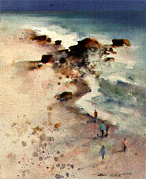
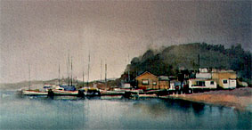
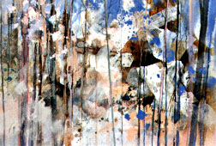
Direction Examples
The strong horizontal lines of the water, boats and buildings give a feeling of stillness and calm
The diagonal lines of the shoreline and the rocks reinforce the feeling of movement
The dominant vertical direction adds a static orderly influence to what might be a random chaotic painting

Slide 7
Size and Texture
Size is simply the relationship of the area occupied by one shape to that of another
Texture is the surface quality of a shape
  Texture can be physical (tactile) or visual: rough, smooth, soft, hard, glossy etc.
  Visual Texture is the illusion of physical texture, created with the materials you use.

Slide 8
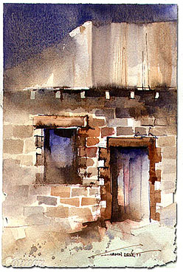
Visual Texture
Graphics displayed on the web will only exhibit visual texture
Contrasting the coarse texture of the bricks with the regular pattern of the iron roof keeps the surface of this work interesting.
Smoother areas of relief provide a resting place for the eye and stop the composition becoming too cluttered and confused.

Slide 9
Color in terms of HSV
In HSV, any color is decomposed along three axes
  Hue: a pure rainbow color from the color wheel
  Saturation: the proportion of this pure color vs. colorless gray
  Value (also called luminance): the overall brightness of the color

Slide 10
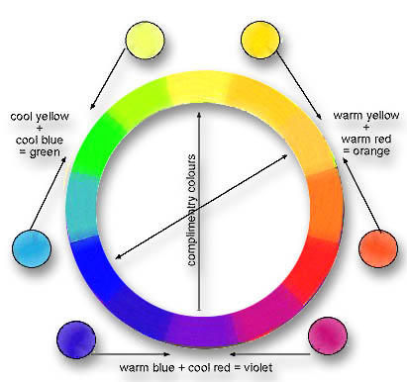
Color or Hue
The color wheel is based
on the three primary colors
( Red, Yellow and Blue )
placed evenly around a circle
The secondary colors (Green, Orange and Violet) are mixtures of the two primaries they sit between
The tertiary colors fall between each primary and secondary. Between yellow and orange, for example, is yellow orange, between blue and violet is blue violet and so on

Slide 11
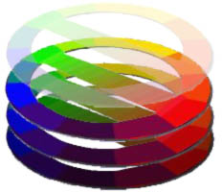
More Color Terminology
Complimentary colors are opposite each other on the color wheel
Saturated colors contain no black, no white and none of their complimentary color
Compound colors contain a mixture of the three primaries, for example: the browns, khakis and earth colors
Tints are made by adding white to a color
Shades are made by adding black
This illustration shows the compound mixtures between red and green, as are tints and shades of the color wheel

Slide 12
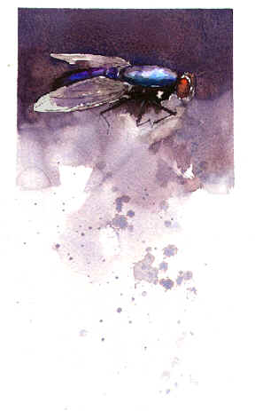
Value or Tone
Value is the lightness or darkness of a color
Tonal contrast is the difference between the light and dark areas in a composition.
  The greater the difference the more attention the area attracts
  In this composition of a fly, the strong tonal contrast between the flies body and wings, causes attention to go immediately to this area.

Slide 13
Principles of Design
The Principles of Design can be thought of as what we do to the elements of design.
How we apply the Principles of Design determines how successful we are in creating a work of art
  Balance
  Repetition
  Dominance
  Unity
  Gradation
  Contrast
  Harmony

Slide 14
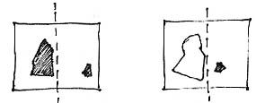
Balance
Balance in design is similar to balance in physics
A large shape close to the center can be balanced by a small shape close to the edge.
A large light toned shape will be balanced by a small dark toned shape (the darker the shape the heavier it appears to be)

Slide 15
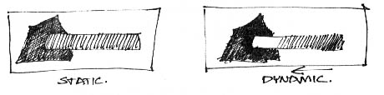
Gradation
Gradation of size and direction produce linear perspective.
Gradation of color from warm to cool and tone from dark to light produce aerial perspective.
Gradation can add interest and movement to a shape.
A gradation from dark to light will cause the eye to move along a shape.

Slide 16
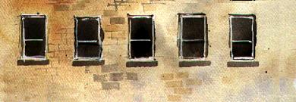
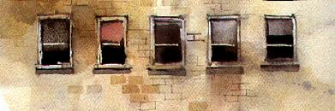
Repetition
Repetition means repeating a design element (color, tone, texture, line, shape, size or direction) throughout a composition
Repetition with variation is interesting, without variation repetition can become monotonous
The repeating rectangle gives the work unity, but it suffers from monotony
Subtle changes from one element
to another allow for unity, but make the windows more interesting

Slide 17
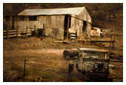
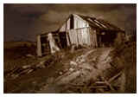
Contrast
Contrast is the juxtaposition of opposing elements
  Opposite colors on the color wheel – red / green,
  blue / orange
  Contrast in tone or value - light / dark.
  Contrast in direction - horizontal / vertical.
The major contrast should be
located at the center of interest.
Too much contrast can destroy
unity and make a work difficult
to look at.

Slide 18
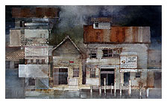
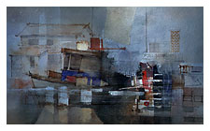
Harmony
Harmony in composition is the visually satisfying effect of combining similar, related elements
  adjacent colors on the color wheel
  similar shapes etc.

Slide 19
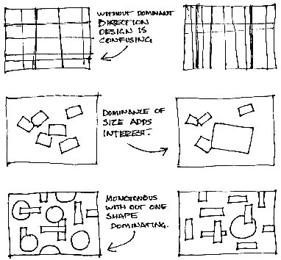
Dominance
Dominance gives
a composition interest, counteracting confusion and monotony.
Dominance can be applied to one or more of the elements to give emphasis

Slide 20
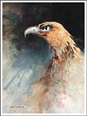
Unity
The principal of unity relates
the design elements to the
idea being expressed in a
composition
  an active aggressive subject would work better with a dominant oblique direction, course, rough texture, angular lines etc.
  whereas a quiet passive subject would benefit from horizontal lines, soft texture and less tonal contrast

Slide 21
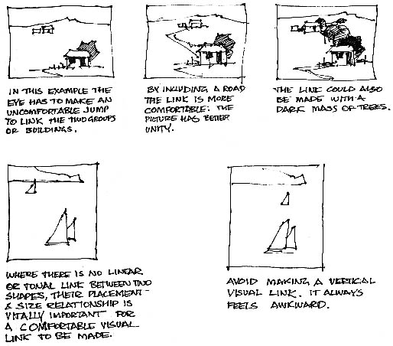
More on Unity
Unity in a composition also refers to the visual linking of various elements of the work

Slide 22
Logo Design 101
Design Lab Lessons about Logos
Dimitry Kirsanov:
http://www.webreference.com/dlab/

Slide 23
What is a Logo?
In print media, a logo has been a piece of graphics and/or text used as a company's symbol---a corporate identity.
On the Web, logos play an even more vital role: They often serve as the main graphic heading---or a part thereof---on the page and, consequently, the visual center of the entire page design.

Slide 24
What makes up a Logo?
Part 1: The media you will work with:
  Forms
  Fonts
  Color
  Finishes
Part 2: The concepts you will apply to the media:
  Proportions
  Contrast
  Repetition
  Nuances

Slide 25
Part I: The Media of Logos
A well crafted logo is the first and foremost place to show off the site creator's artistic skills.
The materials you work use to create a logo are: forms, colors, fonts, and finishes

Slide 26
Forms in Logos
The world around us is made up of forms
Logos usually contain abstract or simplified forms
  Abstract" means "purified, cleared of all non-essential components."
  But it doesn't always mean "simple" and never means "boring."

Slide 27
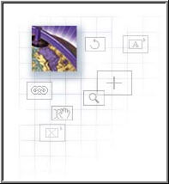
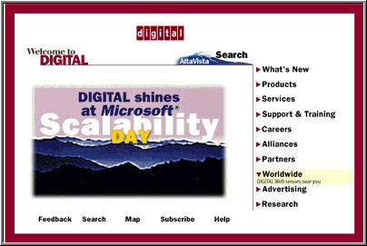

Forms from Geometric Shapes
Straight Lines
Rectangles, rounded
Circles

Slide 28

Fonts in Logos
This Logo uses one font
family, with different
styles: contrasting extra-bold
and extra-light font
Serif fonts- Have adornments on the ends of the characters
Sans-serif fonts- Have no adornments
What if you need more than one font style in a Logo?
  The best option is to use the same font, or its different variants (e.g. bold or italic), for all of your needs
  For an entire document, serif fonts do work fine with sans serifs, and vice versa.
  For a logo, these two varieties of fonts are simply too different
  Using all-lowercase and all-uppercase styles in one logo is also not recommended.

Slide 29

Color in Logos
What colors belong together?
  Warm colors: located on the left side of the color wheel: (red, orange, yellow)
  Cool colors: located on the right side: (green, blue, purple)
  The best-matching colors are those that are located on the wheel at the distance of one quarter (90 degrees) from each other
  Different tints or shades of the same color are also pleasing to the eye

Slide 30


Finishes
Finishes include decorations such as: surface textures, drop shadows, highlights, gradients, and transparency
Finishes may give a finished appearance
  No amount of drop shadows will improve a poorly designed logo
  A good logo must tolerate having all its finishes removed without much damage

Slide 31
Part II: Your Tools
Now it's time to master the tools you apply when working on a logo composition: proportion, contrast, repetition, and nuances
The Web we all browse teems with examples of excellent, mediocre, and horrible design
  Applying good principles of design will make your web creations successful
  When in doubt, ask for a second opinion

Slide 32
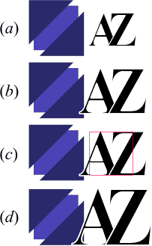
Proportion
Proportion: the comparative relation between things or magnitudes as to size, quantity, number,
Play with sizes (as well as other aspects of your work) and try to find the best proportion
Try to find relations which are simple yet not immediately obvious.
A useful tip: make two non-adjacent objects the same size, or one twice the size of the other

Slide 33
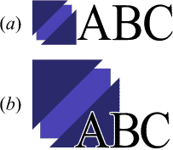
More on Proportion
Text can be the same size as the visual
  The result (a) is acceptable, although maybe just a little bit too ordinary. Lots of logos use this layout.
The height of text can be half the height of the inner square
  The result (b) is a more dynamic, combination

Slide 34

Contrast
One of the most important design skills is to choose the level of contrast that's necessary for your case
  Contrast of Form: use opposites as big vs. small, horizontal vs. vertical, rectangular vs. circular; the multitude of choices are almost unlimited.
  Contrast of Colors: use opposing hue, saturation, or brightness; among these, contrasting brightness is the most natural choice
  Contrast of Fonts: the only meaningful opposition that can be made with fonts in logos is the contrast of different styles within one font family, such as normal, italics, and bold
  Contrast of Finishes: decorate a contrast already expressed in form or color by also applying contrasting textures (e.g. polished vs. rough or raised with a drop shadow vs. flat)

Slide 35

Repetition
Repetition makes us perceive a series of objects as a line of motion, or a sequence of transformation.
Any repetition implies a line (either straight line or curve) along which the repeated objects are positioned.
This line of repetition can be either an undirected line or a directed vector with one end being a "start" and the other, "finish."

Slide 36
How many Repetitions
How many objects should we use in a repetition?
  The most popular number is three
  A pair of objects is not enough---they will most probably be perceived as an implication of either symmetry or contrast
Another approach may be to equate the number of elements to the number of letters in the logo's text

Slide 37
Symmetry
Symmetry is a special case of repetition
  A couple of identical objects are mirrored around an axis or a central point.
  A symmetric arrangement is one of the most engaging and pleasing for human perception.
Symmetry reveals the beauty of a purely abstract form, and it's not accidental that the most perfect real-world creations such as the human body are nearly symmetric
It must not be too obvious. A composition where every detail is in symmetry tends to be too stable and, as a result, boring

Slide 38

Nuances
This logos nuances
are emphasized
by the dashed red lines.
Applying nuances means using the same old design concepts---but with a difference
Let the viewer discover the myriad of relationships that exist in a logo
One kind of nuances deserving special mention is kerning
  Remember, kerning is the manual adjusting the distance between letters
  Nothing is a more undeniable giveaway of an amateur than a title left without kerning.

Slide 39
Secret to Success with Logos
To succeed in the art of logo, you must before all enjoy your material and your tools; you must love to play with forms, fonts, and colors
Enjoying the process of work is the best way to make sure that your audience will enjoy your creation
Nuances come out quite naturally from the author's soulful attitude

Slide 40
Page Layout 101
Web Redesign| Workflow that Works Kelly Goto & Emily Cotler

Slide 41
Designing Page Layouts
Base your layout decisions on the elements and principles of art design.
Objects can be rearranged, subdued or emphasized, included or excluded.
The time to make these decisions is at the planning stage of the layout.
Decide on a subject and what sort of mood, concept or message you wish to convey
Then make a rough wireframe sketch to arrange the page content

Slide 42
Wireframe Example
Show placement of key page content
Images are represented with the X areas
Label navigation, areas of text, links, logo, banner headings, etc.
Above the dashed line, above the fold, is the viewable part of the page
Include screen dimensions
Wireframes do not include visual design elements or color clues
Logo
Home Page Banner
Navigation
Bar
Welcome Message
Animation
480 PX
Image Map
Related
Links
Fold
Contact Info
Validation
Graphic
760 PX (Flexible)

Slide 43
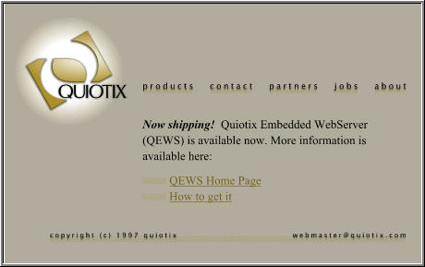
Pulling it all Together

Slide 44

Structuring your Background
Begin to add large areas of flat color, patterns, and graphical elements to your page background
Always remember where content is planned
The background should tie elements together
480 PX
Fold
760 PX (Flexible)

Slide 45
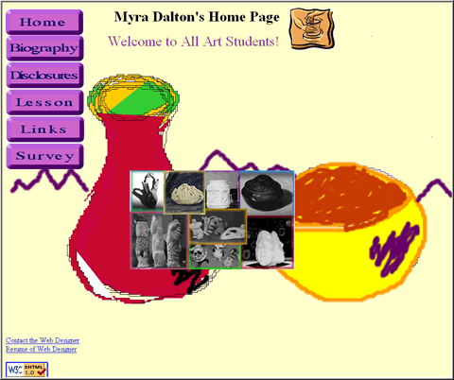
Poor Background Example
The content is placed on this page but…
the background does not pull things together
There is no coordination between the page content and the background

Slide 46
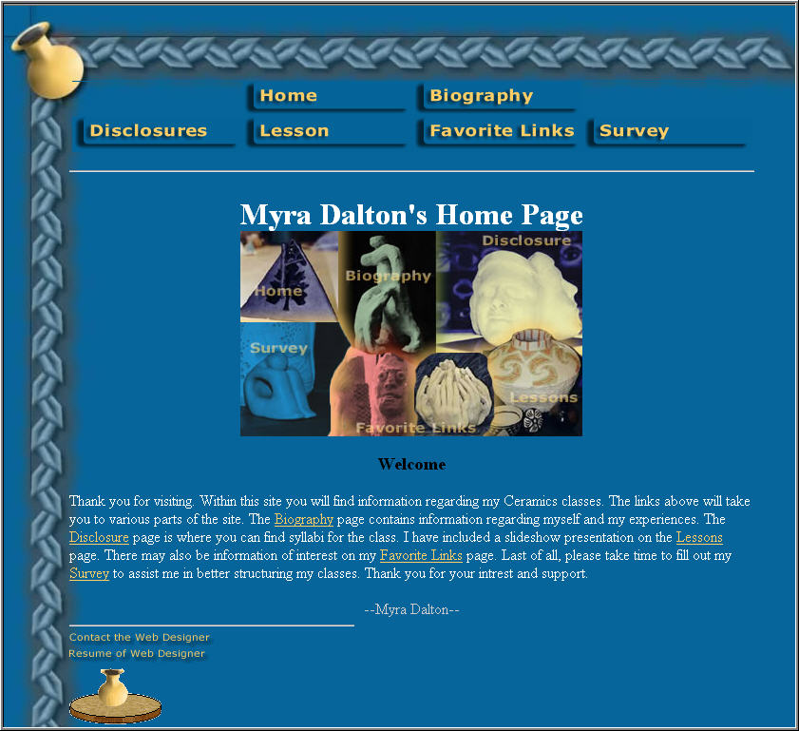
Better Background Example
This background complimented the page content
There was a definite color scheme
Graphical elements fit ceramics theme
Text and link colors picked up colors from background

Slide 47
Designing Page Colors
Giving your page a unique appeal is as simple as selecting the right background and text colors
Spend some time exploring the color universe and looking for the most captivating and least hackneyed colors
One very important area to apply color principles in web design is selection of colors for the background, text, and <body> link attributes: link, vlink and alink

Slide 48
Page Color Scheme (1)
Improvements on the dark-text-on-light-background scheme
  A background color can be made less saturated
  Along the same lines, a text color can be a darker shade with the same hue/saturation values
  Link colors can be used to somehow zest the otherwise monotonous color landscape
  Visited links should somehow signal the fact that they're "exhausted" by being darker or less saturated than non-visited links

Slide 49
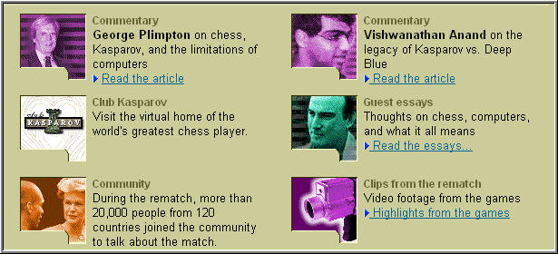
http://www.research.ibm.com/deepblue/home/html/b.html

Slide 50
Page Color Scheme (2)
Easiest choice because of the self-luminous nature of computer screen: light-text-on-dark-background
  Any bright color used for text remains clearly discernible
  Any dark---or even not very dark---color used for background does not damage legibility
  Dark backgrounds favor high levels of saturation

Slide 51

http://www.verso.com/
Hard to read!

Slide 52
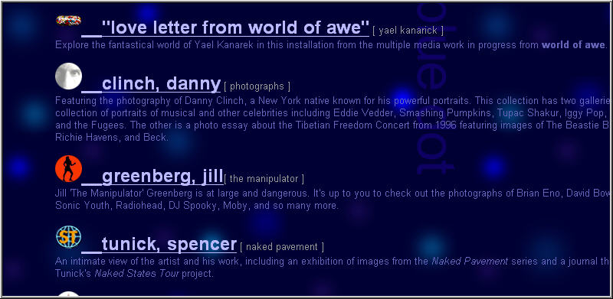
http://www.thebluedot.com/details.html

Slide 53
To Tile or Not Tile, that is the Question?
If your background image is smaller than the dimensions of the browser window, it will tile by default
Creating a small seamless tile is very difficult
Advantage: A small tile image will load very fast!
Disadvantage: while the texture may look perfect with the page heading or navigation bar, it may make text in the body area unreadable
A better solution might be to incorporate the same texture right into the graphics where it is needed, or use a non-tiling background.

Slide 54
Non-Tiling Backgrounds
Expanding the background image in both dimensions creates a background which is not subject to tiling at all.
This technique, used by many professionally designed pages, gives the most creative control over a page's layout.
Naturally, a non-tiling image must be large (at least 1200 pixels wide; its necessary height should be determined by the contents of the page)
To keep file sizes down, only GIFs with few colors or JPEGs with high compression levels should be used
The loss of quality in highly compressed JPEGs is less noticeable if the image has low level of contrast, or is artificially faded or blurred.

Slide 55
Visual Design Issues
In this course, you will not have control over the content of your home page because certain elements are required
You will have absolute control over the visual design of this page including:
  The background
  The logo
  Text graphics
  The navigation look and placement
  The page layout scheme
  The site color scheme

Slide 56
Summary
Incorporating art design principles into your graphical elements will allow your web site to not only be functional, but aesthetically pleasing
A carefully crafted site logo will become an integral part of your site look and feel
The background of a home page or other page should tie together all the elements on the page

