Slide 1
Master Pages in
ASP.Net
Supplemental Material:
ASPNET LESSON 3

Slide 2
Master Page Concepts
Defines a consistent look and feel for a website
Provides a re-usable, easy to manage mechanism to build the site layout
Provide "place holders" for the content
Content pages use the shell designed with the master page layout and content can be plugged-in to the Content controls.
WYSIWYG support for viewing the content embedded in the master page at design time.

Slide 3
Web Forms in ASP.Net-
.aspx Pages
The main page type used in a ASP.Net projects is a web form
This page type has a .aspx file extension
A web form has a form tag with a runat=“server” which means it is executed on a web server
Sometimes you will hear this called “server-side” programming

Slide 4
Master Pages - .master file
Master Pages are a web form even though the file extension is .master
ASP.Net form pages that are created using a master page must be run from a Microsoft web server
Running an application from the Visual Studio environment uses the local Microsoft web server called IIS

Slide 5
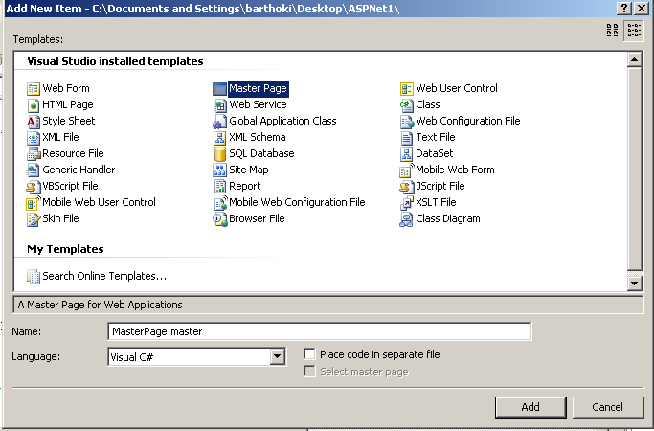
Creating a Master Page
Choose File->New->File then Master Page

Slide 6
Naming the Master Page
As you choose to create a master page, name the page at the same time
The Master Page should have the .master file extension
For our purposes, uncheck the place code is a separate file box

Slide 7
How It Works
Master pages are created to define common layout or blueprint for a group of pages
This layout includes asp:contentplaceholder controls that are place holders for future content.
Content pages created from a master page merge their content into the Master page layout.

Slide 8
The Master Page Template
Master pages have a special @Master directive at the top of the file
Do not change this directive in any way
Master pages can contain HTML tags and other ASP.Net controls like the asp:contentplaceholder.
<%@ Master Language="C#" %>

Slide 9
Basics of a Master Page
Page Directive for the Master Page (template)
<%@ Master Language="C#" %>
<!DOCTYPE html PUBLIC "-//W3C//DTD XHTML 1.0 Transitional//EN" "http://www.w3.org/TR/xhtml1/DTD/xhtml1-transitional.dtd">
<script runat="server">
</script>
<html xmlns="http://www.w3.org/1999/xhtml" >
<head runat="server">
<title>Untitled Page</title>
</head>
…

Slide 10
Basics of a Master Page
Delete the <script> </script> tags
<%@ Master Language="C#" %>
<!DOCTYPE html PUBLIC "-//W3C//DTD XHTML 1.0 Transitional//EN" "http://www.w3.org/TR/xhtml1/DTD/xhtml1-transitional.dtd">
<script runat="server">
</script>
<html xmlns="http://www.w3.org/1999/xhtml" >
<head runat="server">
<title>Untitled Page</title>
</head>
…

Slide 11
Basics of a Master Page
Copy and paste the start.htm meta tags in the head
<%@ Master Language="C#" %>
<!DOCTYPE html PUBLIC "-//W3C//DTD XHTML 1.0 Transitional//EN" "http://www.w3.org/TR/xhtml1/DTD/xhtml1-transitional.dtd">
<html xmlns="http://www.w3.org/1999/xhtml" >
<head runat="server">
<meta name="author" content="Your name here..." />
<meta name="class" content="INFO 2450 - Web Content Design" />
<meta name="keywords" content="Project #, INFO 2450, UVSC, HTML, Web Content Design, whatever else you want..." />
<meta http-equiv="Content-Type" content="text/html; charset=utf-8"/>
<title>Untitled Page</title>
</head>
…

Slide 12
Basics of a Master Page
Link your CSS stylesheet in the head of the page
<head runat="server">
<meta name="author" content="Your name here..." />
<meta name="class" content="INFO 2450 - Web Content Design" />
<meta name="keywords" content="Project #, INFO 2450, UVSC, HTML, Web Content Design, whatever else you want..." />
<meta http-equiv="Content-Type" content="text/html; charset=utf-8"/>
<title>Untitled Page</title>
<link href="StyleSheet.css" rel="stylesheet" type="text/css" />
</head>
…

Slide 13
Basics of a Master Page
Editable region uses a contentplaceholder control
<%@ Master Language="C#“ %>
<form id="form1" runat="server">
<div>
<h3>Welcome to Pets R Us</h3>
<asp:contentplaceholder id=" ContentPlaceHolder1 " runat="server“>
</asp:contentplaceholder>
</div>
</form>
…

Slide 14
Basics of a Master Page
You can have multiple contentplaceholder controls, each needs a unique id.
<%@ Master Language="C#" AutoEventWireup="true"
CodeFile="CompanyMaster.master.cs“ Inherits="CompanyMaster" %>
<form id="form1" runat="server">
<div>
<b>Welcome to Master Company</b>
<asp:contentplaceholder id="ContentPlaceHolder1" runat="server">
This page is under construction.
</asp:contentplaceholder>
</div>
</form>
…

Slide 15
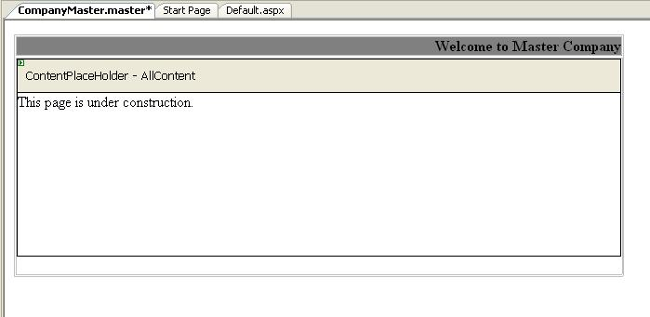
Master Page in Design Mode
Editable Area

Slide 16

ContentPlaceHolder Frustration
When the Master Page creates a contentplaceholder area
  It is not easily movable
  Need to use a div tag or another mechanism to place it
  There is top and bottom padding on this control that cannot be removed

Slide 17
Creating a Content Page
To create a content page in ASP.Net:
  Select File->New->File and choose a Web Form which is an .aspx page
  Visual Studio allows you to select the Master page by checking the box
  For our purposes, uncheck the choose to have the code-behind page created for you.
  Name your new form page something.aspx

Slide 18
Basics of a Content Page
Page directive for Content Page
<%@ Page Language="C#" MasterPageFile="~/MasterPage.master" Title="Untitled Page" %>
<asp:Content ID="Content1" ContentPlaceHolderID="ContentPlaceHolder1" Runat="Server">
<!– Your page content will go here! →
</asp:Content>
…

Slide 19
Basics of a Content Page
Change the Content Page Title
<%@ Page Language="C#" MasterPageFile="~/MasterPage.master" Title="Untitled Page" %>
<asp:Content ID="Content1" ContentPlaceHolderID="ContentPlaceHolder1" Runat="Server">
<!– Your page content will go here! →
</asp:Content>
…

Slide 20
Basics of a Content Page
ContentPlaceHolder area on page
<%@ Page Language="C#" MasterPageFile="~/MasterPage.master" Title="Untitled Page" %>
<asp:Content ID="Content1" ContentPlaceHolderID="ContentPlaceHolder1" Runat="Server">
<!– Your page content will go here! →
</asp:Content>
…

Slide 21
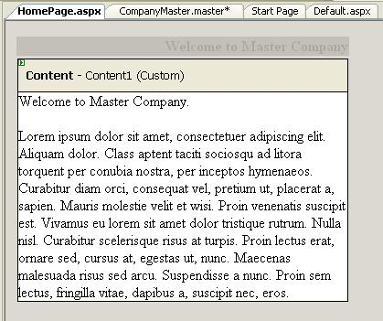
Content Page in Design Mode
Notice the Master
part is grayed out

Slide 22
See MasterTest Example
A Halloween MasterTest page was created
  A background image and text graphic were added
  Two ContentPlaceHolder areas were on the page
    Just copied one to make the other and gave it a unique ID

Slide 23
MasterPage.master-Source Mode
Two ContentPlaceHolder areas
<%@ Master Language="C#“ %>
<div class="topcontent" >
<asp:contentplaceholder id="TopContent" runat="server" >
</asp:contentplaceholder>
</div>
<div class="bottomcontent">
<asp:contentplaceholder id="BottomContent" runat="server" >
</asp:contentplaceholder>
</div>
</div>
…

Slide 24
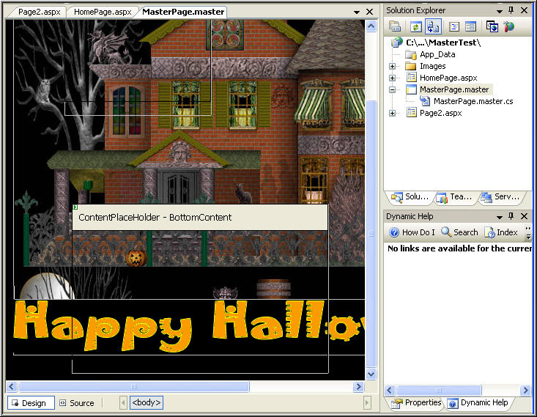
MasterPage.master- Design Mode

Slide 25
HomePage.aspx – Source Mode
Two content areas use the ContentPlaceHolder IDs from the MasterPage
<%@ Page Language="C#" MasterPageFile="~/MasterPage.master“ Title="Halloween Home" %>
<asp:Content ID="Content1" ContentPlaceHolderID="TopContent" runat="server">
<img src="Images/lightningflash.gif" alt="lightening"/><img src="Images/lightningflash.gif" width="80" alt="lightening" />
</asp:Content>
<asp:Content ID="Content2" ContentPlaceHolderID="BottomContent" runat="server">
<img src="Images/pumpkinglw.gif" alt="pumpkin" />
<img src="Images/frankenstein.gif" alt="monster"/>
</asp:Content>

Slide 26
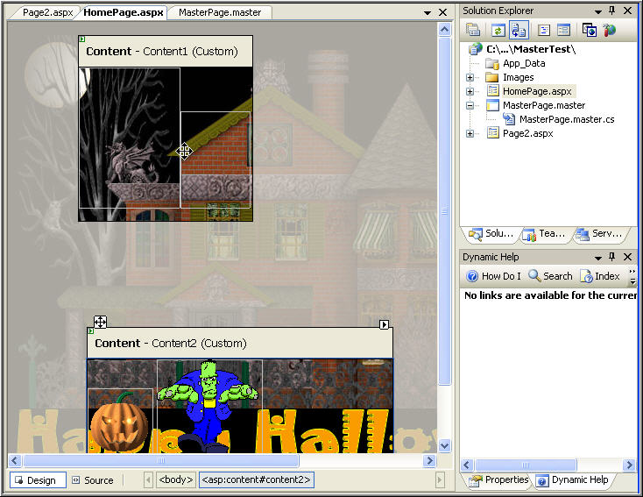
HomePage.aspx – Design Mode

Slide 27
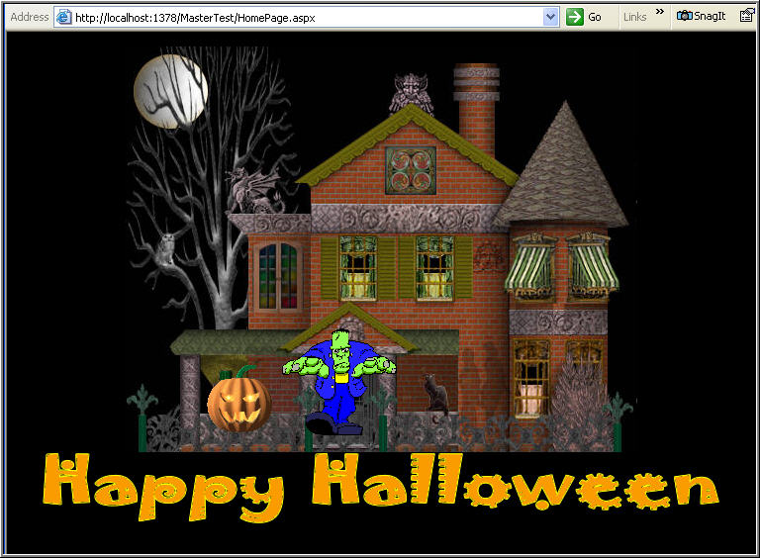


Homepage.aspx – Live Page

Slide 28
Page2.aspx – Source Mode
Two content areas use the ContentPlaceHolder IDs from the MasterPage
<%@ Page Language="C#" MasterPageFile="~/MasterPage.master“ Title="Halloween 2" %>
<asp:Content ID="Content1" ContentPlaceHolderID="TopContent" Runat="Server">
<img src="Images/lightningflash.gif" alt="lightening" />
</asp:Content>
<asp:Content ID="Content2" ContentPlaceHolderID="BottomContent" Runat="Server">
<img src="Images/pumpkinglw.gif" alt="pumkin" />
<img src="Images/mummy.gif" alt="mummy" />
<img src="Images/pumpkinglw.gif" alt="pumpkin"/>
</asp:Content>

Slide 29
Page2.aspx – Design Mode

Slide 30
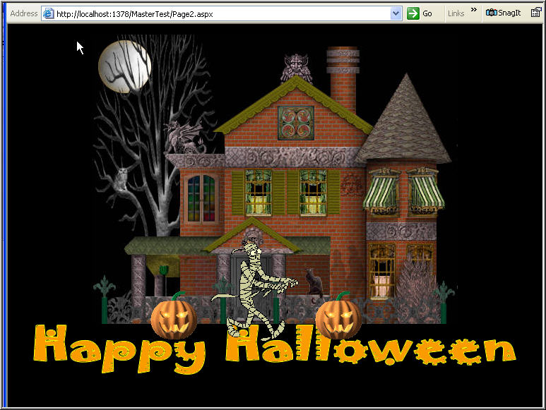

Page2.aspx – Live Page

Slide 31
Summary
The Master Page mechanism
in ASP.Net is similar to templates
in other languages
The Editable areas are created with a ContentPlaceHolder control
Content pages are created from a Master Page

