Slide 1
Introduction to Computer Systems
15-213/18-243, Spring 2010
10th Lecture, Feb. 16th
Instructors:
Bill Nace and Gregory Kesden

Slide 2
Last Time
struct rec {
int i;
int a[3];
int *p;
};
Memory Layout
Structures
Alignment
Unions
i
a
p
0
4
16
20
struct S1 {
char c;
int i[2];
double v;
} *p;
c
3 bits
i[0]
i[1]
4 bits
v
p+0
p+4
p+8
p+16
p+24
union U1 {
char c;
int i[2];
double v;
} *up;
c
i[0]
i[1]
v
up+0
up+4
up+8

Slide 3
Last Time
%st(3)
%st(2)
Floating point
  x87 (getting obsolete)
  x86-64 (SSE3 and later)
  Vector mode and scalar mode
%st(1)
%st(0)
128 bit = 2 doubles = 4 singles
%xmm0
%xmm15
addps
+
addss
+

Slide 4
Today
Memory layout
Buffer overflow, worms, and viruses
Program optimization
  Overview
  Removing unnecessary procedure calls
  Code motion/precomputation
  Strength reduction
  Sharing of common subexpressions
  Optimization blocker: Procedure calls

Slide 5
IA32 Linux Memory Layout
not drawn to scale
FF
Stack
Stack
  Runtime stack (8MB limit)
Heap
  Dynamically allocated storage
  When call malloc(), calloc(), new()
Data
  Statically allocated data
  E.g., arrays & strings declared in code
Text
  Executable machine instructions
  Read-only
8MB
Heap
Data
Upper 2 hex digits
= 8 bits of address
Text
08
00

Slide 6
Memory Allocation Example
not drawn to scale
FF
Stack
char big_array[1<<24]; /* 16 MB */
char huge_array[1<<28]; /* 256 MB */
int beyond;
char *p1, *p2, *p3, *p4;
int useless() { return 0; }
int main()
{
p1 = malloc(1 <<28); /* 256 MB */
p2 = malloc(1 << 8); /* 256 B */
p3 = malloc(1 <<28); /* 256 MB */
p4 = malloc(1 << 8); /* 256 B */
/* Some print statements ... */
}
Heap
Data
Where does everything go?
Text
08
00

Slide 7
IA32 Example Addresses
not drawn to scale
FF
Stack
address range ~2³²
$esp 0xffffbcd0
p3 0x65586008
p1 0x55585008
p4 0x1904a110
p2 0x1904a008
&p2 0x18049760
beyond 0x08049744
big_array 0x18049780
huge_array 0x08049760
main() 0x080483c6
useless() 0x08049744
final malloc() 0x006be166
80
Heap
Data
malloc() is dynamically linked
address determined at runtime
Text
08
00

Slide 8
x86-64 Example Addresses
not drawn to scale
00007F
Stack
address range ~2⁴⁷
$rsp 0x7ffffff8d1f8
p3 0x2aaabaadd010
p1 0x2aaaaaadc010
p4 0x000011501120
p2 0x000011501010
&p2 0x000010500a60
beyond 0x000000500a44
big_array 0x000010500a80
huge_array 0x000000500a50
main() 0x000000400510
useless() 0x000000400500
final malloc() 0x00386ae6a170
000030
Heap
Data
malloc() is dynamically linked
address determined at runtime
Text
000000

Slide 9
C operators
Operators Associativity
() [] -> . left to right
! ~ ++ -- + - * & (type) sizeof right to left
* / % left to right
+ - left to right
<< >> left to right
< <= > >= left to right
== != left to right
& left to right
^ left to right
| left to right
&& left to right
|| left to right
?: right to left
= += -= *= /= %= &= ^= != <<= >>= right to left
, left to right
-> has very high precedence
() has very high precedence
monadic * just below

Slide 10
C Pointer Declarations: Test Yourself!
int *p p is a pointer to int
int *p[13] p is an array[13] of pointer to int
int *(p[13]) p is an array[13] of pointer to int
int **p p is a pointer to a pointer to an int
int (*p)[13] p is a pointer to an array[13] of int
int *f() f is a function returning a pointer to int
int (*f)() f is a pointer to a function returning int
int (*(*f())[13])() f is a function returning ptr to an array[13]
of pointers to functions returning int
int (*(*x[3])())[5] x is an array[3] of pointers to functions
returning pointers to array[5] of ints

Slide 11
C Pointer Declarations (Check out guide)
int *p p is a pointer to int
int *p[13] p is an array[13] of pointer to int
int *(p[13]) p is an array[13] of pointer to int
int **p p is a pointer to a pointer to an int
int (*p)[13] p is a pointer to an array[13] of int
int *f() f is a function returning a pointer to int
int (*f)() f is a pointer to a function returning int
int (*(*f())[13])() f is a function returning ptr to an array[13]
of pointers to functions returning int
int (*(*x[3])())[5] x is an array[3] of pointers to functions
returning pointers to array[5] of ints

Slide 12
Avoiding Complex Declarations
Use typedef to build up the declaration
Instead of int (*(*x[3])())[5] :
    typedef int fiveints[5];
    typedef fiveints* p5i;
    typedef p5i (*f_of_p5is)();
    f_of_p5is x[3];
x is an array of 3 elements, each of which is a pointer to a function returning an array of 5 ints

Slide 13
Today
Memory layout
Buffer overflow, worms, and viruses
Program optimization
  Overview
  Removing unnecessary procedure calls
  Code motion/precomputation
  Strength reduction
  Sharing of common subexpressions
  Optimization blocker: Procedure calls

Slide 14
Internet Worm and IM War
November, 1988
  Internet Worm attacks thousands of Internet hosts.
  How did it happen?

Slide 15
Internet Worm and IM War
November, 1988
  Internet Worm attacks thousands of Internet hosts.
  How did it happen?
July, 1999
  Microsoft launches MSN Messenger (instant messaging system).
  Messenger clients can access popular AOL Instant Messaging Service (AIM) servers
AIM
client
MSN
server
MSN
client
AIM
server
AIM
client

Slide 16
Internet Worm and IM War (cont.)
August 1999
  Mysteriously, Messenger clients can no longer access AIM servers.
  Microsoft and AOL begin the IM war:
    AOL changes server to disallow Messenger clients
    Microsoft makes changes to clients to defeat AOL changes.
    At least 13 such skirmishes.
  How did it happen?
The Internet Worm and AOL/Microsoft War were both based on stack buffer overflow exploits!
    many Unix functions do not check argument sizes.
    allows target buffers to overflow.

Slide 17
String Library Code
Implementation of Unix function gets()
  No way to specify limit on number of characters to read
Similar problems with other Unix functions
  strcpy: Copies string of arbitrary length
  scanf, fscanf, sscanf, when given %s conversion specification
/* Get string from stdin */
char *gets(char *dest)
{
int c = getchar();
char *p = dest;
while (c != EOF && c != '\n') {
*p++ = c;
c = getchar();
}
*p = '\0';
return dest;
}

Slide 18
Vulnerable Buffer Code
/* Echo Line */
void echo()
{
char buf[4]; /* Way too small! */
gets(buf);
puts(buf);
}
int main()
{
printf("Type a string:");
echo();
return 0;
}
unix>./bufdemo
Type a string:1234567
1234567
unix>./bufdemo
Type a string:12345678
Segmentation Fault
unix>./bufdemo
Type a string:123456789ABC
Segmentation Fault

Slide 19
Buffer Overflow Disassembly
080484f0 <echo>:
80484f0: 55 push %ebp
80484f1: 89 e5 mov %esp,%ebp
80484f3: 53 push %ebx
80484f4: 8d 5d f8 lea 0xfffffff8(%ebp),%ebx
80484f7: 83 ec 14 sub $0x14,%esp
80484fa: 89 1c 24 mov %ebx,(%esp)
80484fd: e8 ae ff ff ff call 80484b0 <gets>
8048502: 89 1c 24 mov %ebx,(%esp)
8048505: e8 8a fe ff ff call 8048394 <puts@plt>
804850a: 83 c4 14 add $0x14,%esp
804850d: 5b pop %ebx
804850e: c9 leave
804850f: c3 ret
80485f2: e8 f9 fe ff ff call 80484f0 <echo>
80485f7: 8b 5d fc mov 0xfffffffc(%ebp),%ebx
80485fa: c9 leave
80485fb: 31 c0 xor %eax,%eax
80485fd: c3 ret

Slide 20
Buffer Overflow Stack
Before call to gets
Stack Frame
for main
/* Echo Line */
void echo()
{
char buf[4]; /* Way too small! */
gets(buf);
puts(buf);
}
Return Address
Saved %ebp
%ebp
Stack Frame
for echo
[3]
[2]
[1]
[0]
buf
echo:
pushl %ebp # Save %ebp on stack
movl %esp, %ebp
pushl %ebx # Save %ebx
leal -8(%ebp),%ebx # Compute buf as %ebp-8
subl $20, %esp # Allocate stack space
movl %ebx, (%esp) # Push buf on stack
call gets # Call gets
. . .

Slide 21
Buffer Overflow Stack Example
unix> gdb bufdemo
(gdb) break echo
Breakpoint 1 at 0x8048583
(gdb) run
Breakpoint 1, 0x8048583 in echo ()
(gdb) print /x $ebp
$1 = 0xffffc638
(gdb) print /x *(unsigned *)$ebp
$2 = 0xffffc658
(gdb) print /x *((unsigned *)$ebp + 1)
$3 = 0x80485f7
Before call to gets
Before call to gets
Stack Frame
for main
Stack Frame
for main
0xffffc658
Return Address
08
04
85
f7
Saved %ebp
ff
ff
c6
58
0xffffc638
Stack Frame
for echo
Stack Frame
for echo
[3]
[2]
[1]
[0]
buf
xx
xx
xx
xx
buf
80485f2: call 80484f0 <echo>
80485f7: mov 0xfffffffc(%ebp),%ebx # Return Point

Slide 22
Buffer Overflow Example #1
Before call to gets
Input 1234567
Stack Frame
for main
0xffffc658
Stack Frame
for main
0xffffc658
08
04
85
f7
08
04
85
f7
ff
ff
c6
58
0xffffc638
ff
ff
c6
58
0xffffc638
Stack Frame
for echo
Stack Frame
for echo
00
37
36
35
xx
xx
xx
xx
buf
34
33
32
31
buf
Overflow buf, but no problem

Slide 23
Buffer Overflow Example #2
Before call to gets
Input 12345678
Stack Frame
for main
0xffffc658
Stack Frame
for main
0xffffc658
08
04
85
f7
08
04
85
f7
ff
ff
c6
58
0xffffc638
ff
ff
c6
00
0xffffc638
Stack Frame
for echo
Stack Frame
for echo
38
37
36
35
xx
xx
xx
xx
buf
34
33
32
31
buf
Base pointer corrupted
. . .
804850a: 83 c4 14 add $0x14,%esp # deallocate space
804850d: 5b pop %ebx # restore %ebx
804850e: c9 leave # movl %ebp, %esp; popl %ebp
804850f: c3 ret # Return

Slide 24
Buffer Overflow Example #3
Before call to gets
Input 12345678
Stack Frame
for main
0xffffc658
Stack Frame
for main
0xffffc658
08
04
85
f7
08
04
85
00
ff
ff
c6
58
0xffffc638
43
42
41
39
0xffffc638
Stack Frame
for echo
Stack Frame
for echo
38
37
36
35
xx
xx
xx
xx
buf
34
33
32
31
buf
Return address corrupted
80485f2: call 80484f0 <echo>
80485f7: mov 0xfffffffc(%ebp),%ebx # Return Point

Slide 25
Malicious Use of Buffer Overflow
Stack after call to gets()
void foo(){
bar();
...
}
foo stack frame
return
address
A
B
pad
int bar() {
char buf[64];
gets(buf);
...
return ...;
}
data written
by gets()
exploit
code
bar stack frame
B
Input string contains byte representation of executable code
Overwrite return address with address of buffer
When bar() executes ret, will jump to exploit code

Slide 26
Exploits Based on Buffer Overflows
Buffer overflow bugs allow remote machines to execute arbitrary code on victim machines
Internet worm
  Early versions of the finger server (fingerd) used gets() to read the argument sent by the client:
    finger droh@cs.cmu.edu
  Worm attacked fingerd server by sending phony argument:
    finger “exploit-code padding new-return-address”
    exploit code: executed a root shell on the victim machine with a direct TCP connection to the attacker.

Slide 27
Exploits Based on Buffer Overflows
Buffer overflow bugs allow remote machines to execute arbitrary code on victim machines
IM War
  AOL exploited existing buffer overflow bug in AIM clients
  exploit code: returned 4-byte signature (the bytes at some location in the AIM client) to server.
  When Microsoft changed code to match signature, AOL changed signature location.

Slide 28
Date: Wed, 11 Aug 1999 11:30:57 -0700 (PDT)
From: Phil Bucking <philbucking@yahoo.com>
Subject: AOL exploiting buffer overrun bug in their own software!
To: rms@pharlap.com
Mr. Smith,
I am writing you because I have discovered something that I think you
might find interesting because you are an Internet security expert with
experience in this area. I have also tried to contact AOL but received
no response.
I am a developer who has been working on a revolutionary new instant
messaging client that should be released later this year.
...
It appears that the AIM client has a buffer overrun bug. By itself
this might not be the end of the world, as MS surely has had its share.
But AOL is now *exploiting their own buffer overrun bug* to help in
its efforts to block MS Instant Messenger.
....
Since you have significant credibility with the press I hope that you
can use this information to help inform people that behind AOL's
friendly exterior they are nefariously compromising peoples' security.
Sincerely,
Phil Bucking
Founder, Bucking Consulting
philbucking@yahoo.com
It was later determined that this email originated from within Microsoft!

Slide 29
Code Red Worm
History
  June 18, 2001. Microsoft announces buffer overflow vulnerability in IIS Internet server
  July 19, 2001. over 250,000 machines infected by new virus in 9 hours
  White house must change its IP address. Pentagon shut down public WWW servers for day
When We Set Up CS:APP Web Site
  Received strings of form
  GET /default.ida?NNNNNNNNNNNNNNNNNNNNNNNNNNNNNNNNNNNNNNN....NNNNNNNNNNNNNNNNNNNNNNNNNNNNNNNNNNNNNNNNN%u9090%u6858%ucbd3%u7801%u9090%u6858%ucbd3%u7801%u9090%u6858%ucbd3%u7801%u9090%u9090%u8190%u00c3%u0003%u8b00%u531b%u53ff%u0078%u0000%u00=a
  HTTP/1.0" 400 325 "-" "-"

Slide 30

Code Red Exploit Code
Starts 100 threads running
Spread self
  Generate random IP addresses & send attack string
  Between 1st & 19th of month
Attack www.whitehouse.gov
  Send 98,304 packets; sleep for 4-1/2 hours; repeat
    Denial of service attack
  Between 21st & 27th of month
Deface server’s home page
  After waiting 2 hours

Slide 31
Code Red Effects
Later Version Even More Malicious
  Code Red II
  As of April, 2002, over 18,000 machines infected
  Still spreading
Paved Way for NIMDA
  Variety of propagation methods
  One was to exploit vulnerabilities left behind by Code Red II
ASIDE (security flaws start at home)
  .rhosts used by Internet Worm
  Attachments used by MyDoom (1 in 6 emails Monday morning!)

Slide 32
Avoiding Overflow Vulnerability
/* Echo Line */
void echo()
{
char buf[4]; /* Way too small! */
fgets(buf, 4, stdin);
puts(buf);
}
Use library routines that limit string lengths
  fgets instead of gets
  strncpy instead of strcpy
  Don’t use scanf with %s conversion specification
    Use fgets to read the string
    Or use %ns where n is a suitable integer

Slide 33
System-Level Protections
Randomized stack offsets
  At start of program, allocate random amount of space on stack
  Makes it difficult for hacker to predict beginning of inserted code
Nonexecutable code segments
  In traditional x86, can mark region of memory as either “read-only” or “writeable”
    Can execute anything readable
  Add explicit “execute” permission
unix> gdb bufdemo
(gdb) break echo
(gdb) run
(gdb) print /x $ebp
$1 = 0xffffc638
(gdb) run
(gdb) print /x $ebp
$2 = 0xffffbb08
(gdb) run
(gdb) print /x $ebp
$3 = 0xffffc6a8

Slide 34
Worms and Viruses
Worm: A program that
  Can run by itself
  Can propagate a fully working version of itself to other computers
Virus: Code that
  Add itself to other programs
  Cannot run independently
Both are (usually) designed to spread among computers and to wreak havoc

Slide 35
Today
Memory layout
Buffer overflow, worms, and viruses
Program optimization
  Overview
  Removing unnecessary procedure calls
  Code motion/precomputation
  Strength reduction
  Sharing of common subexpressions
  Optimization blocker: Procedure calls

Slide 36
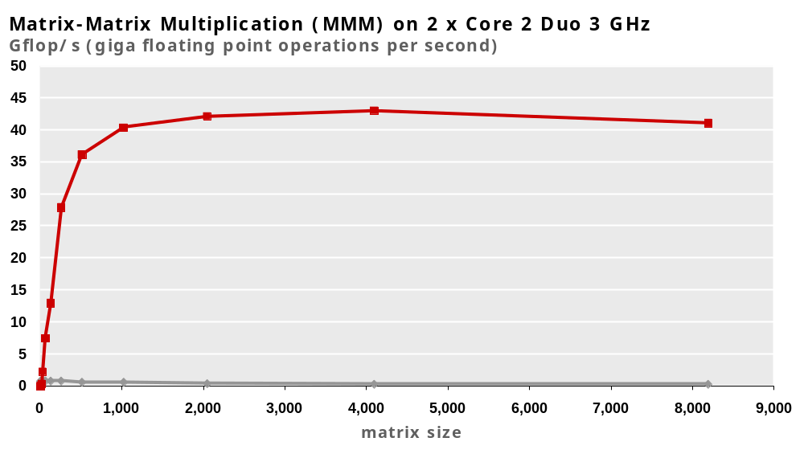
Example Matrix Multiplication
160x
Best code
This code is
not obviously stupid
Triple loop
Standard desktop computer, compiler, using optimization flags
Both implementations have exactly the same operations count (2n³)
What is going on?

Slide 37
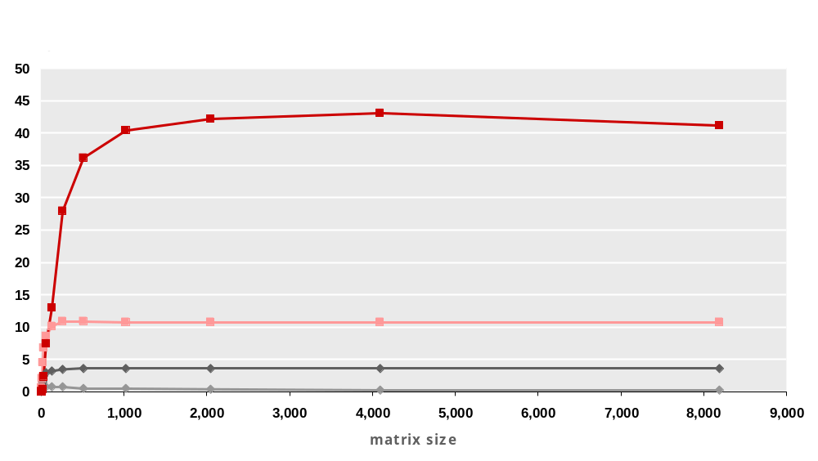
MMM Plot: Analysis
Multiple threads: 4x
(towards end of course)
Vector instructions: 4x
(not in this course)
Memory hierarchy and other optimizations: 20x
Reason for 20x: Blocking or tiling, loop unrolling, array scalarization, instruction scheduling, search to find best choice
Effect: more instruction level parallelism, better register use,
less L1/L2 cache misses, less TLB misses

Slide 38
Harsh Reality
There’s more to runtime performance than asymptotic complexity
One can easily loose 10x, 100x in runtime or even more
What matters:
  Constants (100n and 5n is both O(n), but ….)
  Coding style (unnecessary procedure calls, unrolling, reordering, …)
  Algorithm structure (locality, instruction level parallelism, …)
  Data representation (complicated structs or simple arrays)

Slide 39
Harsh Reality
Must optimize at multiple levels:
  Algorithm
  Data representations
  Procedures
  Loops
Must understand system to optimize performance
  How programs are compiled and executed
    Execution units, memory hierarchy
  How to measure program performance and identify bottlenecks
  How to improve performance without destroying code modularity and generality

Slide 40
Optimizing Compilers
-O
Use optimization flags, default is no optimization (-O0)!
Good choices for gcc: -O2, -O3, -march=xxx, -m64
Try different flags and maybe different compilers

Slide 41
Example
double a[4][4];
double b[4][4];
double c[4][4]; # set to zero
/* Multiply 4 x 4 matrices a and b */
void mmm(double *a, double *b, double *c, int n) {
int i, j, k;
for (i = 0; i < 4; i++)
for (j = 0; j < 4; j++)
for (k = 0; k < 4; k++)
c[i*4+j] += a[i*4 + k]*b[k*4 + j];
}
Compiled without flags:
~1300 cycles
Compiled with –O3 –m64 -march=… –fno-tree-vectorize
~150 cycles
Core 2 Duo, 2.66 GHz

Slide 42
Optimizing Compilers
Compilers are good at: mapping program to machine
  register allocation
  code selection and ordering (scheduling)
  dead code elimination
  eliminating minor inefficiencies
Compilers are not good at: improving asymptotic efficiency
  up to programmer to select best overall algorithm
  big-O savings are (often) more important than constant factors
    but constant factors also matter
Compilers are not good at: overcoming “optimization blockers”
  potential memory aliasing
  potential procedure side-effects

Slide 43
Limitations of Optimizing Compilers
If in doubt, the compiler is conservative
Operate under fundamental constraints
  Must not change program behavior under any possible condition
  Often prevents it from making optimizations when would only affect behavior under pathological conditions.
Behavior that may be obvious to the programmer can be obfuscated by languages and coding styles
  e.g., data ranges may be more limited than variable types suggest
Most analysis is performed only within procedures
  Whole-program analysis is too expensive in most cases
Most analysis is based only on static information
  Compiler has difficulty anticipating run-time inputs

Slide 44
Today
Memory layout
Buffer overflow, worms, and viruses
Program optimization
  Overview
  Removing unnecessary procedure calls
  Code motion/precomputation
  Strength reduction
  Sharing of common subexpressions
  Optimization blocker: Procedure calls
  Optimization blocker: Memory aliasing

Slide 45
Example: Data Type for Vectors
/* data structure for vectors */
typedef struct{
int len;
double *data;
} vec;
len
0
1
len-1
data
/* retrieve vector element and store at val */
double get_vec_element(*vec, idx, double *val)
{
if (idx < 0 || idx >= v->len)
return 0;
*val = v->data[idx];
return 1;
}

Slide 46
Example: Summing Vector Elements
/* retrieve vector element and store at val */
double get_vec_element(*vec, idx, double *val)
{
if (idx < 0 || idx >= v->len)
return 0;
*val = v->data[idx];
return 1;
}
Bound check
unnecessary
in sum_elements
Why?
/* sum elements of vector */
double sum_elements(vec *v, double *res)
{
int i;
n = vec_length(v);
*res = 0.0;
double val;
for (i = 0; i < n; i++) {
get_vec_element(v, i, &val);
*res += val;
}
return res;
}
Overhead for every fp +:
One fct call
One <
One >=
One ||
One memory variable
access
Slowdown:
probably 10x or more

Slide 47
Removing Procedure Call
/* sum elements of vector */
double sum_elements(vec *v, double *res)
{
int i;
n = vec_length(v);
*res = 0.0;
double val;
for (i = 0; i < n; i++) {
get_vec_element(v, i, &val);
*res += val;
}
return res;
}
/* sum elements of vector */
double sum_elements(vec *v, double *res)
{
int i;
n = vec_length(v);
*res = 0.0;
double *data = get_vec_start(v);
for (i = 0; i < n; i++)
*res += data[i];
return res;
}

Slide 48
Removing Procedure Calls
Procedure calls can be very expensive
Bound checking can be very expensive
Abstract data types can easily lead to inefficiencies
  Usually avoided for in superfast numerical library functions
Watch your innermost loop!
Get a feel for overhead versus actual computation being performed

Slide 49
Today
Memory layout
Buffer overflow, worms, and viruses
Program optimization
  Overview
  Removing unnecessary procedure calls
  Code motion/precomputation
  Strength reduction
  Sharing of common subexpressions
  Optimization blocker: Procedure calls
  Optimization blocker: Memory aliasing

Slide 50
Code Motion
Reduce frequency with which computation is performed
  If it will always produce same result
  Especially moving code out of loop
Sometimes also called precomputation
void set_row(double *a, double *b,
long i, long n)
{
long j;
for (j = 0; j < n; j++)
a[n*i+j] = b[j];
}
void set_row(double *a, double *b,
long i, long n)
{
long j;
for (j = 0; j < n; j++)
a[n*i+j] = b[j];
}
long j;
int ni = n*i;
for (j = 0; j < n; j++)
a[ni+j] = b[j];

Slide 51
Compiler-Generated Code Motion
void set_row(double *a, double *b,
long i, long n)
{
long j;
for (j = 0; j < n; j++)
a[n*i+j] = b[j];
}
long j;
long ni = n*i;
double *rowp = a+ni;
for (j = 0; j < n; j++)
*rowp++ = b[j];
Where are the FP operations?
set_row:
xorl %r8d, %r8d # j = 0
cmpq %rcx, %r8 # j:n
jge .L7 # if >= goto done
movq %rcx, %rax # n
imulq %rdx, %rax # n*i outside of inner loop
leaq (%rdi,%rax,8), %rdx # rowp = A + n*i*8
.L5: # loop:
movq (%rsi,%r8,8), %rax # t = b[j]
incq %r8 # j++
movq %rax, (%rdx) # *rowp = t
addq $8, %rdx # rowp++
cmpq %rcx, %r8 # j:n
jl .L5 # if < goot loop
.L7: # done:
rep ; ret # return

Slide 52
Today
Memory layout
Buffer overflow, worms, and viruses
Program optimization
  Overview
  Removing unnecessary procedure calls
  Code motion/precomputation
  Strength reduction
  Sharing of common subexpressions
  Optimization blocker: Procedure calls
  Optimization blocker: Memory aliasing

Slide 53
Strength Reduction
Replace costly operation with simpler one
Example: Shift/add instead of multiply or divide
  16*x → x << 4
  Utility machine dependent
  Depends on cost of multiply or divide instruction
  On Pentium IV, integer multiply requires 10 CPU cycles
Example: Recognize sequence of products
for (i = 0; i < n; i++)
for (j = 0; j < n; j++)
a[n*i + j] = b[j];
int ni = 0;
for (i = 0; i < n; i++) {
for (j = 0; j < n; j++)
a[ni + j] = b[j];
ni += n;
}

Slide 54
Today
Memory layout
Buffer overflow, worms, and viruses
Program optimization
  Overview
  Removing unnecessary procedure calls
  Code motion/precomputation
  Strength reduction
  Sharing of common subexpressions
  Optimization blocker: Procedure calls
  Optimization blocker: Memory aliasing

Slide 55
Share Common Subexpressions
Reuse portions of expressions
Compilers often not very sophisticated in exploiting arithmetic properties
3 mults: i*n, (i–1)*n, (i+1)*n
1 mult: i*n
/* Sum neighbors of i,j */
up = val[(i-1)*n + j ];
down = val[(i+1)*n + j ];
left = val[i*n + j-1];
right = val[i*n + j+1];
sum = up + down + left + right;
int inj = i*n + j;
up = val[inj - n];
down = val[inj + n];
left = val[inj - 1];
right = val[inj + 1];
sum = up + down + left + right;
leaq 1(%rsi), %rax # i+1
leaq -1(%rsi), %r8 # i-1
imulq %rcx, %rsi # i*n
imulq %rcx, %rax # (i+1)*n
imulq %rcx, %r8 # (i-1)*n
addq %rdx, %rsi # i*n+j
addq %rdx, %rax # (i+1)*n+j
addq %rdx, %r8 # (i-1)*n+j
imulq %rcx, %rsi # i*n
addq %rdx, %rsi # i*n+j
movq %rsi, %rax # i*n+j
subq %rcx, %rax # i*n+j-n
leaq (%rsi,%rcx), %rcx # i*n+j+n

Slide 56
Today
Memory layout
Buffer overflow, worms, and viruses
Program optimization
  Overview
  Removing unnecessary procedure calls
  Code motion/precomputation
  Strength reduction
  Sharing of common subexpressions
  Optimization blocker: Procedure calls
  Optimization blocker: Memory aliasing

Slide 57
Optimization Blocker #1: Procedure Calls
Procedure to convert string to lower case
void lower(char *s)
{
int i;
for (i = 0; i < strlen(s); i++)
if (s[i] >= 'A' && s[i] <= 'Z')
s[i] -= ('A' - 'a');
}
  Extracted from 213 lab submissions, Fall 1998

Slide 58
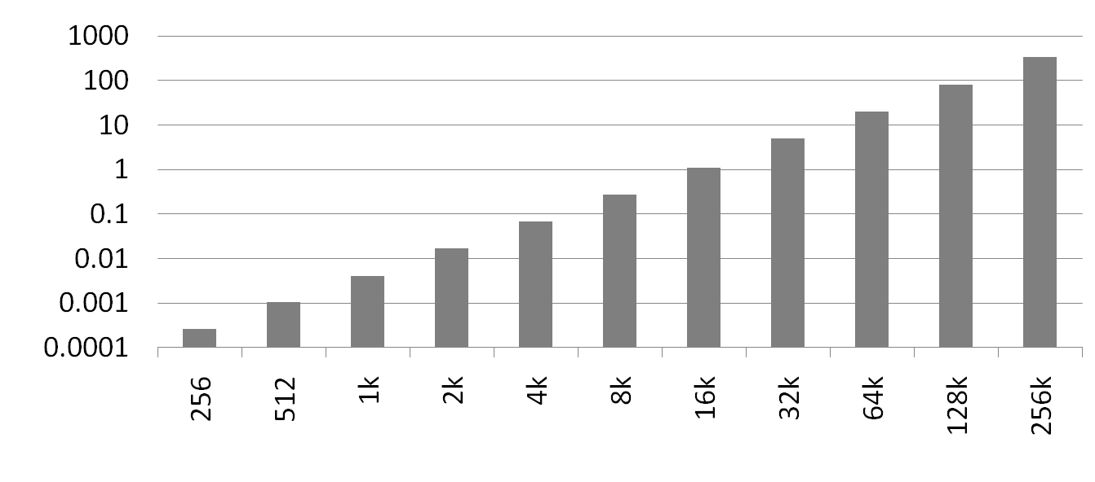
Performance
Time quadruples when double string length
Quadratic performance
CPU Seconds
String Length

Slide 59
Why is That?
void lower(char *s)
{
int i;
for (i = 0; i < strlen(s); i++)
if (s[i] >= 'A' && s[i] <= 'Z')
s[i] -= ('A' - 'a');
}
String length is called in every iteration!
  And strlen is O(n), so lower is O(n²)
/* My version of strlen */
size_t strlen(const char *s)
{
size_t length = 0;
while (*s != '\0') {
s++;
length++;
}
return length;
}

Slide 60
Improving Performance
void lower(char *s)
{
int i;
for (i = 0; i < strlen(s); i++)
if (s[i] >= 'A' && s[i] <= 'Z')
s[i] -= ('A' - 'a');
}
void lower(char *s)
{
int i;
int len = strlen(s);
for (i = 0; i < len; i++)
if (s[i] >= 'A' && s[i] <= 'Z')
s[i] -= ('A' - 'a');
}
Move call to strlen outside of loop
Since result does not change from one iteration to another
Form of code motion/precomputation

Slide 61
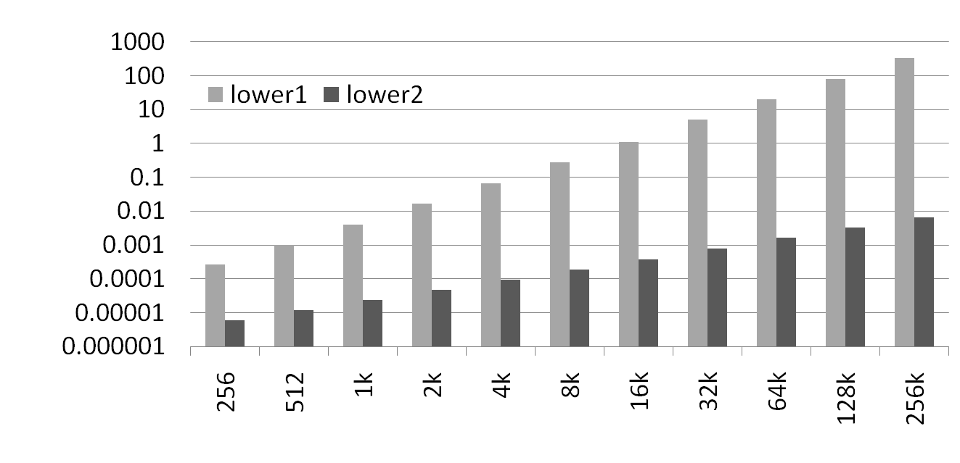
Performance
Lower2: Time doubles when double string length
Linear performance
CPU Seconds
String Length

Slide 62
Optimization Blocker: Procedure Calls
Why couldn’t compiler move strlen out of inner loop?
  Procedure may have side effects
  Function may not return same value for given arguments
    Could depend on other parts of global state
    Procedure lower could interact with strlen
Compiler usually treats procedure call as a black box that cannot be analyzed
  Consequence: conservative in optimizations
Remedies:
  Inline the function if possible
  Do your own code motion
int lencnt = 0;
size_t strlen(const char *s)
{
size_t length = 0;
while (*s != '\0') {
s++; length++;
}
lencnt += length;
return length;
}

