Slide 1
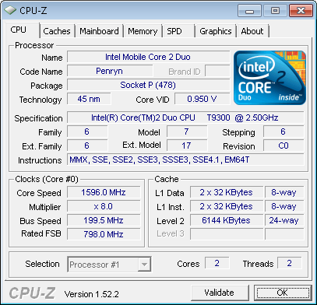
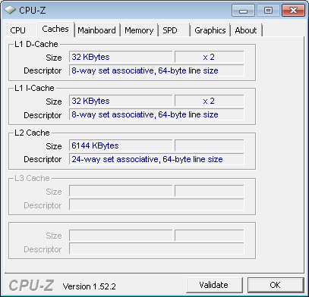
Example
How are these parameters decided?

Slide 2
Comparing cache organizations
Like many architectural features, caches are evaluated experimentally.
  As always, performance depends on the actual instruction mix, since different programs will have different memory access patterns.
  Simulating or executing real applications is the most accurate way to measure performance characteristics.
The graphs on the next few slides illustrate the simulated miss rates for several different cache designs.
  Again lower miss rates are generally better, but remember that the miss rate is just one component of average memory access time and execution time.

Slide 3
Associativity tradeoffs and miss rates
As we saw last time, higher associativity means more complex hardware.
But a highly-associative cache will also exhibit a lower miss rate.
  Each set has more blocks, so there’s less chance of a conflict between two addresses which both belong in the same set.
  Overall, this will reduce AMAT and memory stall cycles.
The textbook shows the miss rates decreasing as the associativity increases.
12%
9%
Miss rate
6%
3%
0%
One-way
Two-way
Four-way
Eight-way
Associativity

Slide 4
Cache size and miss rates
The cache size also has a significant impact on performance.
  The larger a cache is, the less chance there will be of a conflict.
  Again this means the miss rate decreases, so the AMAT and number of memory stall cycles also decrease.
This figure depicts the miss rate as a function of both the cache size and its associativity.
15%
12%
9%
Miss rate
1 KB
2 KB
6%
4 KB
8 KB
3%
0%
One-way
Two-way
Four-way
Eight-way
Associativity

Slide 5
Block size and miss rates
Finally, this figure shows miss rates relative to the block size and overall cache size.
  Smaller blocks do not take maximum advantage of spatial locality.
  But if blocks are too large, there will be fewer blocks available, and more potential misses due to conflicts.
40%
35%
30%
25%
1 KB
8 KB
Miss rate
20%
16 KB
15%
64 KB
10%
5%
0%
4
16
64
256
Block size (bytes)

Slide 6
Memory and overall performance
How do cache hits and misses affect overall system performance?
  Assuming a hit time of one CPU clock cycle, program execution will continue normally on a cache hit. (Our earlier computations always assumed one clock cycle for an instruction fetch or data access.)
  For cache misses, we’ll assume the CPU must stall to wait for a load from main memory.
The total number of stall cycles depends on the number of cache misses and the miss penalty.
Memory stall cycles = # Memory accesses x miss rate x miss penalty
To include stalls due to cache misses in CPU performance equations, we have to add them to the “base” number of execution cycles.
CPU time = (CPU execution cycles + Memory stall cycles) x Cycle time

Slide 7
Performance example
Assume that 33% of the I number of instructions in a program are data accesses. The cache hit ratio is 97% and the hit time is one cycle, but the miss penalty is 20 cycles.
Memory stall cycles = # Memory accesses x miss rate x miss penalty
= ?

Slide 8
Performance example
Assume that 33% of the I number of instructions in a program are data accesses. The cache hit ratio is 97% and the hit time is one cycle, but the miss penalty is 20 cycles.
Memory stall cycles = # Memory accesses x miss rate x miss penalty
= 0.33 I x 0.03 x 20 cycles
= 0.2 I cycles
If I instructions are executed, then the number of wasted cycles will be 0.2 x I.
This code is 1.2 times slower than a program with a “perfect” CPI of 1!

Slide 9
Memory systems are a bottleneck
CPU time = (CPU execution cycles + Memory stall cycles) x Cycle time
Processor performance traditionally outpaces memory performance, so the memory system is often the system bottleneck.
For example, with a base CPI of 1, the CPU time from the last page is:
CPU time = (I + 0.2 I) x Cycle time
What if we could double the CPU performance so the CPI becomes 0.5, but memory performance remained the same?
CPU time = (0.5 I + 0.2 I) x Cycle time
The overall CPU time improves by just 1.2/0.7 = 1.7 times!
Speeding up only part of a system has diminishing returns.

Slide 10
Basic main memory design
There are some ways the main memory can be organized to reduce miss penalties and help with caching.
For some concrete examples, let’s assume the following
three steps are taken when a cache needs to load data
from the main memory.
  It takes 1 cycle to send an address to the RAM.
  There is a 15-cycle latency for each RAM access.
  It takes 1 cycle to return data from the RAM.
In the setup shown here, the buses from the CPU to the
cache and from the cache to RAM are all one word wide.
If the cache has one-word blocks, then filling a block
from RAM (i.e., the miss penalty) would take 17 cycles.
1 + 15 + 1 = 17 clock cycles
The cache controller has to send the desired address to
the RAM, wait and receive the data.
CPU
Cache
Main
Memory

Slide 11
Miss penalties for larger cache blocks
If the cache has four-word blocks, then loading a single block would need four individual main memory accesses, and a miss penalty of 68 cycles!
4 x (1 + 15 + 1) = 68 clock cycles
CPU
Cache
Main
Memory

Slide 12
A wider memory
A simple way to decrease the miss penalty is to widen the memory and its interface to the cache, so we can read multiple words from RAM in one shot.
If we could read four words from the memory at once, a four-word cache load would need just 17 cycles.
1 + 15 + 1 = 17 cycles
The disadvantage is the cost of the wider buses—each additional bit of memory width requires another connection to the cache.
CPU
Cache
Main
Memory

Slide 13
An interleaved memory
Another approach is to interleave the memory, or split it into “banks” that can be accessed individually.
The main benefit is overlapping the latencies of accessing each word.
For example, if our main memory has four banks, each one byte wide, then we could load four bytes into a cache block in just 20 cycles.
1 + 15 + (4 x 1) = 20 cycles
Our buses are still one byte wide here, so four cycles are needed to transfer data to the caches.
This is cheaper than implementing a four-byte bus, but not too much slower.
CPU
Cache
Main Memory
Bank 0
Bank 1
Bank 2
Bank 3

Slide 14
Interleaved memory accesses
Clock cycles
Here is a diagram to show how the memory accesses can be interleaved.
  The magenta cycles represent sending an address to a memory bank.
  Each memory bank has a 15-cycle latency, and it takes another cycle (shown in blue) to return data from the memory.
This is the same basic idea as pipelining!
  As soon as we request data from one memory bank, we can go ahead and request data from another bank as well.
  Each individual load takes 17 clock cycles, but four overlapped loads require just 20 cycles.
Load word 1
Load word 2
Load word 3
Load word 4
15 cycles

Slide 15
Which is better?
Increasing block size can improve hit rate (due to spatial locality), but transfer time increases. Which cache configuration would be better?
Assume both caches have single cycle hit times. Memory accesses take 1+15+1 cycles, and the interleaved memory bus is 8-bytes wide:
  i.e., an 16-byte memory access takes 18 cycles:
1 (send address) + 15 (memory access) + 2 (two 8-byte transfers)
HINT: AMAT = Hit time + (Miss rate x Miss penalty)
What is the miss penalty for a given block size?
 | Cache #1 | Cache #2
Block size | 32-bytes | 64-bytes
Miss rate | 5% | 4%

Slide 16
Which is better?
Increasing block size can improve hit rate (due to spatial locality), but transfer time increases. Which cache configuration would be better?
Assume both caches have single cycle hit times. Memory accesses take 1+15+1 cycles, and the interleaved memory bus is 8-bytes wide:
  i.e., an 16-byte memory access takes 18 cycles:
1 (send address) + 15 (memory access) + 2 (two 8-byte transfers)
HINT: AMAT = Hit time + (Miss rate x Miss penalty)
 | Cache #1 | Cache #2
Block size | 32-bytes | 64-bytes
Miss rate | 5% | 4%
Cache #1:
Miss Penalty = 1 + 15 + 32B/8B = 20 cycles
AMAT = 1 + (.05 * 20) = 2
Cache #2:
Miss Penalty = 1 + 15 + 64B/8B = 24 cycles
AMAT = 1 + (.04 * 24) = ~1.96

Slide 17
The Memory Mountain
Metric: read throughput (read bandwidth)
  Number of bytes read from memory per second (MB/s)
Memory system test
  Run program with many reads in tight loop
  Examine throughput as function of read sequence
    Total size of memory covered (working set size)
    Distance between consecutive references (stride)
Memory mountain
  A compact visualization of memory system performance.
  Surface represents read throughput as a function of spatial and temporal locality.

Slide 18
Memory Mountain Test Function
/* The test function generates the read sequence */
/* References the first elems elements of data[] with a stride offset */
void test(int elems, int stride)
{
int i, result = 0;
volatile int sink;
for (i = 0; i < elems; i += stride)
result += data[i];
sink = result; /* So compiler doesn't optimize away the loop */
}
/* A wrapper to call test() and return measured read throughput (MB/s) */
double run(int size, int stride, double Mhz)
{
double cycles;
int elems = size / sizeof(int);
test(elems, stride); /* warm up the cache */
cycles = fcyc2(test, elems, stride, 0); /* time test(elems,stride) */
return (size / stride) / (cycles / Mhz); /* convert cycles to MB/s */
}

Slide 19
Memory Mountain Main Routine
/* mountain.c - Generate the memory mountain. */
#define MINBYTES (1 << 10) /* Working set size ranges from 1 KB */
#define MAXBYTES (1 << 23) /* ... up to 8 MB */
#define MAXSTRIDE 16 /* Strides range from 1 to 16 */
#define MAXELEMS MAXBYTES/sizeof(int)
int data[MAXELEMS]; /* The array we'll be traversing */
int main()
{
int size; /* Working set size (in bytes) */
int stride; /* Stride (in array elements) */
double Mhz; /* Clock frequency */
init_data(data, MAXELEMS); /* Initialize each element in data to 1 */
Mhz = mhz(0); /* Estimate the clock frequency */
for (size = MAXBYTES; size >= MINBYTES; size >>= 1)
{
for (stride = 1; stride <= MAXSTRIDE; stride++)
printf("%.1f\t", run(size, stride, Mhz));
printf("\n");
}
exit(0);
}

Slide 20
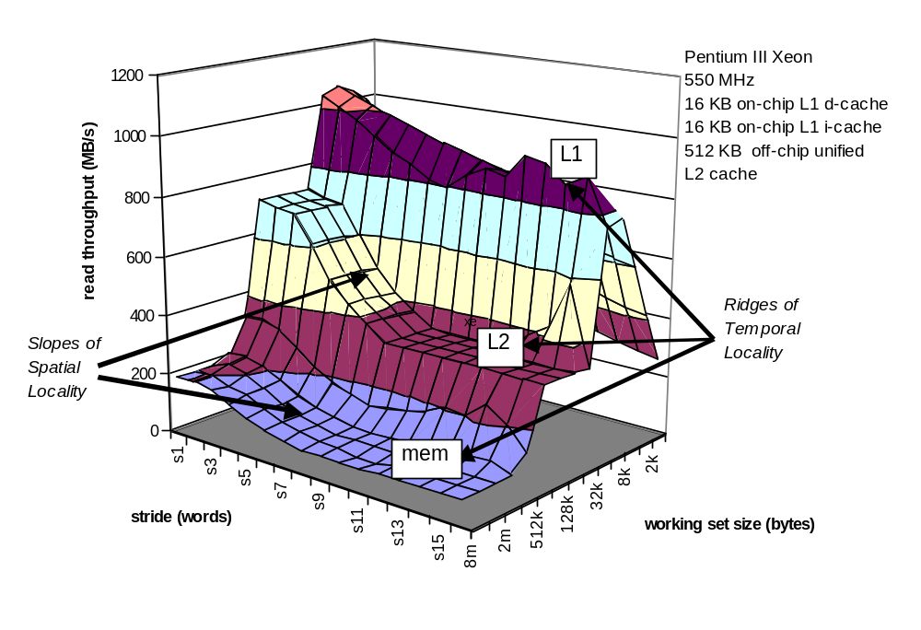
The Memory Mountain

Slide 21
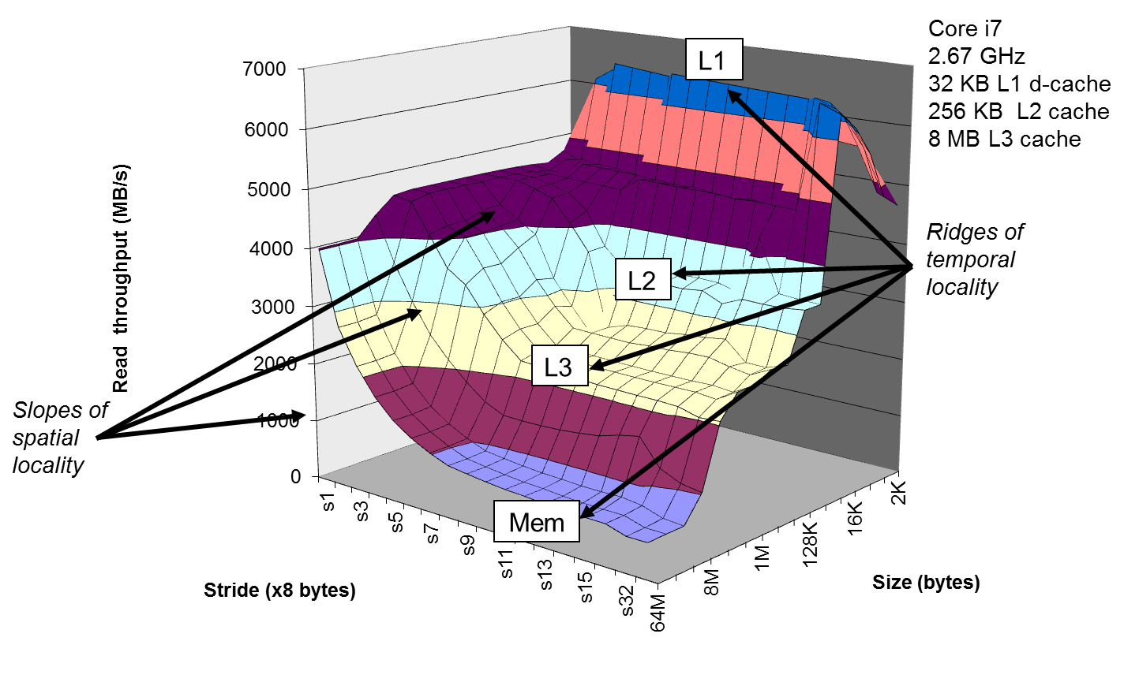
The Memory Mountain

Slide 22
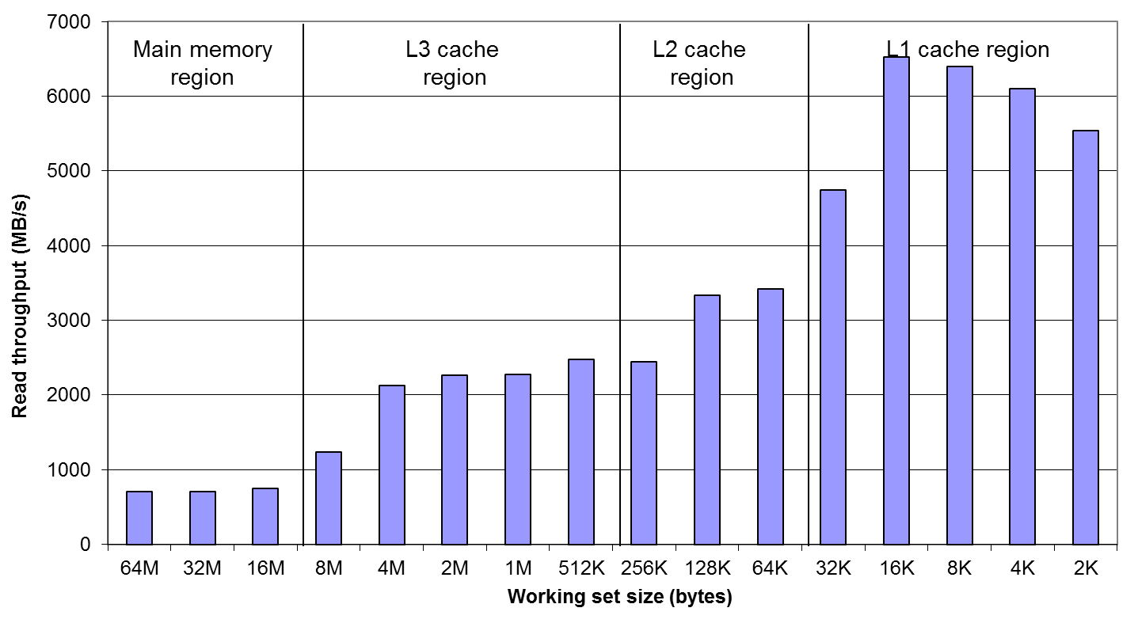
Ridges of Temporal Locality
Slice through the memory mountain with stride=16

Slide 23
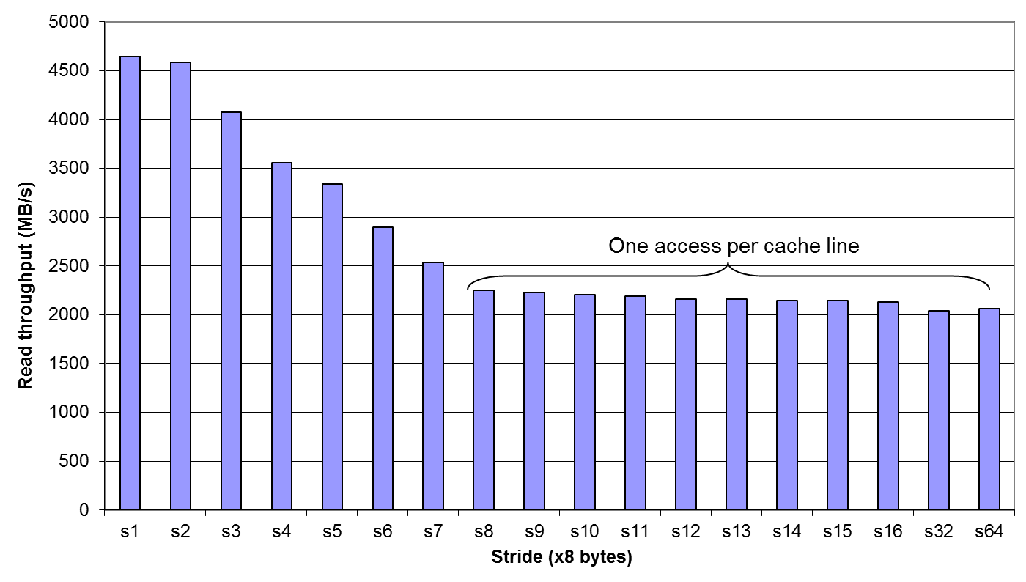
A Slope of Spatial Locality
Slice through memory mountain with size=4MB

Slide 24
Discussion
Given a memory mountain for one hardware platform, what can be determined?
  L1 cache size?
  L1 block size?
  L1 associativity?
  L2 cache size?
  L2 block size?
  L2 associativity?
  Number of levels of cache?
  Main memory bandwidth?

Slide 25
BONUS SLIDES
Didn’t have time to cover in class.
Good reading material on your own time.

Slide 26
Matrix Multiplication Example
Major cache effects to consider
  Total cache size
    Exploit temporal locality, reuse data while in cache
  Block size
    Exploit spatial locality
Description:
  Multiply N x N matrices
    Array elements doubles
  O(N³) total operations
  Accesses
    N reads per source element
    N values summed per destination
      But partial sums may be held in a register
Variable sum
held in register
/* ijk */
for (i=0; i<n; i++) {
for (j=0; j<n; j++) {
sum = 0.0;
for (k=0; k<n; k++)
sum += a[i][k] * b[k][j];
c[i][j] = sum;
}
}

Slide 27
Miss Rate Analysis for Matrix Multiply
Assumptions:
  Line size is 32B (big enough for 4 64-bit doubles)
  Matrix dimension (N) is very large
    Approximate 1/N as 0.0
  Cache is not big enough to hold multiple rows
Analysis method:
  Look at access pattern of inner loop
  Typical code accesses A in rows, B in columns
k
j
j
i
k
i
A
B
C

Slide 28
Layout of C Arrays in Memory (review)
C arrays allocated in row-major order
  Each row in contiguous memory locations
Stepping through columns in one row:
  for (i = 0; i < N; i++)
    sum += a[0][i];
  Accesses successive elements
  If block size (B) > 8 bytes, exploits spatial locality
    Compulsory miss rate = 8 bytes / B
Stepping through rows in one column:
  for (i = 0; i < n; i++)
    sum += a[i][0];
  Accesses distant elements
  No spatial locality!
    Compulsory miss rate = 100% (assuming large rows)

Slide 29
Matrix Multiplication (ijk)
/* ijk */
for (i=0; i<n; i++) {
for (j=0; j<n; j++) {
sum = 0.0;
for (k=0; k<n; k++)
sum += a[i][k] * b[k][j];
c[i][j] = sum;
}
}
Inner loop:
(*,j)
(i,j)
(i,*)
A
B
C
Row-wise
Column-
wise
Fixed
Misses per inner loop iteration:
  A B C
  0.25 1.0 0.0

Slide 30
Matrix Multiplication (jik)
/* jik */
for (j=0; j<n; j++) {
for (i=0; i<n; i++) {
sum = 0.0;
for (k=0; k<n; k++)
sum += a[i][k] * b[k][j];
c[i][j] = sum;
}
}
Inner loop:
(*,j)
(i,j)
(i,*)
A
B
C
Row-wise
Column-
wise
Fixed
Misses per inner loop iteration:
  A B C
  0.25 1.0 0.0

Slide 31
Matrix Multiplication (kij)
/* kij */
for (k=0; k<n; k++) {
for (i=0; i<n; i++) {
r = a[i][k];
for (j=0; j<n; j++)
c[i][j] += r * b[k][j];
}
}
Inner loop:
(i,k)
(k,*)
(i,*)
A
B
C
Fixed
Row-wise
Row-wise
Misses per inner loop iteration:
  A B C
  0.0 0.25 0.25

Slide 32
Matrix Multiplication (ikj)
/* ikj */
for (i=0; i<n; i++) {
for (k=0; k<n; k++) {
r = a[i][k];
for (j=0; j<n; j++)
c[i][j] += r * b[k][j];
}
}
Inner loop:
(i,k)
(k,*)
(i,*)
A
B
C
Fixed
Row-wise
Row-wise
Misses per inner loop iteration:
  A B C
  0.0 0.25 0.25

Slide 33
Matrix Multiplication (jki)
/* jki */
for (j=0; j<n; j++) {
for (k=0; k<n; k++) {
r = b[k][j];
for (i=0; i<n; i++)
c[i][j] += a[i][k] * r;
}
}
Inner loop:
(*,k)
(*,j)
(k,j)
A
B
C
Column -
wise
Fixed
Column-
wise
Misses per inner loop iteration:
  A B C
  1.0 0.0 1.0

Slide 34
Matrix Multiplication (kji)
/* kji */
for (k=0; k<n; k++) {
for (j=0; j<n; j++) {
r = b[k][j];
for (i=0; i<n; i++)
c[i][j] += a[i][k] * r;
}
}
Inner loop:
(*,k)
(*,j)
(k,j)
A
B
C
Column-
wise
Fixed
Column-
wise
Misses per inner loop iteration:
  A B C
  1.0 0.0 1.0

Slide 35
Summary of Matrix Multiplication
ijk (& jik):
  2 loads, 0 stores
  misses/iter = 1.25
kij (& ikj):
  2 loads, 1 store
  misses/iter = 0.5
jki (& kji):
  2 loads, 1 store
  misses/iter = 2.0
for (i=0; i<n; i++) {
for (j=0; j<n; j++) {
sum = 0.0;
for (k=0; k<n; k++)
sum += a[i][k] *
b[k][j];
c[i][j] = sum;
}
}
for (k=0; k<n; k++) {
for (i=0; i<n; i++) {
r = a[i][k];
for (j=0; j<n; j++)
c[i][j] += r *
b[k][j];
}
}
for (j=0; j<n; j++) {
for (k=0; k<n; k++) {
r = b[k][j];
for (i=0; i<n; i++)
c[i][j] +=
a[i][k] * r;
}
}

Slide 36
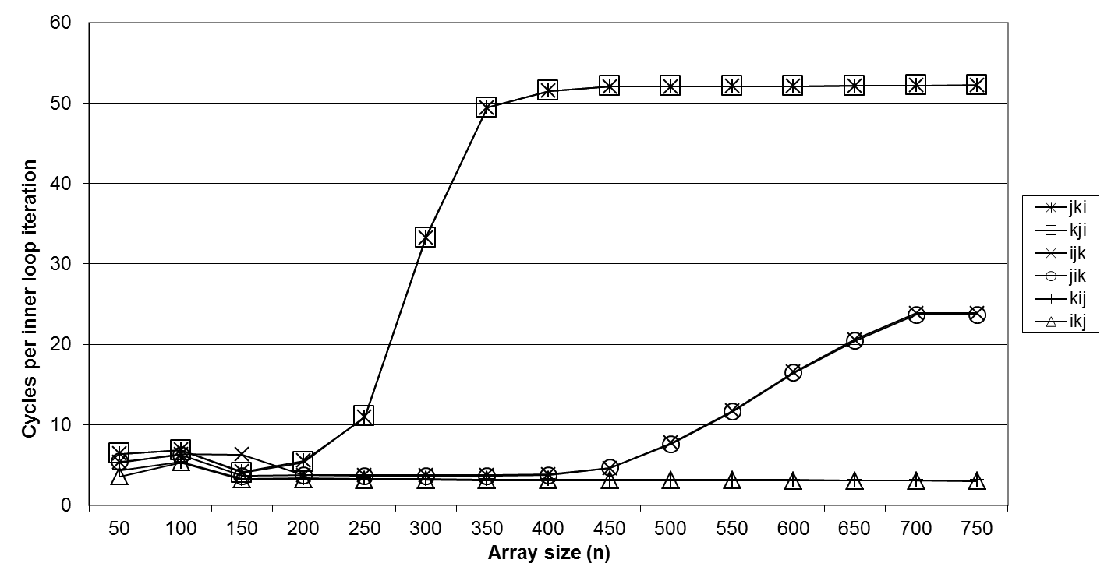
Core i7 Matrix Multiply Performance
Miss rates are better predictor of performance than total memory accesses. (But platform dependent!)

Slide 37
Blocking: Matrix Multiplication
c = (double *) calloc(sizeof(double), n*n);
/* Multiply n x n matrices a and b */
void mmm(double *a, double *b, double *c, int n) {
int i, j, k;
for (i = 0; i < n; i++)
for (j = 0; j < n; j++)
for (k = 0; k < n; k++)
c[i*n+j] += a[i*n + k]*b[k*n + j];
}
j
c
a
b
=
*
i

Slide 38
Cache Miss Analysis
Assume:
  Matrix elements are doubles
  Cache block = 8 doubles
  Cache size C << n (much smaller than n)
First iteration:
  n/8 + n = 9n/8 misses
  Afterwards in cache:
  (schematic)
n
=
*
=
*
8 wide

Slide 39
Cache Miss Analysis
Assume:
  Matrix elements are doubles
  Cache block = 8 doubles
  Cache size C << n (much smaller than n)
Second iteration:
  Again:
  n/8 + n = 9n/8 misses
Total misses (over n² iterations):
  9n/8 * n² = (9/8) * n³
n
=
*
8 wide

Slide 40
Blocked Matrix Multiplication
c = (double *) calloc(sizeof(double), n*n);
/* Multiply n x n matrices a and b */
void mmm(double *a, double *b, double *c, int n) {
int i, j, k;
for (i = 0; i < n; i+=B)
for (j = 0; j < n; j+=B)
for (k = 0; k < n; k+=B)
/* B x B mini matrix multiplications */
for (i1 = i; i1 < i+B; i++)
for (j1 = j; j1 < j+B; j++)
for (k1 = k; k1 < k+B; k++)
c[i1*n+j1] += a[i1*n + k1]*b[k1*n + j1];
}
j1
c
a
b
c
=
*
+
i1
Block size B x B

Slide 41
Cache Miss Analysis
Assume:
  Cache block = 8 doubles
  Cache size C << n (much smaller than n)
  Three blocks fit into cache: 3B² < C
First (block) iteration:
  B²/8 misses for each block
  and 2n/B unique blocks
  2n/B * B²/8 = nB/4
  (omitting matrix c)
  Afterwards in cache
  (schematic)
n/B blocks
=
*
Block size B x B
=
*

Slide 42
Cache Miss Analysis
Assume:
  Cache block = 8 doubles
  Cache size C << n (much smaller than n)
  Three blocks fit into cache: 3B² < C
Second (block) iteration:
  Same as first iteration
  2n/B * B²/8 = nB/4
Total misses:
  nB/4 * (n/B)² = n³/(4B)
n/B blocks
=
*
Block size B x B

Slide 43
Summary
No blocking: (9/8) * n³
Blocking: 1/(4B) * n³
Suggest largest possible block size B, but limit 3B² < C!
(can possibly be relaxed a bit, but there is a limit for B)
Reason for dramatic difference:
  Matrix multiplication has inherent temporal locality:
    Referenced data: 3n², computation: 2n³
    Every array element used O(n) times!
  But program has to be written properly; code more complex

Slide 44
Optimizations for the Memory Hierarchy
Write code that has locality
  Spatial: access data contiguously
  Temporal: make sure access to the same data is not too far apart in time
How to achieve?
  Proper choice of algorithm
  Loop transformations
Cache versus register level optimization:
  In both cases locality desirable
  Register space much smaller + requires scalar replacement to exploit temporal locality
  Register level optimizations include exhibiting instruction level parallelism (conflicts with locality)

Slide 45
Parting Thoughts on Optimization
The competent programmer is fully aware of the strictly limited size of his own skull; therefore he approaches the programming task in full humility, and among other things he avoids clever tricks like the plague.
Edsger Dijkstra
We should forget about small efficiencies, say about 97% of the time: premature optimization is the root of all evil.
Donald Knuth
More computing sins are committed in the name of efficiency (without necessarily achieving it) than for any other single reason – including blind stupidity.
W. A. Wulf
The best is the enemy of the good.
Voltaire
Debugging is twice as hard as writing the code in the first place. Therefore, if you write the code as cleverly as possible, you are, by definition, not smart enough to debug it.
Brian W. Kernighan
You are bound to be unhappy if you optimize everything.
Donald Knuth
Rules of optimization:
Rule 1: Don’t do it.
Rule 2 (For experts only): Don’t do it yet.
M. A. Jackson

