Slide 1
IT 252
Computer Organization and Architecture
Introduction to I/O
Chia-Chi Teng

Slide 2
I/O Programming, Interrupts, and Exceptions
Most I/O requests are made by applications or the operating system, and involve moving data between a peripheral device and main memory.
There are two main ways that programs communicate with devices.
  Memory-mapped I/O (more later)
  Isolated I/O
There are also several ways of managing data transfers between devices and main memory.
  Programmed I/O
  Interrupt-driven I/O
  Direct memory access
Interrupt-driven I/O motivates a discussion about:
  Interrupts
  Exceptions
  and how to program them…

Slide 3
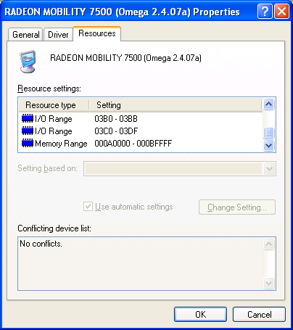
Communicating with devices
Most devices can be considered as memories, with an “address” for reading or writing.
Many instruction sets often make this analogy explicit. To transfer data to or from a particular device, the CPU
can access special addresses.
Here you can see a video card can be accessed via addresses 3B0-3BB, 3C0-3DF and A0000-BFFFF.
There are two ways these addresses can be accessed.

Slide 4
Memory-mapped I/O
With memory-mapped I/O, one address space is divided into two parts.
  Some addresses refer to physical memory locations.
  Other addresses actually reference peripherals.
For example, an Apple IIe had a 16-bit address bus which could access a whole 64KB of memory.
  Addresses C000-CFFF in hexadecimal were not part of memory, but were used to access I/O devices.
  All the other addresses did reference main memory.
The I/O addresses are shared by many peripherals. In the Apple IIe, for instance, C010 is attached to the keyboard while C030 goes to the speaker.
Some devices may need several I/O addresses.
Memory
FFFF
D000
I/O
C000
Memory
0000

Slide 5
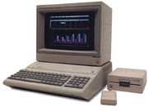
Programming memory-mapped I/O
Control
Address
Data
CPU
Memory
Hard disks
CD-ROM
Network
Display
To send data to a device, the CPU writes to the appropriate I/O address. The address and data are then transmitted along the bus.
Each device has to monitor the address bus to see if it is the target.
  The Apple IIe main memory ignores any transactions whose address begins with bits 1100 (addresses C000-CFFF).
  The speaker only responds when C030 appears on the address bus.

Slide 6
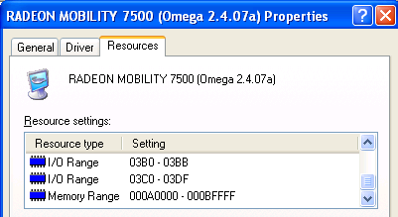
Isolated I/O
Another approach is to support separate address spaces for memory and I/O devices, with special instructions that access the I/O space.
For instance, 8086 machines have a 32-bit address space.
  Regular instructions like MOV reference RAM.
  The special instructions IN and OUT access a separate 64KB I/O address space.
Main
memory
FFFFFFFF
00000000
I/O
devices
0000FFFF
00000000

Slide 7
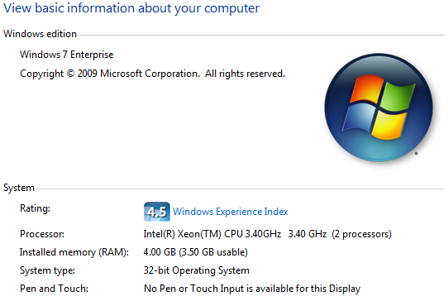
Dude, where’s my 4GB of RAM?

Slide 8
Physical Address Extension (PAE)
Intel Pentium supports 36 bits of physical address: up to 64GB RAM
Disabled on desktop by default, use /PAE option in boot.ini
http://en.wikipedia.org/wiki/Physical_Address_Extension
http://www.microsoft.com/whdc/system/platform/server/PAE/pae_os.mspx

Slide 9
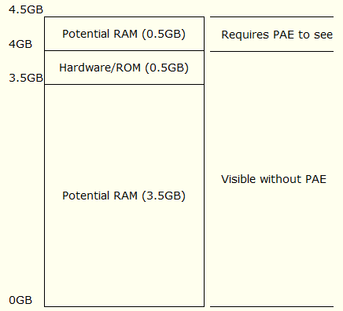
Windows Memory Mapped I/O

Slide 10
Comparing memory-mapped and isolated I/O
Memory-mapped I/O with a single address space is nice because the same instructions that access memory can also access I/O devices.
  For example, issuing MIPS sw instructions to the proper addresses can store data to an external device.
With isolated I/O, special instructions are used to access devices.
  This is less flexible for programming.

Slide 11
Transferring data with programmed I/O
The second important question is how data is transferred between a device and memory.
Under programmed I/O, it’s all up to a user program or the operating system.
  The CPU makes a request and then waits for the device to become ready (e.g., to move the disk head).
  Buses are only 32-64 bits wide, so the last few steps are repeated for large transfers.
A lot of CPU time is needed for this!
  If the device is slow the CPU might have to wait a long time—as we will see, most devices are slow compared to modern CPUs.
  The CPU is also involved as a middleman for the actual data transfer.
(This CPU flowchart is based on one from Computer Organization and Architecture by William Stallings.)
CPU sends read
request to device
Not ready
CPU waits
for device
Ready
CPU reads word
from device
CPU writes word
to main memory
No
Done?
Yes

Slide 12
Can you hear me now? Can you hear me now?
Continually checking to see if a device is ready is called polling.
It’s not a particularly efficient use of the CPU.
  The CPU repeatedly asks the device if it’s ready or not.
  The processor has to ask often enough to ensure that it doesn’t miss anything, which means it can’t do much else while waiting.
An analogy is waiting for your car to be fixed.
  You could call the mechanic every minute, but that takes up all your time.
  A better idea is to wait for the mechanic to call you.
CPU sends read
request to device
Not ready
CPU waits
for device
Ready

Slide 13
Interrupt-driven I/O
Interrupt-driven I/O attacks the problem of the processor having to wait for a slow device.
Instead of waiting, the CPU continues with other calculations. The device interrupts the processor when the data is ready.
The data transfer steps are still the same as with programmed I/O, and still occupy the CPU.
(Flowchart based on Stallings again.)
CPU sends read
request to device
CPU does other stuff
. . .
CPU receives interrupt
CPU reads word
from device
CPU writes word
to main memory
No
Done?
Yes

Slide 14
Interrupts
Interrupts are external events that require the processor’s attention.
  Peripherals and other I/O devices may need attention.
  Timer interrupts to mark the passage of time.
These situations are not errors.
  They happen normally.
  All interrupts are recoverable:
    The interrupted program will need to be resumed after the interrupt is handled.
It is the operating system’s responsibility to do the right thing, such as:
  Save the current state.
  Find and load the correct data from the hard disk
  Transfer data to/from the I/O device.

Slide 15
Exceptions
Exceptions are typically errors that are detected within the processor.
  The CPU tries to execute an illegal instruction opcode.
  An arithmetic instruction overflows, or attempts to divide by 0.
  The a load or store cannot complete because it is accessing a virtual address currently on disk
    we’ll talk more about virtual memory later in 344.
Occur “within” an instruction, for example:
  During IF: page fault
  During ID: illegal opcode
  During EX: division by 0
  During MEM: page fault; protection violation

Slide 16
Exception handling
When an exception occurs
  Address (PC) of offending instruction saved in Exception Program Counter (a register not visible to ISA).
    Work with pipeline
  Transfer control to OS
OS handling of the exception. Two methods
  Register the cause of the exception in a status register which is part of the state of the process
  Transfer to a specific routine tailored for the cause of the exception, i.e. exception handlers; this is called vectored interrupts
There are two possible ways of resolving these errors.
  If the error is un-recoverable, the operating system kills the program.
  Less serious problems can often be recovered/fixed by the O/S or the program itself, e.g. page fault, arithmetic overflow
  O/S save the state of the process, and restore when done

Slide 17
Review: Page fault handler (simplified)
Page fault exceptions are cleared by an O.S. routine called the page fault handler which will
  Grab a physical frame from a free list maintained by the O.S.
  Find out where the faulting page resides on disk
  Initiate a read for that page (DMA, more later)
  Choose a frame to free (if needed), i.e., run a replacement algorithm
  If the replaced frame is dirty, initiate a write of that frame to disk
  Context-switch, i.e., give the CPU to a task ready to proceed
  DMA will copy the page from HD to RAM without the CPU, and interrupt the CPU when it’s completed

Slide 18
How interrupts/exceptions are handled
For simplicity exceptions and interrupts are handled the same way.
When an exception/interrupt occurs, we stop execution and transfer control to the operating system, which executes an “exception handler” to decide how it should be processed.
The exception handler needs to know two things.
  The cause of the exception (e.g., overflow or illegal opcode).
  What instruction was executing when the exception occurred. This helps the operating system report the error or resume the program.
This is another example of interaction between software and hardware, as the cause and current instruction must be supplied to the operating system by the processor.

Slide 19
Direct memory access
One final method of data transfer is to introduce a direct memory access, or DMA, controller.
The DMA controller is a simple processor which does most of the functions that the CPU would otherwise have to handle.
  The CPU asks the DMA controller to transfer data between a device and main memory. After that, the CPU can continue with other tasks.
  The DMA controller issues requests to the right I/O device, waits, and manages the transfers between the device and main memory.
  Once finished, the DMA controller interrupts the CPU.
(Flowchart again.)
CPU sends read
request to DMA
unit
CPU does other stuff
. . .
CPU receives DMA
interrupt

Slide 20
Main memory problems
System bus
CPU &
cache
Memory
DMA unit
Hard disks
CD-ROM
Network
As you might guess, there are some complications with DMA.
  Since both the processor and the DMA controller may need to access main memory, some form of arbitration is required.
  If the DMA unit writes to a memory location that is also contained in the cache, the cache and memory could become inconsistent.

Slide 21
Lab10: x86 Serial Port IO
How many in today’s section?
Work in pairs
Write a simple serial terminal program to send/receive characters via COM1
UART
  Data Register 0x3F8
  Line Control Register 0x3FB
  Line Status Register 0x3FD
Memory-mapped vs Isolated IO
Polling vs Interrupt Driven IO
Programming
  GNU inline assembly
  Ncurses
  http://www.et.byu.edu/groups/it252/10fa/labs.php

Slide 22
Inline Assembly
void initSerial() {
// initialize serial port
__asm__ __volatile__(
"movw $0x3fb,%dx\n"
"movb $0x80,%al\n"
"outb %al,%dx\n"
...
);
}
void sendChar(char cData) {
// TODO:
// check the line status register for transmit data register ready (TxDE) bit.
// do this in a loop and exit the loop when the bit is set,
// i.e. it's ready for us to send data.
// send the character to the data register
__asm__ __volatile__("outb %%al,%%dx"::"a"(cData),"d"(0x3f8));
}

Slide 23
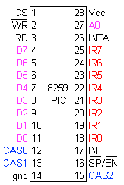
Interrupt Vector/Service Routine
Programmable Interrupt Controller (PIC) handles HW Interrupt Request (IRQ)
x86 has 256 interrupts numbered from 0-256
Interrupt Vector Table (Interrupt Description Table)
  Each vectors contains a 32bit address to its Interrupt Service Routine (ISR).
INT (Hex) | IRQ | Common Uses
08 | 0 | System Timer
09 | 1 | Keyboard
0A | 2 | Redirected
0B | 3 | Serial Comms. COM2/COM4
0C | 4 | Serial Comms. COM1/COM3
0D | 5 | Reserved/Sound Card
0E | 6 | Floppy Disk Controller
0F | 7 | Parallel Comms.
70 | 8 | Real Time Clock
71 | 9 | Reserved
72 | 10 | Reserved
73 | 11 | Reserved
74 | 12 | PS/2 Mouse
75 | 13 | Maths Co-Processor
76 | 14 | Hard Disk Drive
77 | 15 | Reserved

Slide 24
Interrupt Action
The PIC informs the processor that an interrupt has occurred by asserting the processor's interrupt pin.
The processor finishes the currently executing instruction.
The processor sends an acknowledgement signal to the PIC.
The PIC then passes to the processor the vector number for the interrupt that occurred.
The processor uses this vector number to determine the address where the ISR (interrupt service routine) is stored. The vector number is used as an index into the interrupt vector table (or interrupt descriptor table). The corresponding entry in the interrupt vector table contains the address for the ISR.
The processor pushes the flags, and IP onto the stack.
The processor clears IF, disabling interrupts.
The processor then sets IP to the address of the ISR that was read from the vector table and begins execution.

Slide 25
Link them all together
HW interrupt (IRQ)
Programmable interrupt controller (PIC)
Interrupt vector
Interrupt vector table
Interrupt service routine (ISR)

Slide 26
Setup Interrupt Driven IO
void interrupt COM1INT() /* Interrupt Service Routine (ISR) for PORT1 */ {
…
data = inportb(0x3F8);
…
}
void main(void) {
…
setvect(0x0C, COM1INT); /* Set Interrupt Vector Entry */
…
}
INT (Hex) | IRQ | Common Uses
0C | 4 | Serial Comms. COM1/COM3

Slide 27
Device Driver
Device Driver
  Abstraction layer that hides all these ugliness
Easier to program
  Intel vs 3COM NIC
Portable program
  Intel/AMD (desktop) vs Broadcom (Linksys router) vs ARM (smartphone)

Slide 28
I/O is slow!
How fast can a typical I/O device supply data to a computer?
  A fast typist can enter 9-10 characters a second on a keyboard.
  Common local-area network (LAN) speeds go up to 100 Mbit/s, which is about 12.5MB/s.
  Today’s hard disks provide a lot of storage and transfer speeds around 40-60MB per second.
Unfortunately, this is excruciatingly slow compared to modern processors and memory systems:
  Modern CPUs can execute more than a billion instructions per second.
  Modern memory systems can provide 2-4 GB/s bandwidth.
I/O performance has not increased as quickly as CPU performance, partially due to neglect and partially to physical limitations.
  This is changing, with faster networks, better I/O buses, RAID drive arrays, and other new technologies.

Slide 29
I/O speeds often limit system performance
Many computing tasks are I/O-bound, and the speed of the input and output devices limits the overall system performance.
This is another instance of Amdahl’s Law. Improved CPU performance alone has a limited effect on overall system speed.
Execution time after improvement | = | Time affected by improvement | + | Time unaffected by improvement
 |  | Amount of improvement

Slide 30
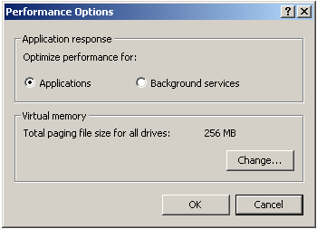

Common I/O devices
Hard drives are almost a necessity these days, so their speed has a big impact on system performance.
  They store all the programs, movies and assignments you crave.
  Virtual memory systems let a hard disk act as a large (but slow) part of main memory.
Networks are also ubiquitous nowadays.
  They give you access to data from around the world.
  Hard disks can act as a cache for network data. For example, web browsers often store local copies of recently viewed web pages.

Slide 31
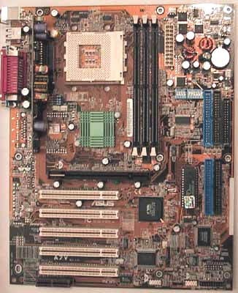

The Hardware (the motherboard)
CPU socket
Serial,
parallel,
and USB
ports
Memory slots
IDE drive
connectors
(Back)
(Front)
AGP slot
PCI slots

Slide 32
What is all that stuff?
Different motherboards support different CPUs, types of memories, and expansion options.
The picture is an Asus A7V.
  The CPU socket supports AMD Duron and Athlon processors.
  There are three DIMM slots for standard PC100 memory. Using 512MB DIMMs, you can get up to 1.5GB of main memory.
  The AGP slot is for video cards, which generate and send images from the PC to a monitor.
  IDE ports connect internal storage devices like hard drives, CD-ROMs, and Zip drives.
  PCI slots hold other internal devices such as network and sound cards and modems.
  Serial, parallel and USB ports are used to attach external devices such as scanners and printers.

Slide 33
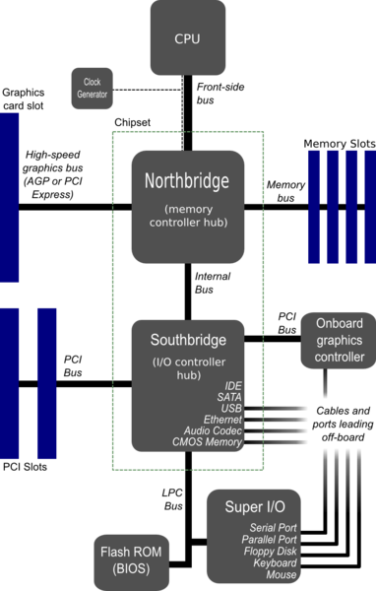
Component and Bus Layout
Clock
Bus width
Bandwidth
Transfer/clock
FSB
Clock Multiplier
Overclock
PCI
AGP
PCIe
IDE
SATA
Serial vs Parallel

Slide 34




How is it all connected?
CPU
3GHz
3GB/s
3GB/s
16GB/s
Memory
North Bridge
chip
AGP
port
Video
card
133MB/s
PCI bus
South Bridge
chip
PCI slots
Modem
Sound card
IDE controller
Serial, parallel
and USB ports
Hard disks
CD-ROM

Slide 35
Frequencies
CPUs actually operate at two frequencies.
  The internal frequency is the clock rate inside the CPU, which is what we’ve been talking about so far.
  The external frequency is the speed of the processor bus, which limits how fast the CPU can transfer data.
The internal frequency is usually a multiple of the external bus speed.
  A 2.167 GHz Athlon XP sits on a 166 MHz bus (166 x 13).
  A 2.66 GHz Pentium 4 might use a 133 MHz bus (133 x 20).
    You may have seen the Pentium 4’s bus speed quoted at 533MHz. This is because the Pentium 4’s bus is “quad-pumped”, so that it transfers 4 data items every clock cycle.
Processor and Memory data rates far exceed PCI’s capabilities:
  With an 8-byte wide “533 MHz” bus, the Pentium 4 achieves 4.3GB/s
  A bank of 166MHz Double Data Rate (DDR-333) Memory achieves 2.7GB/s
PC I/O

Slide 36
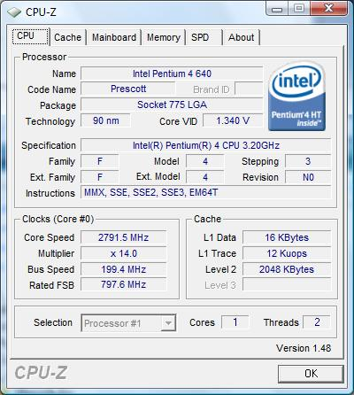
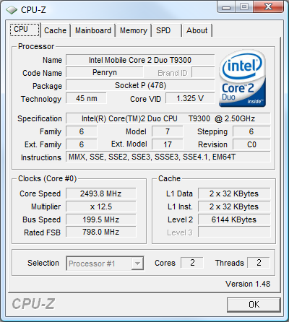
Know your CPU, Cache, Bus, Clock …

Slide 37
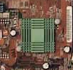
The North Bridge
To achieve the necessary bandwidths, a “frontside bus” is often dedicated to the CPU and main memory.
  “bus” is actually a bit of a misnomer as, in most systems, the interconnect consists of point-to-point links.
  The video card, which also need significant bandwidth, is also given a direct link to memory via the Accelerated Graphics Port (AGP).
All this CPU-memory traffic goes through the “north bridge” controller, which can get very hot (hence the little green heatsink).
CPU
Memory
64
North Bridge
chip
32
AGP
port
Video
card
2.7GB/s @ 133MHz
1.1GB/s @ 133MHz x 2
PC I/O
AGP 4x

Slide 38
Intel Core i7 & AMD Opteron
No FSB
Direct connect architecture
  Intel: QuickPath Interconnect (QPI)
    3.2 GHz
    × 2 bits/Hz (double data rate)
    × 20 (QPI link width)
    × (64/80) (data bits/flit bits)
    × 2 (two links to achieve bidirectionality)
    ÷ 8 (bits/byte)
    = 25.6 GB/s
  AMD: HyperTransport
Non-uniform memory access
Multi core scalability

Slide 39
PCI
Peripheral Component Interconnect is a synchronous 32-bit bus running at 33MHz, although it can be extended to 64 bits and 66MHz.
The maximum bandwidth is about 132 MB/s.
33 million transfers/second x 4 bytes/transfer = 132MB/s
Cards in the motherboard PCI slots plug directly into the PCI bus.
Devices made for the older and slower ISA bus standard are connected via a “south bridge” controller chip, in a hierarchical manner.
North Bridge
chip
33 MHz PCI bus
South Bridge
chip
PCI slots
PC I/O

Slide 40


External buses
External buses are provided to support the frequent plugging and un-plugging of devices
  As a result their designs significantly differ from internal buses
Two modern external buses, Universal Serial Bus (USB) and FireWire, have the following (desirable) characteristics:
  Plug-and-play standards allow devices to be configured with software, instead of flipping switches or setting jumpers.
  Hot plugging means that you don’t have to turn off a machine to add or remove a peripheral.
  The cable transmits power! No more power cables or extension cords.
  Serial links are used, so the cable and connectors are small.
PC I/O

Slide 41
The Serial/Parallel conundrum
Why are modern (internal & external) buses serial rather than parallel?
Generally, one would think that having more wires would increase bandwidth and reduce latency, right?
  Yes, but only if they can be clocked at comparable frequencies.
Two physical issues allow serial links to be clocked significantly faster:
  On parallel interconnects, interference between the signal wires becomes a serious issue.
  Skew is also a problem; all of the bits in a parallel transfer could arrive at slightly different times.
  More in IT 327
Serial links are being increasingly considered for internal buses:
  Serial ATA is a new standard for hard drive interconnects
  PCI-Express (aka 3GI/O) is a PCI bus replacement that uses serial links
  Intel QuickPath & AMD HyperTransport

Slide 42
More Serial Buses
Point-to-Point transport replacing FSB, AGP
AMD: HyperTransport (HT) in Athlon
Intel: QuickPath Interconnection (QPI) in Core i7
3.2 GHz, 25.6 GB/s (double 1600 MHz FSB)

Slide 43

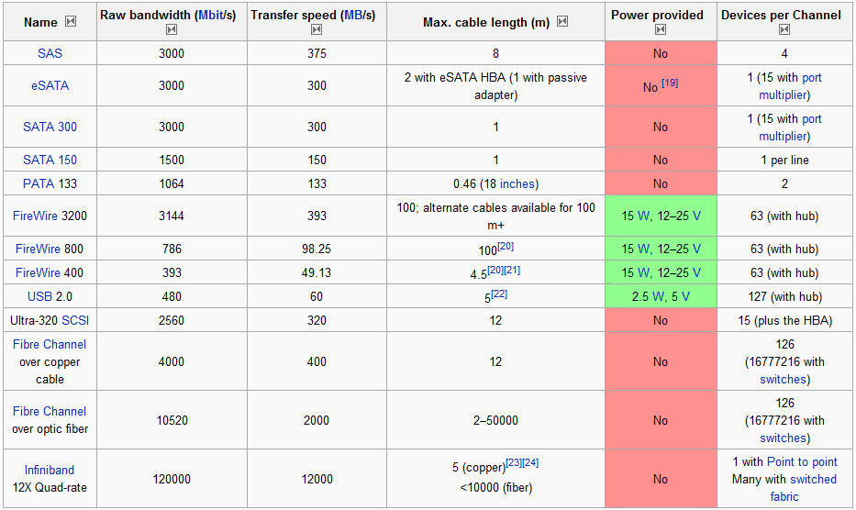
External Bus Comparison

Slide 44
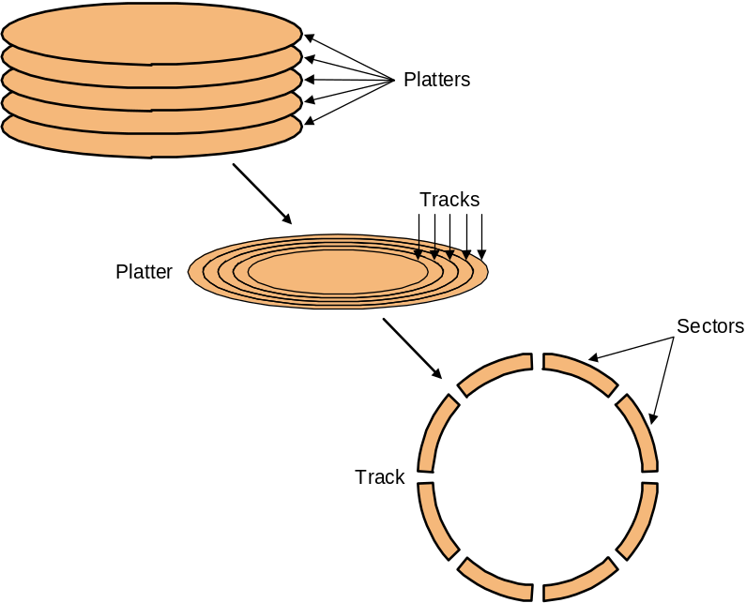
Hard drives
Figure 8.4 in the textbook shows the ugly guts of a hard disk.
  Data is stored on double-sided magnetic disks called platters.
  Each platter is arranged like a record, with many concentric tracks.
  Tracks are further divided into individual sectors, which are the basic unit of data transfer.
  Each surface has a read/write head like the arm on a record player, but all the heads are connected and move together.
A 75GB IBM Deskstar has roughly:
  5 platters (10 surfaces),
  27,000 tracks per surface,
  512 sectors per track, and
  512 bytes per sector.

Slide 45
Accessing data on a hard disk
Accessing a sector on a track on a hard disk takes a lot of time!
  Seek time measures the delay for the disk head to reach the track.
  A rotational delay accounts for the time to get to the right sector.
  The transfer time is how long the actual data read or write takes.
  There may be additional overhead for the operating system or the controller hardware on the hard disk drive.
Rotational speed, measured in revolutions per minute or RPM, partially determines the rotational delay and transfer time.
T
r
a
c
k
s
P
l
a
t
t
e
r
S
e
c
t
o
r
s
T
r
a
c
k

Slide 46
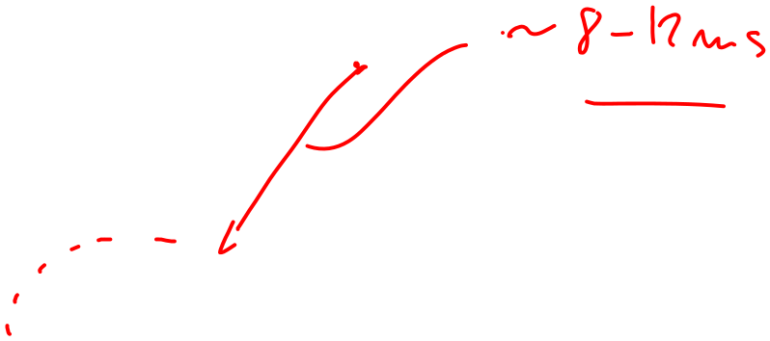

So, why so slow?

Slide 47
Estimating disk latencies (seek time)
Manufacturers often report average seek times of 8-10ms.
  These times average the time to seek from any track to any other track.
In practice, seek times are often much better.
  For example, if the head is already on or near the desired track, then seek time is much smaller. In other words, locality is important!
  Actual average seek times are often just 2-3ms.

Slide 48
Estimating Disk Latencies (rotational latency)
Once the head is in place, we need to wait until the right sector is underneath the head.
  This may require as little as no time (reading consecutive sectors) or as much as a full rotation (just missed it).
  On average, for random reads/writes, we can assume that the disk spins halfway on average.
Rotational delay depends partly on how fast the disk platters spin.
Average rotational delay = 0.5 x rotations x rotational speed
  For example, a 5400 RPM disk has an average rotational delay of:
0.5 rotations / (5400 rotations/minute) = 5.55ms

Slide 49
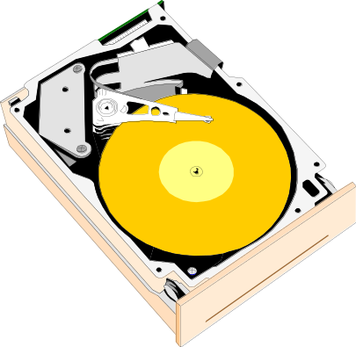
Estimating disk times
The overall response time is the sum of the seek
time, rotational delay, transfer time, and overhead.
Assume a disk has the following specifications.
  An average seek time of 9ms
  A 5400 RPM rotational speed
  A 10MB/s average transfer rate
  2ms of overheads
How long does it take to read a random 1,024 byte sector?
  The average rotational delay is 5.55ms.
  The transfer time will be about (1024 bytes / 10 MB/s) = 0.1ms.
  The response time is then 9ms + 5.55ms + 0.1ms + 2ms = 16.7ms. That’s 16,700,000 cycles for a 1GHz processor!
One possible measure of throughput would be the number of random sectors that can be read in one second.
(1 sector / 16.7ms) x (1000ms / 1s) = 60 sectors/second.

Slide 50
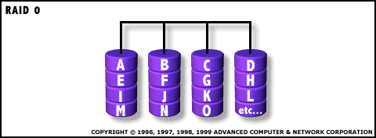
Parallel I/O
Many hardware systems use parallelism for increased speed.
  Pipelined processors include extra hardware so they can execute multiple instructions simultaneously.
  Dividing memory into banks lets us access several words at once.
A redundant array of inexpensive disks or RAID system allows access to several hard drives at once, for increased bandwidth.
  The picture below shows a single data file with fifteen sectors denoted A-O, which are “striped” across four disks.
  This is reminiscent of interleaved main memories from last week.

Slide 51
Administrivia
Course rating – BYU
  Professionalism
Course outcome survey – blackboard
  Professionalism
HW 12, chapter 8, exceptions & system calls, due next Wednesday
Quiz 7, to be posted, due next Monday
Final exam, available next Thursday 12/9, due 5PM following Monday, Dec 13th
  Cover everything after mid-term
  Memory structure, cache, VM
  Linker
  Interrupt/exception, IO, disk
Late work deadline, Wednesday, Dec 15th

