Slide 1
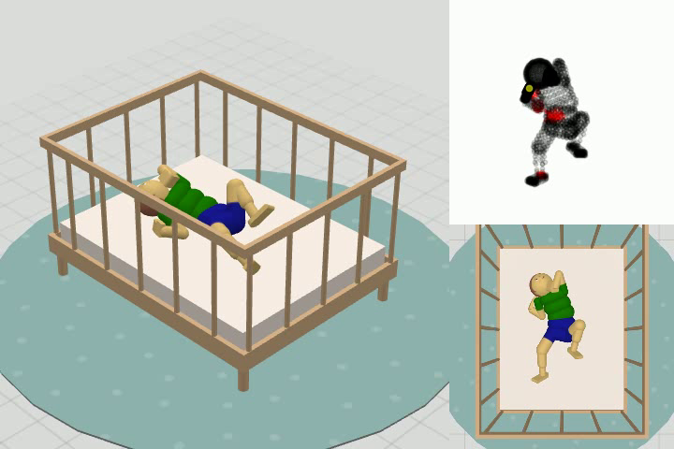
Learning Infant-Like Self-Touch in BabyBench
COMP0223 Robot Learning Coursework
Task: self-touch learning without extrinsic rewards
Platform: BabyBench + MIMo
Approach: intrinsic-motivation RL
Question: can the robot discover its own body through self-generated exploration?

Slide 2
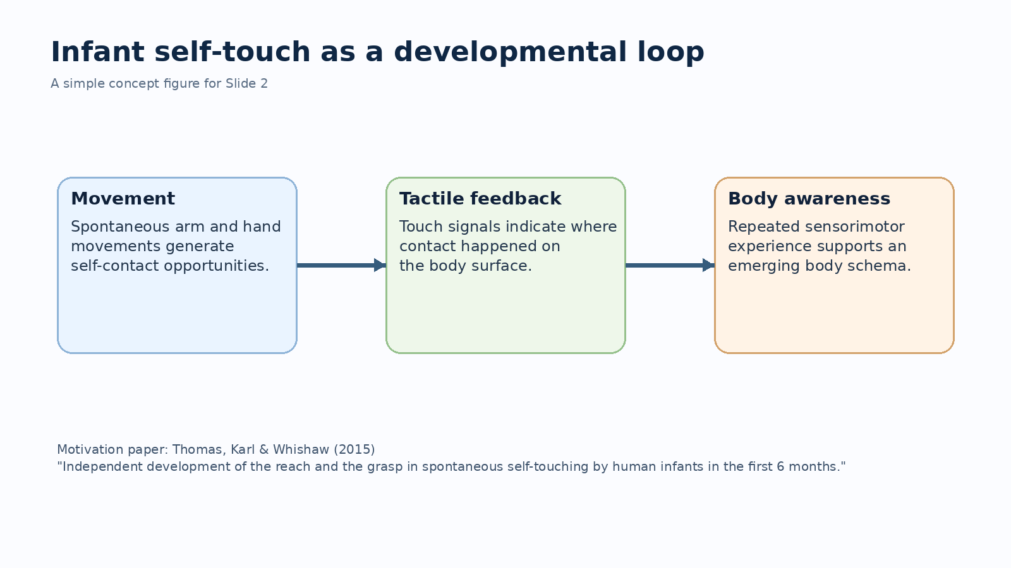

Slide 3
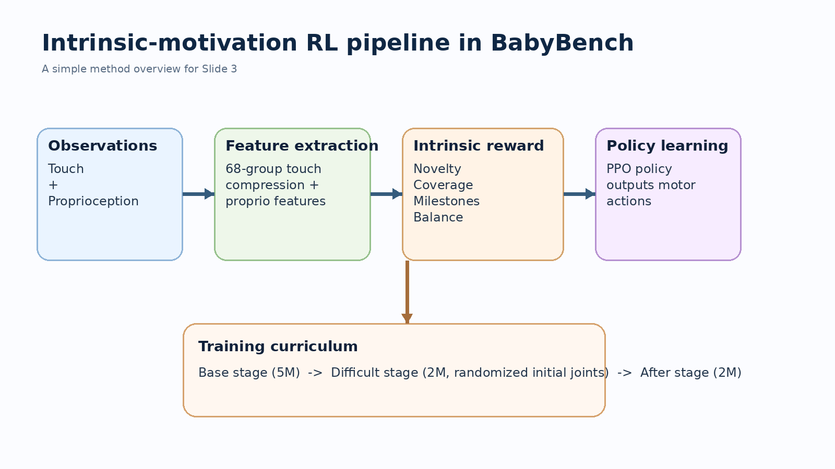

Slide 4
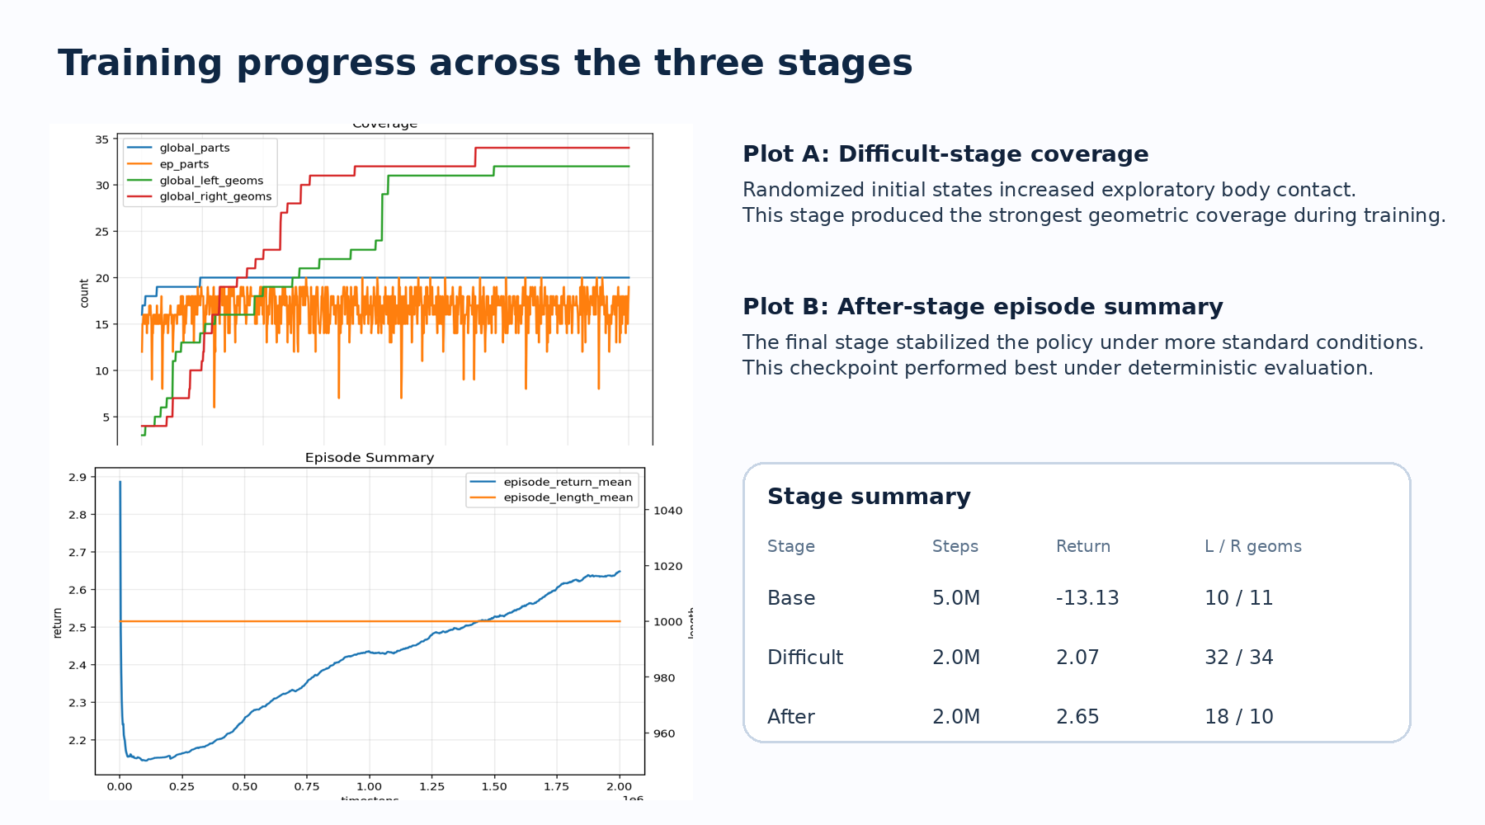

Slide 5
