Slide 1
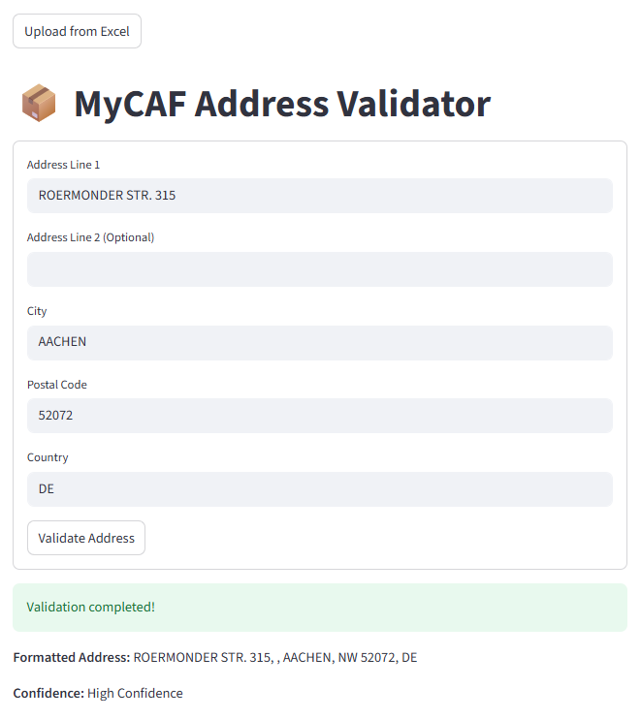
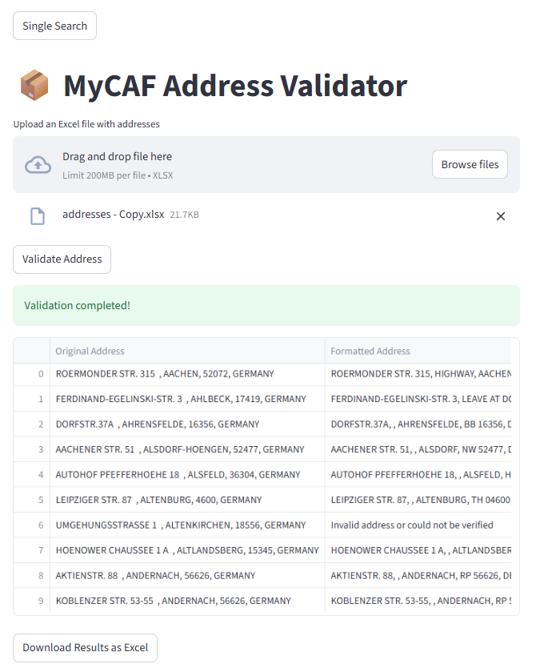
Validation Output:
Formatted Addresses: Formatted to postal standards
Confidence:
High Confidence (✓) - Verified and ready to use
Low Confidence (!) - Requires manual review and confirmation
MyCAF Address Validator
https://mycafaddrvalid.streamlit.app/
Batch Upload
Single Search
Upload template: "M:\Accounting\Processes\Address Validator\addresses_upload_template.xlsx"
Page Navigator

Slide 2
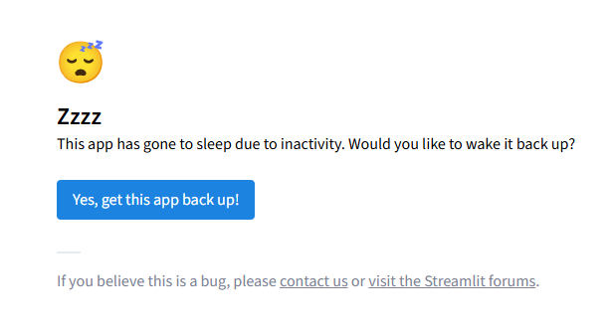
MyCAF Address Validator
Due to inactivity, it will have this notice when reopen the app. Simply click on ‘Yes, get this app back up’ to resume!

