Slide 1
Information Storage and Retrieval
Team: CME
Kulendra Kumar Kaushal, Rutwik Kulkarni, Aarohi Sumant, Chaoran Wang, Liling Yuan, Chenhan Yuan
CS 5604: Information Storage and Retrieval, Fall 2019 Instructor: Dr. Edward A. Fox Department of Computer Science, Virginia Tech Blacksburg, VA 24061 December 05, 2019

Slide 2
Outline
Introduction
Metadata Extraction
Text Extraction and Preprocessing
Chapter Level Text Extraction
Development of an Automated Suite
Contribution
Future Scope
Acknowledgements
Notes:
Introduction - Chaoran
Metadata Extraction - Liling
Text Extraction and Preprocessing - Chenhan + Aarohi
Chapter Level Text Extraction - Rutwik
Development of an Automated Suite - Kulendra
Contribution and Future Work - Aarohi

Slide 3
Introduction

Slide 4
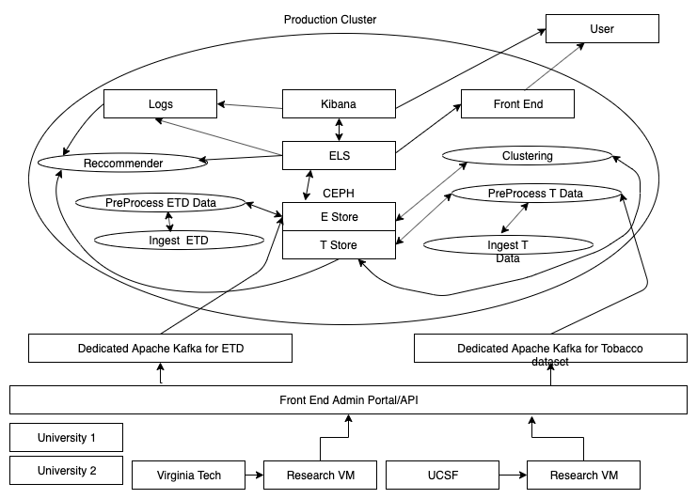
Our position in the system

Slide 5
Research Questions
Our team addressed the problems related to the extraction of metadata and preprocessing from the ETDs by addressing the following research questions:
RQ 1: Can we extract metadata from an ETD document, and transform it into a format that can be ingested into Elasticsearch?
RQ 2: Can we produce text files from PDF files as well as from extracted elements, thus having content suitable for subsequent indexing and searching?
RQ 3: Can we expand the extracted data by including a file for each chapter?
RQ 4: Can we develop an automated system that can extract the metadata from new documents, format it and ingest it into Elasticsearch?

Slide 6
Organize metadata
Clean text
Submit visualization requirements
Setup GROBID
Research different parsers and pick the best ones for this project
Presentation
Final Report
09.19.2019
10.10.2019
10.31.2019
11.21.2019
12.05.2019
Parse and organized ETD data and put in ceph
Chapterwise Extraction
Extract TF-IDF tags
Create an Automated Suite
Upload all scripts on Gitlab

Slide 7
Metadata Extraction

Slide 8
Comparison of Parsers
Different parsers can extract metadata and text from a ETD document. Each parser has its pros and cons. We performed a detailed review of the existing parsers for deciding the most accurate parser for our problem statement.
The parsers which we studied includes:
a. GROBID
b. Apache TIKA
c. Science Parse
d. PyPDF2
e. PDFMiner

Slide 9
Parser comparison
Parser | Extraction Format | Advantages | Disadvantages
GROBID | XML | Easy to set up Structured format Can be tuned | Slow parsing Not able to extract chapter wise content
Apache TIKA | Text | Can be used for different file formats Able to process tables Can extract content as well as metadata | It is hard to extract combination of two different types of information
Science Parse | JSON | Structured format Detects abstract correctly | Difficult to set up Skips or merges chapters Skips some references
PyPDF2 | Text | Easy to set up Extracts text and document information | No output in JSON or XML format
PDFMiner | Text, XML, HTML | Easy to set up Compatible to both Py2.x &3.x | It cannot process table and image

Slide 10
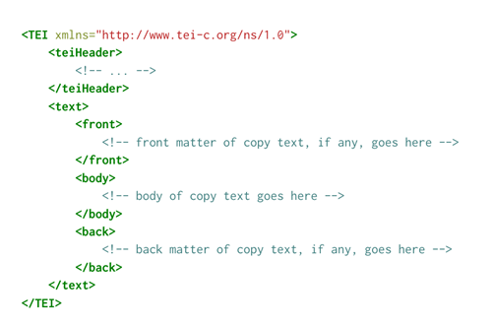

GROBID-GeneRation Of BIbliographic Data
GROBID takes the PDF format of each scientific document as the input and makes use of machine learning models (cascading of linear-chain CRF) for extracting the metadata from the document in XML format. As GROBID could extract maximum metadata with minimum noise it was selected as the parser for extracting the metadata.

Slide 11
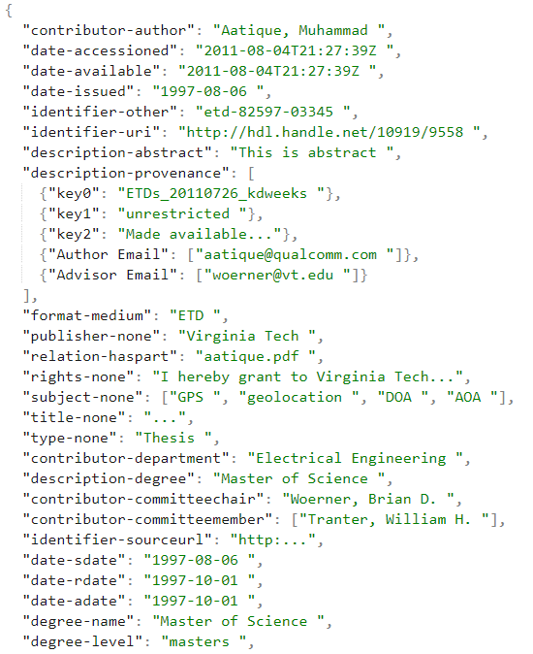
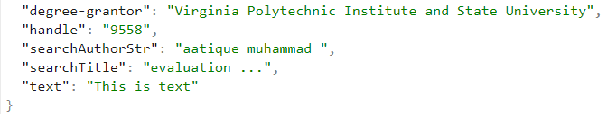
Conversion of Metadata into ingestible format
Notes:
Code to convert xml to json
Check all the data type in each entry and make sure they are the same (Pre processing)
If they are different, convert each one to dictionary data type
The format can be ingested to elasticsearch team

Slide 12
RQ 1: Can we extract metadata from an ETD document, and transform it into a format that can be ingested into Elasticsearch?
Comparison of Parsers
Use GROBID to extract metadata
Convert the extracted metadata into ingestible format
The data of small subset (2017 ETDs) and larger dataset (all 30K ETDs) is ingested.
Evaluated whether the obtained data is in correct format ( To be discussed in the next sections)

Slide 13
Text Extraction and Preprocessing

Slide 14
Overview and Need
In order to facilitate full text search for the ETDs, extraction of full texts and adding this as a field in the metadata is necessary.
Additionally, the Text Analysis and Machine Learning Team needed the preprocessed data for implementing machine learning algorithms

Slide 15
Text Extraction
Toolkits used to convert PDF to text:
PyPDF2
APIs are reachable;
PDFminer.six
Only scripts are offered to extract PDF, no APIs document.
Still under developing

Slide 16
PyPDF2
ERROR : TypeError: ord() expected string of length 1, but int found
This happens when decoding LZW algorithm
Lempel–Ziv–Welch (LZW) is a compressing algorithm based on reference dictionary
Line 205 nextbits=ord(self.data[self.bytepos])
The decoding processing will probably generate integer instead of string.
To address this issue, a new ord() function is re-defined (override the built-in)

Slide 17
Garbage values in the extracted text
The full text documents contained a lot of garbage data and redundant numerical values which needed to be removed.
For example:
b' at the start of the extracted text.
[23]: Reference numbers are garbage values for clustering
Figure 4.1: Figure numbers area also irrelevant for clustering
PDF parsers are not able to extract contents of the image and hence produce garbage value, so such garbage strings are removed, 51sin()kNzzkFmgmx12223242(.)NNNNfFFFF1234(.)
PDF parsers are also not able to extract the formulae from the document and these formulate appear as garbage and are removed

Slide 18

Preprocessing
Used NLTK library in Python to remove stop words.
stopwords.words('english')
Used regular expression to remove the garbage values and irrelevant numerical data. For example:
Replace "..." by ""
"[\d{1,20}]"
"[\d{1,20}\.\d{1,20}]"
Replace "[\(\[].*?[\)\]]" by ""
Extracting TF-IDF tags and abstracts separately for clustering

Slide 19
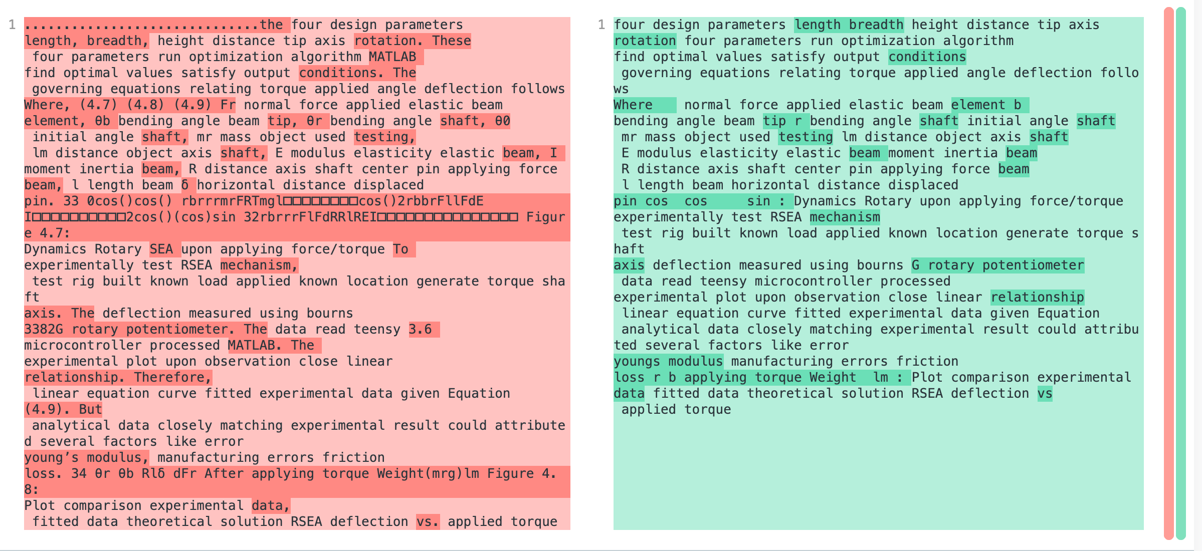

Slide 20
RQ 2: Can we produce text files from PDF files as well as from extracted elements, thus having content suitable for subsequent indexing and searching?
We extracted full text from all 30K ETD documents.
We ingested this text in the metadata to facilitate full text searching.
We preprocessed the data, so that it could be used for training machine learning algorithms.
We extracted the abstracts and TF-IDF tags of all the ETDs to facilitate clustering.

Slide 21
Chapter Level Text Extraction

Slide 22
Xpath based Chapter Level Text Extraction
Various projects have successfully used GROBID for capturing the structure of ETD documents. Therefore, due to previous successful usage and ease of installation, we decided to use GROBID for chapter level text extraction.
The TEI output format does not explicitly define a chapter tag <chapter>, neither does it provide @type=chapter attribute for the <div> element.
Therefore, due to the lack of explicit tags for the indication of the start or end of a chapter, chapter level extraction from ETD documents is a difficult task.

Slide 23
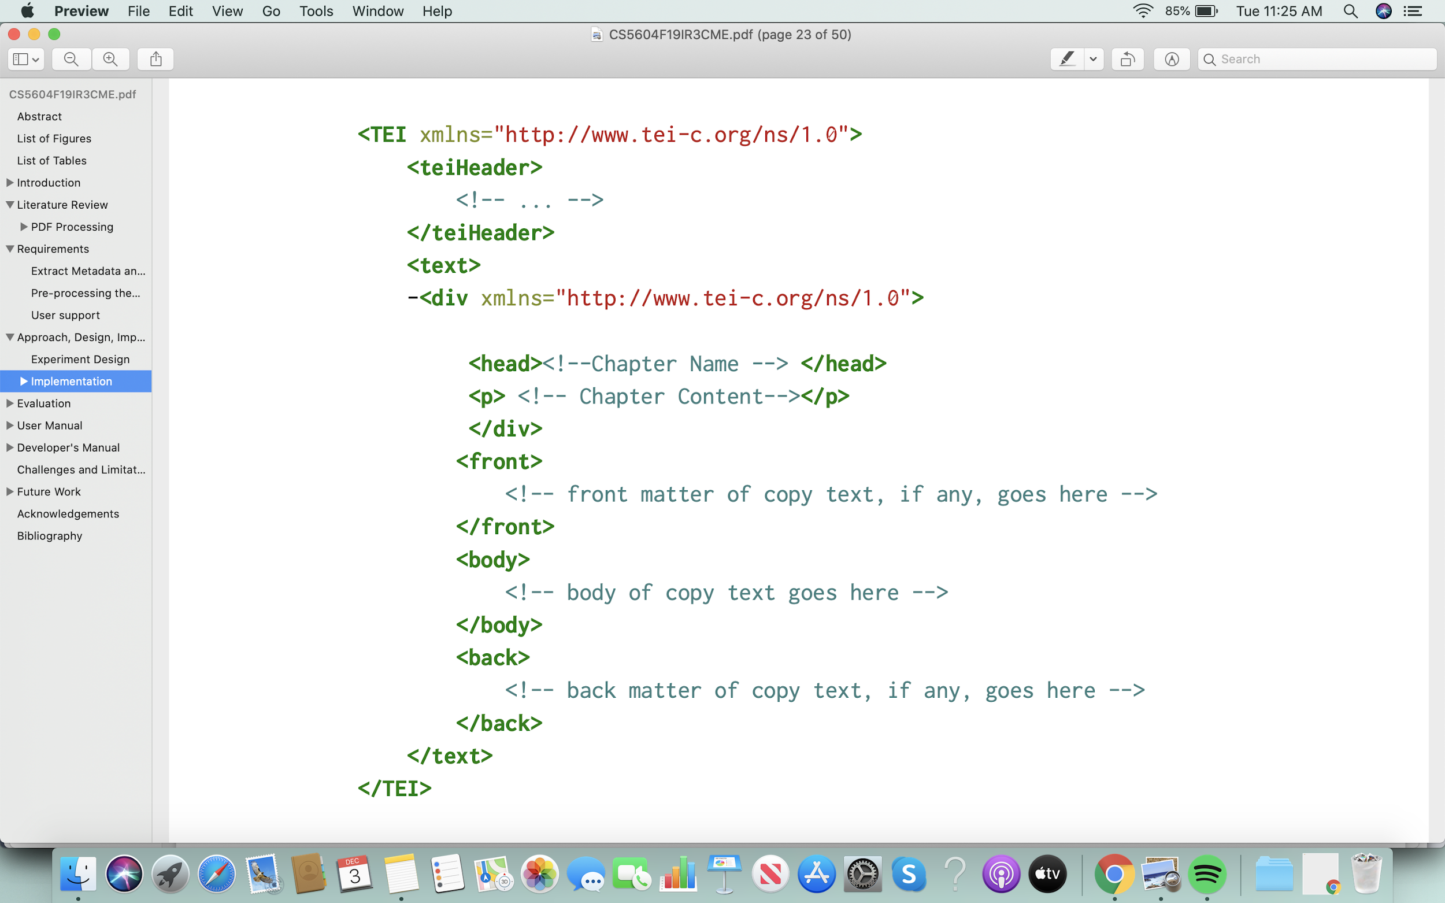
Xpath based Chapter Level Text Extraction
“Chapter Name'' is generally present in the <head>tag which is wrapped inside the <div> tag.
XPath expression used:
/tei:TEI/tei:text/tei:body/tei:div[tei:head]

Slide 24
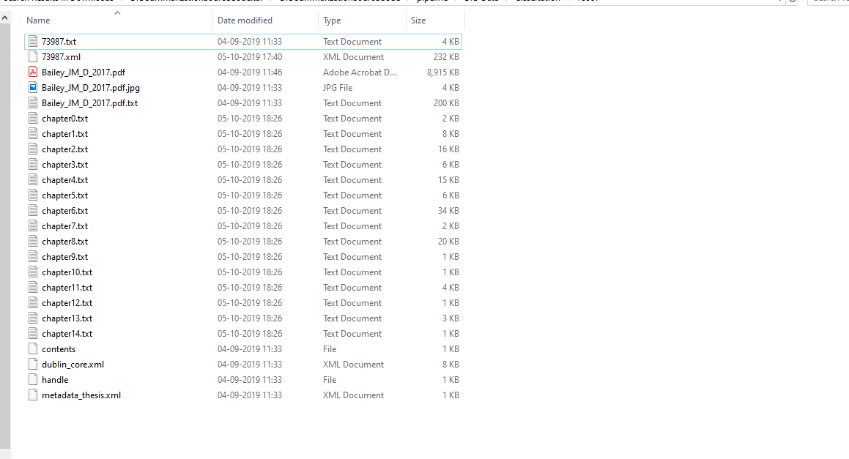
Results
Method Extracted more chapters
Treated subsections as chapters
The ETD having 5 chapters was segmented into 15 chapters!!

Slide 25
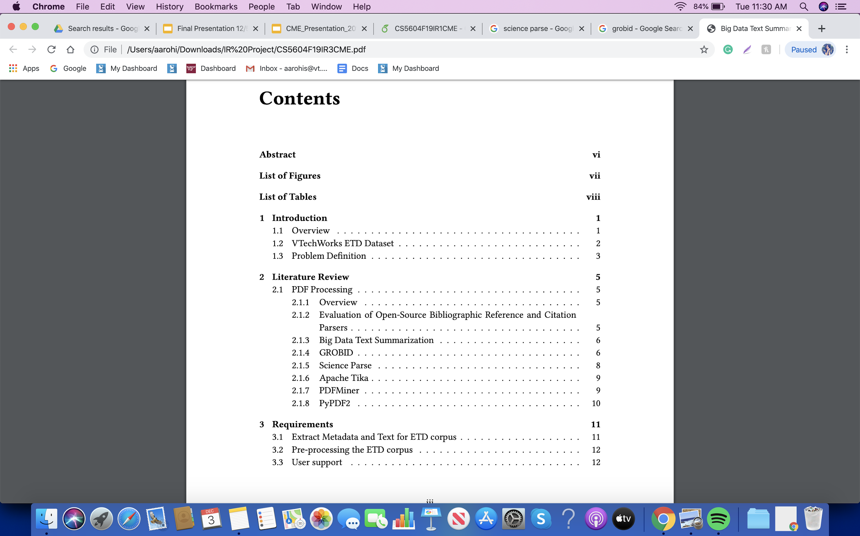
Chapter Level Text extraction based on Table of Contents
Table of Contents provides the page numbers on which a user can find these sections and subsections.

Slide 26
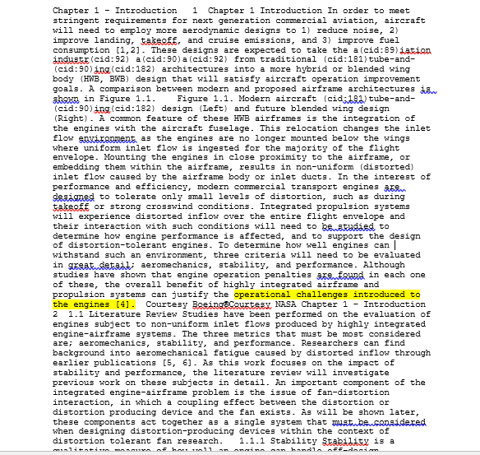
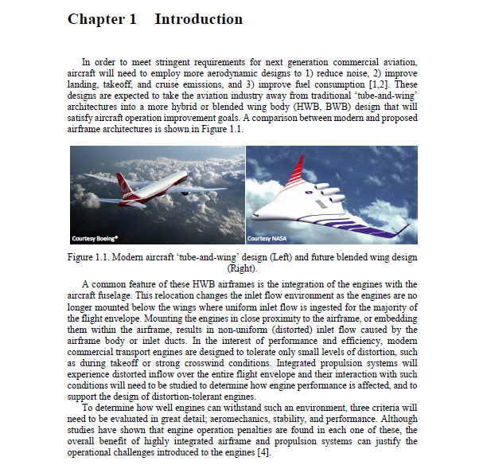
Chapter Level Text extraction based on Table of Contents- Issues

Slide 27
Manual Chapter Level Extraction
We finally did a manual chapter level extraction from 20 ETD documents.
This gives the gold standard result.

Slide 28
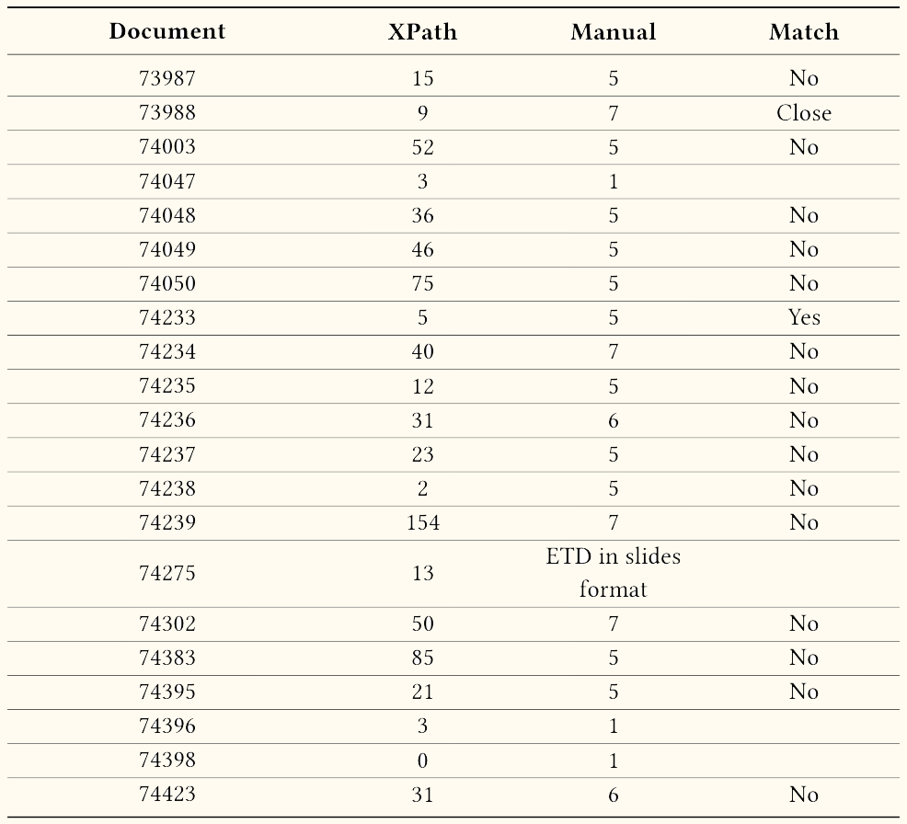
Differences of number of chapters

Slide 29
Evaluation
 | XPath | Manual
Chapter completeness on average | 43.90% | 90.88%
Formulas | No | Yes but lots of illegal characters
Illegal characters | No | Some letters are converted to {cid:}
References in-text | No | Yes
References | No | Yes
Texts in figures | No | Yes but many illegal characters

Slide 30
RQ 3: Can we expand the extracted data by including a file for each chapter?
Tried Xpath based and table of contents based method for chapter level text extraction
Evaluated these methods against gold standards (Manual Chapter level text extraction)
This result can be used for Big Data summarization problem
There is a scope for improvement

Slide 31
Development of an Automated System

Slide 32
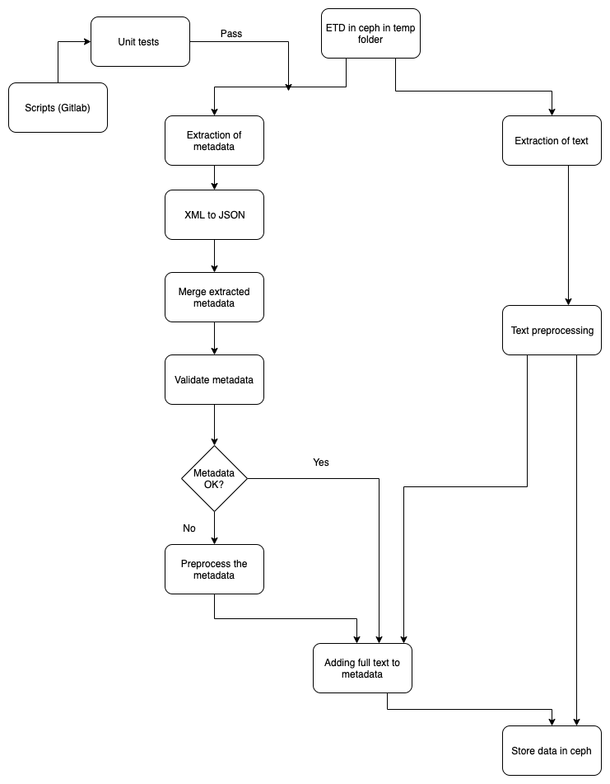
Flowchart

Slide 33
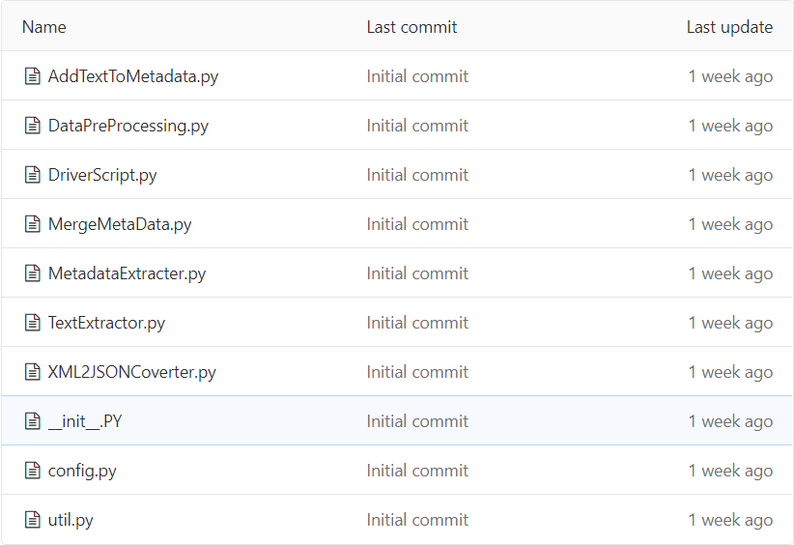
Script Description

Slide 34
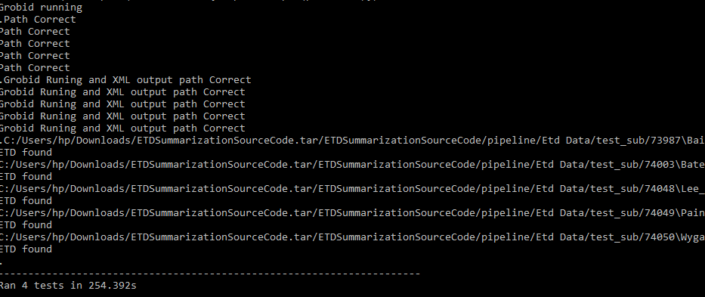
Features and Advantages
Unit tests to test the scripts (e.g check whether GROBID is running or not)
Automatic extraction of the new metadata and merging it to the existing file
Unit tests to validate the metadata
Extraction of text that can be used by Text Analysis and Machine Learning Team

Slide 35
Limitations and Assumptions
Cannot scrape the data from vtechworks/ircluster. (The new data should be added in a folder called “temp:” on ceph)
The folder structure of ETD document should be the same as we are currently using.

Slide 36
RQ 4: Can we develop an automated system that can extract the metadata from new documents, format it and ingest it to Elasticsearch?
Such an automated system which will automate the entire project done by CS5604 class can be developed.

Slide 37
Our contribution

Slide 38
Full text extraction and preprocessing
Metadata extraction and conversion into ingestible format
Automation suite for adding new documents

Slide 39
Future Scope

Slide 40
Improve chapter level text extraction.
Batch metadata processing of ETD documents.

Slide 41
Acknowledgements

Slide 42
This project was completed over the course of CS4984/5984: Big Data Text Summarization at Virginia Tech. ETD data analyzed was provided by Virginia Tech University Libraries, and the students who have submitted theses or dissertations in connection with their Virginia Tech studies.
The authors would like to thank Dr. Edward A. Fox, Ziqian Song, and our classmates for providing insight and expertise that greatly helped us accomplish this research project.
We thank Bipasha Banerjee for her help and insights on ETD processing.
We thank the other teams TML, CMT, FEK, INT, and ELS for their valuable help and coordination.
Last but not least, we are immensely grateful to the creators of all the open source software we used to create this project. Thank you very much!

Slide 43
Thank you!
Any Questions?
Team: CME
Kulendra Kumar Kaushal, Rutwik Kulkarni, Aarohi Sumant, Chaoran Wang, Liling Yuan, Chenhan Yuan

