Slide 1
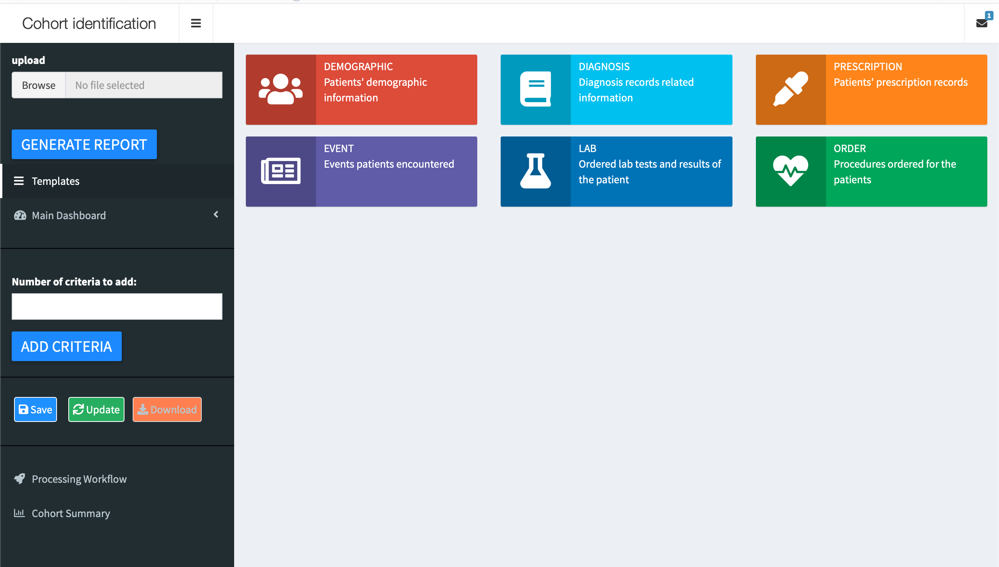
Upload parsed Json file
Check and correct selected templates for each criteria
Modify the templates to generate results
Save the change and update the result
Visualize the selected process and the summary of the cohort

Slide 2
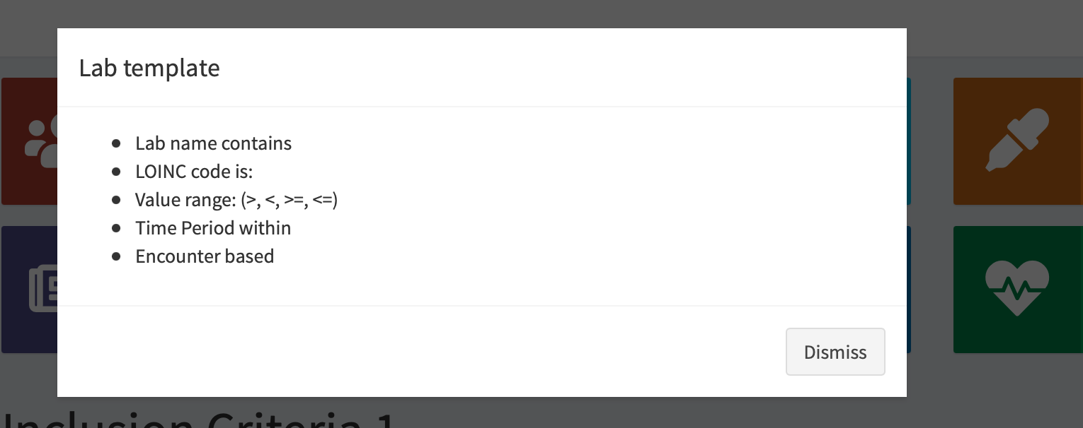
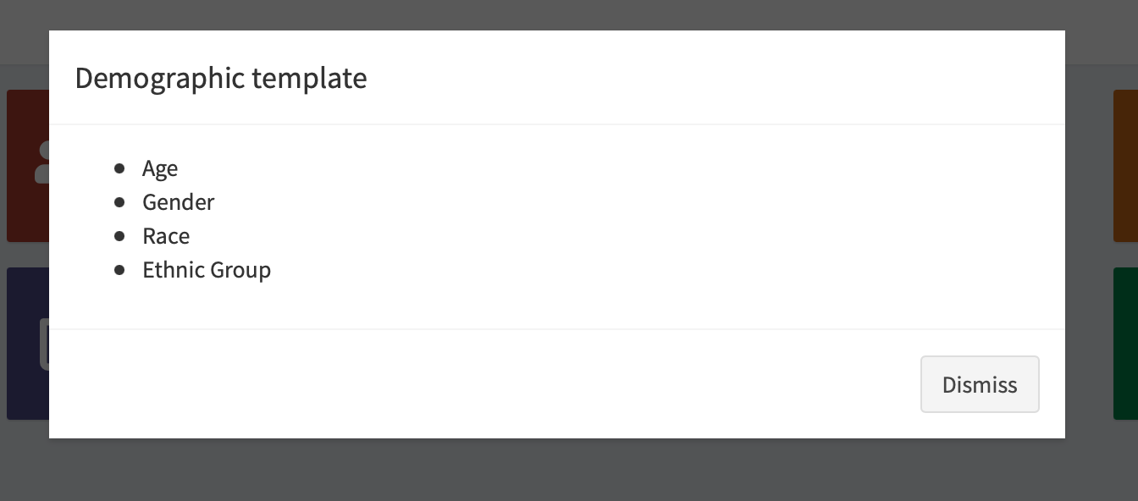
Click the information box on the page, you can have a view of what information can be included in this template

Slide 3
Test trial: NCT03805308
Inclusion criteria
Exclusion criteria
18 to 85 years of age
Presenting with symptoms consistent with an acute ischemic stroke
Imaging evidence of an anterior circulation occlusion of the Internal Carotid Artery (ICA) terminus and/or Middle Cerebral Artery Main Stem (MCA M1) segment
NIHSS score >6 at the time of randomization
Ability to randomize within 24 hours of stroke onset
Pre-stroke mRS score 0-1
Ability to obtain signed informed consent
Females who are pregnant, or those of child-bearing potential with positive urine or serum beta Human Chorionic Gonadotropin (HCG) test
Known severe allergy (more than a rash) to contrast media uncontrolled by medications
Refractory hypertension (defined as persistent systolic blood pressure >185 mmHg or diastolic blood pressure >110 mmHg)
CT evidence of the following conditions:
Midline shift or herniation
Evidence of intracranial hemorrhage
Mass effect with effacement of the ventricles
Computed Tomography Angiography (CTA) evidence suggestive of difficult endovascular access per the treating interventionalist
Presence of cervical ICA occlusion (e.g., related to atherosclerotic disease or dissection)
Rapidly improving neurological status prior to randomization to NIHSS <6
Bilateral strokes or multiple intracranial occlusions
Intracranial tumors
Known hemorrhagic diathesis, coagulation factor deficiency, or on anticoagulant therapy with an International Normalized Ratio (INR) of >3.0 or Partial Thromboplastin Time (PTT) >3 times of normal
Baseline platelet count <30,000 per microliter (µl)
Life expectancy less than 90 days prior to stroke onset
Participation in another randomized clinical trial that could confound the evaluation of the study
Any other condition (in the opinion of the site investigator) that precludes an endovascular procedure or poses a significant hazard to the patient if an endovascular procedure was performed

Slide 4
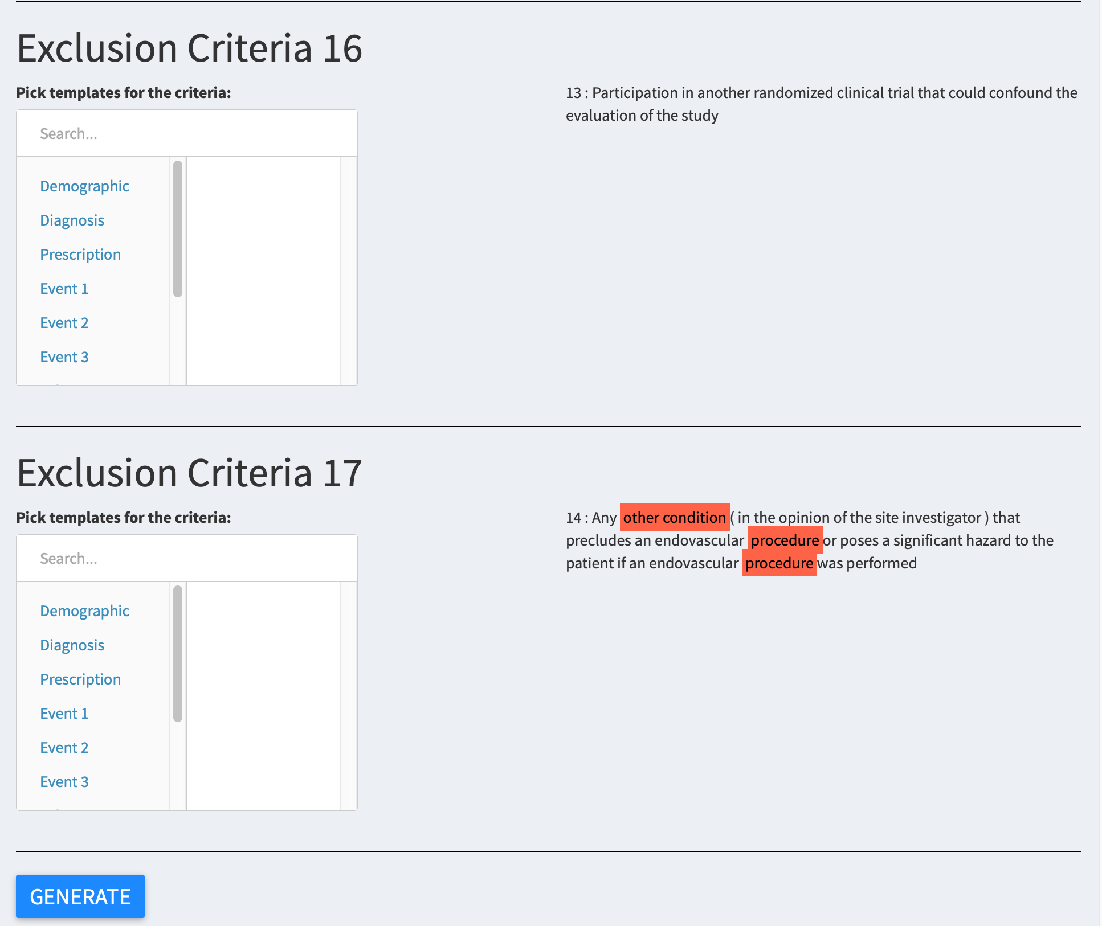
Upload parsed Json file
Check and correct selected templates for each criteria
Modify the templates to generate results
Save the change and update the result
Visualize the selected process and the summary of the cohort

Slide 5
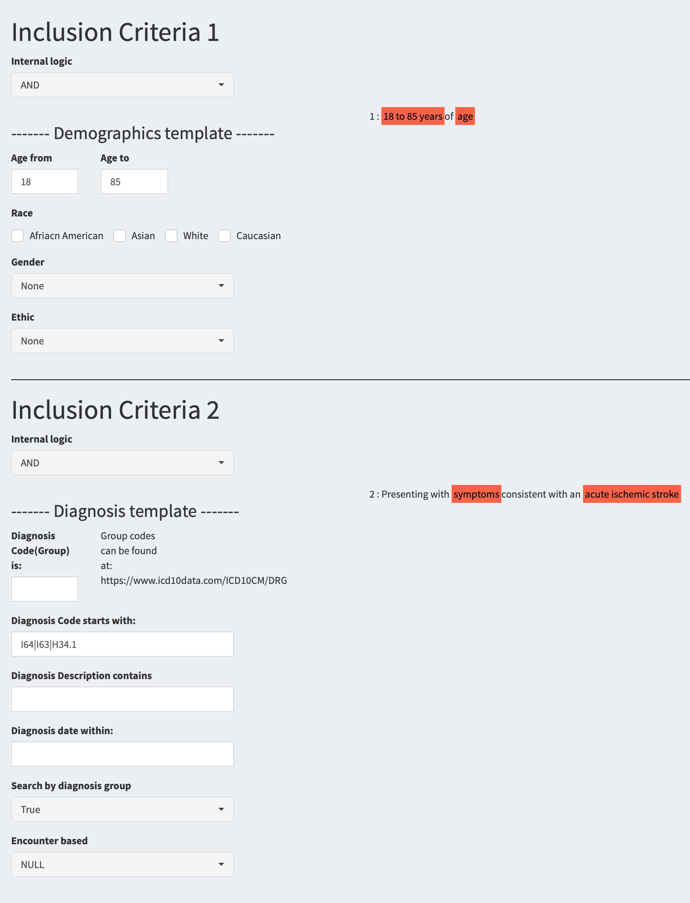

Upload parsed Json file
Check and correct selected templates for each criteria
Modify the templates to generate results
Save the change and update the result
Visualize the selected process and the summary of the cohort

Slide 6
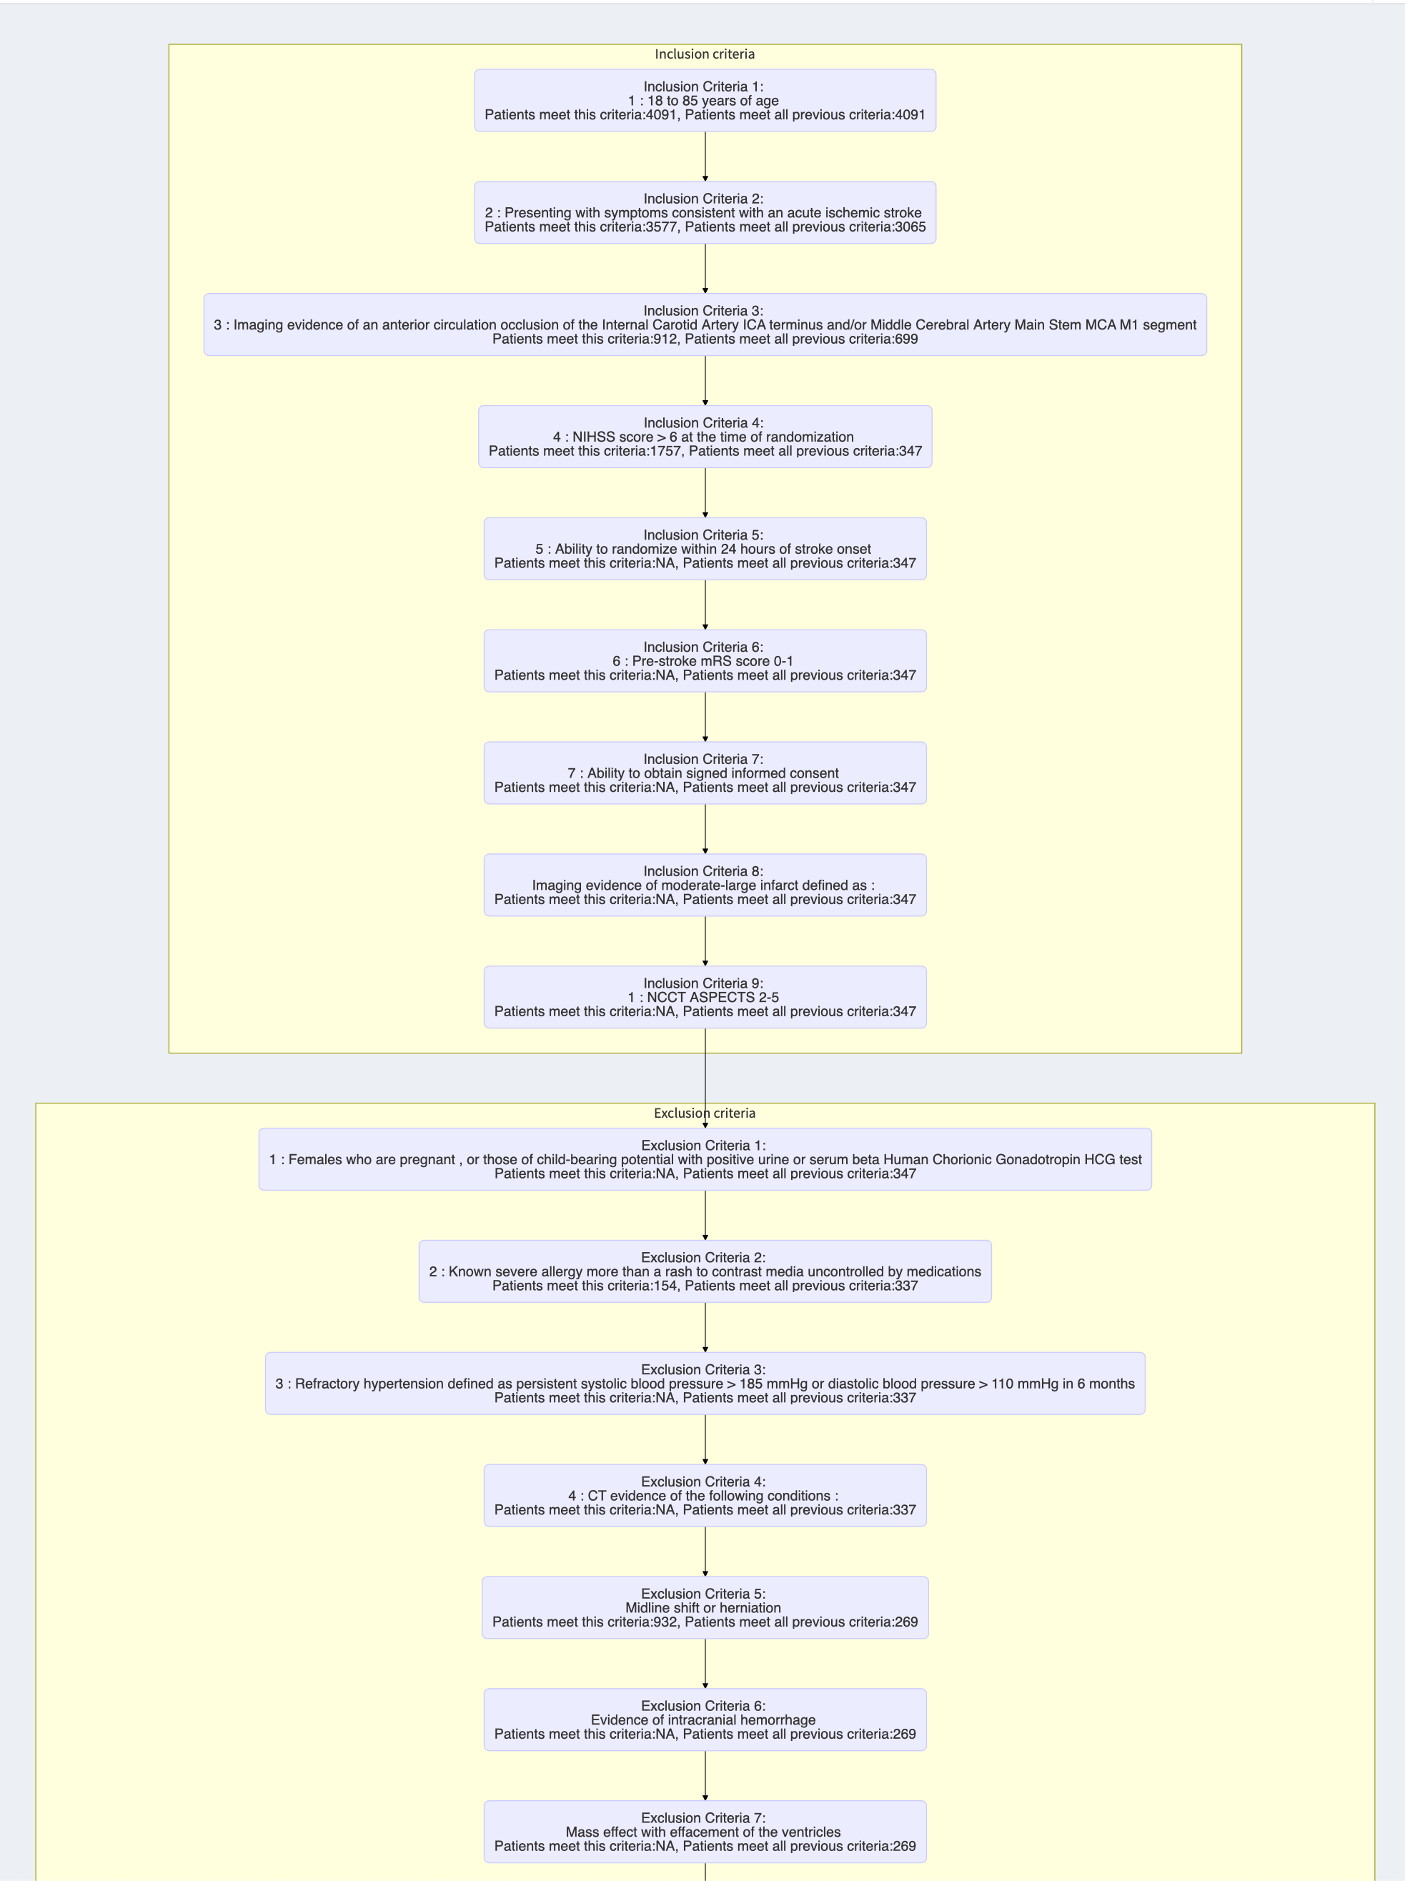

Upload parsed Json file
Check and correct selected templates for each criteria
Modify the templates to generate results
Save the change and update the result
Visualize the selected process and the summary of the cohort

Slide 7
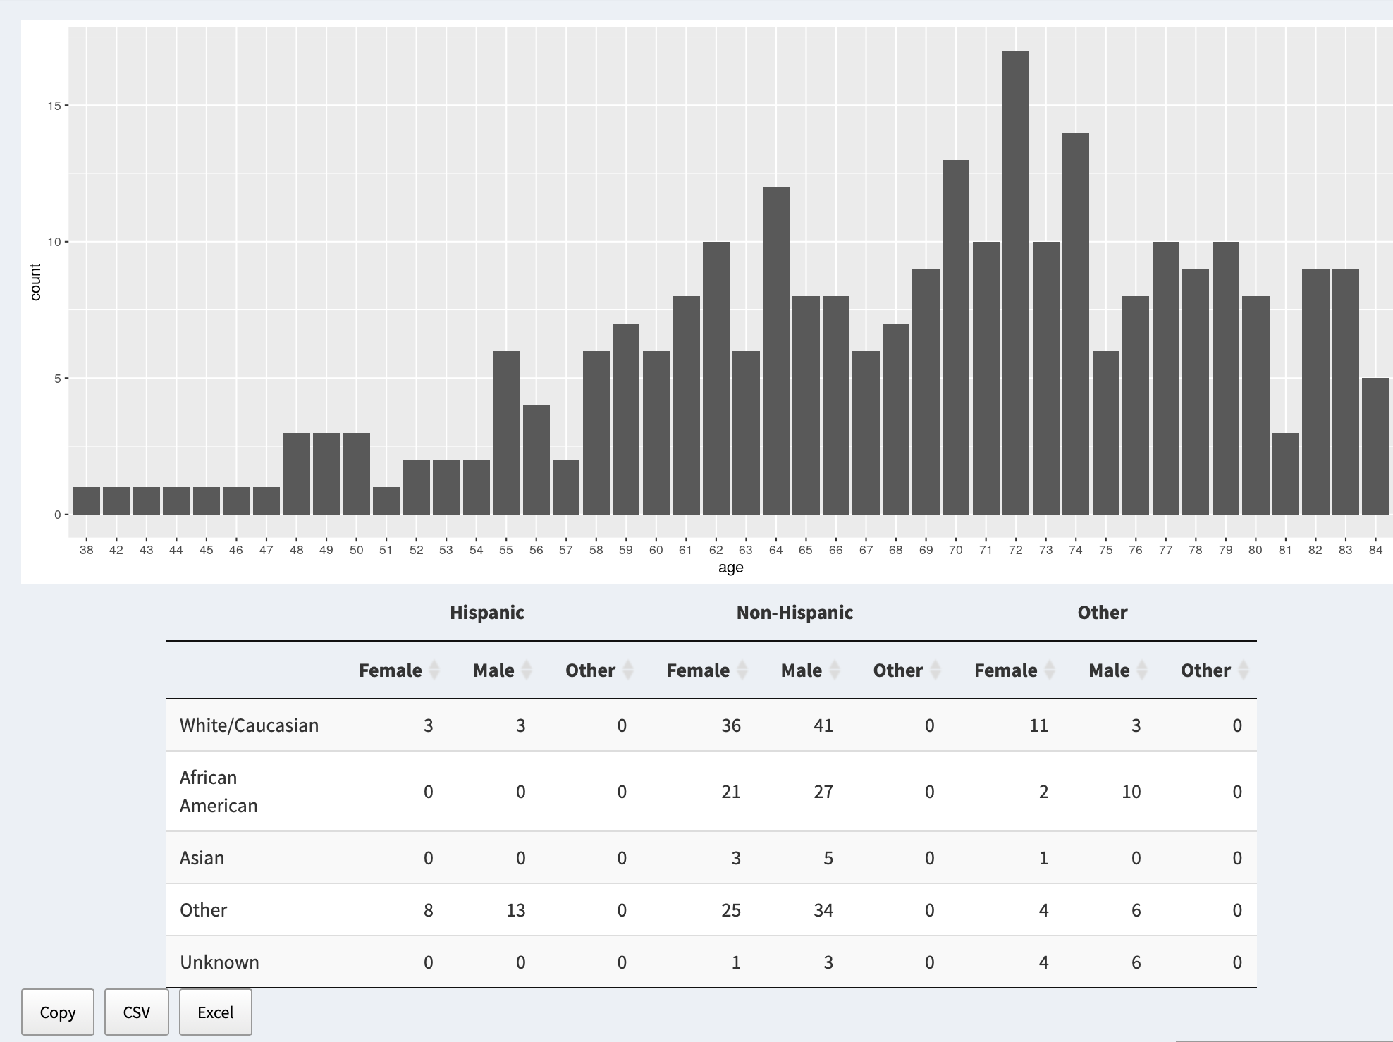

Upload parsed Json file
Check and correct selected templates for each criteria
Modify the templates to generate results
Save the change and update the result
Visualize the selected process and the summary of the cohort

